Slide 1
WORK, POWER AND ENERGY! (ACCORDING TO PHYSICS)

Slide 2
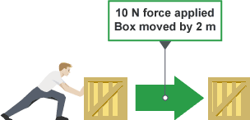
WORK
APPLYING A FORCE OVER A DISTANCE
THE OBJECT MUST MOVE IN THE DIRECTION OF THE FORCE

Slide 3
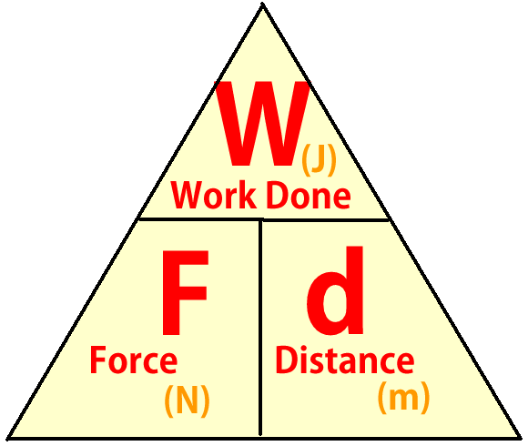
EQUATION: WORK = FORCE X DISTANCE or W=Fxd UNITS : J N m joules newtons meters

Slide 4
HOW MUCH WORK IS DONE IN EACH PICTURE?

Slide 5
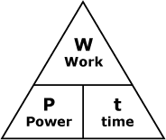
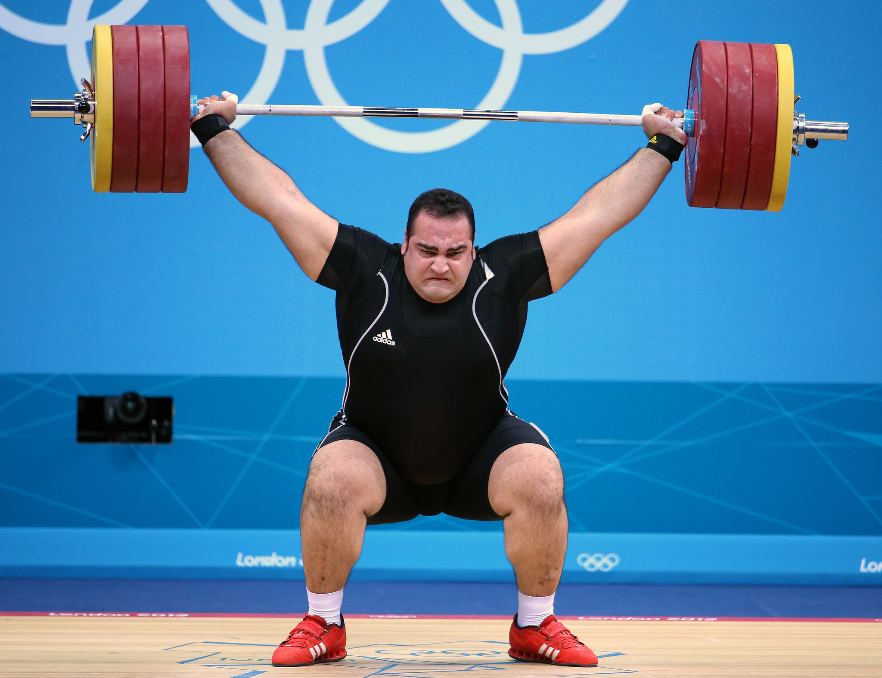
POWER
THE RATE AT WHICH WORK IS DONE (HOW FAST)
EQUATION : POWER = WORK or P = W
TIME t

Slide 6
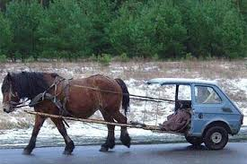
Power is measured in watts which is one joule of work in one second and one horsepower equals 746 watts and a kilowatt is 1000 watts

Slide 7
EX)

Slide 8
CAN MACHINES REDUCE WORK?
NO!
THEY CAN ALLOW YOU TO USE LESS FORCE OVER A GREATER DISTANCE OR THEY CAN INCREASE DISTANCE AND SPEED WITH LESS FORCE

Slide 9
ENERGY
ANYTHING THAT HAS THE ABILITY TO DO WORK
IT CAN ONLY BE OBSERVED WHEN IT IS TRANSFERRED FROM ONE SYSTEM TO ANOTHER
THERE ARE MANY KINDS OF ENERGY AND DIFFERENT WAYS TO CATEGORIZE IT
IT IS ALSO MEASURED IN JOULES

Slide 10
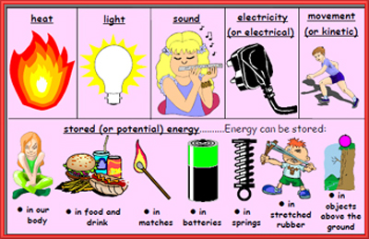

Slide 11
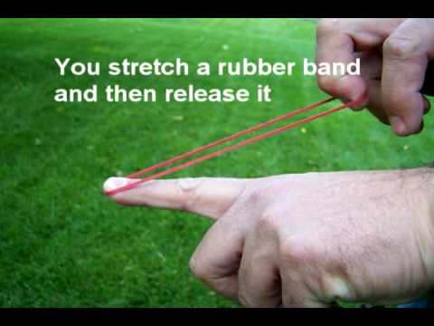
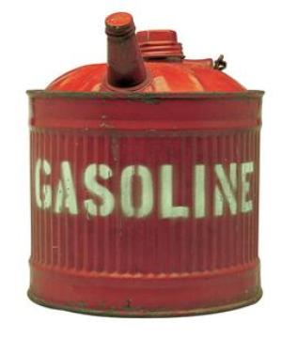
POTENTIAL ENERGY (PE)
STORED ENERGY OR ENERGY OF POSITION
EX) A STRETCHED RUBBER BAND HAS ELASTIC POTENTIAL ENERGY

Slide 12
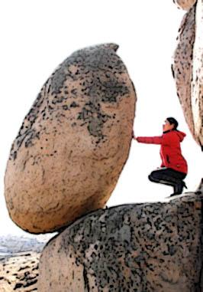
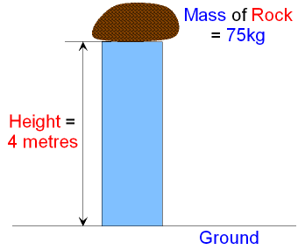
GRAVITATIONAL POTENTIAL ENERGY (PEg)
ENERGY OF POSITION DUE TO GRAVITY
DEPENDS ON AN OBJECTS MASS AND HEIGHT

Slide 13
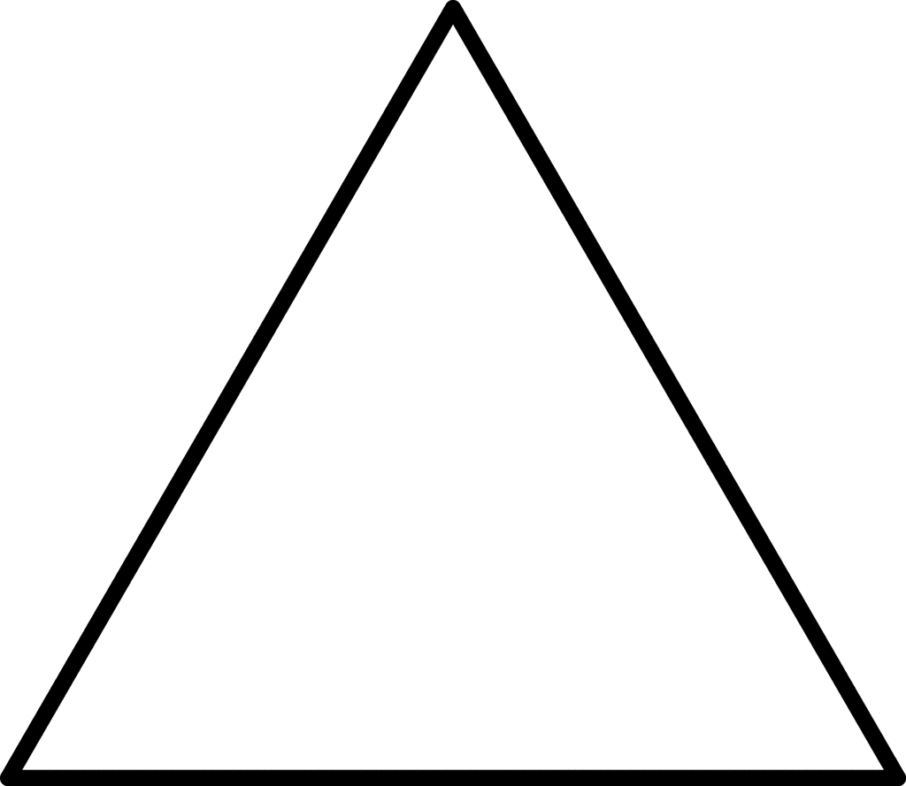
FORMULA IF YOU KNOW MASS IN KILOGRAMS PEg = mgh or PEg = mass x gravity x height FORMULA IF YOU KNOW WEIGHT IN NEWTONS PEg = Fgh or PEg = weight x height

Slide 14
EX)

Slide 15
EX)

Slide 16
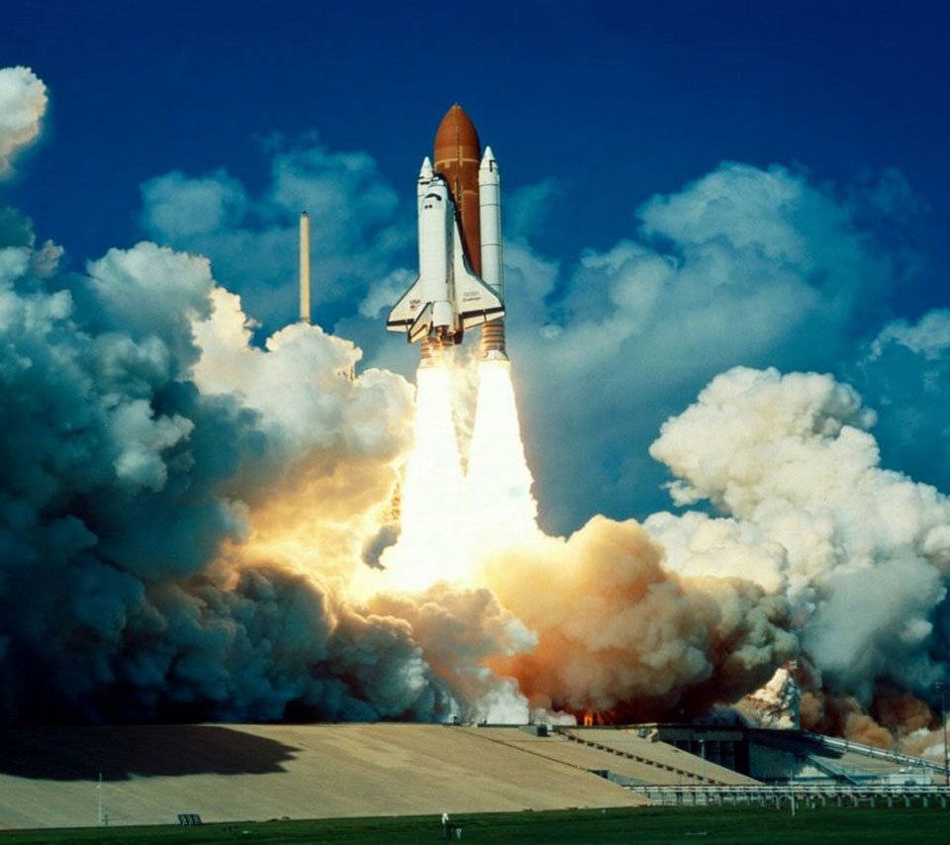
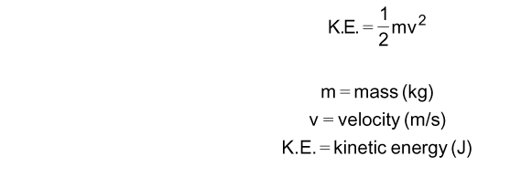
KINETIC ENERGY
THE ENERGY AN OBJECT HAS DUE TO IT’S MOTION
IT IS SIMILAR TO MOMENTUM
KINETIC ENERGY = ½ X MASS X VELOCITY²

Slide 17
EX)

Slide 18
EX)

