Slide 1
mechanisms
Changes in gene pool (types of genes) cause evolution!
Mutation: can cause changes to a gene
- IMPORTANT: has to affect sex cells so the mutations are passed on!
Variation provides the material for natural selection to work on!

Slide 2
Speciation
(new species)
when small populations become isolated http://www.youtube.com/watch?v=YCoEiLOV8jc
Geographic isolation: two populations of the same species become separated by a physical barrier. Over time, they become two different species and can no longer interbreed.

Slide 3
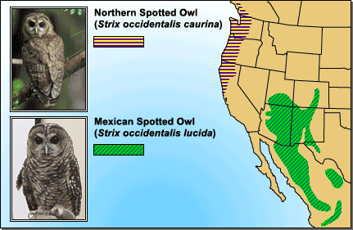

Slide 4
Co-Evolution
The evolution of one species influences the evolution of the other species.

Slide 5
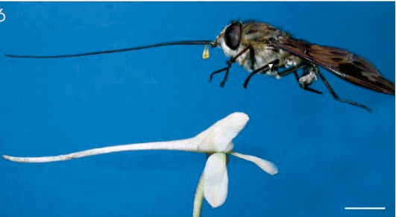
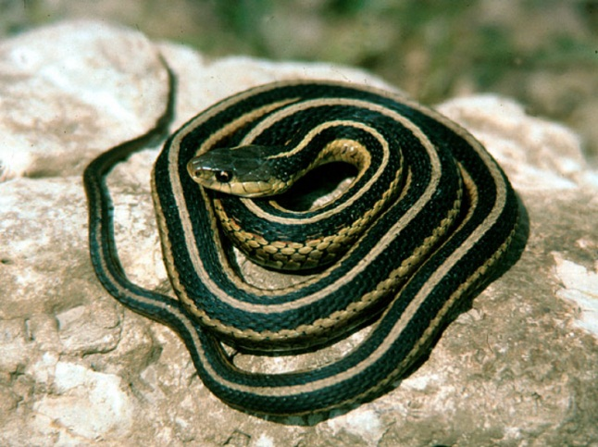
Co-Evolution
Example
Example
A moth and a flower. They evolve together so the moth’s tongue is exactly the right shape to fit in the flower and eat the nectar, while pollinating the flower.
Garter snakes and a rough-skinned newt. The snake eats the newt and the newt has developed chemicals to poison the snakes. Some snakes developed a mutation to be resistant to the poison so they can eat the newts.

Slide 6
Do Now
What are the 2 ways to date fossils?
How can the anatomy of organisms serve as evidence of evolution?
What are vestigal structures? Give an example.
What is biochemistry and how does that relate to evolution?
What is speciation and how does it happen?
What is co-evolution? Give an example.

Slide 7
Do Now
What is speciation and how does it happen?
What is co-evolution? Give an example.
What is the “biology” definition of a species?
*this is important to know!*
Planet Earth has an estimated 8.7 million species. How would YOU keep track of them all if that were your job?

Slide 8
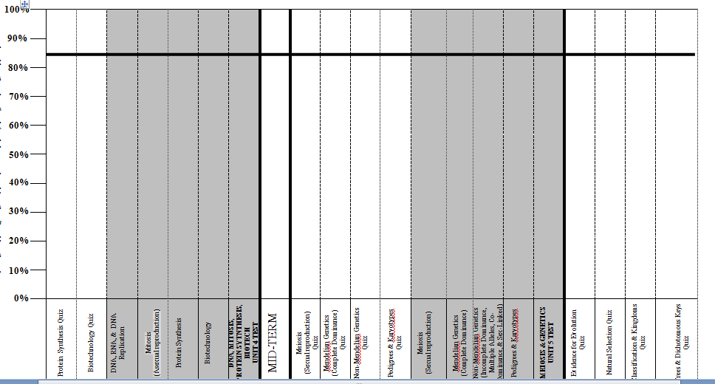
Data Tracking

Slide 9
mimicry
"To mimic = to copy" When organisms have evolved to share common characteristics. This adaptation may increase the fitness of the organism and allow it to survive better. * Example: Camouflage and wing patterns in butterflies

Slide 10
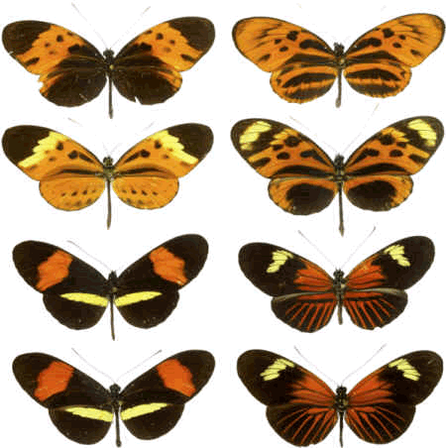

Slide 11
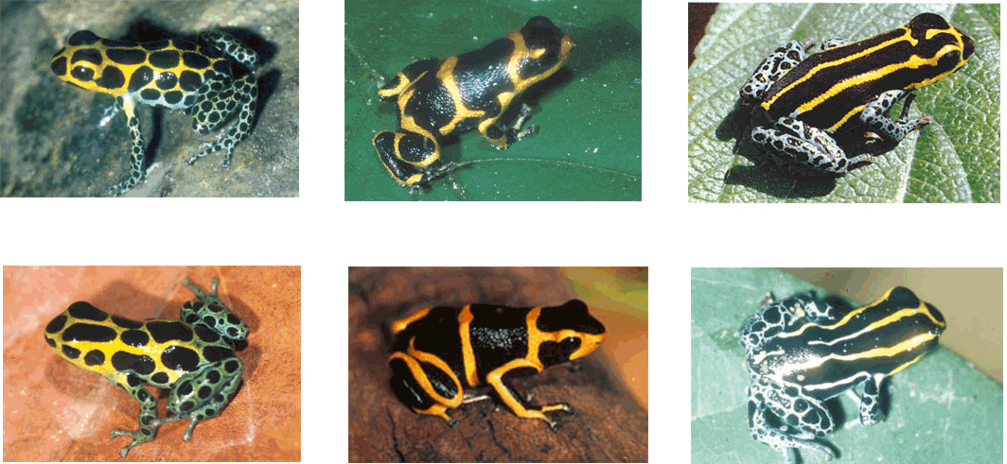
mimicry

Slide 12
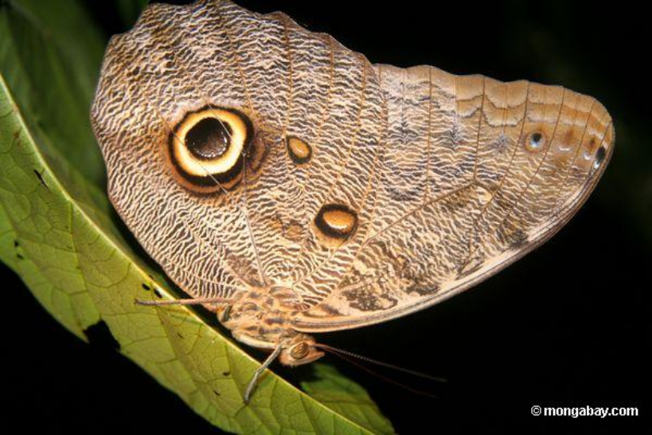
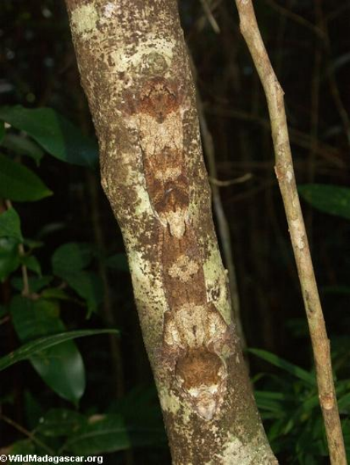
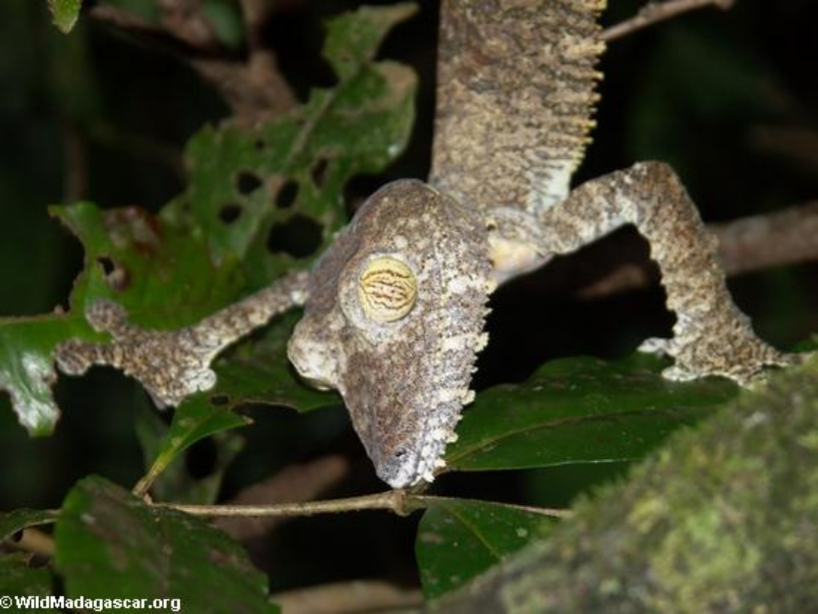
mimicry

Slide 13
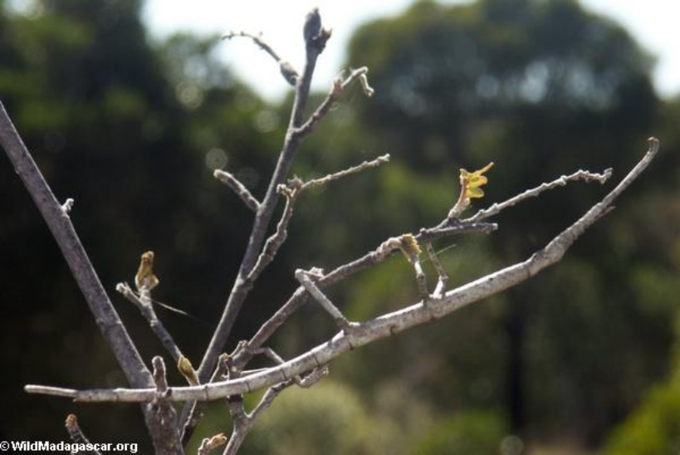
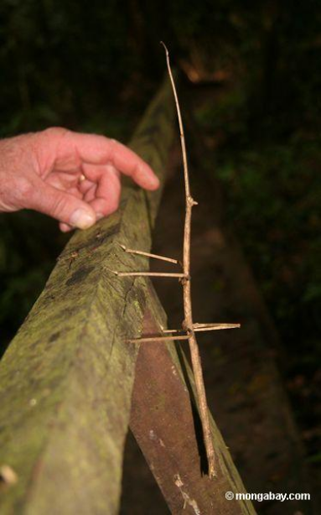
Mimicry – walking stick

Slide 14
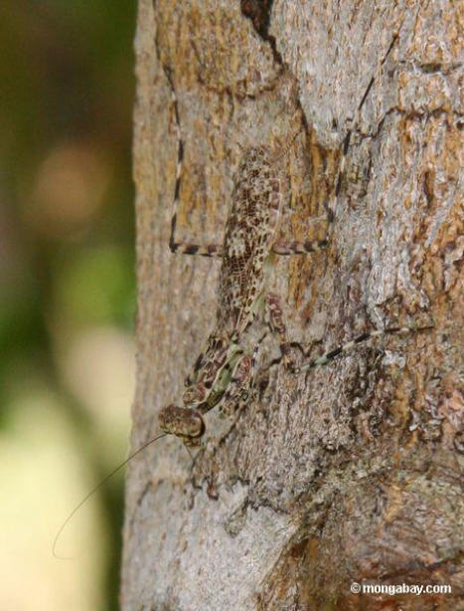
Praying mantis

Slide 15
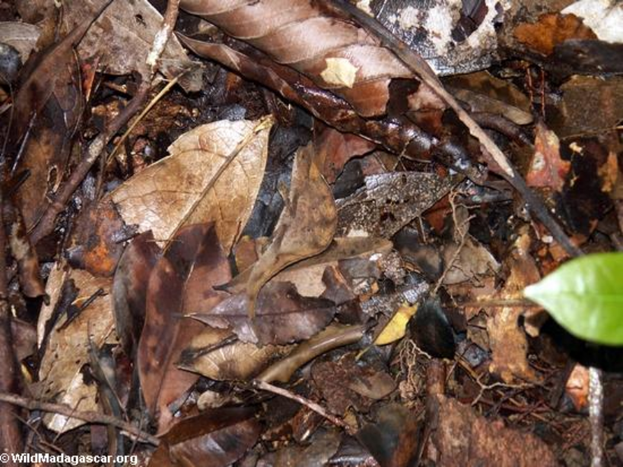
Chameleon playing dead

Slide 16
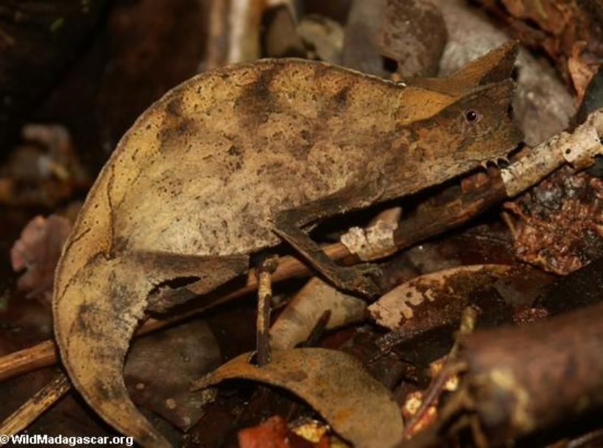

Slide 17
The environment
The environment decides which adaptations are favorable and which are not. An organism cannot determine if it will be more fit; it's all up to the environment!

Slide 18
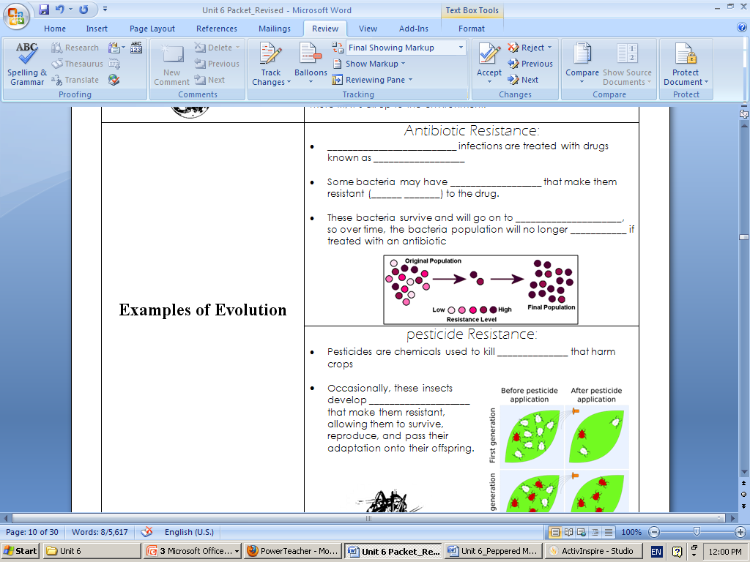
U6-12

Slide 19
Examples of Evolution Antibiotic Resistance * Bacterial infections are treated with drugs known as antibiotics * Some bacteria may have mutations that make them resistant (don't die) to the antibiotic * These bacteria survive, and will go on to reproduce, so over time, the bacteria population will no longer die if treated with an antibiotic

Slide 20
Tuberculosis
http://www.youtube.com/watch?v=Sfgg3S0xnzk

Slide 21
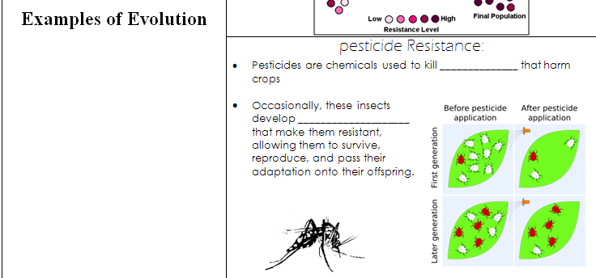
U6-12

Slide 22
Examples of Evolution Pesticide Resistance * Pesticides are chemicals used to kill insects that harm crops * Occasionally, these insects develop adaptations that make them resistant, allowing them to survive, reproduce, and pass on their adaptation onto their offspring

Slide 23
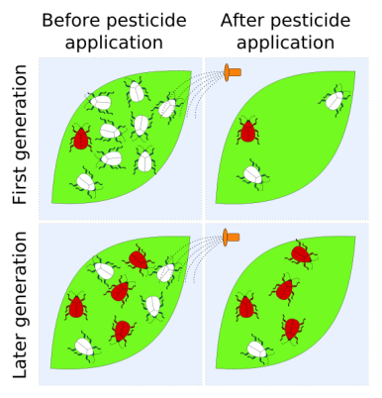

Slide 24
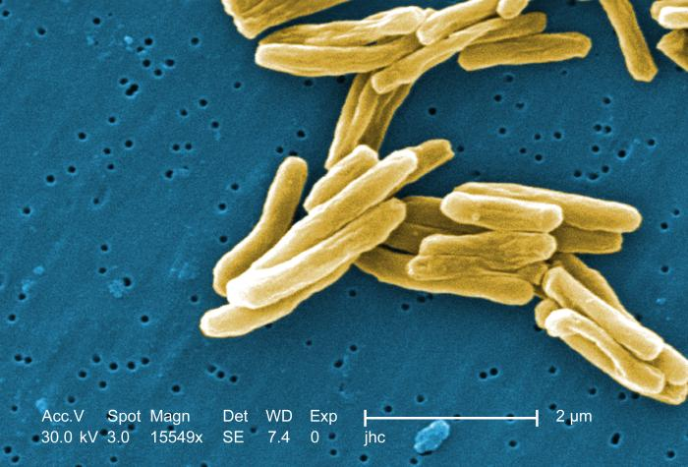

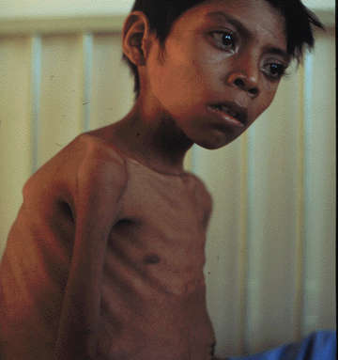
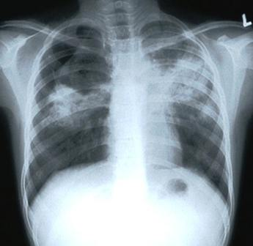
tuberculosis

Slide 25
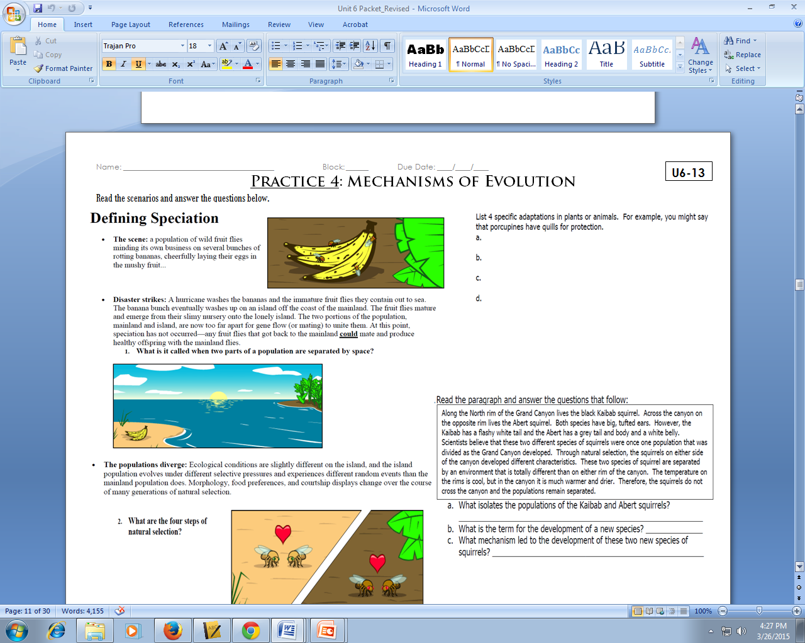
Practice 4: Mechanisms of Evolution

Slide 26
Do Now
What is speciation and how does it happen?
What is co-evolution? Give an example.
Where in the cell does cellular respiration take place?
What are the 2 organelles that a plant cell has that an animal cell does not have?

Slide 27
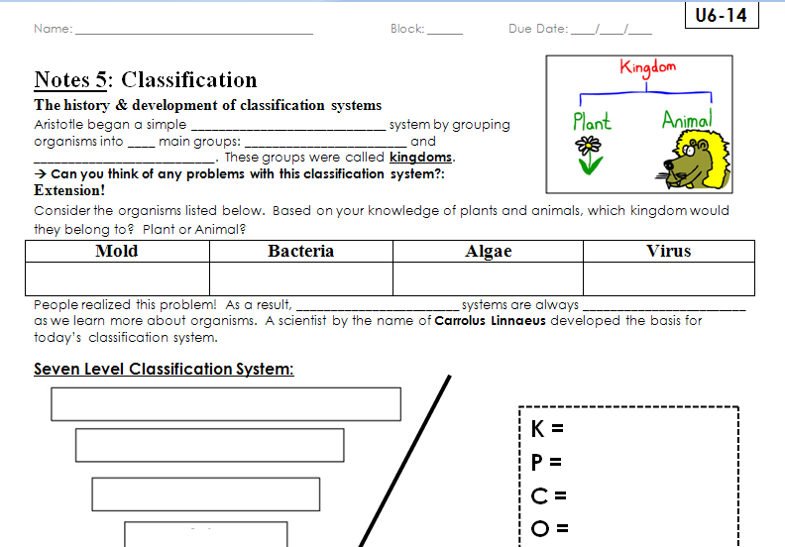
Notes 5: Classifcation

Slide 28
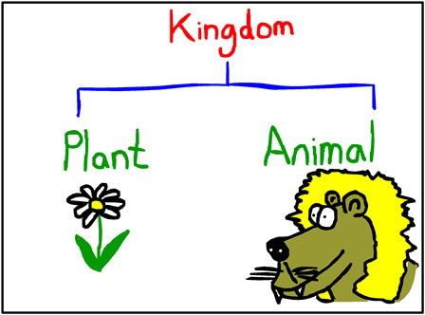
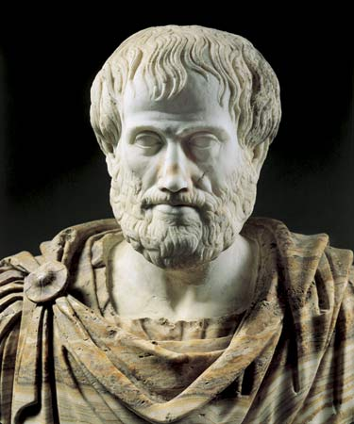
The history & development of classification system
Aristotle began a simple classification system by grouping organisms into two main groups: PLANTS and ANIMALS. These groups were called kingdoms.

Slide 29
Why is Aristotle’s first classification system problematic?
Plant… or …. Animal?

Slide 30
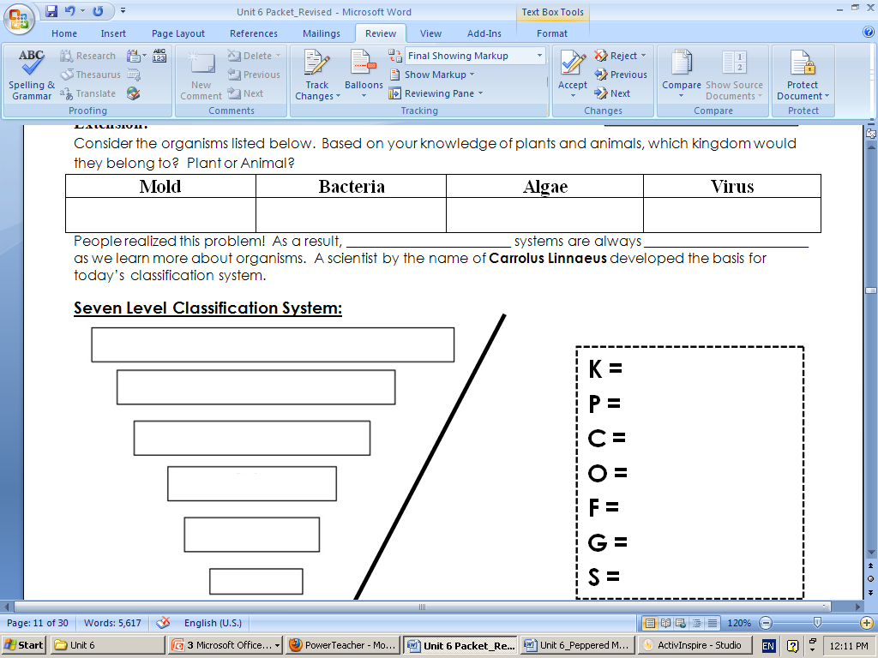
Stop and Think

Slide 31
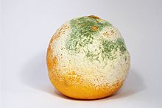
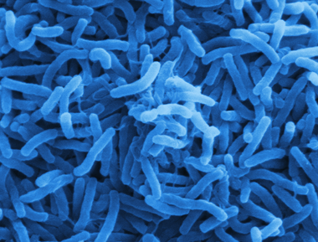
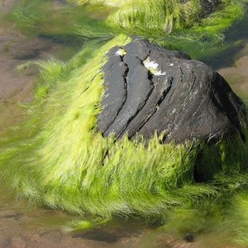
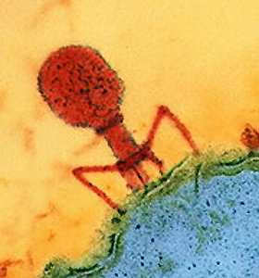
Plant or animal?
Mold | Bacteria | Algae | Virus
People realized this problem! As a result, classification systems are always changing as we learn more about organisms. A scientist by the name of Carrolus Linnaeus developed the basis for today’s classification system

Slide 32
Do Now
Using the chart on page 459 of a textbook, fill in the chart on page U6-15 in your packets
For kingdom Monera, use the information from Eubacteria and Archaebacteria
I will help you with the sexual/asexual column but you should be able to figure this out on your own
Must be completed by 7:35

Slide 33
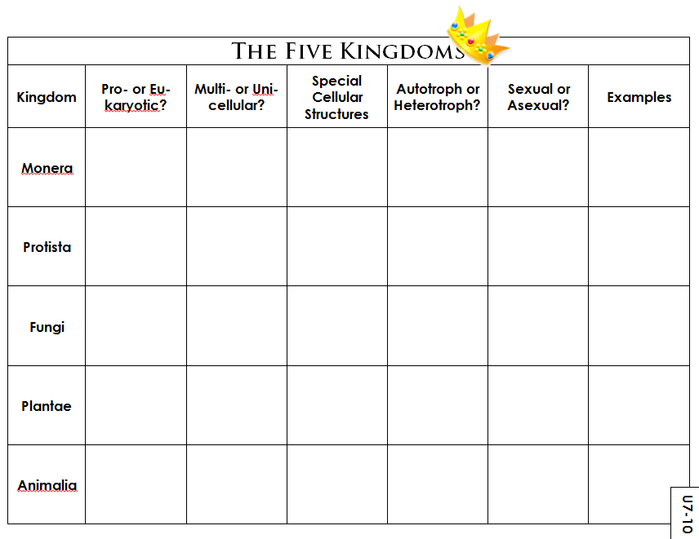
U6-15

Slide 34
Monera
(Bacteria)

Slide 35
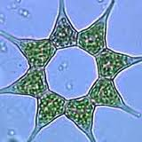
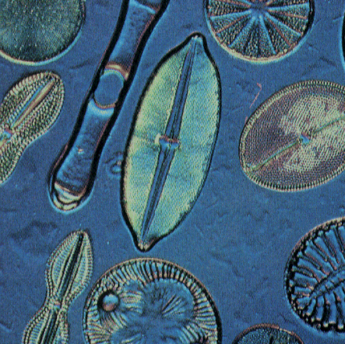
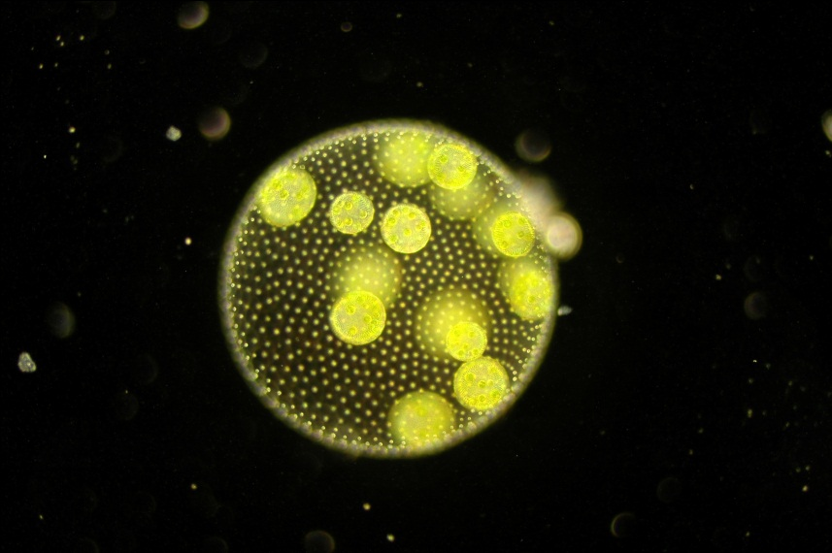
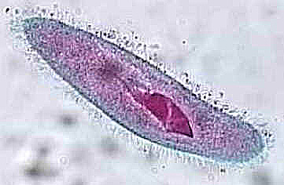
Protista
(Protists)

Slide 36
Fungi

Slide 37
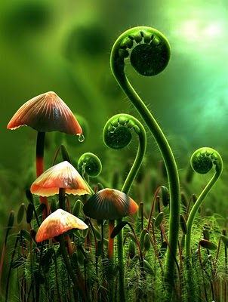
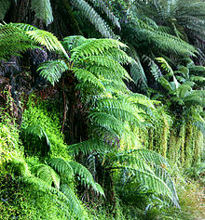
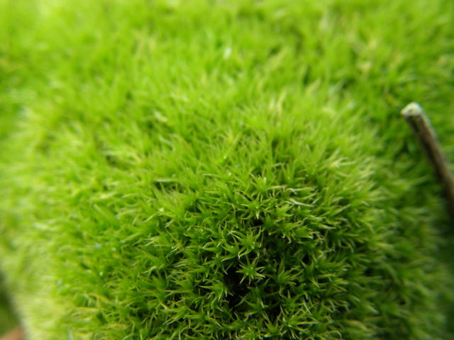
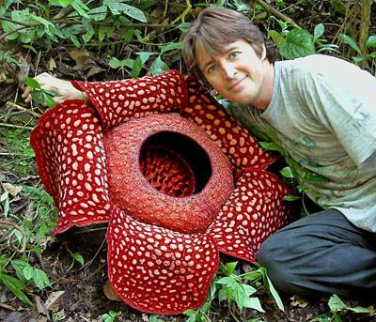
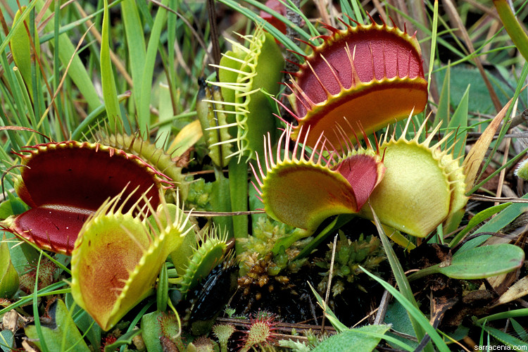
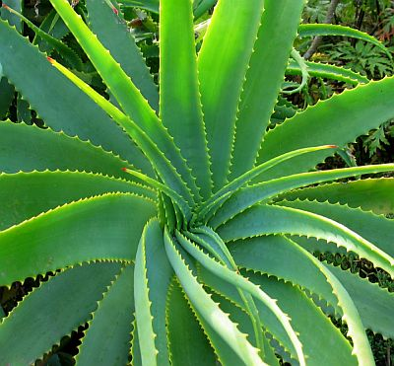
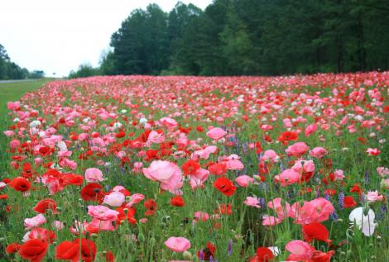
Plantae
(Plants)

Slide 38
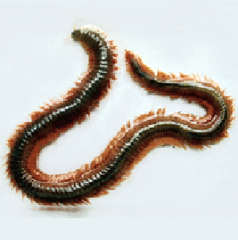
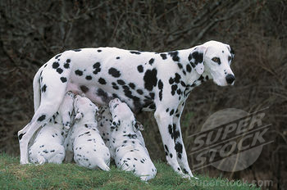
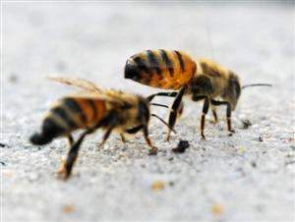
Animalia
(animals)

Slide 39
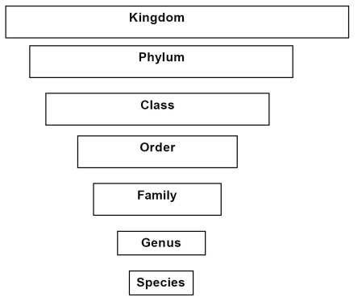
KINGDOM
PHYLUM
CLASS
ORDER
FAMILY
GENUS
SPECIES

Slide 40
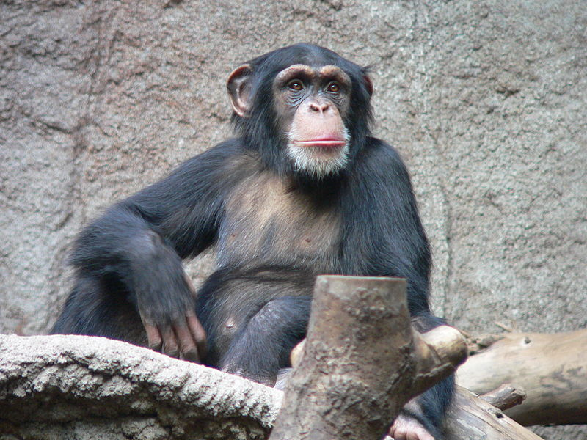
naming
Kingdom: Animalia
Phylum: Chordata
Class: Mammalia
Order: Primates
Family: Hominidae
Genus: Pan
Species: troglodytes
Common name: chimpanzee

Slide 41
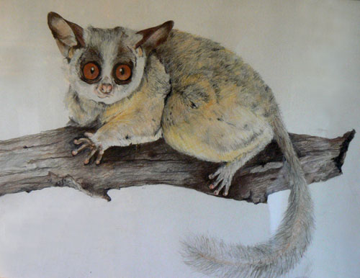
naming
Animalia
Chordata
Mammalia
Primates
Galagidae
Otolemur
crassicaudatus
Common name: bush baby

Slide 42
naming
Animalia
Chordata
Mammalia
Primates
Hominidae
Pan
troglodytes
Animalia
Chordata
Mammalia
Primates
Galagidae
Otolemur
crassicaudatus

Slide 43
Do Now
Who was the first man to group organisms?
What were those first 2 groups? Explain what was wrong with this thought.
What are the 5 kingdoms today?
What are the 7 levels of classification?
Giraffa camelopardalis is the scientific name of a giraffe. Using this information what is the genus and species?

