Slide 1
Essential Vocabulary
Mass murder: The killing of several people at one location.
Modus operandi: the usual way that a particular criminal performs a crime
Serial murder: The killing of three or more victims over an extended period of time.
Spree murder: The killing of several people at different locations over a period of several days.
Notes:
http://www.karisable.com/crserial1.htm
Add later:
Psychopath: a person suffering from chronic mental disorder with abnormal or violent social behavior.
Signature: Unusual characteristics of a murder that are repeated at several crime scenes
Sociopath: a person with a personality disorder manifesting itself in extreme antisocial attitudes and behavior and a lack of conscience.

Slide 2
Q: What is the difference between a serial killer and a mass murderer?

Slide 3
By technical definition…
Mass Murder:
The USA Bureau of Justice Statistics defines a mass murder as "[involving] the murder of four or more victims at one location, within one event
Serial Killer:
A person who kills three or more people in three or more separate events over a period of time including an "emotional cooling-off" period in between the homicides (FBI definition)

Slide 4
Mass Murder
Kill a large number of people, typically at the same time in a single location
Many mass murders end with the death of the perpetrator (self-infliction or being killed by law enforcement)
Characteristics of mass murderers:
Generally dissatisfied people, poor social skills, few friends
Male
Paranoid individuals with acute behavioral or social disorders
Social misfits or loners pushed over the edge
Ever heard of the phrase “going postal”?

Slide 5
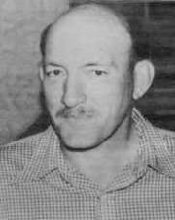
Going Postal!
Expression derives from a series of incidents from 1986 onward in which United States Postal Service (USPS) workers shot and killed managers, fellow workers, and members of the police or general public in acts of mass murder.
Edmond, Oklahoma in 1986
Patrick Sherrill shot 20 coworkers (killing 14) before committing suicide.

Slide 6
Serial Murder
The FBI defines serial murder as
A minimum of 3-4 victims
“Cooling off” period in between victims
Murders appear unconnected or random
Killer is usually a stranger to the victim
Murders reflect a need to dominate the victim
Murders are psychologically motivated
Rarely motivated for profit
Victim has a “symbolic” value for the killer
Victims are generally vulnerable

Slide 7
Summary
Mass Murderer
Multiple Victims
Victims wrong place / time
Usually single crime scene
Single Episode
No specific methodology involved
Serial Killer
Multiple Victims
Victims carefully selected
Several crime scenes
Several episodes
Very specific methodology

Slide 8
Introduction to Serial Murder
Serial murder is neither a new phenomenon, nor is it uniquely American.
Serial murder is a relatively rare event, estimated to comprise less than one percent of all murders committed in any given year.
Much of the general public’s knowledge concerning serial murder is a product of Hollywood productions. Story lines are created to heighten the interest of audiences, rather than to accurately portray serial murder. By focusing on the atrocities inflicted on victims by “deranged” offenders, the public is captivated by the criminals and their crimes. This only lends more confusion to the true dynamics of serial murder.

Slide 9
Q: What is the key to serial murders?
Killings are separate (serial) and occur with greater or less frequency, often escalating over a period of time, sometimes years.
Generally little (if any) previous connection between the serial killer and the victim and the persons involved are generally not related.
The victim as a symbolic object of someone or something that they find desirable but they cannot possess or someone or something they find repulsive and they want to destroy.
Notes:
Ethnicity: The majority of serial killers are caucasian (82-86%)
African Americans = 13-20%
Hispanics = 2%

Slide 10
Essential Vocabulary
Psychopath: a person suffering from chronic mental disorder with abnormal or violent social behavior.
Signature: Unusual characteristics of a murder that are repeated at several crime scenes
Sociopath: a person with a personality disorder manifesting itself in extreme antisocial attitudes and behavior and a lack of conscience.

Slide 11
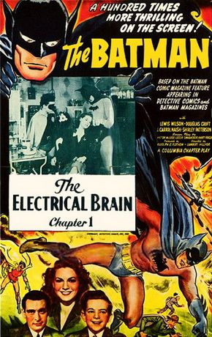
Q: Where did serial killers originate?
The term serial killer was likely coined by Robert K. Ressler (FBI Agent; Behavioral Science Unit) in the mid 1970’s
Ressler said description of serial crimes reminded him of the movie industry term “serial adventures”
Short episodic films, featuring the likes of Batman and the Lone Ranger, shown in theaters on Saturday afternoons during the 1930s and 1940s.
Notes:
Over the centuries there have been hundreds of documented cases of serial murder around the world but the term “serial killer” is relatively new. Up until the 1970s, serial killers were generally called mass murderers by both the criminal justice system and the media.
As explained by Peter Vronsky in his 2004 book Serial Killers: The Method and Madness of Monsters, the term “serial killer” was probably coined by the late FBI agent and profiler Robert Ressler. According to the story, Ressler was lecturing at the British police academy at Bramshill, England, in 1974, where he heard the description of some crimes as occurring in series, including rapes, arsons, burglaries, robberies and murders.
Ressler said that the description reminded him of the movie industry term “serial adventures” which referred to short episodic films, featuring the likes of Batman and the Lone Ranger, shown in theaters on Saturday afternoons during the 1930s and 1940s. Each week, youthful matinee audiences were lured back for the next installment in the series by an inconclusive ending known as a “cliffhanger” that left them wanting more (1).
The FBI agent recalled from his youth that no episode had a satisfactory conclusion and the ending of each one increased rather than decreased the tension in the viewer. Similarly, Ressler believed that the conclusion of every murder increases the tension and desire of a serial killer to commit a more perfect murder in the future—one closer to his/her ideal fantasy. Rather than being satisfied when they murder, serial killers are instead agitated toward repeating their killings in an unending “serial” cycle (2).
http://www.ice.udl.es/udv/demoassig/asignaturas/Humanmonster/modul2/m231.htm
Jack video: http://www.youtube.com/watch?v=fSWRmOmTsuE

Slide 12
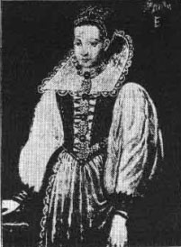
Countess Elizabeth Bathory
Killed over 600 girls for their blood
The Prime Minister of Hungary decided to take a stand and arrested the Countess and her associates
Sentence = death
Died in 1614 at the age of 54
Notes:
Born in Hungary in 1560
Married a Count at the age of 15
Took part in black magic and demonic rituals with her husband
Was middle aged when her husband died.
One day, she beat one of her servants and caused her to bleed. Elizabeth believed the blood gave her a youthful appearance so she took to killing girls
Believing herself to be a vampire, she bathed and drank the blood of her murder victims
13 min video – stop at 9

Slide 13
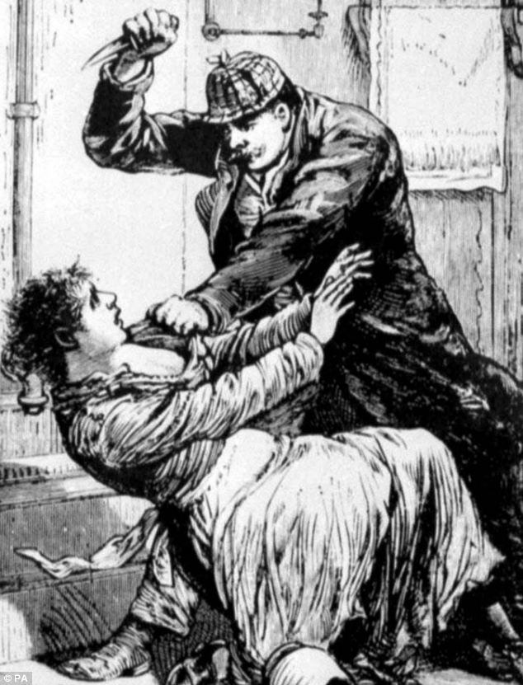
Jack The Ripper
An unidentified serial killer believed to have been active in the largely impoverished area of the Whitechapel district of London in 1888.
5 female victims
Has Jack The Ripper been found?
Notes:
Jack The Ripper
The best known name given to an unidentified serial killer generally believed to have been active in the largely impoverished areas in and around the Whitechapel district of London in 1888.
The name "Jack the Ripper" originated in a letter written by someone claiming to be the murderer that was disseminated in the media.
The letter is widely believed to have been a hoax, and may have been written by journalists in an attempt to heighten interest in the story and increase their newspapers' circulation. Within the crime case files, as well as in contemporary journalistic accounts, the killer was called "the Whitechapel Murderer" as well as "Leather Apron".
r

Slide 14
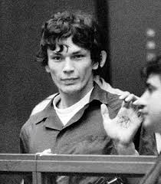
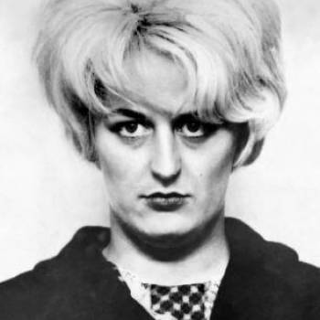
Q: Who is the typical serial killer?
White men between 20 and 30/35
Female serialists do also exist.
15% of the serialists operating in the US from 1800 to 1995 are female
Differences in the typology of the crime
Males tend to use brute force and direct their rage to strangers, women tend to focus more on members of the family and use poison.
Female serial killers tend to kill for money whiles males tend to kill for control or sexual gratification.
Notes:
Ethnicity: The majority of serial killers are caucasian (82-86%)
African Americans = 13-20%
Hispanics = 2%
Female = myra hindley
Known as "The Moors Murderer" and "The Most Evil Woman in Britain", Myra Hindley and her lover, Ian Brady, plotted and carried out the rape and deaths of five young children 1963-65 in England. The pair were turned in to the police by Hindley's brother-in-law who had witnessed Brady killing a boy with an axe. Hindley died in prison in 2002 at age 60.

Slide 15
Q: Who is the typical serial killer?
Middle-class background even though there are also killers that belong to other social strata.
Generally have memory disorders and an inability to tell the truth.
Drug or alcohol abuse (or their parents have histories of alcohol or drug abuse).
History of assault, robbery, fetish robbery or cruelty to animals.
May have demonstrated abnormal sexual behavior or hyper sexuality.
IQ = generally borderline, average
Notes:
Ethnicity: The majority of serial killers are caucasian (82-86%)
African Americans = 13-20%
Hispanics = 2%

Slide 16
Q: Markers in Childhood?
The Macdonald Triad
AKA the triad of sociopathy or the homicidal triad
A set of three behavioral characteristics that predicts later violent tendencies
Predicts future violent behavior if all three or any combination of two are present together

Slide 17
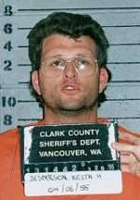
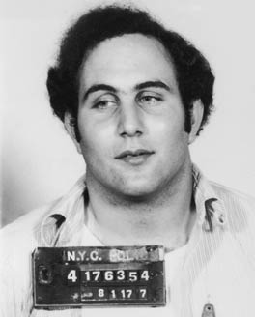
Q: Markers in Childhood?
Torturing Animals
Animals = “practice” for killing humans
Keith Jesperson
Pyromania
Often a sexually stimulating activity for future killers
The dramatic destruction of property feeds the same perverse need to destroy another human.
David Berkowitz (“Son of Sam”)
Enuresis (Bed Wetting)
Unintentional bed-wetting during sleep, persistent after the age of five
60% of multiple murderers wet their beds past adolescence.
Notes:
The Son of Sam, David Berkowitz, set 1,412 fires but switched over to killing because it gave him more excitement and TV news coverage
Keith Jesperson, a serial killer from British Columbia who murdered more than 160 victims, started with dozens of cats and other small animals, before he moved on to human beings

Slide 18
Q: Insane? Psychopaths? Sociopaths?
Very few serial killers suffer from any mental illness to such a debilitating extent that they are considered to be insane by the criminal justice system
To be classified legally insane, an individual must be unable to comprehend that an action is against the law at the extent moment the action is undertaken
Most serial killers are aware of illegality of murder while they are in the process of killing their victims
Understanding of right and wrong does nothing to impede crimes
Desire and compulsion to kill causes them to ignore criminal law
Notes:
Can easily gain people’s trust
Learn how to mimic emotions despite inability to feel them
Appear normal to unsuspecting people
Well educated, can hold steady jobs
May have families or long-term relationships

Slide 19
Q: Insane? Psychopaths? Sociopaths?
Commonalities:
Disregard for laws and social mores
Disregard for the rights of others
Failure to feel remorse or guilt
Tendency to display violent behavior
Notes:
"I'm the most cold-blooded sonofabitch you'll ever meet," said Ted Bundy. "I just liked to kill, I wanted to kill.”
John Gacy, never showing an ounce of remorse, called his victims "worthless little queers and punks," while the "Yorkshire Ripper" Peter Sutcliffe brashly declared that he was "cleaning up the streets" of the human trash.

Slide 20
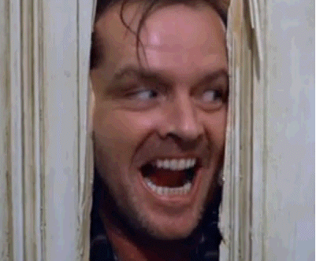
Q: Insane? Psychopaths? Sociopaths?
Sociopaths
Nervous
Easily agitated
Volatile and prone to emotional outbursts
Likely to be uneducated or live on the fringes of society
Notes:
Emotional = fits of rage

Slide 21
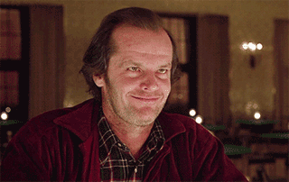
Q: Insane? Psychopaths? Sociopaths?
Sociopaths
Unable to hold down a job or sty in one place for long
Appears to be disturbed in the eyes of others
Crimes will be haphazard, disorganized and spontaneous
Notes:
Emotional = fits of rage

Slide 22
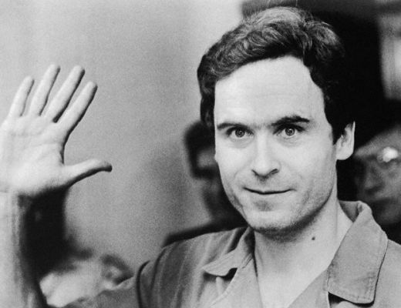
Q: Psychopaths? Sociopaths?
Psychopaths
Unable to form emotional attachments or feel empathy with others
Disarming or charming personalities
Very manipulative
Carefully plan out every detail of crimes in advance and often have contingency plans
Criminals are cool, calm and meticulous
Notes:
Can easily gain people’s trust
Learn how to mimic emotions despite inability to feel them
Appear normal to unsuspecting people
Well educated, can hold steady jobs
May have families or long-term relationships

Slide 23
Q: How are serial killers classified?
Serial Killers can be classified in a variety of ways
According to their motives
According to their mobility
According to planning
According to their nature and modus operandi

Slide 24
Serial Killers: Crime Stories
Take notes
Who were the victims?
Were they any similarities between the victims?
Who is the suspect?
Describe him
What classification would he fall under?
What was his M.O.?
Any evidence of signature behavior?
What do you think: was he born or made into a killer?
Write down your opinion. Record supporting evidence.
Be prepared to share.

Slide 25
Q: What is the Modus Operandi?
Object - kind of property taken, such as bras and panties
Time - time of day or night, weekdays, non-work days, holidays (when people would not miss the perpetrator at work)
Style - the description the criminal gives the victim to gain entrance (plumber, cable TV repairman)
Tale - any disclosure the criminal makes as to his business/purpose
Pals - any co-conspirators
Transport - what type of vehicle was used in connection with the crime
Trademark - any unusual act committed by the suspect while in the commission of the crime (i.e. poisoning the cat, eating at the scene after murdering the grandmother)

Slide 26
Q: What are Signatures?
Signature: the murderer's psychological calling card
Unusual characteristics of a murder that are repeated at several crime scenes
Example: intentionally displaying victims in a spread-eagle position.
This behavior reinforces the perpetrators underlying psychological needs.

Slide 27
Q: What are Signatures?
Signatures may include:
posing the victims (post death)
concealing victims
using the same type of weapon
using the same method of killing
mutilating all the victims in the same manor
Signatures can sometimes be souvenirs

Slide 28
Modus Operandi or Signature?
Two murderers both burn their victims by dousing them with gasoline.
The first murderer does so as an anger-retaliatory act.
This is a signature behavior.
The second murderer douses the victim with gasoline to cover up the crime.
This murderer does so to evade detection.
This therefore is a precautionary act, and as such is a modus operandi behavior.

Slide 29
Q: What is staging?
Staging: occurs when someone purposely alters the crime scene prior to the arrival of the police
Two reasons:
Direct the investigation away from the most logical suspect
Protect the victim or victim’s family
Red Flags: inconsistencies at a staged crime scene

Slide 30
Q: Are serialists born or made?
Three theories based on childhood
Theory One: The compulsion (need) to kill may be the result of trauma to the brain
Theory Two: The compulsion to kill is genetic. A mutation in the DNA happens that puts people on the homicidal path.
Theory Three: The compulsion is a result of something dreadful that happened to the child in childhood
Commonality: All theories believe that serial killers begin to show signs in childhood
Notes:
At the heart of this debate – nature vs. nurture
Are serial killers born or made?

Slide 31
Q: Are serialists born or made?
One of the enduring questions of development involves how much people’s behavior is due to genetics and how much to the physical and social environment
Nature = traits, abilities and capacities that are inherited from one’s parents
Produced by maturation (the predetermined unfolding of genetic information)
Notes:
One of the enduring questions of development involves how much people’s behavior is due to genetics (nature) and how much to the physical and social environment (nurture)

Slide 32
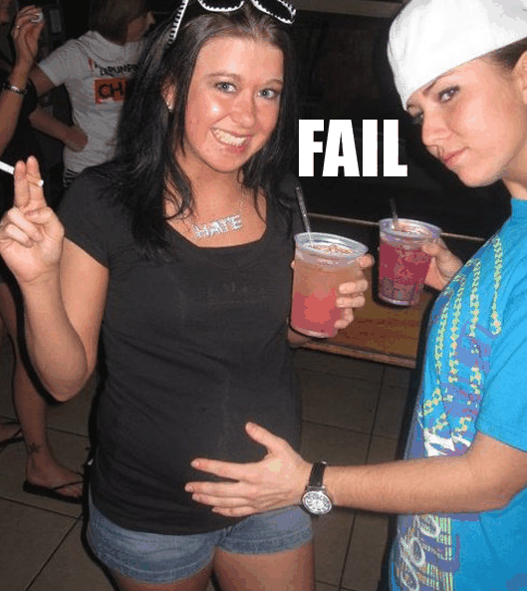
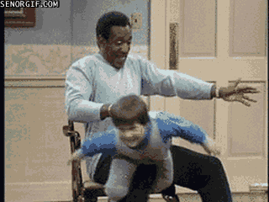
Q: Are serialists born or made?
Nurture = the environmental influences that shape behavior
Influences may be…
Biological (i.e., the impact of a pregnant mother’s use of cocaine on her unborn child)
Social (i.e., the way parents discipline a child, peer pressure)
Societal factors (i.e., socioeconomic status)
Notes:
One of the enduring questions of development involves how much people’s behavior is due to genetics (nature) and how much to the physical and social environment (nurture)

Slide 33
Q: Are serialists born or made?
To fully understand the nurture aspect of the debate, we have to understand some different theories of psychological development
Your task:
View the chapter from the textbook posted on the class website
Answer questions on worksheet
Worksheet will count as your notes
Notes:
Make copies of pages from developing the lifespan text
http://www.sagepub.com/upm-data/60087_chapter_6_for_sales_01312014.pdf
Ch 10 “book” file = females

Slide 34
Psychological Theories of Crime
20 minutes
End
Notes:
http://www.sagepub.com/upm-data/60087_chapter_6_for_sales_01312014.pdf

Slide 35
Review: Choose Your Own Adventure
Make a “C” (69-79)…
Complete review booklet sheet
Make an “B”(80-89)…
Complete “C” level
Make a foldable or graphic organizer of 20 essential vocab words/definitions
Create a 20-question test covering general topics
Make an “A” (90-100)…
Complete “C” and “B” level
Forensic Science Bloom Ball

Slide 36
Serial Killers: Crime Stories
Take notes
Who were the victims?
Were they any similarities between the victims?
Who is the suspect?
Describe him
What classification would he fall under?
What was his M.O.?
Any evidence of signature behavior?
What do you think: was he born or made into a killer?
Write down your opinion. Record supporting evidence.
Be prepared to share.

Slide 37
Female Serial Killers

Slide 38
Q: How Common?
Females account for only 15% of all violent crime
Female serial killers account for only 8% of American serial killers

Slide 39
General Overview
Males
27.5 is average age at first kill
9 is the youngest (Clarence Hill)
72 is the oldest (Ray Copeland)
Jesse Pomeroy (Boston in the 1870s)
Killed 28 people by the age of 14
Spent 58 years in solitary confinement until he died
Females
30 is average age at first kill
14 is youngest (Caril Ann Fugate)
55 is oldest (Marie Becker)
Angels of death, revenge killers, and team killers tend to be younger

Slide 40
Q: Compare and Contrast
MALE:
Method of choice:
Stabbing
Strangulation
Shooting
Choice of victim:
Wide range, often strangers
Usually of same race as killer
Usually adults
FEMALE:
Method of choice:
Poison/injection (80%)
Suffocation (16%)
Drowning (5%)
Choice of victim:
Family members or lovers
Often children or the elderly
Gets away with it for a longer period of time!

Slide 41
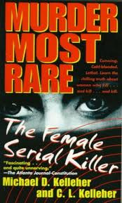
Q: Types of female serial killers ?
Kelleher & Kelleher – 9 categories and two forms of actions
Note: there are some female serial killers that do not fit neatly into typology

Slide 42
Female Serial Killers

Slide 43
Q: How Common?
Females account for only 15% of all violent crime
Female serial killers account for only 8% of American serial killers

Slide 44
General Overview
Males
27.5 is average age at first kill
9 is the youngest (Clarence Hill)
72 is the oldest (Ray Copeland)
Jesse Pomeroy (Boston in the 1870s)
Killed 28 people by the age of 14
Spent 58 years in solitary confinement until he died
Females (Kelleher & Kelleher, 1998)
30 is average age at first kill
14 is youngest (Caril Ann Fugate)
55 is oldest (Marie Becker)
Angels of death, revenge killers, and team killers tend to be younger

Slide 45
Q: Compare and Contrast
MALE:
Method of choice:
Stabbing
Strangulation
Shooting
Choice of victim:
Wide range, often strangers
Usually of same race as killer
Usually adults
FEMALE:
Method of choice:
Poison/injection (80%)
Suffocation (16%)
Drowning (5%)
Choice of victim:
Family members or lovers
Often children or the elderly
Gets away with it for a longer period of time!

