Slide 2
Trace Evidence
Trace evidence is physical evidence that it often difficult to detect by the naked eye, therefore some type of magnification or sensitive analytical technique is often required to detect or view it.
Gunshot residue (GSR) is one of the most widely utilized and widely examined forms of trace evidence.

Slide 3
GSR Evidence
In the United States, 1.3 million people are confronted each year by criminals carrying handguns.
Firearms have been used in 40% of robberies, 20% of aggravated assaults, and 68% of all criminal homicides.
GSR evidence has helped to solve many violent crimes.

Slide 4
GSR Evidence
When a crime involves the discharge of a firearm, the first thing that must be determined by investigators is who fired the gun.
When properly obtained and analyzed, gunshot residue can connect the criminal to the proverbial “smoking gun.”

Slide 5
GSR Evidence
Gunshot residue may be found on the hands or clothing of the suspected shooter, as well as on any object or person in the vicinity of the fired weapon.
The face of a suspected shooter can also be sampled. This may prove especially useful when a rifle or shotgun has been used in a shooting.
Larger amounts of gunshot residue are deposited on the face, chest, and hair when these types of weapons are used, as they cause significant blow-back of residue.

Slide 6
GSR Evidence
Gunshot residue is best preserved on articles of clothing, even if a longer period of time has passed from the time of shooting.
When a gun is fired, a plume of residue is created that spreads from all openings in the firearm. This cloud then leaves residue deposits on the areas in the immediate vicinity of the discharge.
Using adhesive strips or tacky adhesive stubs, forensic analysts frequently examine the objects at a crime scene and take samples from furniture, walls, curtains, carpet or floorings, and other indoor items to help conclude where a shooting took place.

Slide 7
GSR Evidence
Gunshot residue should be collected as soon as possible, but particles may remain at a crime scene indefinitely.
These particles are extremely durable because they are composed of heavy metals: lead, barium, and antimony.
This residue is not readily water-soluble, and, if left to dry in the environment, deposits will not diminish.

Slide 8
Distance Estimation Overview
The deposition of GSR on evidence such as clothing varies with the distance from the muzzle of the firearm to the target.
Patterns of GSR can be duplicated using a questioned firearm and ammunition combination fired into test materials at known distances.
These patterns serve as a basis for estimating muzzle-to-garment distances.

Slide 9
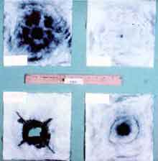

Slide 10
Modifed Griess Test
Using the suspected ammunition from the case, reference shots are fired into white denim cloth at varying distances.
The Modified Griess Test is then performed on the test patterns. This test detects nitrite residues and is used to determine muzzle-to-garment distance.
The clothing specimen with the gunshot residue is placed against a piece of desensitized photographic paper, and the back of the specimen is steam ironed with an acid solution in the iron instead of water.

Slide 11
Modified Griess Test
Acidic vapors penetrate the specimen causing a reaction between nitrite residues and chemicals in the photographic paper.
Comparing tested residue patterns to that of the actual item of evidence, one can estimate the distance of discharge.
Patterns that occur from close range shots will show a more concentrated and tighter configuration of residue compared to distant range shots that will exhibit a sparser and less perceptible arrangement.

Slide 12
Lead Testing
To confirm the presence of lead, the Sodium Rhodizonate Test is used.
This test is performed by spraying the specimen to be tested with sodium rhodizonate and distilled water.
Any lead residue present on the evidence will react with the sodium rhodizonate and turn a bright pink color.

Slide 13
GSR Detection
It is possible to detect traces of the metals barium, antimony and lead, on the back of the firing hand of individuals who have fired a gun. The metals originate from the primer.
Cotton tipped swabs wet with dilute acid (10% hydrochloric acid or 5% nitric acid) are used to recover residues for analysis by flameless atomic absorption spectrometry (FAAS) and neutron activation analysis (NAA).
Adhesive material is used to recover residues for analysis using scanning electron microscopy and energy-dispersive X-ray spectroscopy (EDAX).

Slide 14
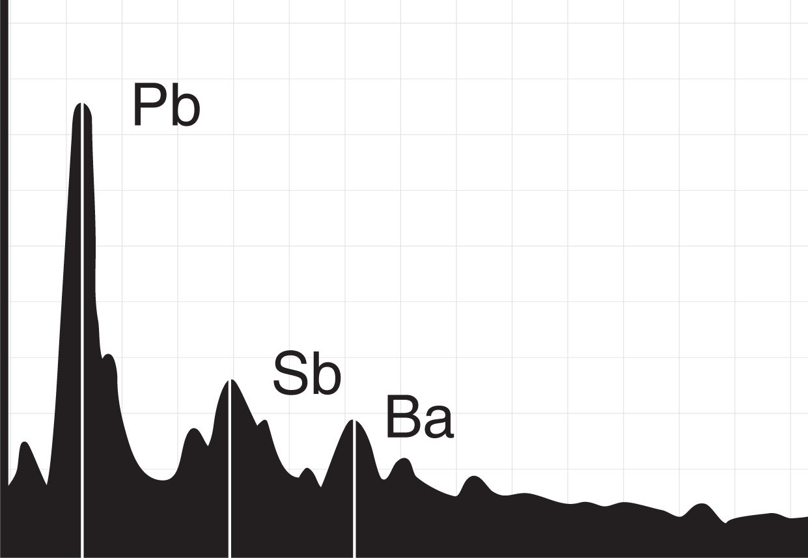
Elemental Analysis
The gunshot residue deposited in a gunshot wound can be detected by using scanning electron microscopy coupled with energy-dispersive x-ray microanalysis to demonstrate the characteristic elemental pattern of the primer residue containing lead, antimony, and barium.

Slide 15
GSR Detection
All three metals are not always present in rimfire primers.
Neutron activation only detects antimony and barium, and must be used in conjunction with FAAS to detect lead.
NAA and FAAS are both quantitative elemental analytical methods which do not distinguish the source of the metals. False positives are therefore theoretically possible.
SEM with EDAX can potentially absolutely identify all gunshot residue. In practice, residues are detected in 90% of persons who have fired handguns, but only 50% of persons who have fired rifles and shotguns.

Slide 16
GSR Detection
The quantity and distribution of the three metals can be described as consistent or not consistent with gunshot residue and with firing a weapon.
Residues on the palms of the hands could indicate a defense gesture, or handling of a previously fired weapon.
In suicides, residues are often detected on the non-firing hand used to steady the muzzle against the body.
Residues of barium alone may be the result of contamination with barium rich soil.

Slide 17
Collecting GSR Evidence
Plastic gloves should be worn by the evidence technician when taking the hand-wiping.
The cotton swab is moistened with two or three drops of acid solution.
About 20 seconds of swabbing per swab is recommended and important. Each area is swabbed twice.

Slide 18
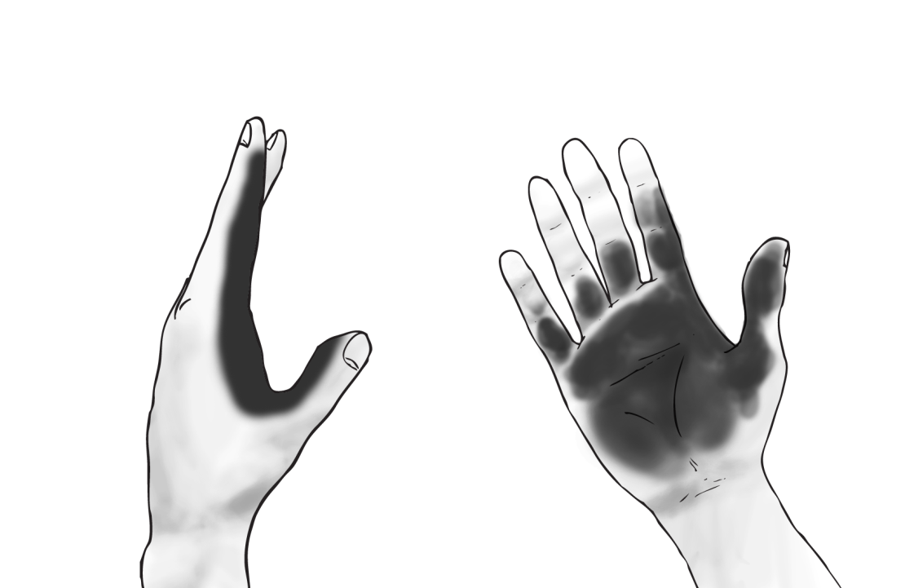
Collecting GSR Evidence
The four areas swabbed are the backs of both hands and the palms of both hands.
On the back of the hand the radial aspect of the forefinger, the dorsal aspect of the thumb, and the skin web between is swabbed.
On the palm of the hand the palmar aspect of the forefinger and thumb together with the base of the forefinger and thumb and the skin web between is swabbed.

Slide 19
Submitting Firearms Evidence
Clothing submitted for gunshot residue examination should be carefully handled, air dried, and each article individually wrapped in paper.
Clothing with blood must be air dried and labeled BIOHAZARD on the inner and outer containers. The date, time, location, collector's name, case number, and evidence number should be on the container.

Slide 20
Legal Implications of GSR Evidence
The finding of gunshot residue can certainly implicate an individual that might be involved in a crime with a firearm.
However, someone within close proximity of a fired gun might have similar concentrations, patterns, and locations of gunshot residue.
This evidence does not necessarily assign guilt but may be a tool to explaining a guilty action, the events of the crime, and/or placing an individual at the scene of the crime.

Slide 21
