Slide 1
SOLUTIONS AND OTHER MIXTURES

Slide 2
1. HETEROGENEOUS MIXTURES- UNEVENLY MIXED AND CAN OFTEN SEE DIFFERENT PARTS
A. SUSPENSIONS- LARGE PARTICLES. SETTLES OUT OR CAN BE FILTERED EX) OIL AND VINEGAR, ORANGE JUICE WITH PULP
B. COLLOIDS- MEDIUM PARTICLES, DON’T SETTLE BUT SCATTER LIGHT (TYNDALL EFFECT) EX) PAINT, WHIPPED CREAM, EGG WHITES
EMULSIONS(TYPE OF COLLOID)- TWO OR MORE LIQUIDS THAT DON’T USUALLY MIX DISPERSED IN EACH OTHER. EX) MAYO, COFFEE CREAM

Slide 3
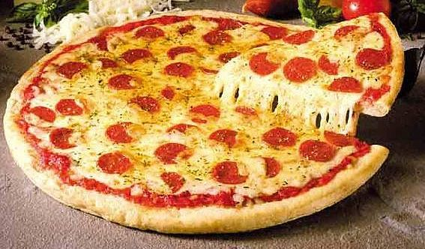
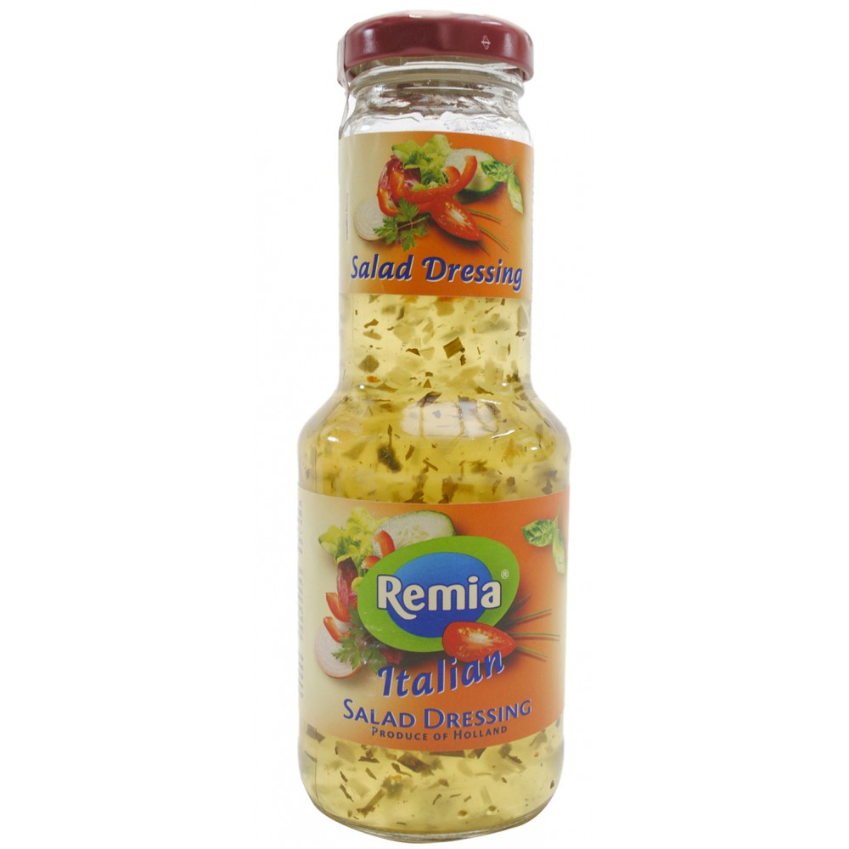
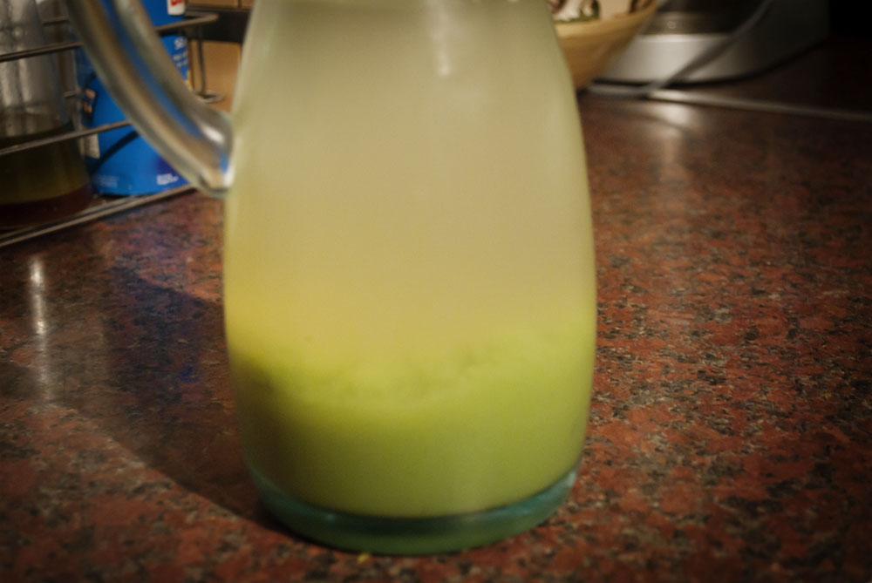
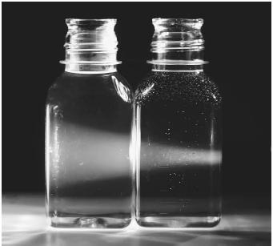
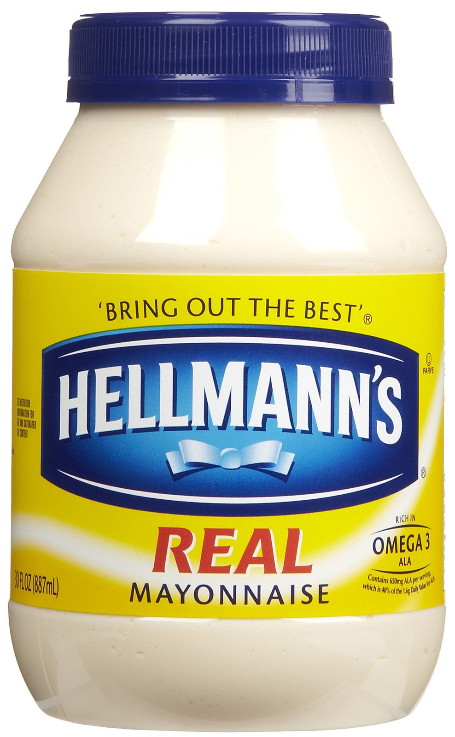
EXAMPLES OF HETEROGENEOUS MIXTURES

Slide 4
2. HOMOGENEOUS MIXTURES “SOLUTIONS” (PARTICLES ARE EVENLY MIXED AND TOO SMALL TO SEE OR FILTER) MUST BE MISCIBLE OR MIXABLE
SOLUTE- GETS DISSOLVED OR LESS OF IT
EX) THE SALT IN SALT WATER
EX) OXYGEN IN AIR BECAUSE IT MAKES UP ONLY 20%
SOLVENT- DOES THE DISSOLVING OR THERE IS MORE OF IT
EX) THE WATER IN SALT WATER
EX) NITROGEN IN AIR BECAUSE IT MAKES UP 79% OF IT

Slide 5
DIFFERENT TYPES OF SOLUTIONS
A. LIQUID SOLUTIONS- SALT WATER, GASOLINE
B. SOLID SOLUTIONS- “ALLOYS” BRASS IS COPPER AND ZINC MIXED
C. GAS SOLUTIONS- AIR IS MOSTLY NITROGEN AND OXYGEN
YOU CAN ALSO HAVE GASES DISSOLVED IN A LIQUID (FISH BREATHE OXYGEN DISSOLVED IN WATER)

Slide 6
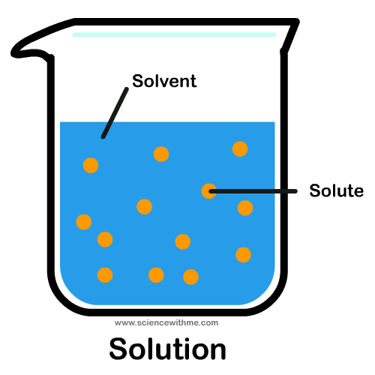
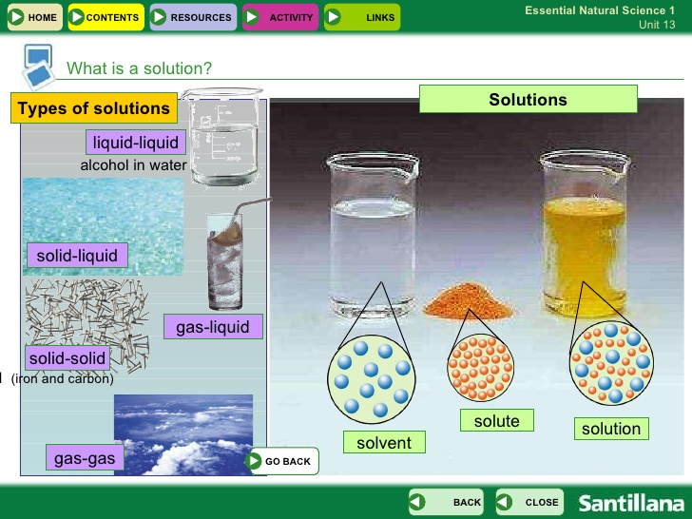
TYPES OF SOLUTIONS

Slide 7
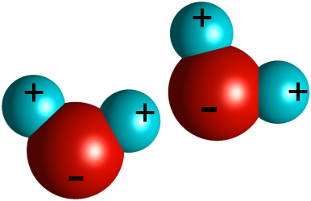
3. WATER “THE UNIVERSAL SOLVENT”
WATER IS A POLAR MOLECULE- HAS POSITIVE AND NEGATIVE CHARGES ON IT’S ENDS
PULLS APART IONIC CRYSTALS INTO IONS
DISSOLVES MANY COVALENT COMPOUNDS
WATER MOLECULES ATTRACT EACH OTHER
CALLED HYDROGEN BONDING

Slide 8
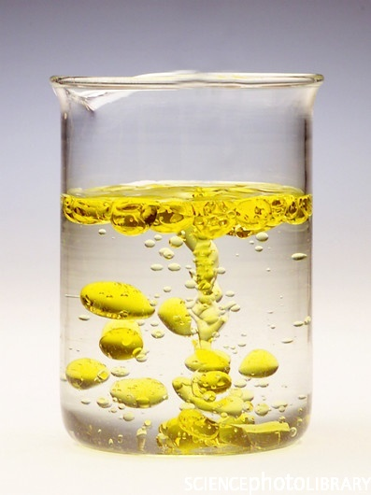
4. LIKE DISSOLVES LIKE
POLAR SOLUTES TEND TO DISSOLVE IN POLAR SOLVENTS (WATER AND LATEX PAINT)
NONPOLAR SOLUTES TEND TO DISSOLVE IN NONPOLAR SOLVENTS (OIL PAINT AND PAINT THINNER)
OIL AND WATER DON’T MIX!

Slide 9
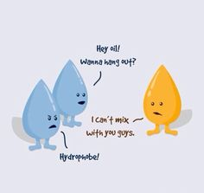

Slide 10
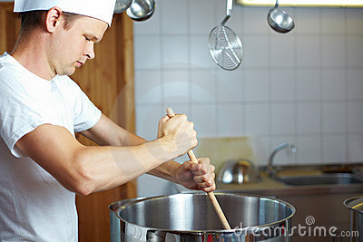
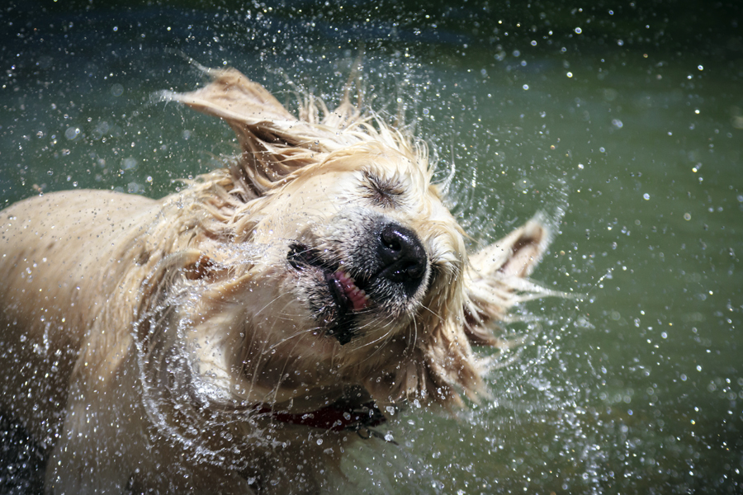
5. TO SPEED DISSOLVING RATE
CRUSH, STIR,SHAKE OR HEAT IF IT’S A SOLID IN A LIQUID

Slide 11
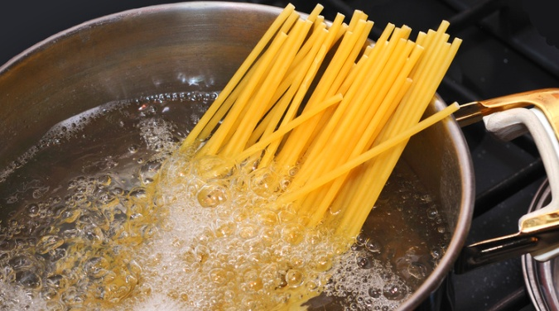
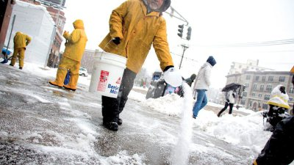
6. MANY SOLUTES, WHEN ADDED TO A SOLVENT:
INCREASE THE BOILING POINT OF THE SOLUTION
DECREASE THE FREEZING POINT OF THE SOLUTION

