Slide 2
Handgun Examples
Revolver: A firearm designed to be fired from the hand and having a rifled barrel and a revolving cylinder containing several chambers each of which holds one cartridge.
Auto-loading pistol: A firearm designed to be fired from the hand and having a rifled barrel and a removable magazine storing cartridges with a mechanism for auto-loading.

Slide 3
Rifle
Definition: A firearm with a rifled barrel designed to be fired from the shoulder.
Types:
Single shot
Lever action
Bolt action
Pump action
Auto-loading (erroneously called "automatic rifles“ or “assault rifles”)

Slide 4
Shotgun
Definition: A firearm with a smooth bored barrel designed to fire multiple pellets simultaneously and to be fired from the shoulder.
Types:
Single shot
Over and under
Double barrel
Bolt action
Lever action
Pump action
Auto-loading

Slide 5
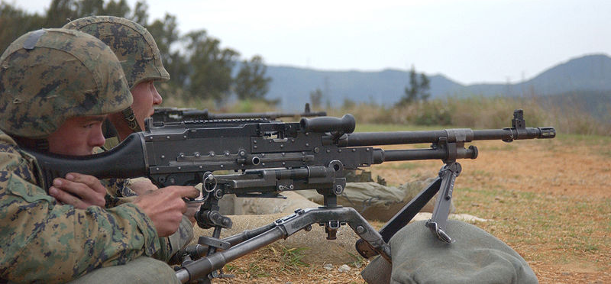
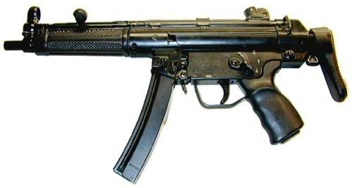
Machine Gun / Submachine Gun
A firearm with a rifled barrel firing rifle ammunition and capable of fully automatic fire.
Submachine guns function identically but fire pistol rounds and are more portable.

Slide 6
What is Caliber?
Caliber (or calibre) is the internal diameter of the firearm’s barrel, or the diameter of the projectile it fires.
A small bore rifle with a diameter of 0.22 inches is a .22 caliber
Some bullets have a metric caliber rather than an inch caliber, such as the 10 mm caliber.

Slide 7
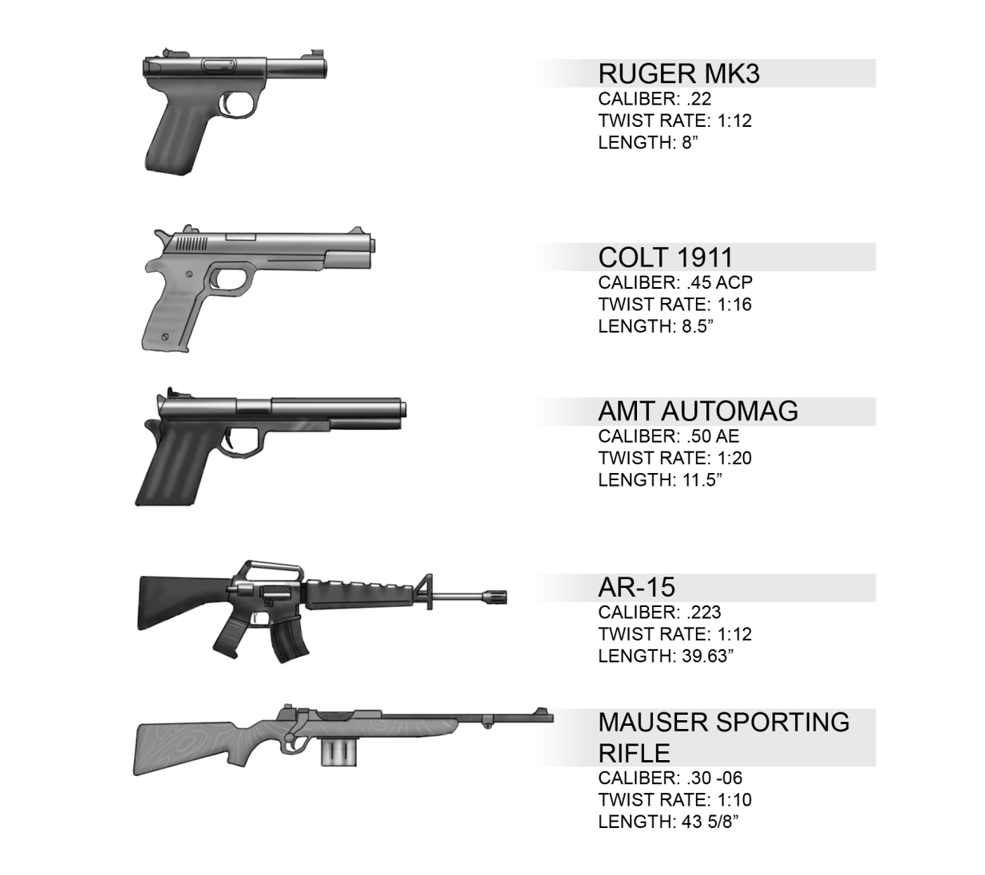
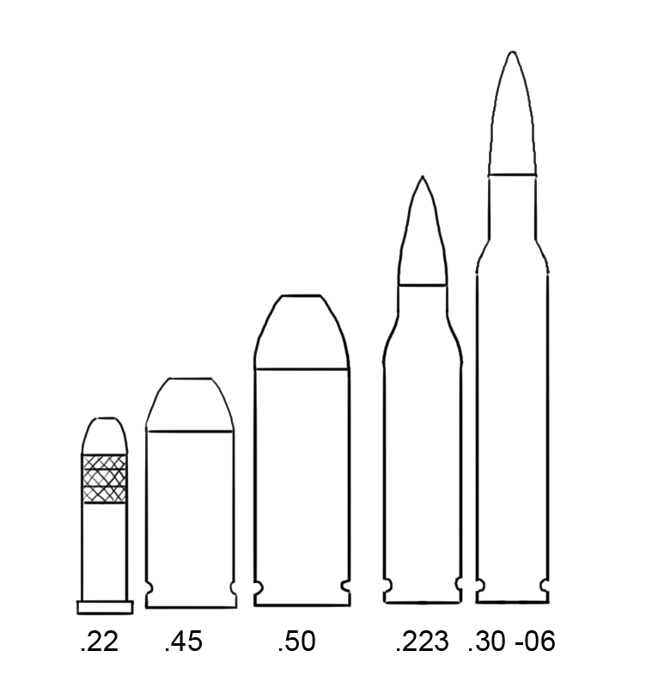
Common Calibers

Slide 8
Bullet Velocity
Low Velocity Bullets
Bullets nominally rated for 800 to 1600 feet per second muzzle velocities, such as 22 LR, most pistols, and older rifle cartridges, must follow a rather high arc in order to reach a target 100 yards away. Slower cartridges are generally only useful to about 50-75 yards.
High Velocity Bullets
Bullets at 2600 fps and up, such as:
.223 22-250
.243/6mm .270
.308 30-06
These follow a much lower arc to reach a target, and their useful range can be upward of 200 yards. These are often referred to as "flatter" trajectories. With higher velocities, these bullets go much further before gravity and air resistance cause them to fall below the initial line of sight.

Slide 9
Bullet Trajectory
Ballistics is the scientific discipline that deals with the flight, behavior, and effects of projectiles, especially bullets.
Bullet trajectory can be calculated when there is an entrance and exit mark in a wall or body.
If you have these marks or one mark and the trajectory, you can calculate the missing data:
Angle of impact.
Height of shooter.
Distance from point of impact.
Notes:
http://www.personal.psu.edu/jbl5036/blogs/engl202c/instruction%20set.pdf
http://www.youtube.com/watch?v=mq3HHmj7rfU

Slide 10
Bullet Trajectory
Bullet trajectory is important for reconstruction of the crime.
For a high powered rifle with high velocity ammunition, the bullet can travel over a mile. The trajectory can identify the location of the shooter.

Slide 11
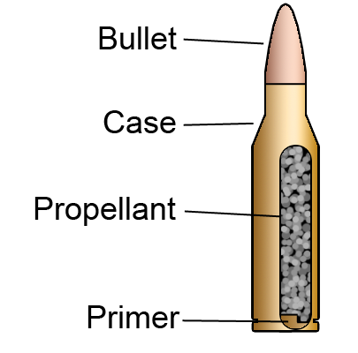
Small Arms Ammunition

Slide 12
Cartridge Case
Function:
Expands and seals chamber against rearward escape of gases.
Composition:
Usually brass (70% copper 30% zinc); Also plastic and paper in shotgun shell tubes.

Slide 13
Cartridge Case
Shape:
straight (pistol ammunition)
bottleneck (rifle ammunition)
Extractor flange:
The configuration of the cartidge base; rimmed, semi-rimmed, rimless, belted, rebated
Headstamp:
Manufacturer’s identification imprinted or embossed on cartridge case

Slide 14
Bullet
Function: The part of the cartridge which exits the muzzle and strikes the target.
Composition:
Lead alloyed with tin and/or antimony with/without copper or copper alloy "gilding" (less than 0.0002 inches thick).
Metal jacketed with lead or steel core and jacket of copper-zinc, copper-nickel or aluminum (0.0165 to 0.03 inches thick).

Slide 15
Bullet
Shapes:
Lead bullets - roundnose, wadcutter, semi-wadcutter, hollowpoint; generally all have cannelures or grooves.
Metal-jacketed -
full jacketing in military ammunition
partial jacketing in hunting rifle and semi-automatic pistol ammunition: semi-jacketed soft point, semi-jacketed hollow point, silver-tip (aluminum).

Slide 16
Bullet
Uses:
Lead bullets - traditionally only for revolvers and .22 caliber rimfire ammunition; copper gilding in .22 caliber high-velocity rimfire ammunition.
Metal-jacketed bullets - traditionally for semi-automatic pistols and high velocity rifles.

Slide 17
Primer
Function:
Explodes on compression, igniting the propellant.
Composition:
Commonly lead styphnate, barium nitrate, antimony sulphide.
Typically centerfire ammunition contains all 3 elements (lead, barium antimony) but rimfire ammunition sometimes contains only lead or lead and barium.
Considered in elemental trace tests to determine if a person fired a weapon.

Slide 18
Primer
Location:
Centerfire - centrally-placed primer assembly comprising primer cup (struck by firing pin), primer, anvil with flash holes.
Rimfire - No primer assembly. Primer spun into rim of cartridge case (rim struck by firing pin) and in contact with propellant.

Slide 19
Propellant
Function:
Burns to produce large volumes of gases under pressure.
Composition:
Black powder (charcoal, sulphur, potassium nitrate), now obsolete. Smokeless powder (nitrocellulose with/without nitroglycerine) is most common in modern rounds.
Shape:
Sheets of smokeless powder cut into disc, flake or cylinder shapes. Alternatively produced as ball and flattened ball smokeless powder (as in Winchester brand propellants) which may be coated with silver-black graphite.

Slide 20
Cartridge Cases
Cartridge case or shotshell casing examinations can determine the caliber or gauge, the manufacturer, and whether there are any marks that may be of value for comparison.
The microscopic characteristics of evidence cartridge cases and shot shell casings can be examined to determine whether they were fired in a specific firearm.

Slide 21
Cartridge Cases
Examinations of unfired cartridges or shot shells can determine the caliber or gauge and whether there are marks of value for comparison.
Examinations can also determine whether the ammunition was loaded into and extracted from a specific firearm.
Unfired and fired cartridges or shot shells can be associated through manufacturing marks.

Slide 22
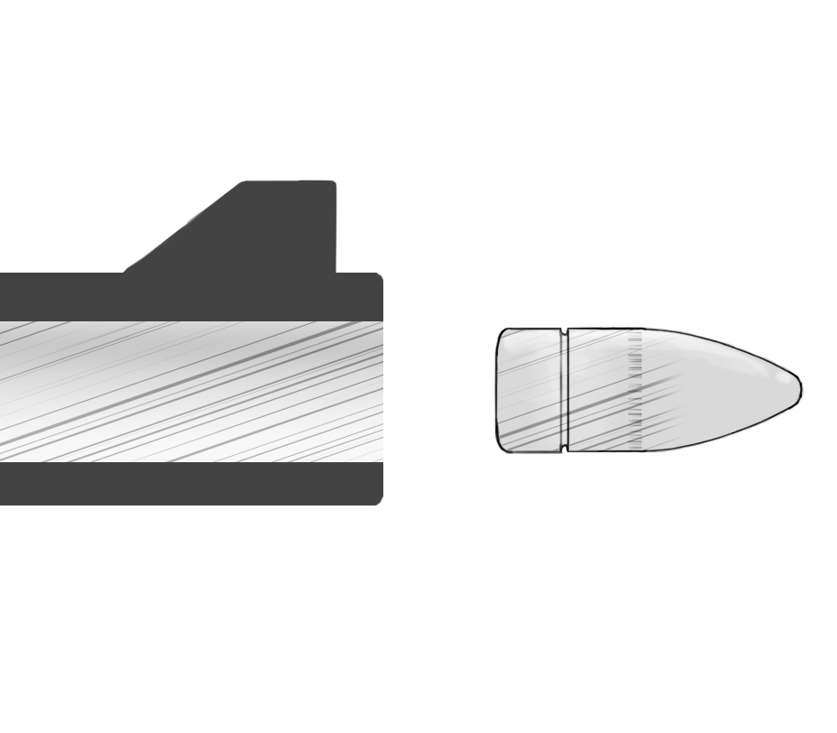
Rifling
Rifling is a helical machined surface inside the barrel that has unique microscopic characteristics as a result of the manufacturing process.
Rifles and handguns (but not shotguns) have rifled barrels.

Slide 23
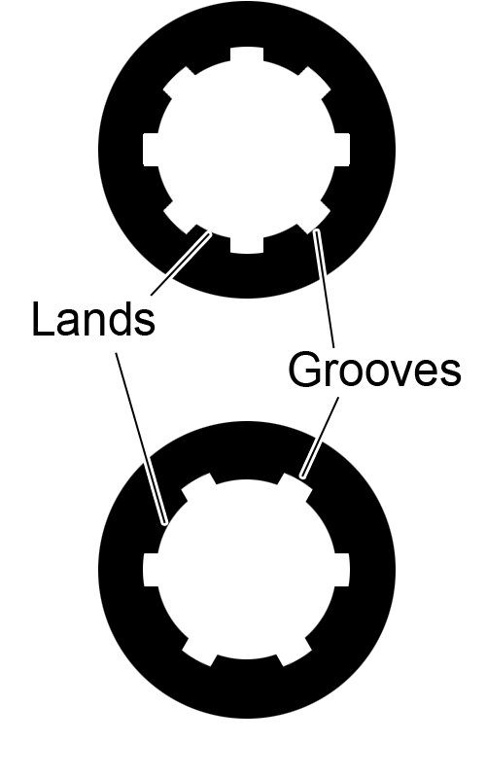
Rifling
The raised metal between the grooves is the lands. In the US, caliber is measured between opposing grooves. Elsewhere, it is measured between opposing lands.
Some markings have "class characteristics" indicative of the make and model of the firearm.
Other markings have "individual characteristics" which reflect imperfections peculiar to a particular firearm and may allow its specific identification.

Slide 24
Bullet Striations
Also known as tool marking; when a hard object is brought into forceful contact with a softer object, the softer object will be marked.
This is what happens when a soft bullet engages the hard rifling in the interior of a barrel.
Bullet jackets are typically made of some softer metal such as a lead or copper while rifle barrels are commonly steel.

Slide 25
Bullet Striations
Studies have shown that no two firearms, even those of the same make and model, will produce the same unique marks on fired bullets and cartridge cases.
Manufacturing processes, use, and abuse leave surface characteristics within the firearm that cannot be exactly reproduced in other firearms.

Slide 26
Bullet Striations
Firearms do not normally change much over time.
This allows for firearms recovered months or even years after a shooting to be identified as having fired a specific bullet or cartridge case.
Tests have been conducted that found even after firing several hundred rounds through a firearm, the last bullet fired could still be connected to the first.

Slide 27
Bullet Striations
Fired bullets can be examined to determine the general rifling characteristics such as caliber and physical features of the rifling impressions and the manufacturer of the bullets.
The microscopic characteristics on evidence bullets can be compared to test-fired bullets from a suspect firearm to determine whether the evidence bullet was fired from that firearm.

Slide 28
Bullet Identification Characteristics
Number of lands and grooves (usually 4 to 6 but range from 2 to 22).
Diameter of lands and grooves.
Width of lands and grooves.
Depth of grooves.
Degree of twist (twist is the number of inches of bore required for one complete rifling spiral).
Direction of rifling twist (commonly right/clockwise, less commonly left/counterclockwise e.g. Colt).

Slide 29
Pattern Matching
The process of determining whether or not the striated toolmarks on two objects, such as fired bullets, correspond.
This is a somewhat subjective process based on the observations and experience of the examiner.

Slide 30
Consecutive Matching Striae
Quantitative method of describing observed patterns in bullet striations.
Evolving concept in bullet comparison, initially proposed in 1959 by Al Biasotti.

Slide 31
CMS Criteria for Identification
In three dimensional toolmarks, at least two different groups of at least three consecutive matching striae must appear in the same relative position.
In three dimensional toolmarks, at least one group of six consecutive matching striae must be in agreement in an evidence toolmark when compared to a test toolmark.
In two dimensional toolmarks, at least two groups of at least five consecutive matching striae must appear in the same relative position.

Slide 32
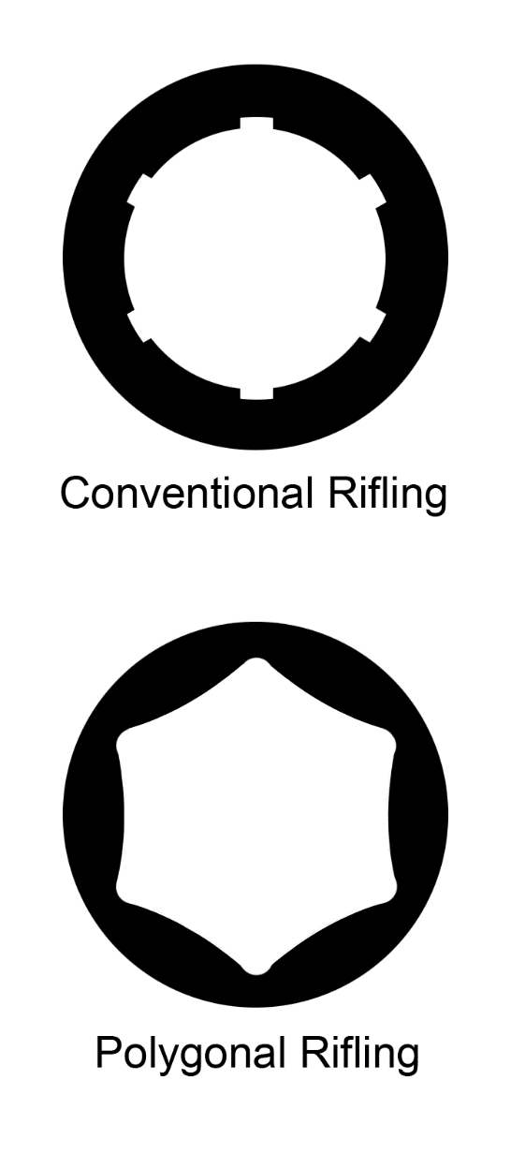
Glock Rifling is an Exception
Some weapons (e.g. Glock pistols) do not make usable striation pattern on fired bullets because they use polygonal rifling instead of conventional rifling.
One group of eight consecutive matching striae in agreement would be considered a matching evidence toolmark from this type of rifling.

Slide 33
Initial Examination of a Fired Bullet
Determination of general rifling characteristics for the firearm that fired it through bullet inspection.
Narrows the possible makes and models of firearm that could have fired the bullet.
An initial examination for trace evidence that might be destroyed in the course of bullet testing.
Textile fibers, traces of paint, or bits of concrete and brick from intermediate targets
Pattern of the badge embossed on its nose

Slide 34
Caliber Determination
If the bullet is not deformed, its diameter can be measured with a micrometer.
Lead and lead‐alloy bullets are larger in diameter than full metal jacket or semi‐jacketed bullets of the same nominal caliber.
If the bullet is severely deformed, its possible caliber(s) may be determined by weighing it.
The weight of the bullet will rarely pinpoint its caliber but will serve to eliminate a number of calibers. For example, a 72‐grain bullet may be .32 caliber but it cannot be .22 caliber.

Slide 35
Fired Standards
Fired standards – Bullets fired from firearms having known rifling characteristics.
Generally simpler to compare each questioned bullet to a set of fired standards than to other collected bullets at the scene.

Slide 36
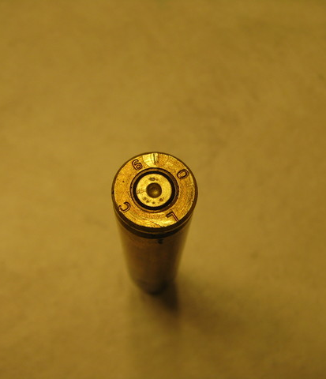
Determining Class Characteristics
Class characteristics of firearms can also be determined from expended cartridges:
Caliber
Shape of firing chamber
Location of the firing pin
Size of extractors and ejectors (if any)
Size and shape of the firing pin
Geometrical relationship of the extractor and ejector
ejector mark
firing pin mark

Slide 37
Determining Class Characteristics
Care should be exercised in inferring the general class characteristic of a weapon.
A shotgun can be converted into a rifle
Sub‐caliber cartridges can be wrapped so they fit in larger barrels
Determine if the weapon’s class characteristics are consistent with those found on the fired bullets or cartridges.
The weapon must be test fired to obtain bullets and cartridges for comparative microscopic examination IF it operates properly and if the weapon can be safely fired.

Slide 38
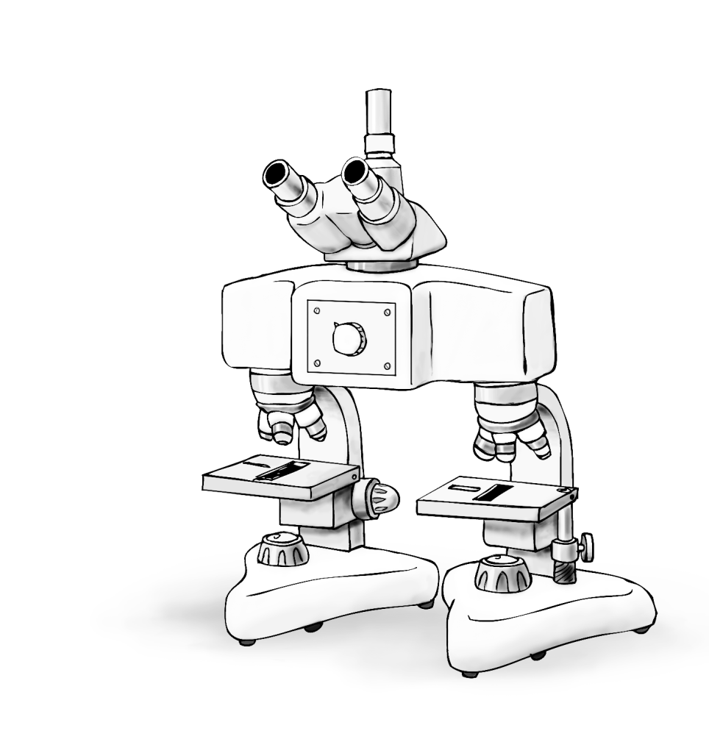
Comparison Microscope
A comparison microscope consists of two compound microscopes connected by an optical bridge.
Two specimens are viewed side by side to simplify comparison.

Slide 39
Bullet Comparison
First the test‐fired bullets are compared with each other to verify that the weapon’s barrel consistently marks the bullets fired through it.
If consistent marking does not occur further comparison of the questioned bullet is useless.
Once a distinctive pattern of parallel striations are found the technician rotates the other bullet slowly in an attempt to find a matching pattern.

Slide 40
Bullet Comparison
If no matching pattern is found, the examiner tries to find another distinctive pattern of striations on the first bullet and again tries to find a matching pattern on the second bullet.
Most firearms examiners require that identical patterns of three or more consecutive striations be found on each bullet for a match (CMS).
Not all striations on the two bullets must match.
Debris in the weapon’s barrel may have made stray markings on the bullet within the land impressions of two bullets fired from the same semiautomatic pistol.

Slide 41
Bullet Comparison
Jacketed and semi‐jacketed bullets may not expand sufficiently to fill the groove of the rifling.
Skid marks are marks parallel to the axis of the bullet, made when the bullet initially enters the rifling edges. Surfaces of the lands will scrape along the bullet surface before the bullet is fully gripped by the rifling.
The term skid mark is also applied to marks near the nose of a bullet caused by contact with the forcing cone in the barrel of a revolver.

Slide 42
Bullet Comparison
Slippage marks are made on a bullet when it slips along the tops of the lands instead of being firmly gripped by the rifling.
They are the result of the barrel being worn or having been bored out and may also result if a sub‐caliber bullet is fired in a weapon.
Slippage marks are hard to replicate in test firings.

Slide 43
Firing Pin Impression
Firing pin impressions and breech block markings on the primer (also called bolt‐face signatures) should be compared first because they can only be produced by firing a cartridge in a firearm.
Chambering, extractor, ejector, and magazine marks may be made by loading a cartridge in a weapon without firing it.

Slide 44
Possible Conclusions from Analysis
Positive identification – The class characteristics are consistent and individual characteristics match. This means that the likelihood that a firearm other than the firearm submitted for examination fired the questioned bullet or cartridge is very unlikely.
Negative identification - The questioned bullet or cartridge was not fired in the submitted weapon. The class characteristics did not match.
Inconclusive - There was too little information on which to base a conclusion or that while the class characteristics matched, sufficient individual characteristics to declare a match could not be found.

Slide 45
How Reliable are Bullet Identifications?
The National Research Council set up a Committee to investigate forensic methods and released a report in January 2009. They found that the basic premises of firearms and toolmark identification had not been scientifically established.
Additional research is recommended to better support the contention these are unique methods.

Slide 46
National Integrated Ballistic Information Network (NIBN)
In this program, ATF administers automated ballistic imaging technology for NIBIN Partners: Federal, State and Local law enforcement agencies.
NIBIN allows NIBIN Partners to submit digital images of the markings made on spent ammunition recovered from a crime scene or a crime gun test fire.
The images are then correlated (in a matter of hours) against earlier entries via electronic image comparison. If a high-confidence candidate for a match emerges, the original evidence is compared via microscope to confirm the match or NIBIN “hit.”

Slide 47
National Integrated Ballistic Information Network (NIBN)
Since 1979, ATF’s annual appropriations have prohibited the expenditure of funds for consolidating or centralizing Federal firearms licensee acquisition and disposition records.
Therefore, NIBIN cannot be used to capture or store ballistic information acquired at the point of manufacture, importation, or sale; nor can it be used to capture purchaser or date of manufacture or sale information.

Slide 48
National Integrated Ballistic Information Network (NIBN)
Typical database entry data include:
Type of breech block marking.
Size, shape and location of extractor marks.
Size, shape and location of ejector marks.
Size, shape and location of firing pin marks (the most important identifying marks in rimfire cartridge cases).

Slide 49
DRUGFIRE
DRUGFIRE is a database that links firearms evidence from serial shooting investigations used in firearms laboratories in the United States.
Of the 65,000 processed homicide and murder cases, 5,200 have been solved using DRUGFIRE.
Examiners from across the country can compare and link evidence obtained in the form of spent cartridges and other ammunition casings.

Slide 50
Other Firearms Evidence
Fingerprints may be found on casings but usable prints are rarely found on the firearm.
Obliterated and/or altered firearm serial numbers can sometimes be restored.
Firearms can be test fired to obtain known specimens for comparison to evidence ammunition components such as bullets, cartridge cases, and shotshell casings.

Slide 51
Other Firearms Evidence
Firearms examinations can determine the general condition of a firearm and whether the firearm is mechanically functional.
Trigger-pull examinations can determine the amount of pressure necessary to release the hammer or firing pin of a firearm.
Examinations can determine whether a firearm was altered to fire in the full-automatic mode.

Slide 52
Other Firearms Evidence
Shot Pellets, Buckshot, or Slugs
Examinations of shot pellets, buckshot, or slugs can determine the size of the shot, the gauge of the slug, and the manufacturer.
Wadding
Examinations of wadding components can determine the gauge and the manufacturer.

Slide 53
Other Firearms Evidence
Shot pattern examinations can determine the approximate distance at which a shotgun was fired by testing a specific firearm and ammunition combination at known distances.
Silencers are muzzle attachments can reduce the noise of a firearm by suppressing sound during firing. Testing can determine whether a muzzle attachment can be classified as a silencer based upon a measurable sound-reduction capability.
Gun Parts examinations can determine the caliber and model of gun from which the parts originated.

Slide 54
