Slide 1
RADIOACTIVITY

Slide 2
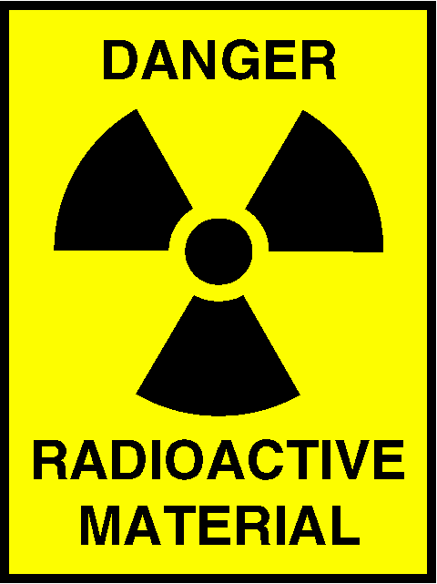
1. WHAT IS RADIOACTIVITY
AN UNSTABLE NUCLEUS RELEASING PARTICLES OR ENERGY
SOMETIMES CHANGES ONE ELEMENT INTO ANOTHER
THE PROCESS IS CALLED NUCLEAR DECAY
EX) URANIUM CAN TURN INTO LEAD!

Slide 3
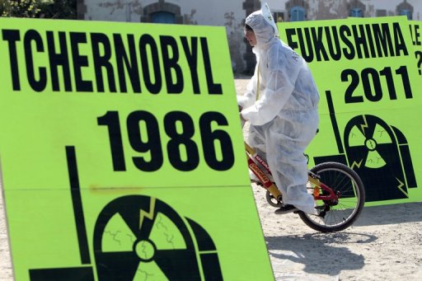
2. WHAT IS NUCLEAR RADIATION
THE MATTER OR ENERGY RELEASED DURING NUCLEAR DECAY
THERE ARE FOUR MAIN TYPES
EACH TYPE AFFECTS OTHER MATTER DIFFERENTLY

Slide 4
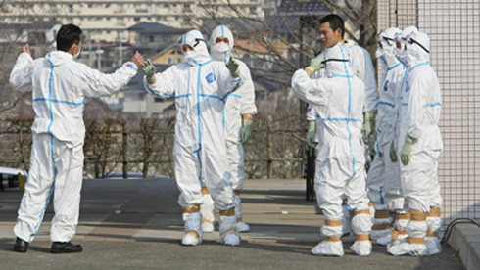
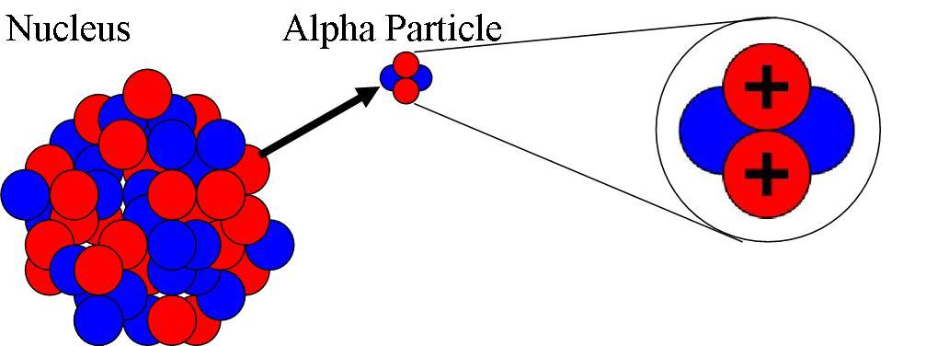
A. ALPHA PARTICLES
MADE OF TWO PROTONS AND TWO NEUTRONS
CAN BARELY PENETRATE PAPER
THEY DO IONIZE MATTER

Slide 5
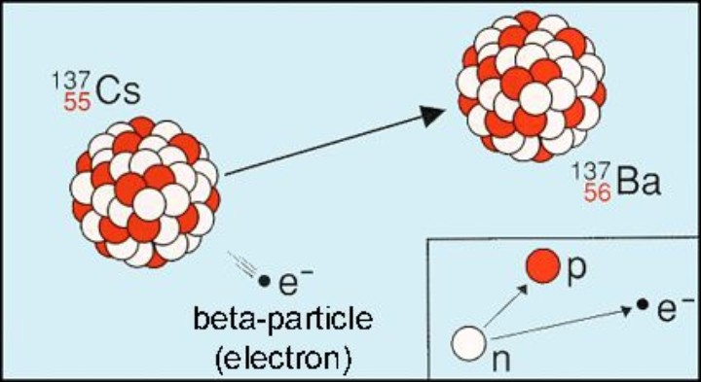
B. BETA PARTICLES
MADE OF HIGH SPEED ELECTRONS
CAN PENETRATE 3mm OF ALUMINUM OR 10mm OF WOOD
THEY DO IONIZE OTHER MATTER
A NEUTRON TURNS INTO A PROTON?

Slide 6
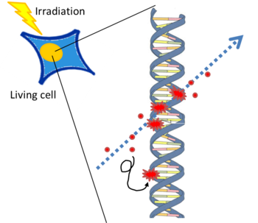
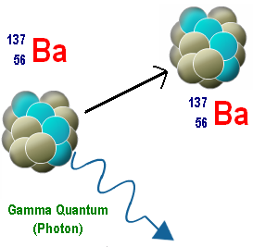
C. GAMMA RAYS
STRONG FORM OF ELECTROMAGNETIC ENERGY (NOT A PARTICLE)
CAN PENETRATE 60 cm OF ALUMINUM OR 7cm OF LEAD
EASILY IONIZES MATTER (GREATER HEALTH HAZARD)

Slide 7
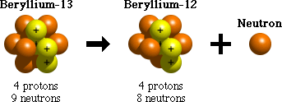
D. NEUTRON EMISSION
MADE OF A NEUTRON
CAN PENETRATE UP TO 15 cm OF LEAD!
DOES NOT IONIZE OTHER MATTER

Slide 8
FOUR RADIATION TYPES
TYPE SYMBOL CHARGE
ALPHA PARTICLE ⁴₂He +2
BETA PARTICLE ⁰₋₁e -1
GAMMA RAY ⁰₀Y 0
NEUTRON EMISSION ¹₀n 0

