Slide 1
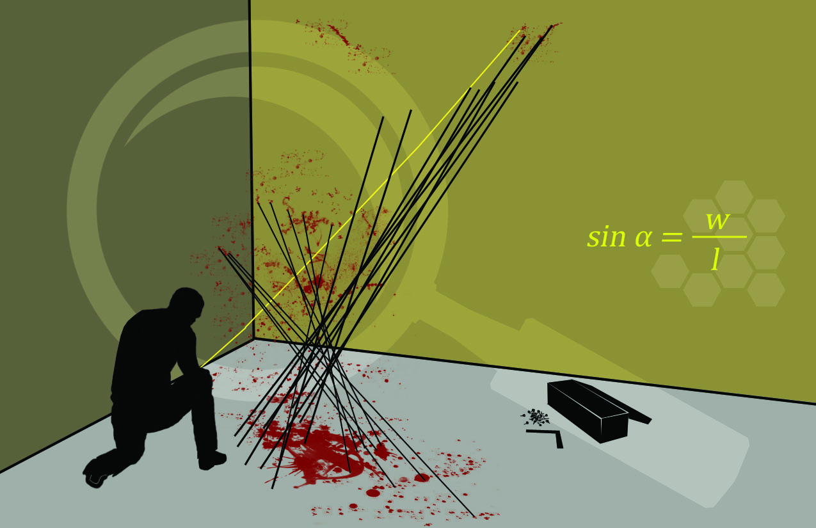
Patterns of Murder
Blood Spatter Analysis

Slide 2
Blood Stain Evidence
Bloodstain patterns can help investigators reconstruct events in a crime scene.
Analysis of the blood stain can tell whether it is animal or human.
Projected blood stains are called blood spatter.

Slide 3
Blood Spatter
Blood spatter analysis can approximate:
distance from the source of the blood to the pattern
direction from which the blood impacted
speed the droplet was traveling
location of the point of origin
movement of a bleeding individual throughout the scene
These approximations may agree or disagree with statements made by witnesses, victims, or suspects.

Slide 4
Physical Properties of Blood
Unlike water, blood is a suspension of solids and gases in a liquid.
Blood behaves differently than water when it is moving.
The viscosity of blood lowers as its shear rate increases (pumps easier at high flow rates).

Slide 5
Physical Properties of Blood
The surface tension of blood is slightly less than water.
Blood forms a spherical projectile, not a teardrop.
A large amount of blood from a small wound means that the victim survived for a fair length of time.
Blood normally clots in 3-15 minutes.

Slide 6
Physical Properties of Blood
Fluid flow is driven by a pressure difference.
Blood pressure drops with excessive blood loss and the bleeding rate slows due to this lower pressure difference.
Upon death blood pressure falls to zero and bleeding stops.

Slide 7
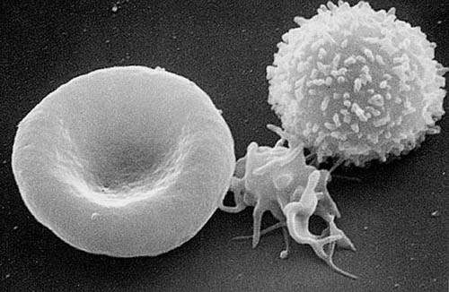
Biological Properties of Blood
Blood delivers nutrients and oxygen to the cells and transports waste products away from cells.
Red blood cells
carry oxygen
and carbon
dioxide.

Slide 8
Biological Properties of Blood
White blood cells fight off infection and reject foreign tissue.

Slide 9
Biological Properties of Blood
Platelets assist in clotting.

Slide 10
Surface Tension
Surface tension acts to reduce surface area. It resists penetration and separation.
The smallest surface area to volume ratio is a sphere, which is why blood droplets fall in a spherical rather than teardrop shape.
This sphere of blood does not break up until impact with a solid surface.

Slide 11
Drop Sizes
The standard drop size is about 0.05 mL.
Rapid bleeding gives a slightly larger drop.
Shaking movement casts off smaller drops.
Gunshot wounds produce high velocity spatter that results in a spray of very tiny drops.

Slide 12
Free Falling Blood Droplets
Blood droplet size affects both the terminal velocity and the distance that the droplet will fall before reaching terminal velocity.
Droplet | A | B | C | D
Volume (µL) | 0.06 | 0.12 | 0.50 | 50
Diameter (mm) | 1.10 | 1.32 | 2.12 | 4.60
Terminal Velocity (m/s) | 2.2 | 3.3 | 4.6 | 7.5
Distance (m) | 0.6 | 0.9 | 2.5 | 5

Slide 13
Free Falling Blood Droplets
The height from which a droplet falls will affect the diameter of its spatter.
This can be seen in experimental data:
Droplet | A | B | C | D | E | F | G
Height (ft) | 1 | 2 | 3 | 4 | 5 | 6 | 7+
Diameter (mm) | 15 | 17 | 18.5 | 19 | 20.5 | 21 | 22

Slide 14
Free Falling Blood Droplets
A smooth surface will cause the spatter to spread out smoothly.
An irregular surface will create a broken edge and more small spatter.

Slide 15
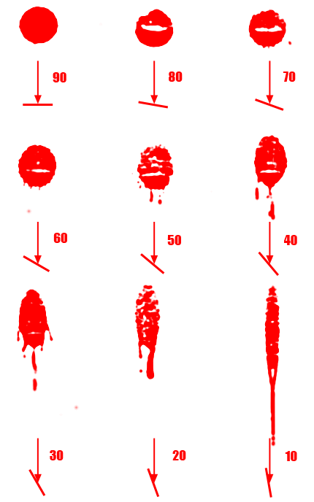
Angle of Impact
The bottom of the spatter stain will be more dense than the top of the stain.

Slide 16
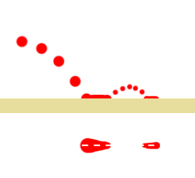
Wave Cast-Off
When a droplet bounces off a surface the tails of the parent and wave cast-off will point toward each other.

Slide 17
Determining Directionality
The pointed end of a bloodstain always faces its direction of travel.
The impact angle can be determined by measuring the degree of elliptical distortion.
At right angles the blood drop is circular.

Slide 18
Trigonometry and Angle of Impact
To determine the angle of impact:
Measure the width and length of the blood spatter. Length must be longer than width.
Divide width by length.
Take the arcsine of your result.
This formula will not produce accurate results at extreme angles ( less than 10˚ or greater than 60 ˚).
$$sinθ=\frac{w}{l}$$
$$θ=arcsine \frac{w}{l}$$

Slide 19
Area of Convergence (2d area)
To determine the area of convergence, investigators calculate the direction and angle of many blood stains.
For each blood stain analyzed, they place a string at the stain which is parallel to the angle of the blood droplet.

Slide 20
Area of Convergence (2d area)
After many strings have been placed, a general area of convergence will appear where the strings overlap.
This can also be done on a computer with image analysis software.

Slide 21
Point of Origin (3d volume)
The procedure for generating the point of origin is just like the area of convergence, except the angle of impact for each stain is calculated.
This is a method of adding a third dimension to the 2d area of convergence calculation.
2d Solution – no angular data

Slide 22
Point of Origin (3d volume)
The procedure for generating the point of origin is just like the area of convergence, except the angle of impact for each stain is calculated.
This is a method of adding a third dimension to the 2d area of convergence calculation.
3d Solution – with angular data

Slide 23
Point of Origin (3d volume)
The term point of origin is really a misnomer, as the 3d intersection of the strings creates a 3d volume rather than a single point.
This can also be done with a computer by taking careful measurements at the scene for each blood droplet’s dimensions, location, and direction.

Slide 24
Limitations of our Model
Projectiles launched at an angle do not follow a straight line.
In our previous example of calculating the point of origin, it would be lower than calculated because the blood would follow an arc rather than a line. This simplified model doesn’t account for gravity.

Slide 25
Limitations of our Model
At high velocities (gun shots) the linear model of projectile motion is fairly accurate.
The model is better suited to disproving testimony than to accurately re-constructing the events at a crime scene.
In a real crime scene, the investigator usually uses lasers instead of string to allow others access to the crime scene.

Slide 26
For More Info - SWGSTAIN
FBI Scientific Working Group on Bloodstain Pattern Analysis
The mission of SWGSTAIN is to promote and enhance the development of quality forensic bloodstain pattern analysis (BPA) practices through the collaborative efforts of government forensic laboratories, law enforcement, private industry, and academia.
http://www.swgstain.org/

Slide 27
