Slide 1
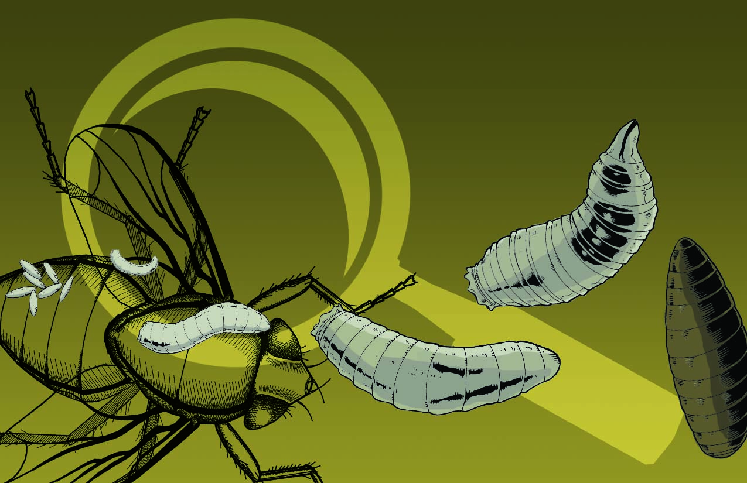
Nature’s Witness
Forensic Entomology

Slide 2
Entomology – the study of insects
Insects are the most diverse and abundant forms of life on earth.
There are over a million described species (that’s more than a third of all known organisms).
Estimates predict that if the biomass (mass of biological tissue) of all humans and all insects were measured, insects would outweigh humans more than 30 to 1.

Slide 3
Entomology – the study of insects
Insects undergo either incomplete or complete metamorphosis (Egg to larva to pupa to insect)
Larva have a soft tubular body and look like worms. Fly species larvae are called “maggots”

Slide 4
Forensic Entomology
Forensic Entomology is the use of the insects and other arthropods that feed on decaying remains to aid legal investigations.
These investigations fall into one of three categories:
Medicolegal (criminal)
Urban (criminal and civil)
Stored Product Pests (civil)

Slide 5
Forensic Entomology - Medicolegal
Often focuses on violent crimes, such as:
Determination of the time or site of human death
Cases involving possible sudden death
Traffic accidents with no immediately obvious cause
Possible criminal misuse of insects

Slide 6
Forensic Entomology - Urban
Urban forensic entomology deals with pest infestations where there may be litigation, such as building owners and exterminators or landlords and tenants.

Slide 7
Forensic Entomology – SPP
Several dozen insect species infest common household products of animal origin. These are known as Stored Product Pests

Slide 8
Uses of Forensic Entomology
Using insects as evidence of where a car has traveled.
http://www.smithsonianchannel.com/site/sn/show.do?episode=141561
Using maggots to estimate time of death
http://www.smithsonianchannel.com/site/sn/show.do?episode=141561#measuring-time-with-maggots

Slide 9
Forensic Entomologist
A forensic entomologist:
Identifies the immature insects
Determines the size and development of the insects
Calculates the growth of the insects and passage through stages of the life cycle in laboratory
Compares the growth against weather conditions to estimate time of oviposition (egg laying)

Slide 10
Breeding grounds
Estimates of postmortem intervals can be made from insects inhabiting remains. The estimates are based on:
The time required for a given species to reach a particular stage of development.
Comparisons of all insect species present on the remains at the time of examination.
Ecological succession occurs as an unexploited habitat (like a corpse) is invaded by a series of different organisms.

Slide 11
Invertabrate habitat
Necrophages - the first species feeding on corpse tissue. Includes rue flies (Diptera) and beetles (Coleoptera).
Omnivores - species such as ants, wasps, and some beetles that feed on both the corpse and associated maggots. Large populations of omnivores may slow the rate of a corpse’s decomposition by reducing populations of necrophagous species.
Parasites and Predators - beetles, true flies and wasps that parasitize immature flies.
Incidentals – pill bugs, spiders, mites, centipedes that use the corpse as an extension of their normal habitat

Slide 12
Carrion Flies
Many organisms use “carrion”, or carcasses, as a food source. Some fly species specialize in living on carrion. These carrion flies are the most important insects to the forensic entomologist.

Slide 13
Carrion Fly Families
There are two families of carrion flies: the blowflies, in the family Calliphoridae, and the flesh flies, in the family Sarcophagidae.
Adult calliphorid flies are easily identified by their iridescent blue, green, copper, or black bodies. Sarcophagid flies, on the other hand, are grayish, usually with three distinct longitudinal dark stripes on the dorsal thorax.

Slide 14
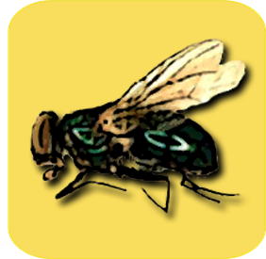
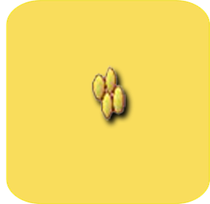
Fly life cycle
The adult female fly lays her eggs on the exposed tissue within minutes of death.
She lays all eggs in one sitting, but may return to the same site to lay again several times over the course of her 2-3 week lifespan.
adult
egg

Slide 15
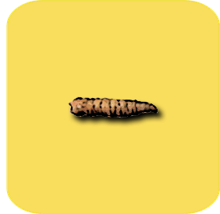
Fly life cycle
The eggs hatch within approximately 24 hours of being laid.
Fly larvae, known as maggots, are now in the first instar stage. They crawl to the closest food source and begin to eat.
adult
egg
1st instar

Slide 16
Fly life cycle
The first instar maggots are small and do little more than eat to support their rapid growth.
Over the next 27 hours, they will double in size until their skin literally can’t hold them anymore.
adult
egg
1st instar

Slide 17
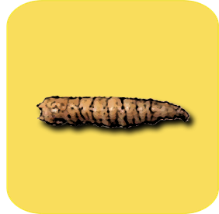
Fly life cycle
The maggots shed their old skin and are now considered second instar maggots.
This stage is very similar to the first instar in that the maggots continue to devour their food source and grow rapidly.
adult
egg
1st instar
2nd instar

Slide 18
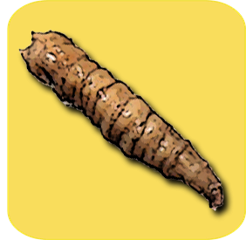
Fly life cycle
After another 22 hours, these maggots will have reached the maximum size their current skin will allow and they will shed once more.
They are now in their third instar
adult
egg
1st instar
3rd instar (feed)
2nd instar

Slide 19
Fly life cycle
The third instar stage is divided into two halves, the feeding third instar and the migrating third instar
During the first half, the maggots continue to eat, storing up as much energy as possible.
adult
egg
1st instar
3rd instar (feed)
2nd instar

Slide 20
Fly life cycle
The second half of the third instar begins when the maggots stop eating and begin to move away from their food source.
The maggots will move to a patch of soil where they can burrow and begin the next life stage.
Overall, the maggots spend about 100 hours in their third instar.
adult
egg
1st instar
3rd instar
2nd instar

Slide 21
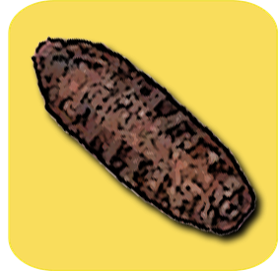
Fly life cycle
Once burrowed, the maggots enclose themselves in a hard shell and begin the metamorphosis (change) that will result in an adult fly.
At this stage, the maggots are now known as pupae.
adult
egg
Pupae
1st instar
3rd instar
2nd instar

Slide 22
The Post Mortem Interval
Forensic entomology provides data used to estimate the time that elapsed between the actual death and when the body was first discovered.
This period is referred to as the post mortem interval, or PMI.

Slide 23
The Post Mortem Interval
Recent PMI (0-50 hours) is estimated by a medical examiner or forensic pathologist based on physical changes to the cadaver.
If a body remains exposed to the environment for a longer period of time, the normal physical changes observed after death may not provide an accurate PMI estimate.

Slide 24
Body Temperature | Rigor Mortis | Post-Mortem Interval
Warm | Far extremities and small muscles only | < 3 hours
Warm | Middle extremities and medium muscles | 3 – 8 hours
Cold | Throughout body | 8 – 36 hours
Cold | None | > 36 hours

Slide 25
The Post Mortem Interval
Cadavers decompose in four stages: fresh, bloated, decay, and dry. The time the body spends in any individual stage will vary depending on environmental conditions; warm, wet weather speeds decay, while cold, dry weather slows it.

Slide 26
The Post Mortem Interval
Different insects are attracted to each of the four different stages of decomposition. The ordered series of insects attracted to the decomposing body is called a succession.
The succession pattern is useful in estimating how long a cadaver has been exposed to the insects.

Slide 27
The Post Mortem Interval
For example, carrion flies are attracted to a bloated corpse, therefore they will only be present on a corpse once that stage is reached.
Adult blowflies, however, are attracted to the fresh corpse and lay their eggs rapidly after death.

Slide 28
Factors influencing decay
Most important environment factors in corpse decay:
Temperature
Access by insects
Depth of burial
Other Factors
Chemical-- embalming agent, insecticides, lime, etc.
Animals disrupting the corpse

Slide 29
Factors influencing decay
Entomologists develop and maintain succession databases.
When a crime scene is investigated, the forensic entomologist compares the insect species and their distribution of larval stages to the database to estimate the time of death.

Slide 30
Degree-hours
The time it takes each life cycle to develop is measured in degree-hours because the development rate is VERY temperature dependent.
If an egg takes 23 hours to develop into the 1st instar at 70˚F, then 1610 degree-hours would have accumulated.

Slide 31
Calculating PMI from Accumulated Degree Hours (ADH)
From | To | Temp | Hours | ADH | Total
Egg | 1st Instar | 70° F | 23 | 1610 | 1610
1st Instar | 2nd Instar | 70° F | 27 | 1890 | 3500
2nd Instar | 3rd Instar | 70° F | 22 | 1540 | 5040
3rd Instar | Pupa | 70° F | 130 | 9100 | 14140
Pupa | Adult Fly | 70° F | 143 | 10010 | 24150

Slide 32
Time of Death vs PMI
Time of death and Post-Mortem Interval are usually different because of the assumptions of the PMI calculation.
PMI is restricted to the time that the corpse or body has been exposed to an environment which would allow insect activity to begin. This could be affected by factors such as:
Closed windows
Body in box or bag
Cold temperatures
Deeper burial

Slide 33
Important Considerations
In addition to the succession of insects on the decaying cadaver, there is a succession of species of insects throughout the year, especially in a temperate climate.
Some fly species are active in the early spring, different species are active in the fall, and others are continuously active.

Slide 34
Important Considerations
In regions with cold winters, bodies are often discovered when the snow melts in the spring, and investigators are called upon to determine in which season the death occurred.
If an insect larvae which is more abundant in the fall is discovered, this can indicate the body was undiscovered for many months, while if larvae are found from spring flies, this could indicate the cadaver is more recent, or that it was recently exposed to the newly emerged adult flies.

Slide 35
