Slide 1
MEASURING MOTION DISPLACEMENT? SPEED? AVERAGE SPEED? VELOCITY? RESULTANT VELOCITY? ACCELERATION?

Slide 2
A. MOTION - A CHANGE IN POSITION RELATIVE TO A FRAME OF REFERENCE -THE FRAME OF REFERENCE IS AN ASSUMED STATIONARY OBJECT AND EARTH IS THE MOST COMMON FRAME OF REFERENCE

Slide 3
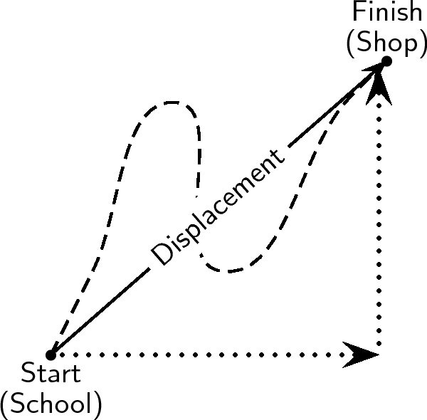
B. DISPLACEMENT -THE NET CHANGE IN THE POSITION OF AN OBJECT - INCLUDES DISTANCE AND DIRECTION - IT HAS TO BE IN A STRAIGHT LINE - THE DISTANCE TRAVELED IS SEPARATE

Slide 4
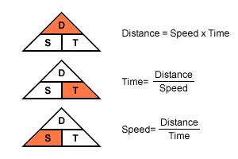
C. SPEED -HOW FAST AN OBJECT MOVES - FORMULA : SPEED = DISTANCE TIME -AVERAGE SPEED = TOTAL DISTANCE TOTAL TIME -AVERAGE SPEED MAY INCLUDE STOPS ALONG THE WAY

Slide 5
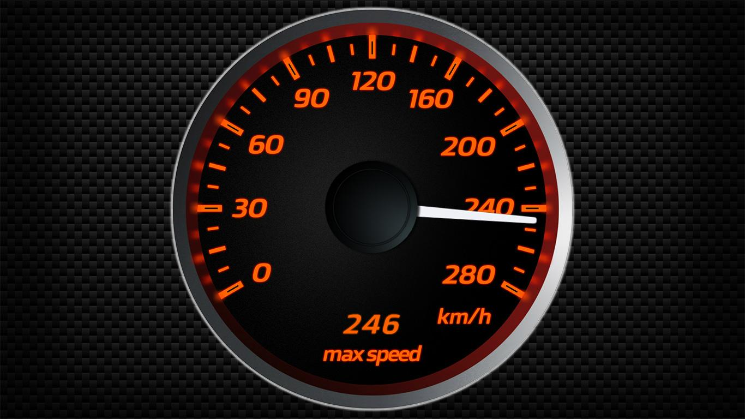
INSTANTANEOUS SPEED -SPEED AT A GIVEN INSTANT (MEASURED BY SPEEDOMETER)

Slide 6
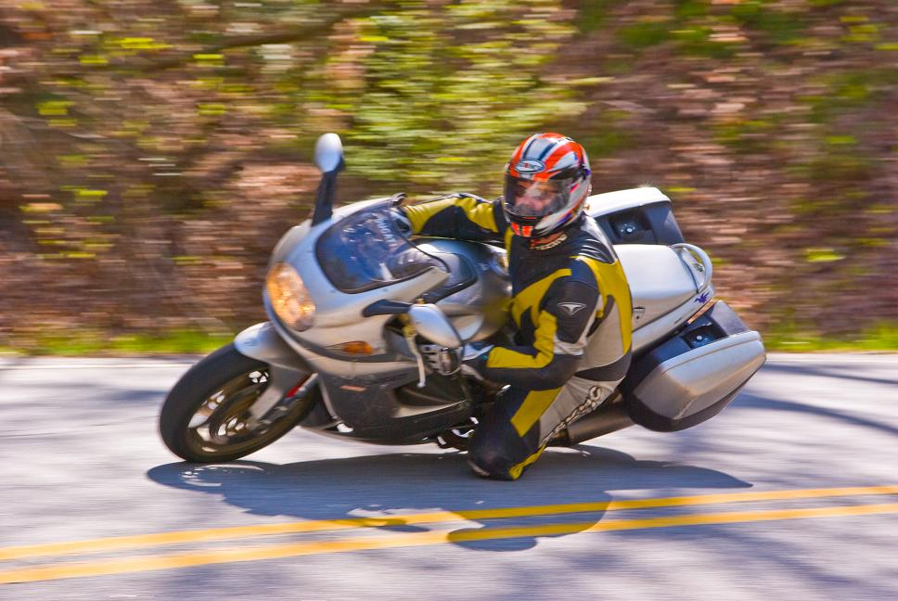
D. VELOCITY - SPEED IN A GIVEN DIRECTION EX) 40 MPH NORTH * IF YOU ARE CHANGING SPEED OR DIRECTION YOU ARE CHANGING YOUR VELOCITY AND YOU FEEL IT! -QUESTION? WHAT 3 THINGS IN A CAR ARE MADE TO CHANGE YOUR VELOCITY?

Slide 7
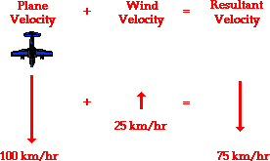
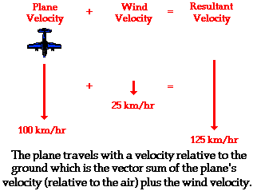
E. RESULTANT VELOCITY - VELOCITIES CAN ADD UP TO MAKE YOU PROGRESS FASTER -OR THEY CAN NEGATE EACH OTHER

Slide 8
A. ACCELERATION -ANY CHANGE IN VELOCITY -THIS INCLUDES A CHANGE IN SPEED OR DIRECTION ARE YOU ACCELERATING WHEN: YOU ARE SPEEDING UP? YES YOU ARE TURNING A CORNER? YES YOU ARE SLOWING DOWN? YES (THIS IS CALLED NEGATIVE ACCELERATION OR DECELERATION)

Slide 9
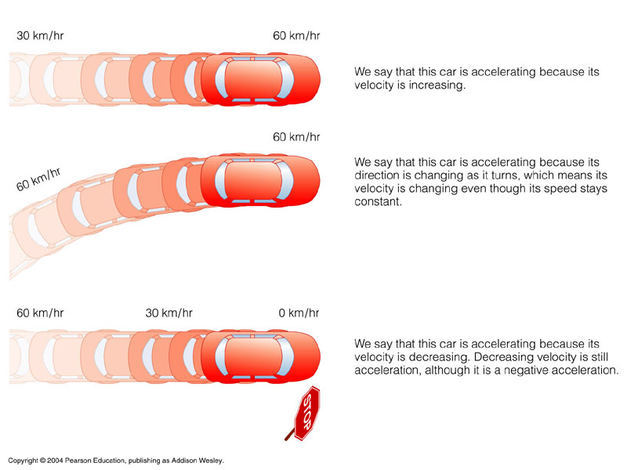

Slide 10
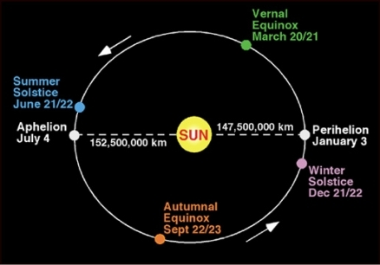
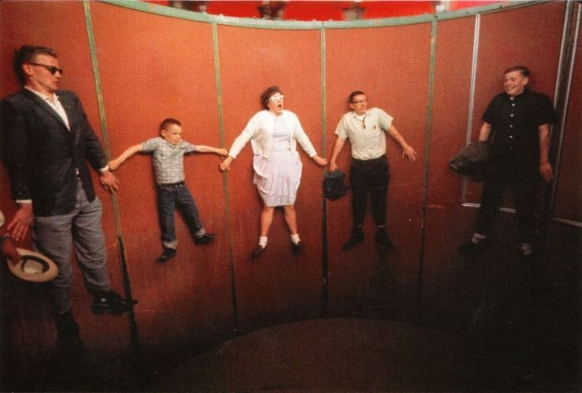
B. UNIFORM CIRCULAR MOTION - MOVING IN A CONSTANT CIRCLE OR ORBIT (LIKE EARTH OR A FAN BLADE) ALSO CAUSES ACCELERATION: CENTRIPETAL ACCELERATION

Slide 11
C. CALCULATING ACCELERATION: ACCELERATION = FINAL VELOCITY - INITIAL VELOCITY TIME *often measured in meters/second/second or m/s/s or m/s²

Slide 12
EX) a = 22m/s - 2m/s 4 s a = 20 m/s 4s a = 5 m/s/s or 5m/s²

