Slide 1
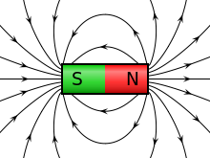
MAGNETISM

Slide 2
MAGNETIC FORCE
THE FORCE MAGNETS EXERT OVER A REGION CALLED THE MAGNETIC FIELD
STRENGTH DEPENDS UPON MAGNET TYPE AND HOW MUCH IT IS MAGNETIZED
WEAKENS WITH DISTANCE
RESULTS IN OPPOSITE QUALITIES ON ENDS CALLED POLES
OPPOSITE POLES ATTRACT LIKE POLES REPEL
(SEE NEXT SLIDE AND DRAW)

Slide 3
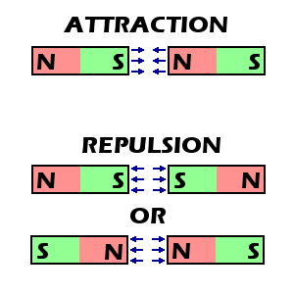

Slide 4
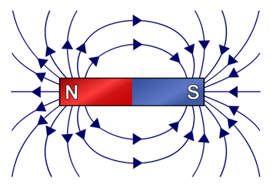
MAGNETIC FIELD LINES
CAN SHOW STRENGTH OF FORCE
FORM CLOSED LOOPS FROM ONE POLE TO THE NEXT
CLOSE LINES SHOW STRONGER FORCE (NEAR POLES)

Slide 5
PERMANENET MAGNETS
CAN BE MAGNETIC ALL OF THE TIME
CAN MAGNETIZE OTHER PIECES OF IRON BY TOUCHING THEM
SOFT MAGNETS – MADE OF IRON, EASY TO MAGNETIZE, LOSE MAGNETISM EASILY
HARD MAGNETS – MADE OF COBALT AND NICKEL (ALNICO), HARD TO MAGNETIZE, MAKE STRONG, LONG LASTING MAGNETS
LOADSTONE – NATURAL MAGNETS MADE OF A MINERAL CALLED MAGNETITE

Slide 6
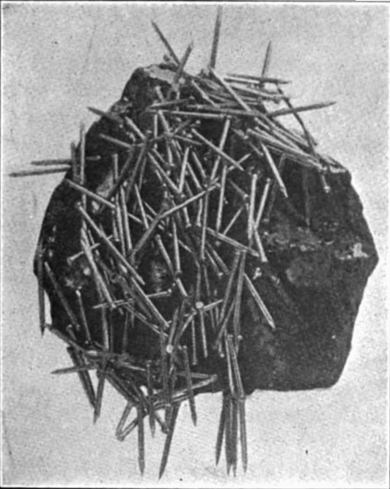
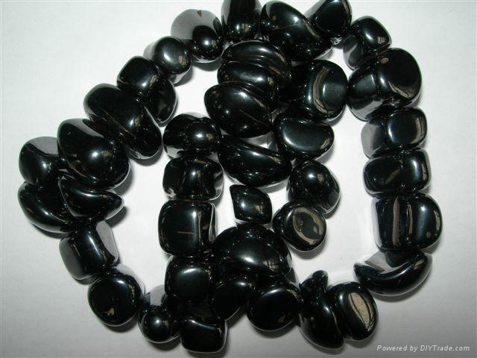

Slide 7
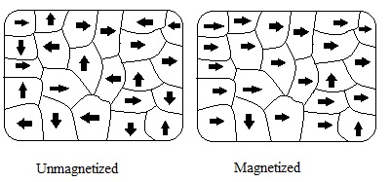
WHAT CAUSES THIS MAGNETISM
MOVEMENT OF CHARGES (ELECTRONS)
REGIONS CALLED DOMAINS HAVE SIMILAR ELECTRON SPIN
IN A MAGNET, DOMAINS CAN BE ALIGNED WITH OTHER DOMAINS
DON’T DROP OR HEAT MAGNETS! IT SCRAMBLES THEIR DOMAINS

Slide 9
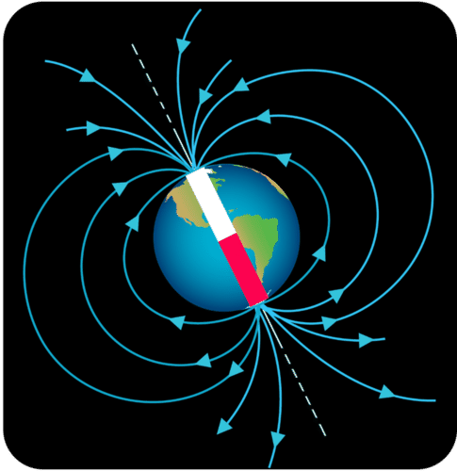
EARTH
ACTS LIKE A BIG BAR MAGNET
RELATED TO SPINNING IRON CORE???
FORCE IS STRONGEST AT MAGNETIC POLES
MAGNETIC POLES FLIP ABOUT EVERY 500,000 YEARS

Slide 10
- THE NORTH POLE ATTRACTS THE SOUTH SIDE OF A MAGNET SO MAGNETICALLY THE NORTH POLE IS A SOUTH! - GEOGRAPHIC POLES (ON MAP) ARE NOT IN THE SAME SPOTS AS THE MAGNETIC POLES - COMPASS – POINTS AT MAGNETIC POLES - LESS ALIGNED WITH GEOGRAPHIC AS YOU MOVE CLOSER TO THE POLES (SEE NEXT SLIDE AND DRAW IT)

Slide 11
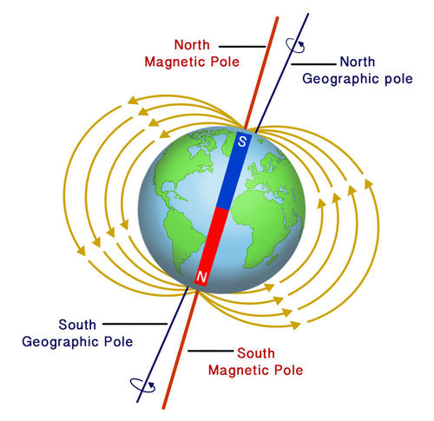

Slide 12
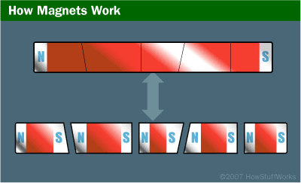
WHAT HAPPENS IF YOU BREAK A BAR MAGNET?
YOU GET A BUNCH OF BABY MAGNETS

