Slide 1
LAWS OF MOTION (BY Sir Isaac Newton)

Slide 2
Newtons first law
Objects at rest tend to remain at rest and objects in motion tend to remain in motion at constant velocity.
Unless it encounters an unbalanced force such as friction.
This is also called the law of inertia (THE TENDENCY OF OBJECTS TO RESIST CHANGES IN MOTION.
MORE MASS = MORE INERTIA

Slide 3
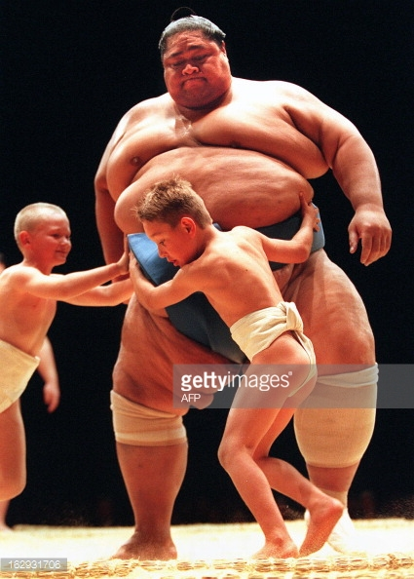
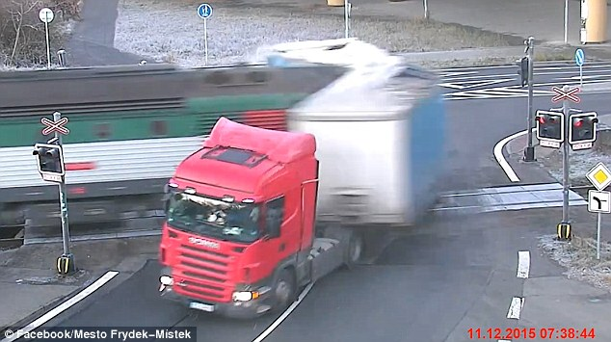
EX) IT IS HARDER TO GET HEAVY OBJECTS TO MOVE OR STOP MOVING. EX) ROCKS DON’T TEND TO MOVE ON THEIR OWN EX) YOU MAY GO THROUGH A WINDSHIELD IF YOU DON’T WEAR YOUR SEATBELT

Slide 4
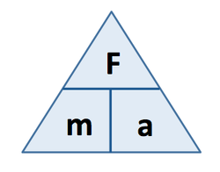
NEWTONS SECOND LAW
THE UNBALANCED FORCE ACTING ON AN OBJECT EQUALS IT’S MASS TIMES IT’S acceleration.
FORCE = MASS X ACCELERATION OR F = ma

Slide 5
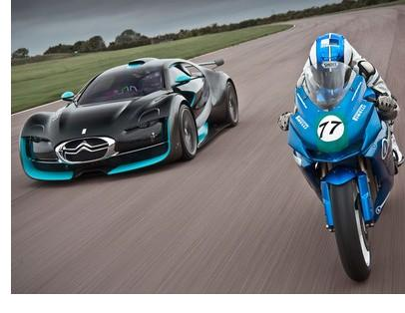
Ex) if the same force is applied to a heavy and a light object, the light object will have greater acceleration

Slide 6
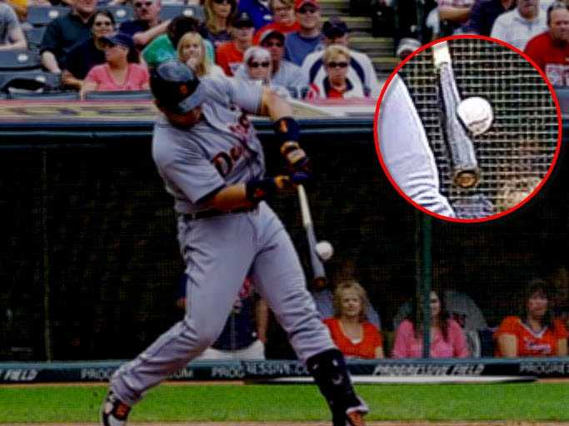
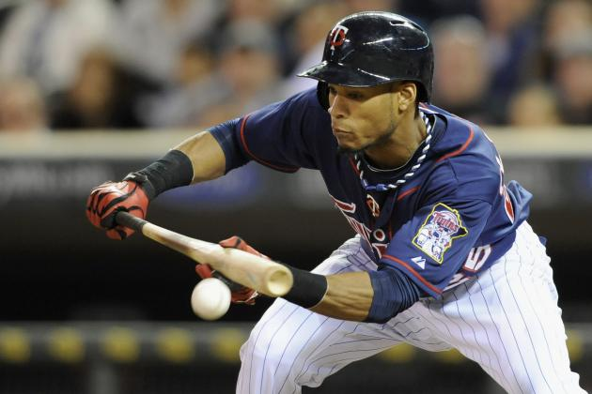
Ex) a greater force makes any object accelerate more than a smaller force on the same mass

Slide 7
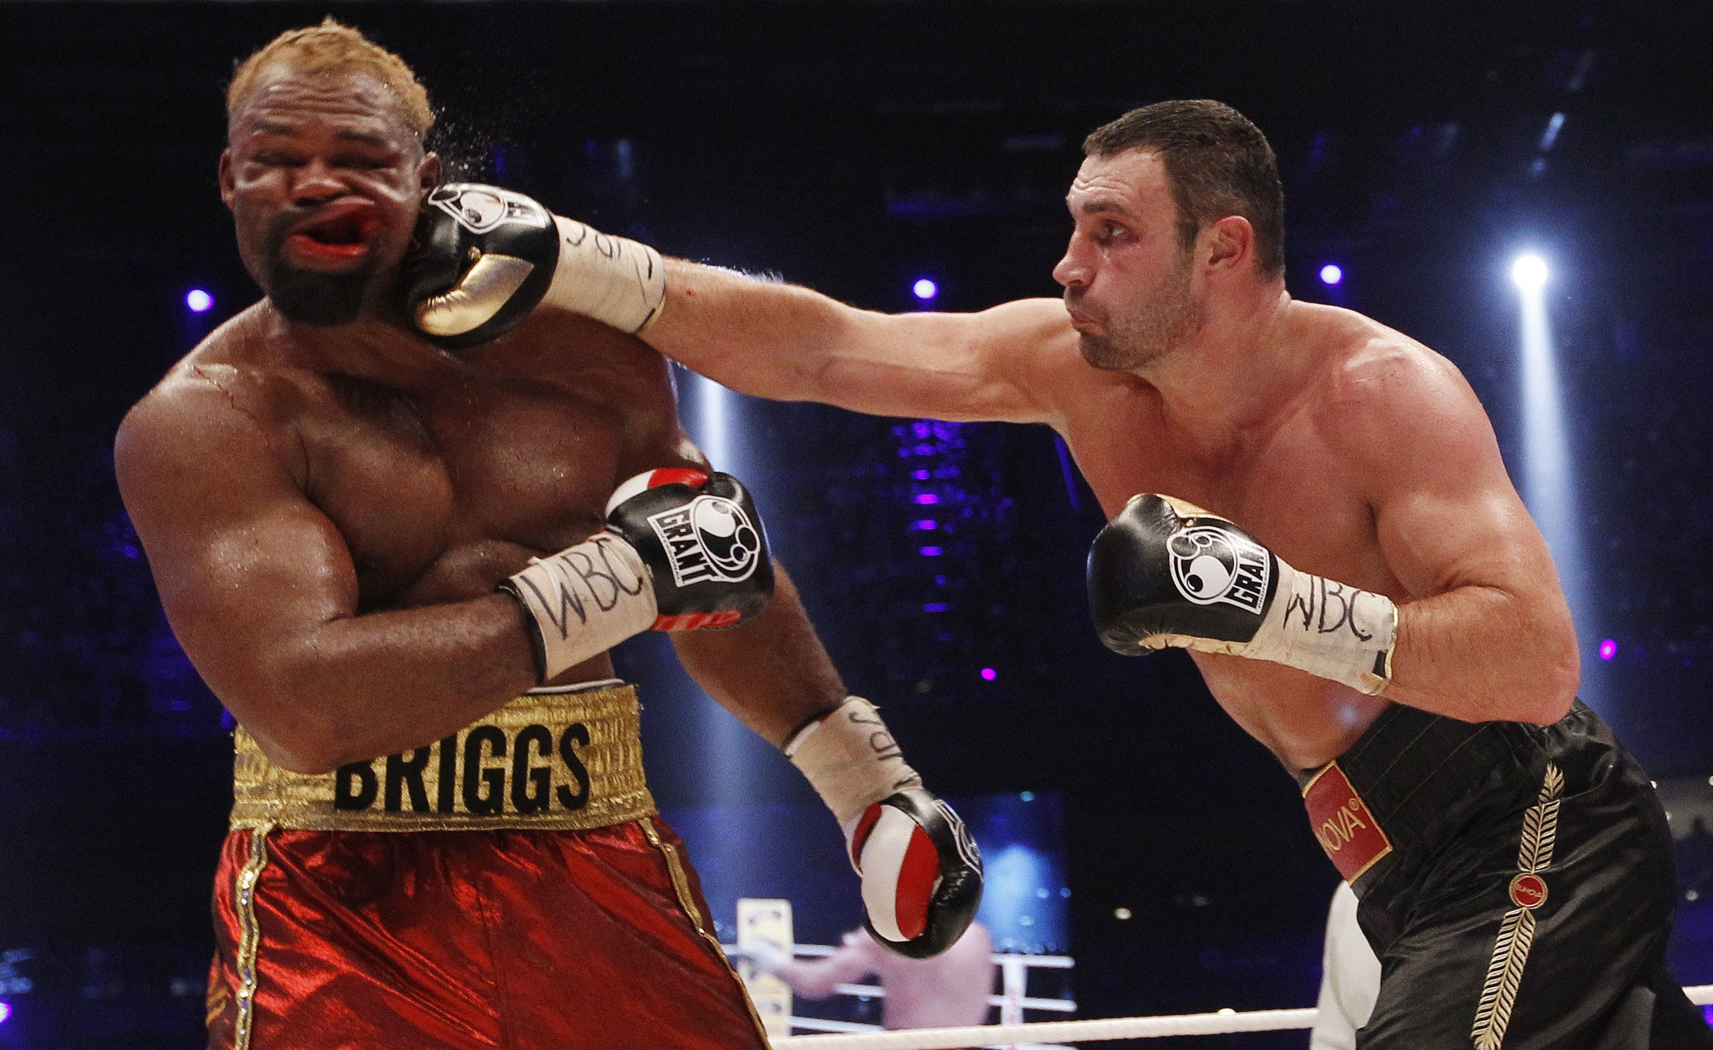
Ex) any object with more mass or more acceleration will hit you with greater force

Slide 8
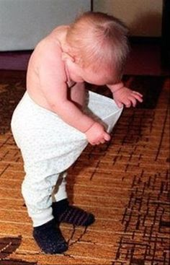
Don’t forget to check your units !!! This is not what I mean!

Slide 9
Force in newtons n mass in kilograms kg ACCELERATION IN METERS/SECOND² m/s² *SO 1N = 1kg X 1 m/s²

Slide 10
Newtons third law
FOR EVERY ACTION FORCE THERE IS AN EQUAL AND OPPOSITE REACTION FORCE
ALL FORCES ACT IN PAIRS

Slide 11
EX) WHEN YOU KICK A BALL (ACTION FORCE) THE BALL MOVES FORWARD BUT YOUR LEG SLOWS DOWN (REACTION FORCE)

Slide 12
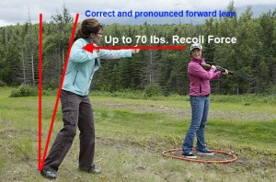
EX) BULLET FORWARD = YOU AND YOUR GUN GO BACK!

Slide 13
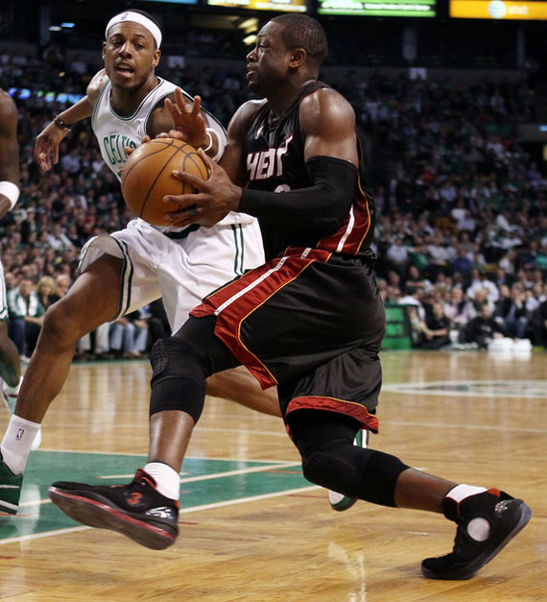
EX) SHOE PUSHES BACK, YOU GO FORWARD

Slide 14
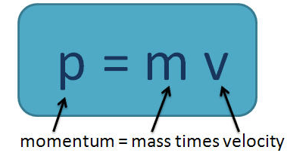
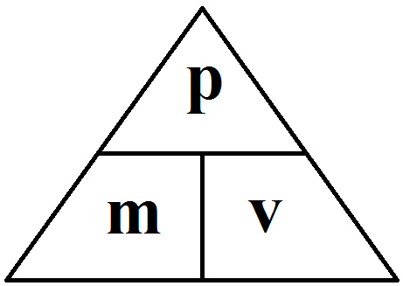
MOMENTUM
A PROPERTY OF ALL MOVING OBJECTS WHICH IS A PRODUCT OF IT’S MASS AND VELOCITY
NO MOVEMENT = NO MOMENTUM
EQUATION: MOMENTUM = MASS X VELOCITY
Kg m/s = Kg X m/s

Slide 15
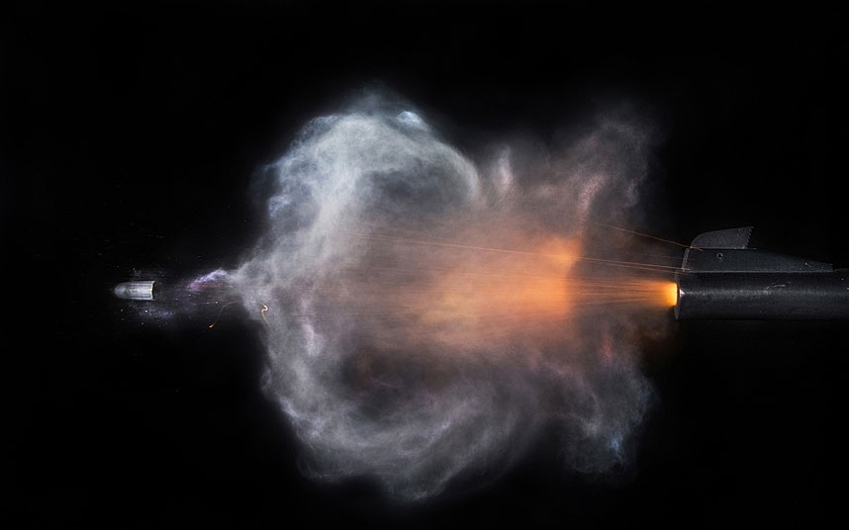
Ex) a bullet has lots of momentum due to it’s velocity

Slide 16
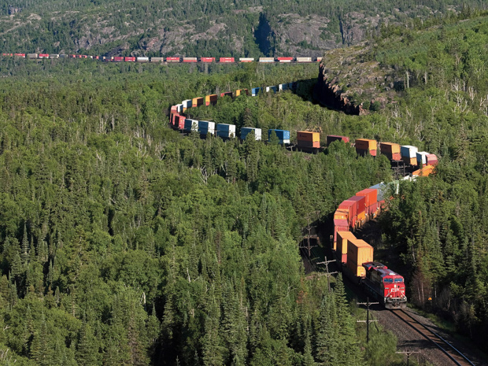
Ex) a train has lots of momentum due to it’s mass

Slide 17
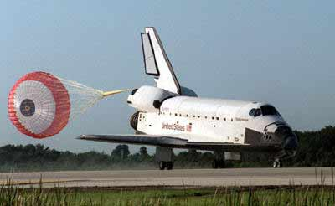
Ex) the space shuttle has lots of momentum due to both

Slide 18
Law of conservation of momentum
The total amount of momentum in an isolated system is conserved
Anytime two or more objects collide, they may exchange momentum but the total momentum remains the same

Slide 19
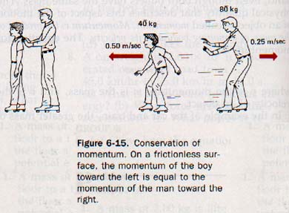
Mass x velocity = mass x velocity

Slide 20
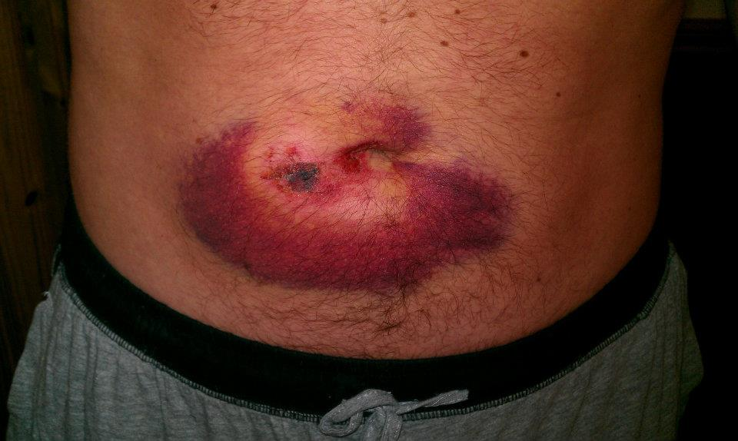
Ex) a small bullet pushes a large person

Slide 21
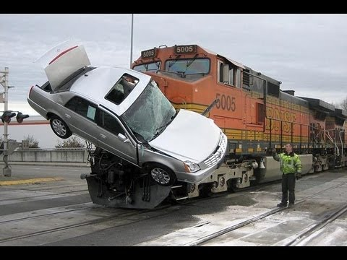
When a train hits a car, the car flies out of the way.

Slide 22
Ex) a butterfly almost killed me! How?

