Slide 1
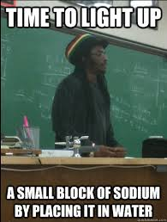
6. WHAT ARE VALENCE ELECTRONS ?
-THE NUMBER OF ELECTRONS IN THE OUTER SHELL OF AN ATOM.
-DECIDES HOW AN ATOM REACTS

Slide 2
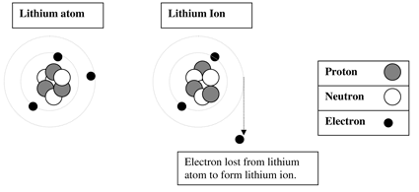
7. ION FORMATION
-ATOMS GAIN OR LOSE ELECTRONS TO FILL THEIR OUTER ORBITAL (SHELL) THEY BECOME IONS
-THEY LIKE TWO IN THE FIRST ORBITAL AND EIGHT IN THE REST
SEE IONIZATION BELOW
THE LITHIUM ION HAS A +1
OVERALL CHARGE

Slide 3
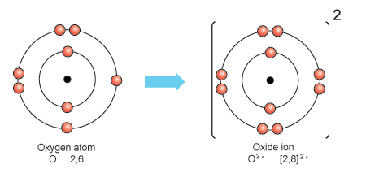
ANOTHER EXAMPLE

Slide 4
8. WHAT ION WILL YOU FORM
ATOMS WITH 1 VALENCE ELECTRON WILL LOSE 1 AND BECOME +1 ION
ATOMS WITH 2 VALENCE ELECTRONS WILL LOSE 2 AND BECOME +2 IONS
ATOMS WITH 3 VALENCE ELECTRONS WILL LOSE 3 AND BECOME +3 IONS
ATOMS WITH 4 VALENCE ELECTRONS WILL GAIN OR LOSE 4 AND BECOME +/-4 IONS
ATOMS WITH 5 VALENCE ELECTRONS WILL GAIN 3 AND BECOME -3 IONS
ATOMS WITH 6 VALENCE ELECTRONS WILL GAIN 2 AND BECOME -2 IONS
ATOMS WITH 7 VALENCE ELECTRONS WILL GAIN 1 AND BECOME -1
ATOMS WITH 8 VALENCE ELECTRONS ARE HAPPY AND WON’T FORM IONS 0!

Slide 5
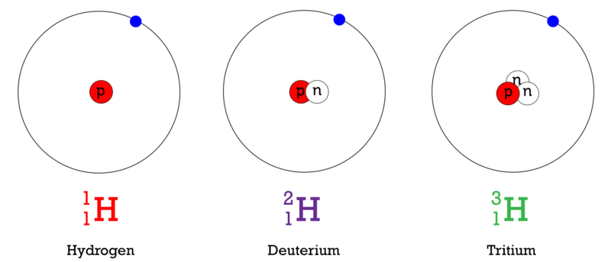
9. WHAT ARE ISOTOPES
-ATOMS OF THE SAME ELEMENT WITH DIFFERENT NUMBERS OF NEUTRONS SO THEY HAVE DIFFERENT MASSES (SEE BELOW)

Slide 6
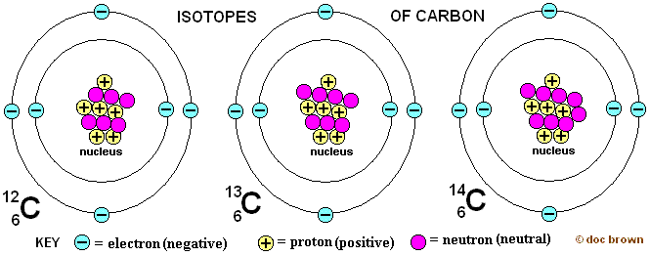
ANOTHER EXAMPLE

