Slide 1
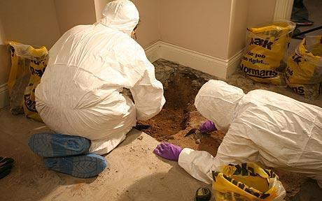
Introduction to Criminal Forensic Science 2016

Slide 2
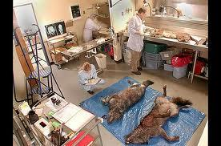
Objectives
Define and distinguish forensic science from other sciences
Describe the processes involved in administering justice

Slide 3
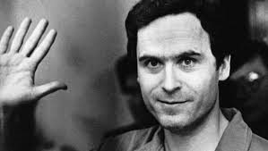
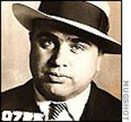
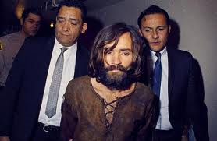
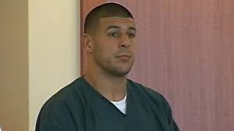
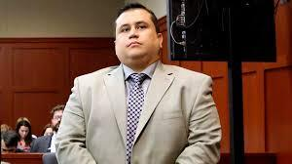
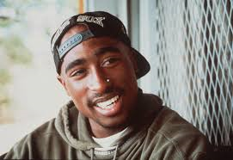
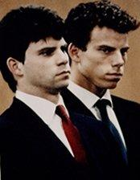
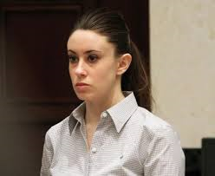
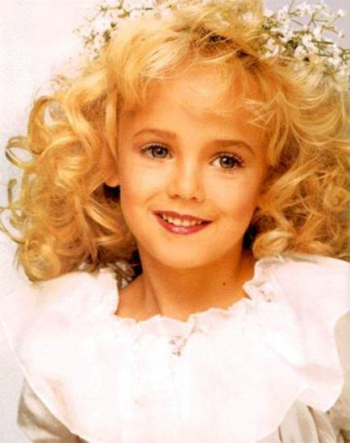
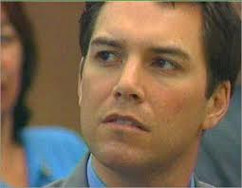

Slide 4
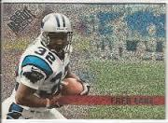
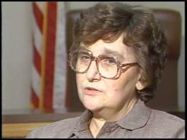
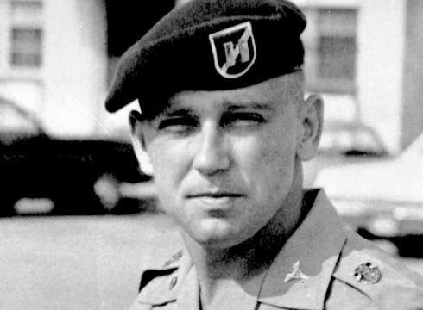
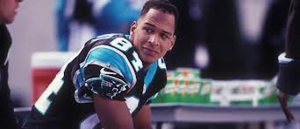
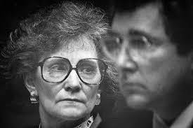

Slide 5
Literary Influences
Sherlock Holmes by Sir Arthur Conan Doyle
Made scientific crime-detection “cool” and popular
A Study in Scarlet (1887)

Slide 6
What is Forensic Science?
The application of science to the criminal and civil laws that are enforced by police in the criminal justice system.
Helps supply accurate and objective information that reflects events that have occurred at the crime scene

Slide 7
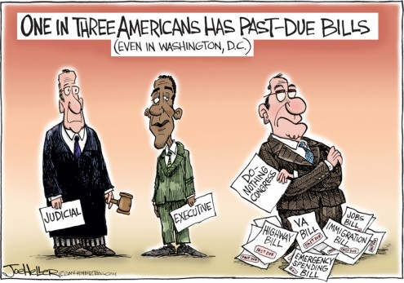
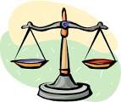
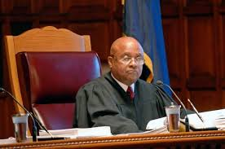
Types of Law
Statutory law: a law that is on the books as enacted by a government body or agency having the power to make laws (Congress) based on the constitution
Common law/case law: laws made by judges
Precedents: decisions made in previous cases or superior courts that are used as a basis later to justify decisions in similar cases
Must be followed
Become part of the law itself
Civil law: law that deals with non-criminal suits brought to protect or preserve civil or private rights or matters
Criminal law: regulation and enforcement of rights; sets the acceptable limits of conduct in society; concerned with offenses against an individual that are deemed offensive to society
Equity law; remedial or preventive law
Example: issuing a restraining order
Administrative law: rules and laws established by agencies such as the Internal revenue service, the Food and Drug Administration or the military

Slide 8
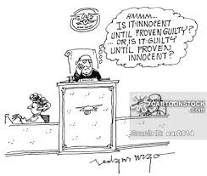
The roots of law date back to medieval England where offenders who violated the “King’s Peace” were through to be offending not just an individual but the order established under the rule of the monarch.
“stare decisis” ---to stand by the decision

Slide 9
Types of Charges
Misdemeanor: minor crime such as theft, minor assault and battery, possession of small amounts of illegal drugs
Felony: major crime; murder, rape, armed robbery, serious assault, dealing illegal drugs, fraud, auto theft, forgery
Punishment (sentences);
Large fines imposed
Required community service
Probation
Incarceration (jail/prision)
Life imprisionment
Death penalty

Slide 10
Your Rights as a citizen of the United States
Innocent until proven guilty
Right to be free from unlawful search and seizure
Right not to be arrested without probable cause
Right against self-incrimination
Right to fair questioning by the police
Right to protection from physical harm throughout the justice process
Right to an attorney
Right to a trail by a jury of peers
Right to know the charges brought against you
Right to cross-examine witnesses
Right to speak and present witnesses
Right not to be tried again for the same crime (double jeopardy)
Right to be protected form cruel and unusual punishment
Right to due process (began with the Magna Carta in 1215)
Right to a speedy trail
Right against excessive bail
Right against excessive fines
Right to be treated the same as everyone else.

Slide 11
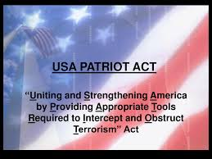
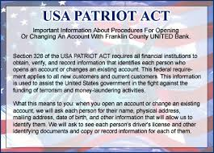
The Patriot Act of 2001
USA PATRIOT is an acronym for Uniting and Strengthening America by Providing Appropriate Tools Required to Intercept and Obstruct Terrorism
“clear and present danger” to national security of the country may lead to suspension of limitations of these rights”
Expired June 1, 2015

Slide 12
Categories of Crime
Category
Crime (wrongful act)
Violent crime
Property crime
Crimes Against morality
Crimes against public order
Crimes against government
Hate Crime
Organized Crime
White collar crime
Occupational Crime
Victimless crime
High tech crime
Murder, rape, threats, violence
Stealing, trespassing, arson,
Prostitution, slavery, kid porn
Disorderly conduct, threats to safety
Genocide, torture, brutality, civil rgts.
Bias, prejudice, discrimination
Money laundering, dealing drugs
Deception, illegal gain of money
Misuse of capacities; opportunism
Addiction, illegal exchange of good
Fraud, illicit computer use, black mail

Slide 13
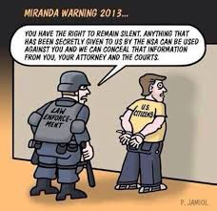
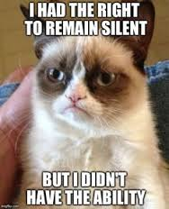
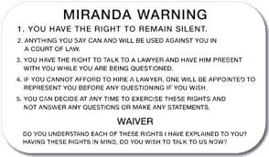
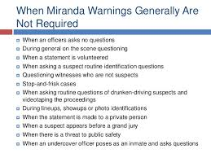
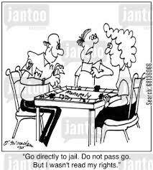
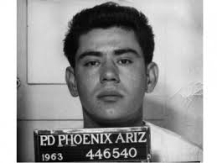

Slide 14
Booking: procedure following arrest that records information about the suspect (photo, fingerprints, lineup)
Arraignment: First act in a criminal proceeding; the defendant hears the charges and responds with a plea
Guilty, not guilty
Nolo contendere : no contest
Bail: money put up to guarantee the defendant will appear in court as directed
Bondsman: 10% of the bail is his fee for “insuring” suspect will appear. If suspect flees, bounty hunter is hired to find the suspect.
Preliminary or evidentiary hearing:
No jury present
Prosecutor presents the case
Accused can produce evidence
Judge decides to dismiss or reduce charges if evidence against suspect is insufficient
If sufficient evidence is presented, then judge sets a date for arraignment for trial
Grand Jury: composed of 16-23 citizens who serve a one year term
evidence in a felony case can be presented to a grand jury for review and decide to indict the suspect on the charges and proceed with a formal trial
Only the prosecutor presents evidence in a grand jury proceeding

Slide 15
Expert witness: person who is a specialist in a subject that is often technical, who may present his/her expert opinion without actually witnessing any occurrence relating to the case * must be qualified through expertise, training, or special knowledge
Indict: formally accuse a suspect
Plea bargain:
Agreement where defendant pleads guilty to a lesser charge; prosecutor in return drops more serious charges to avoid time and cost of court
90% of cases end in plea bargains
Probative: tending to prove something
Material: relevant and significant
Hearsay: testimony in which the witness relates information obtained from what others have said and not what the witness actually saw or heard for themselve
1984 Comprehensive Crime Control Act
“Guilty by reason of insanity’ or the ‘insanity plea’
Defendant is required to prove by clear and convincing evidence that at the time of the commission of the acts constituting the criminal offense, the defendant, as a result of sever mental disease or defect was unable to appreciate the nature and quality or the wrongfulness of his act
Contains guidelines that set out sentencing and provision for dealing with offenders who are or have been mentally ill
Removes “intent”

Slide 16
Junk science: theories based on distorted, flawed or untested hypotheses and not derived from or tested by the scientific method.
Frye Standard: established in the case Frye v. United States
“general acceptance test”
Scientific evidence is admissible at trail only if the methodology or principle on which the opinion is based is “sufficiently established to have gained general acceptance in a particular field in which it belongs.
Applies to new or novel scientific methods or procedures
Daubert v. Merrill-Dow Pharmaceuticals
Applies to Federal Courts
Revised Frye standard
Implicitly endorses a classical definition of the scientific method including hypothesis, testing, error rates, pee-reviewed publication
It is the responsibility of the trial judge to determine admissibility and validity
Of the evidence presented in his/her courtroom.
Guidelines:
1. must be testable
2. must be subject to peer review or publication
3. rate of error or possible errors must be given
4. Technique must follow set standards
5. Court must consider whether the theory or technique has attracted
widespread acceptance within a relevant portion of the scientific community

Slide 17
Historical People and Contributions
Mathieu Orfila: established forensic toxicology as a legit science (father of forensic toxicology)
Alphonse Bertillon: developed first system of personal identification based on a series of body measurements
Francis Galton: first definitive study of fingerprints and developed a system for classifying them
Karl Landsteiner: discovered that blood can be classified into groups later recognized as types A, B, AB, and O
Leone Lattes: developed a procedure for determining blood group of a dried blood stain

Slide 18
Calvin Goddard: comparison studies with bullets using a comparison microscope
Albert S. Osborn: principles of document examination and the acceptance of documents as scientific evidence
Hans Gross: described the application of scientific disciplines to criminal investigation
Edmond Locard: “Locard’s Exchange Principle”; whenever two objects come with one another, there is an exchange or cross-transfer of materials between them

Slide 19
Crime Laboratories
1932: FBI (Federal Bureau of Investigation) under the direction of J. Edgar Hoover offered forensic services to all law enforcement agencies.
Oldest lab in U.S. is at the Los Angeles Police Department (LAPD) established in in 1923

Slide 20
International Crime Laboratories
Great Britain: national system of regional laboratories under jurisdiction of Home Office
(not independent labs like in U.S.)
Metropolitan Police Lab (London)
Uses a fee for service model
Canada: 3 institutes (government funded)
Royal Canadian Mounted Police region lab
Centre of Forensic Sciences in Toronto
Institute of Legal Medicine and Police Science in Montreal

Slide 21
Types of Crime Laboratories
State /Local
Federal
N.C. State Bureau of Investigation (SBI)
South Carolina law Enforcement Division (SLED)
Charlotte-Mecklenburg Police Department Crime lab
FBI (Federal Bureau of Investigation in Quantico, Va.)
The Drug Enforcement Administration labs (DEA) of the Department of Justice
Bureau of Alcohol, Tobacco, and Firearms (ATF) of the Departmen of Justice
U.S. Postal Service Inspection Service

Slide 22
Services provided by Crime labs
Basic
Optional Services
Physical science unit: chemical testing of evidence
Biology unit: identify and perform DNA profiling, hair and fiber analysis, other biological materials
Firearms: ballistics tests, gun powder residue tests
Document examination
Photography unit
Toxicology: determines presence or absence of drugs in body fluids and tissues
Latent fingerprint identification
Polygraph unit (lie detector tests)
Voiceprint analysis (voice comparison, text to speech)
Crime scene investigation unit (group of trained technicians)

Slide 23
Duties of a Forensic Scientist
Analysis of physical evidence
Collect and preserve all evidence according to procedures
Testing of evidence
Maintaining chain of custody
Use underlying principles of scientific method to ensure that the outcome of an investigation is not tainted by human emotion or compromised by ignoring contrary evidence
Maintain perspective/limit bias/go where the evidence leads

Slide 24
Other Areas of Service
Forensic Psychiatry
Forensic Odontology
Forensic Engineering
Forensic computer and digital analysis

