Slide 1
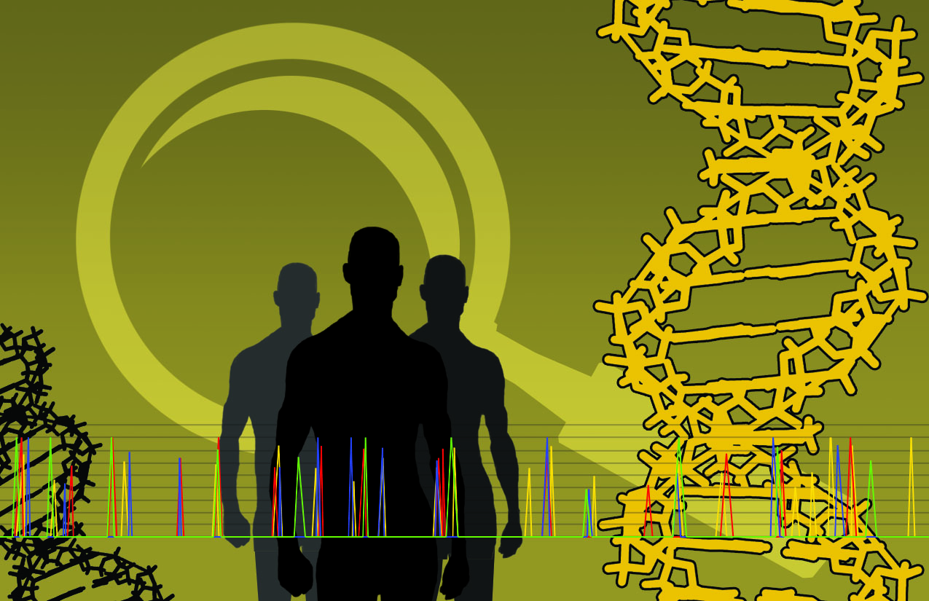
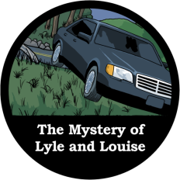
An Identity Crisis
DNA Typing

Slide 2
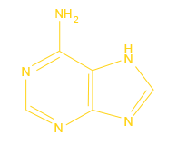
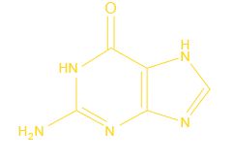
Introduction – The ABC’s of DNA
DNA (deoxyribonucleic acid) is a negatively-charged double-stranded chain of nucleotides.
Purine Bases
Adenine (A)
Guanine (G)
Pyrimidine Bases
Thymine (T)
Cytosine (C)
Copyright © 2013 Crosscutting Concepts, LLC. All Rights Reserved.
www.CrosscuttingConcepts.com

Slide 3
Introduction – The ABC’s of DNA
This chain also includes a ‘backbone’ made from molecules of sugar (deoxyribose) and phosphate.
In 1950, biochemist Erwin Chargaff discovered that the number of Adenine and Thymine were equal and that the same was true for Guanine and Cytosine.
What conclusions can you draw from Chargaff’s discovery?
Copyright © 2013 Crosscutting Concepts, LLC. All Rights Reserved.
www.CrosscuttingConcepts.com

Slide 4
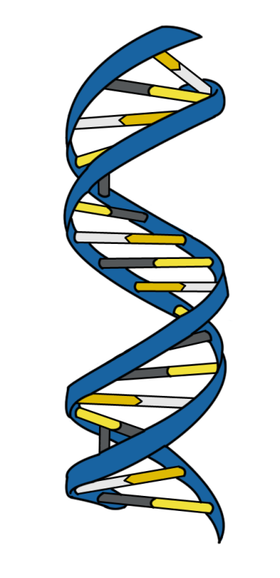
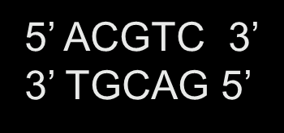
DNA Double Helix
DNA has directionality – each chain has a ‘top’ and a ‘bottom’ end.
‘Top’ end is called Five Prime (5’)
‘Bottom’ end is called Three Prime (3’)
Two nucleotide chains together wind into a double helix.
Hydrogen bonds between paired bases hold the two DNA strands together..
DNA strands are antiparallel and complementary to each other.
Copyright © 2013 Crosscutting Concepts, LLC. All Rights Reserved.
www.CrosscuttingConcepts.com

Slide 5
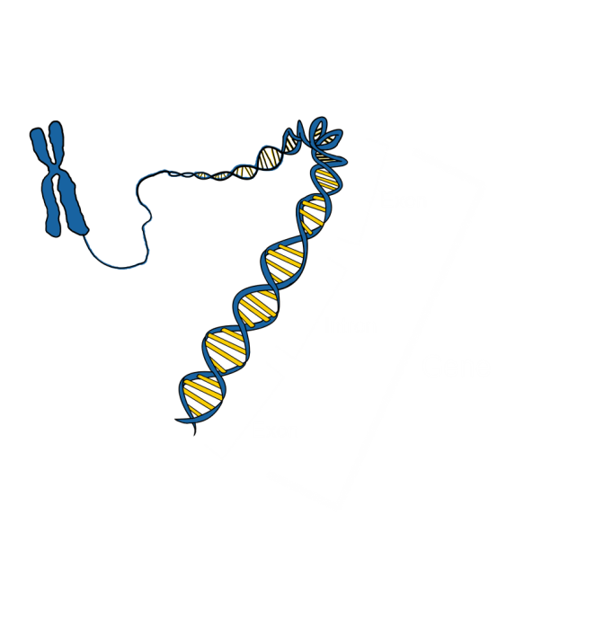
Genes – Cellular Blueprints
A gene is a series of nucleotides that codes for a certain polypeptide (protein). Each gene has at least
Promoter region
Initiation or start site
Coding region
Termination site
Eukaryotic genes can be as large as 100,000 base pairs.
Introns are non-coding regions, usually spliced out of created proteins
Exons are coding regions
Copyright © 2013 Crosscutting Concepts, LLC. All Rights Reserved.
www.CrosscuttingConcepts.com

Slide 6
Chromosomes – DNA Packaging
DNA is not floating loose inside the nucleus – most of the time it is wrapped tightly around special proteins called histones in structures called chromosomes.
There are two special chromosomes known as X and Y which determine the sex of an individual. Almost all individuals have two of these chromosomes.
An XX combination is a female
An XY combination is a male
A YY combination is impossible
All other chromosomes – those which do not determine sex – are known as autosomes.
Copyright © 2013 Crosscutting Concepts, LLC. All Rights Reserved.
www.CrosscuttingConcepts.com

Slide 7
Chromosomes – DNA Packaging
Almost all human cells are diploid – each of our 23 chromosomes come in pairs. One half of each pair comes from the mother’s haploid egg (containing only one copy of each chromosome); the other half comes from the father’s haploid sperm.
The two chromosomes in each pair are called homologous chromosomes because they each carry similar genes controlling the same inherited characteristics.
The prefix homo means ‘same’ or ‘similar’ – what other scientific terms use it?
Copyright © 2013 Crosscutting Concepts, LLC. All Rights Reserved.
www.CrosscuttingConcepts.com

Slide 8
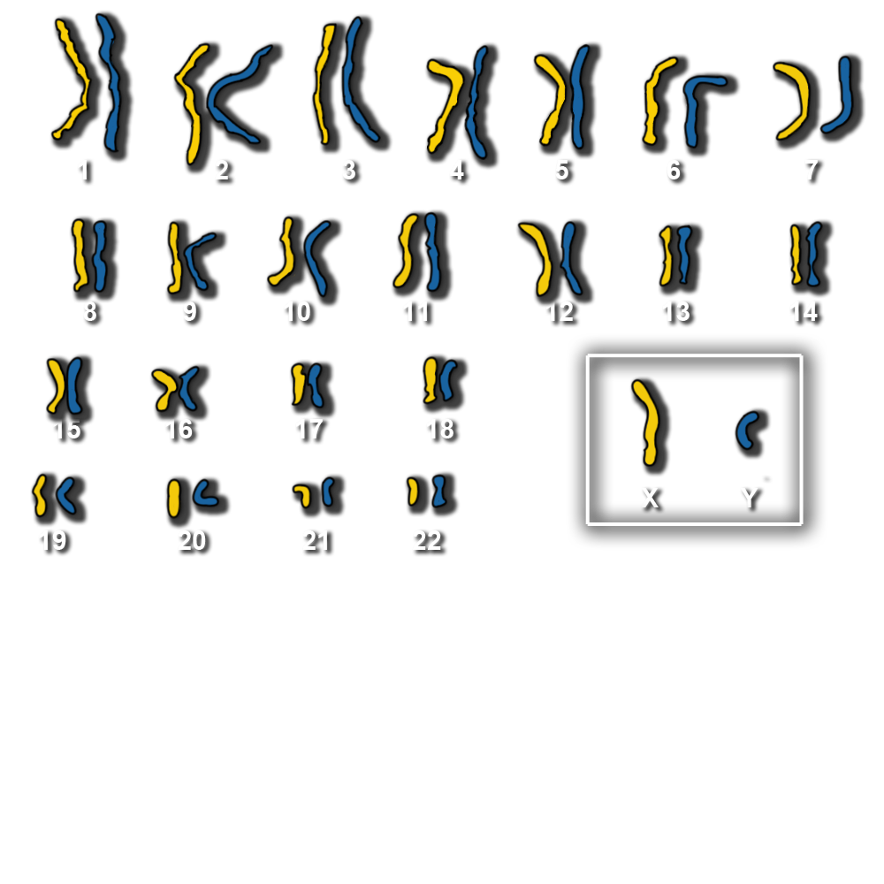
Copyright © 2013 Crosscutting Concepts, LLC. All Rights Reserved.
www.CrosscuttingConcepts.com

Slide 9
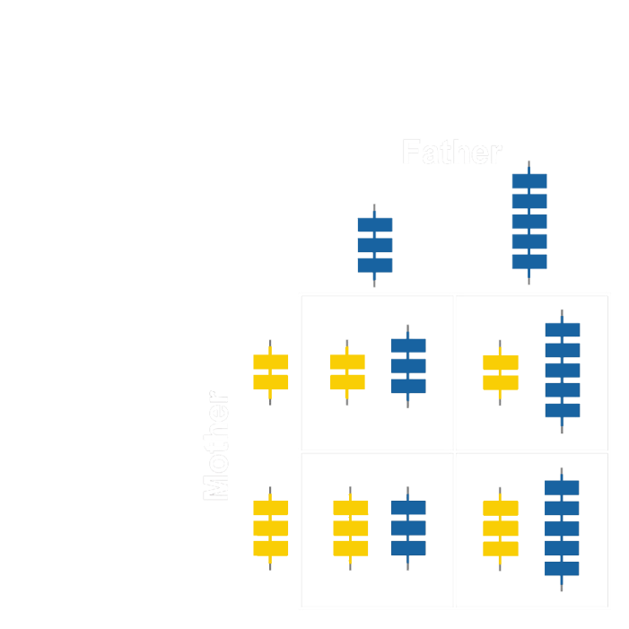
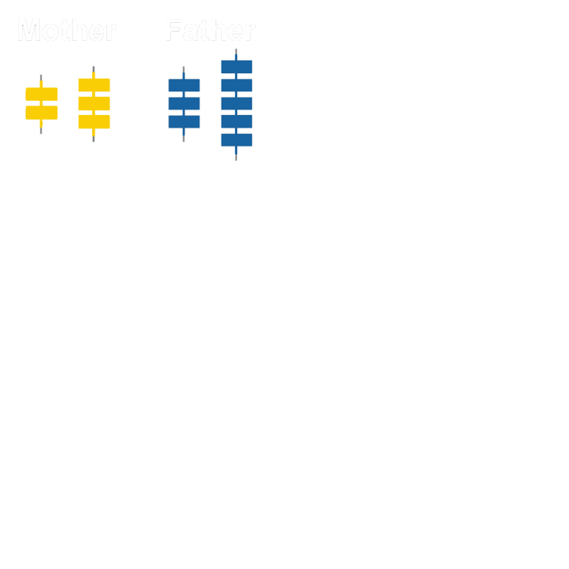
Sexual Reproduction
Two parents give rise to offspring that have unique combinations of genes inherited from the two parents.
Each chromosome pair is distinct and different and contains different genes.
Copyright © 2013 Crosscutting Concepts, LLC. All Rights Reserved.
www.CrosscuttingConcepts.com

Slide 10
Sexual Reproduction
Each of the two members of a chromosome pair can have slight differences in the DNA sequences of the genes it contains.
Different versions of the sequence in the same gene are called alleles.
The pair of alleles inherited from your parents is called a genotype.
Copyright © 2013 Crosscutting Concepts, LLC. All Rights Reserved.
www.CrosscuttingConcepts.com

Slide 11
Sexual Reproduction
If an individual has inherited the same gene sequences from mom and dad, they are homozygous for those alleles. If they inherit different sequences, they are heterozygous.
Which of these offspring squares are homozygous and which are heterozygous?
Copyright © 2013 Crosscutting Concepts, LLC. All Rights Reserved.
www.CrosscuttingConcepts.com

Slide 12
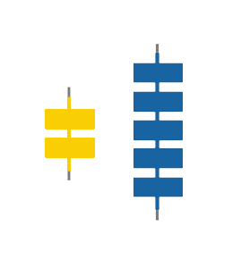
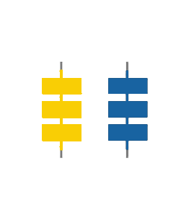
Heterozygote: individual having two different alleles at a genetic location
Homozygote: individual having two copies of the same allele at a genetic location
Copyright © 2013 Crosscutting Concepts, LLC. All Rights Reserved.
www.CrosscuttingConcepts.com

Slide 13
Allelic Dominance
Dominant: An allele A is dominant when its phenotype (physical expression) of the heterozygote Aa is the same as that of the homozygote AA but differs from the homozygote aa
Recessive: An allele a is recessive if the phenotype of the homozygote is different from that of the heterozygote Aa and homozygote AA, which are the same.
Codominant: An allele is codominant if both A and a contribute to the phenotype of the heterozygote Aa equally.
Copyright © 2013 Crosscutting Concepts, LLC. All Rights Reserved.
www.CrosscuttingConcepts.com

Slide 14
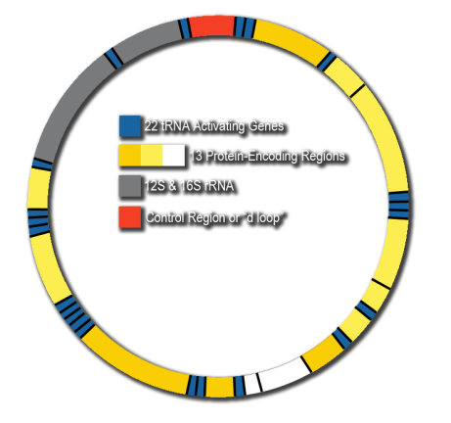
Mitochondrial DNA
Mitochondria are organelles inside each cell that turn molecules of sugar (glucose) into energy.
Each mitochondria has its own DNA separate from the DNA of the cell itself.
Copyright © 2013 Crosscutting Concepts, LLC. All Rights Reserved.
www.CrosscuttingConcepts.com

Slide 15
Mitochondrial DNA
Mitochondrial DNA (mtDNA) is different from the DNA found in the nucleus of the cell.
Ring shaped
Less Protection from mutation
Codes for only 37 genes
Has about 16,000 bp
mtDNA is haploid not diploid
Because the tiny amount of mitochondria in human sperm is destroyed during fetal development, mtDNA is always inherited from the mother’s egg – a male’s mtDNA comes from his mother, but will not pass on to his offspring.
Copyright © 2013 Crosscutting Concepts, LLC. All Rights Reserved.
www.CrosscuttingConcepts.com

Slide 16
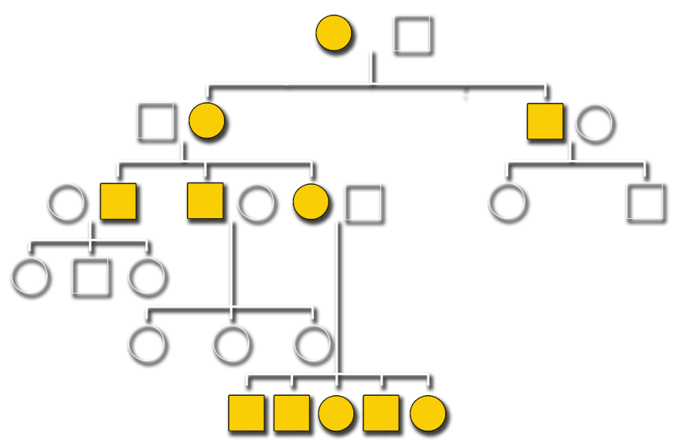
mtDNA Pedigree
Copyright © 2013 Crosscutting Concepts, LLC. All Rights Reserved.
www.CrosscuttingConcepts.com

Slide 17
Microsatellites - Short Tandem Repeats
The portion of human DNA that forms genes which code for proteins or RNA molecules is very small – over 98% of human DNA is considered to be non-coding DNA.
For a long time, the function of this DNA was unknown, leading to the term junk DNA becoming popular. Scientists now believe that much of this non-coding DNA may have important biological functions – we simply haven’t discovered what they are yet.
Copyright © 2013 Crosscutting Concepts, LLC. All Rights Reserved.
www.CrosscuttingConcepts.com

Slide 18
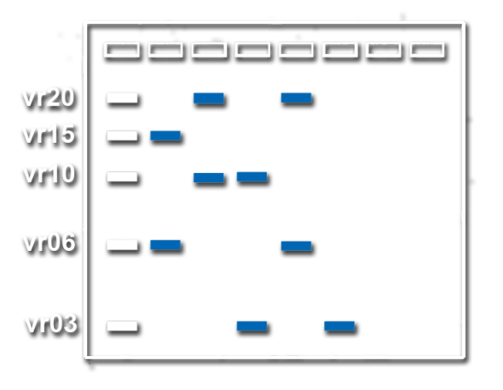
Microsatellites - Short Tandem Repeats
Inside these sections of non-coding DNA are sequences of 2-6 base pairs called microsatellites.
The microsatellites we’re interested in for this lesson are called Short Tandem Repeats (STRs) which:
Are usually 2-5 bp and co-dominant
Have a high degree of polymorphism (variation in DNA sequence between individuals) due to the different number of times the sequence is repeated in individuals
Are used in forensic cases and paternity testing
Copyright © 2013 Crosscutting Concepts, LLC. All Rights Reserved.
www.CrosscuttingConcepts.com

Slide 19
Microsatellites - Short Tandem Repeats
But what does all that mean?
To illustrate, let’s go back to our inheritance example from earlier.
Copyright © 2013 Crosscutting Concepts, LLC. All Rights Reserved.
www.CrosscuttingConcepts.com

Slide 20
Microsatellites - Short Tandem Repeats
These are STR sequences from two separate people, each block on the ‘string’ represents one repeat of an STR sequence on a chromosome – for this example, we’ll say the sequence is GATA.
Notice that the mother has two repeats of the GATA sequence on one chromosome and three on the other, while the father has three repeats on one chromosome and five on the other – even if they were both the same color in this representation, there would still be a visible difference between them.
It is this measurable difference that makes STRs so valuable in forensic science.
Copyright © 2013 Crosscutting Concepts, LLC. All Rights Reserved.
www.CrosscuttingConcepts.com

Slide 21
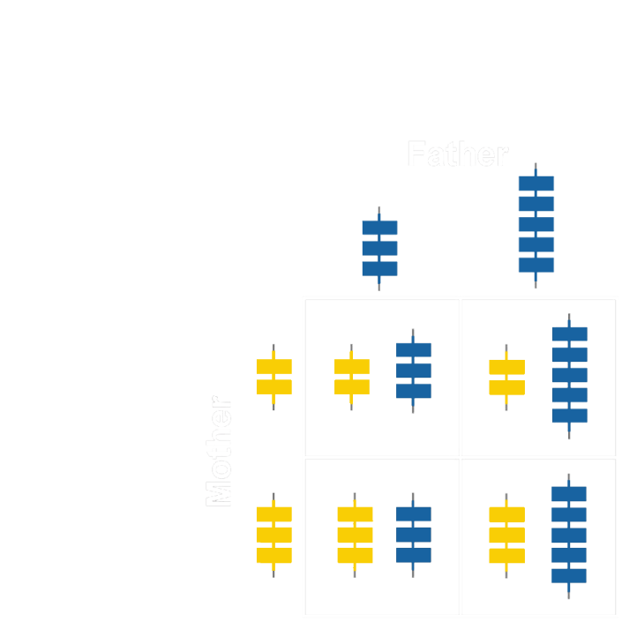
Microsatellites - Short Tandem Repeats
Now we see what might happen if those two people had children
We know that STRs are in regions of non-coding DNA on chromosomes and that each person gets one half of their chromosomes from their mother and the other half from their father – tables like this one show the different possible combinations of STR lengths of the offspring of these two individuals
It is this inheritance of STR lengths that makes it so useful in studies of genetics and also in paternity testing.
Copyright © 2013 Crosscutting Concepts, LLC. All Rights Reserved.
www.CrosscuttingConcepts.com

Slide 22
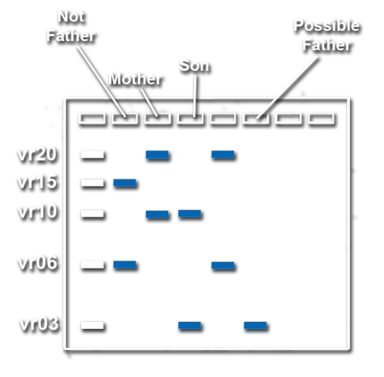
Microsatellites - Short Tandem Repeats
Now we see what might happen if those two people had children.
We know that STRs are in regions of non-coding DNA on chromosomes and that each person gets one half of their chromosomes from their mother and the other half from their father – tables like this one show the different possible combinations of STR lengths of the offspring of these two individuals.
It is this inheritance of STR lengths that makes it so useful in studies of genetics and also in paternity testing.
Copyright © 2013 Crosscutting Concepts, LLC. All Rights Reserved.
www.CrosscuttingConcepts.com

Slide 23
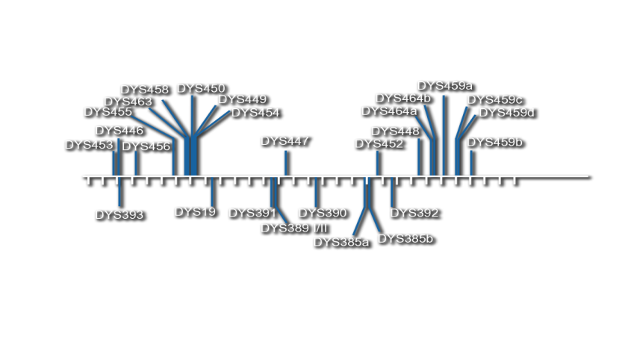
Y Chromosome STRs
There are certain short tandem repeats that occur only on the Y chromosome. If DNA analysis is performed and there is a result for any of these STRs, then a Y chromosome must be present.
Since the Y chromosome only occurs in the XY pairing, any sample which contains these STRs must be genetically male.
The STRs on the Y chromosome are highly conserved in each generation. A man inherits his Y-STRs from his father and will pass them on to his sons.
Often this will not point to a single suspect, as with autosomal STRs, but their use can potentially narrow the field to one family.
Copyright © 2013 Crosscutting Concepts, LLC. All Rights Reserved.
www.CrosscuttingConcepts.com

Slide 24
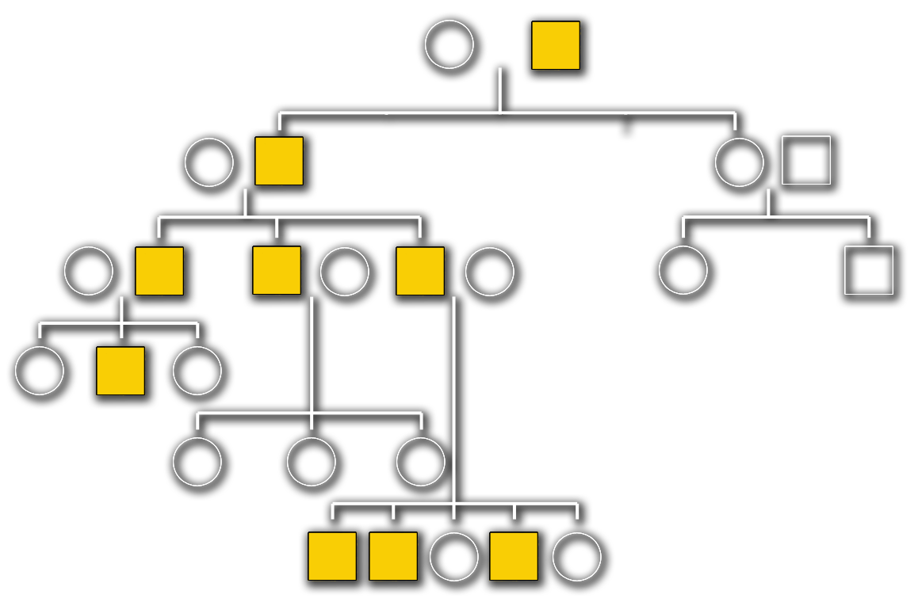
Y Chromosome Pedigree
Copyright © 2013 Crosscutting Concepts, LLC. All Rights Reserved.
www.CrosscuttingConcepts.com

Slide 25
Why the Digression into Genetics?
Forensic DNA analyzes the alleles present
in a variety of genes.
The specific alleles you inherit depend on which half of the chromosomal pair you receive from each parent.
Every gamete is a mixture of chromosomes from both parents because each chromosome is inherited independently.
Statistics can be collected to allow investigators to estimate how commonly any allele occurs in the population, by itself or in another combination of genes.
Copyright © 2013 Crosscutting Concepts, LLC. All Rights Reserved.
www.CrosscuttingConcepts.com

Slide 26
Allelic Frequency Calculations
For many applications, it is important to know how rare a specific allele is within a population.
This is called population genetics – the study and measurement of traits in a specific population.
Copyright © 2013 Crosscutting Concepts, LLC. All Rights Reserved.
www.CrosscuttingConcepts.com

Slide 27
Allelic Frequency Calculations
To do this, scientists pick a trait and they look at the possible outcomes. The example we’re going to use has been simplified so that we can learn this first step without too much complication.
Copyright © 2013 Crosscutting Concepts, LLC. All Rights Reserved.
www.CrosscuttingConcepts.com

Slide 28
Allelic Frequency Calculations
We’re going to look at population genetics in terms of STRs. To do that, we will assume the following things.
P is the allele for 3 repeats
Q is the allele for 5 repeats
These alleles are co-dominant
Copyright © 2013 Crosscutting Concepts, LLC. All Rights Reserved.
www.CrosscuttingConcepts.com

Slide 29
Hardy-Weinberg Formula
When scientists want to calculate how rare or common that certain allele is within a population, one of the methods used is this formula, which is known as the Hardy-Weinberg Formula.
This equation may look familiar. In math, it is known as binomial expansion (Hint: Think about the expression (a+b)² and FOIL.)
Copyright © 2013 Crosscutting Concepts, LLC. All Rights Reserved.
www.CrosscuttingConcepts.com

Slide 30
We know that in humans, we get one allele from our mother and one from our father, so when looking at population genetics we know that half the alleles come from males and half from females.
Knowing that either gender can posses either allele, we can use this Punnett Square to show us not only all possibilities within the population, but which possibility is more likely to occur.
Looking at this table, we can see where the pieces of the Hardy-Weinberg Formula come from.
Based on what you see in this table, which combination of alleles should be most common?
Copyright © 2013 Crosscutting Concepts, LLC. All Rights Reserved.
www.CrosscuttingConcepts.com

Slide 31
Hardy-Weinberg Formula
If we look at this in terms of our example in a population, the following is true:
p² = the percentage of individuals with three repeats of the STR sequence on both chromosomes
2pq = the percentage of individuals with one chromosome with three repeats and one with five repeats
q² = the percentage of individuals with five repeats of the STR sequence on both chromosomes
It all is set equal to 1 because we are looking at parts of a whole, and so the sum will always equal 100% - which can also be expressed as 1.
Copyright © 2013 Crosscutting Concepts, LLC. All Rights Reserved.
www.CrosscuttingConcepts.com

Slide 32
In our sample population, only 3% of people have five repeats on both chromosomes. The other 97% either have three repeats on both chromosomes or one of each allele. This means that
q² = 3% or q² = .03
To find q we need to take the square root of q² which, in our example, is approximately 0.17 or 17%.
We know that p + q = 1 (all alleles are one or the other) and we know that q = 0.17 so our equation now looks like this:
p + 0.17 = 1
Using basic algebra, we can solve for the unknown (p) by subtracting 0.17 from 1. When we do that, we see that p = 0.83.
If we want to check our work, we can add p and q together again.
If p + q = 1 then we’ve done it correctly.
Copyright © 2013 Crosscutting Concepts, LLC. All Rights Reserved.
www.CrosscuttingConcepts.com

Slide 33
We now have the values for p and q.
p = 0.83
q = 0.17
Copyright © 2013 Crosscutting Concepts, LLC. All Rights Reserved.
www.CrosscuttingConcepts.com

Slide 34
Given that data, the equation can be expressed as follows:
(0.83)² + 2(0.83)(0.17) + (0.17)² = 1
0.69 + 2(0.14) + 0.03 = 1
0.69 + 0.28 + 0.03 = 1
1 = 1
Copyright © 2013 Crosscutting Concepts, LLC. All Rights Reserved.
www.CrosscuttingConcepts.com

Slide 35
We solve the equation to check our work. If we find 1 = 1 then we have calculated correctly.
Since our example worked out to 1=1
we know the following to be true:
69% of the population is homozygous 3 (3 & 3)
28% of the population is heterozygous (3 & 5 or 5 & 3)
3% of the population is homozygous 5 (5 & 5)
Why are these proportions different from what we saw in the Punnett Square?
Copyright © 2013 Crosscutting Concepts, LLC. All Rights Reserved.
www.CrosscuttingConcepts.com
Notes:
Answer: Because in the Punnett Square, the proportions were a perfect 25:25:50. Our example used a much more realistic homozygous recessive number of 3%, so the other proportions must shift to make up the adjustment to 100%

Slide 36
In STR analysis, there are anywhere from 6 to 20 possible alleles for each gene, but each individual only has one or two alleles.
To determine the allele frequency scientists extract and analyze DNA from a large number of randomly selected individuals in the population. Often they get these samples from a blood bank.
They use these numbers to calculate the frequency of each allele in the population.
Copyright © 2013 Crosscutting Concepts, LLC. All Rights Reserved.
www.CrosscuttingConcepts.com
Notes:
Answer: Because in the Punnett Square, the proportions were a perfect 25:25:50. Our example used a much more realistic homozygous recessive number of 3%, so the other proportions must shift to make up the adjustment to 100%

Slide 37
For example, if there are 100 people in this population, there are 200 total alleles for each STR.
The frequency of an allele is determined by the number of times that allele occurs divided by the total number of alleles (200).
The Hardy-Weinberg Equilibrium formula still applies even when working with more than two possible alleles.
Copyright © 2013 Crosscutting Concepts, LLC. All Rights Reserved.
www.CrosscuttingConcepts.com
Notes:
Answer: Because in the Punnett Square, the proportions were a perfect 25:25:50. Our example used a much more realistic homozygous recessive number of 3%, so the other proportions must shift to make up the adjustment to 100%

Slide 38
Day Two
Copyright © 2013 Crosscutting Concepts, LLC. All Rights Reserved.
www.CrosscuttingConcepts.com

Slide 39
Gel Electrophoresis
Have you ever heard the saying that opposites attract?
DNA molecules have a negative charge, which means that they will be attracted to a positive charge.
Agarose is a gelatinous substance acquired by boiling red algae. When it has been made into a gel it appears smooth, but has billions of microscopic pores through which it is possible for certain molecules to pass.
Copyright © 2013 Crosscutting Concepts, LLC. All Rights Reserved.
www.CrosscuttingConcepts.com

Slide 40
Gel Electrophoresis
For electrophoresis (using an electric field to move charged particles) an agarose gel is placed in a special chamber with electrical terminals at the top and bottom.
The top terminal is for the negative charge (black)
The bottom terminal is for the positive charge (red)
DNA is pipetted into wells in the top end of the gel, closest to the negatively charged terminal.
When the apparatus is plugged into a power source and turned on, a negative current flows through the top and a positive current flows through the bottom.
Copyright © 2013 Crosscutting Concepts, LLC. All Rights Reserved.
www.CrosscuttingConcepts.com

Slide 41
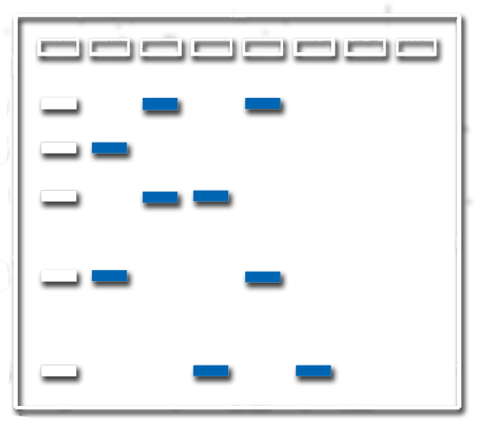
Some pieces of DNA are longer than others.
Pores in the agarose gel are all roughly the same size.
Smallest molecules will travel fastest
Largest molecules will travel slowest
Gels are run for a specific length of time, so those molecules which are smallest will be closest to the bottom of the gel, with those that are largest closest to the top and the other sizes ranging in-between.
Copyright © 2013 Crosscutting Concepts, LLC. All Rights Reserved.
www.CrosscuttingConcepts.com

Slide 42
A lane is the straight line traveled by the DNA molecules between the well and the positive end of the gel.
A size ladder is a solution of DNA molecules of known lengths which is usually run on the first and/or last lanes of the gel to let us measure the sizes of the DNA pieces being tested.
Copyright © 2013 Crosscutting Concepts, LLC. All Rights Reserved.
www.CrosscuttingConcepts.com

Slide 43
Forensic DNA Analysis
DNA is a very small molecule – small enough to fit all the
code for every protein our bodies make into each and every one of our cells.
This means that it is too small for scientists to be able to easily analyze. In order to obtain meaningful information from DNA, one of two things must be true.
1. A large amount of sample must be present
2. Copies of a small amount of sample must be made
We will look at two methods of forensic DNA analysis, RFLP and STR.
Copyright © 2013 Crosscutting Concepts, LLC. All Rights Reserved.
www.CrosscuttingConcepts.com

Slide 44
Restriction Fragment Length Polymorphism
Restriction enzymes are molecules that cut DNA.
Each restriction enzyme only breaks the DNA at a cut site where it finds a specific nucleotide sequence. These cut sites occur in known places on the DNA molecule but a mutation in the cut site sequence will mean a change in the length of the fragment it creates.
Copyright © 2013 Crosscutting Concepts, LLC. All Rights Reserved.
www.CrosscuttingConcepts.com

Slide 45
Restriction Fragment Length Polymorphism
If a large enough amount of DNA sample is present, scientists can add the enzyme to that sample and to another sample from the suspect.
The enzyme digests the DNA over a period of several hours and then both samples are run side by side on a gel.
If the fragment sizes on the two samples don’t match, they do not come from the same person.
This process is very time-consuming and it can take up to eight weeks to process one crime scene.
Copyright © 2013 Crosscutting Concepts, LLC. All Rights Reserved.
www.CrosscuttingConcepts.com

Slide 46
Polymerase Chain Reaction
In cases where at least a small amount of a DNA sample is present, a quicker method is available.
In order to isolate and amplify the desired portion of DNA, we can use a process called the polymerase chain reaction (PCR).
PCR approximates the body’s own method of duplicating DNA to make millions of copies of the pieces we want to study.
Over the next few slides, we’ll get an inside look at how this process works.
Copyright © 2013 Crosscutting Concepts, LLC. All Rights Reserved.
www.CrosscuttingConcepts.com

Slide 47
PCR – Preliminary Step
In order to perform PCR, a number of ‘ingredients’ and tools are necessary.
The most important ones are:
DNA sample
Polymerase – Polymerase binds to open DNA and synthesizes a complementary strand from primer bound to the original strand; Taq polymerase is a special polymerase which does not degrade at high temperatures
Primers – Short sequences of DNA that bind to specific complementary (matching) regions of the DNA sample – called the target sequence – that we want to amplify
Nucleotides – Raw material for the polymerase to synthesize new DNA strands
Thermocycler – Machine used to precisely raise and lower the temperature of the DNA samples for specific lengths of time
Copyright © 2013 Crosscutting Concepts, LLC. All Rights Reserved.
www.CrosscuttingConcepts.com

Slide 48
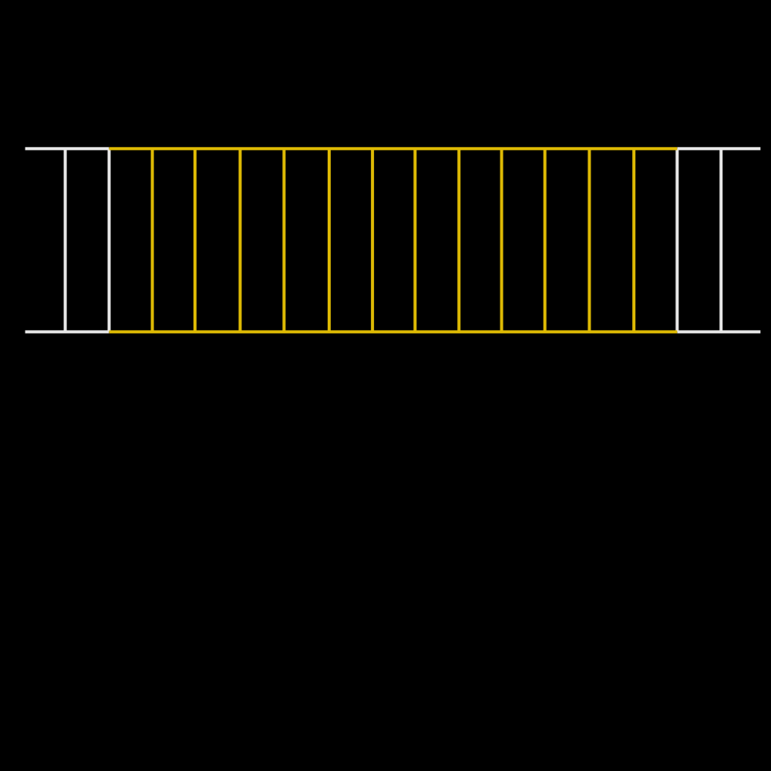
PCR – Starting Point
Copyright © 2013 Crosscutting Concepts, LLC. All Rights Reserved.
www.CrosscuttingConcepts.com

Slide 49
PCR – Cycle One
In order to simplify the explanation, this example begins with only one molecule of DNA. In reality, even the smallest samples usually have many molecules to start with.
The DNA is first ‘unzipped’ by raising the temperature to 95°C.
This breaks the hydrogen bonds which hold each nucleotide base to its complement on the opposite strand.
Copyright © 2013 Crosscutting Concepts, LLC. All Rights Reserved.
www.CrosscuttingConcepts.com

Slide 50
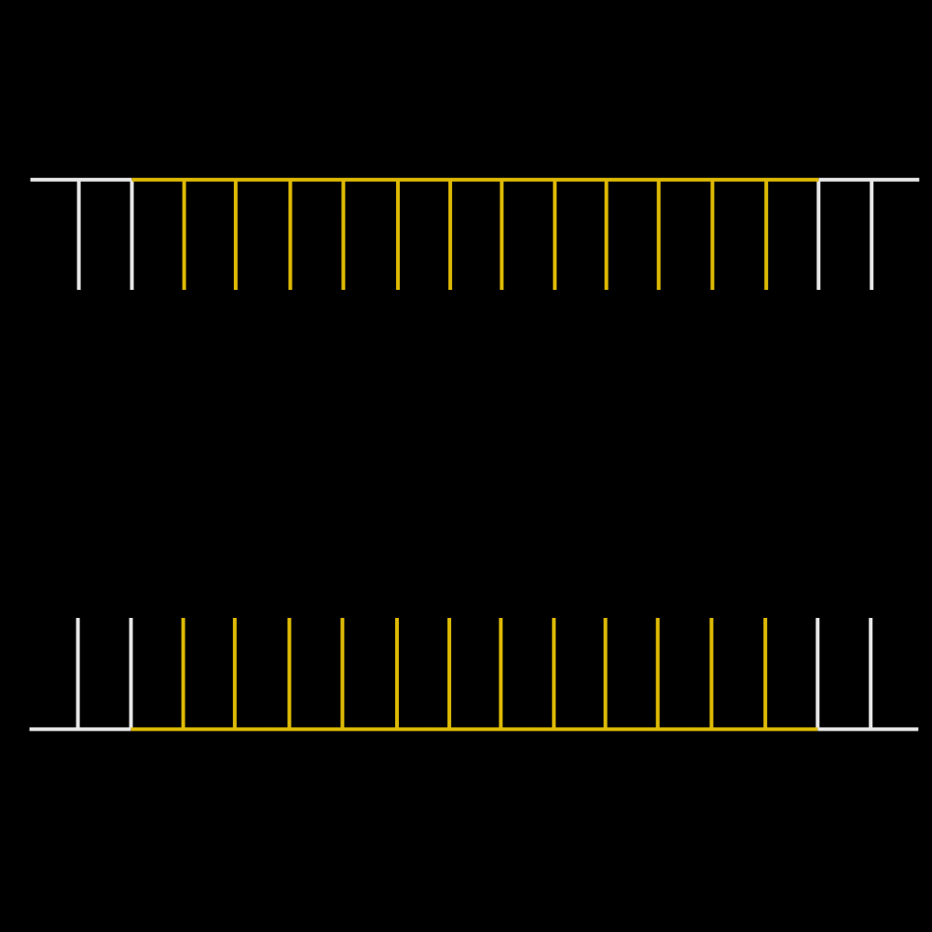
PCR – Mid-Cycle One
Copyright © 2013 Crosscutting Concepts, LLC. All Rights Reserved.
www.CrosscuttingConcepts.com

Slide 51
PCR – Cycle One
After the strands are opened, the temperature is
lowered to 60°C.
The primers attach to complementary sequences on each half of the open target sequence.
These primers then attract the polymerase, which binds to the 3’ end of each primer and proceeds to create a complementary strand to each of the two template strands in the 5’ to 3’ direction.
Only DNA containing the target sequence is copied, because Taq polymerase can only bind to sections with a primer.
At the end of Cycle One, there are two partially double-stranded DNA molecules.
Copyright © 2013 Crosscutting Concepts, LLC. All Rights Reserved.
www.CrosscuttingConcepts.com

Slide 52
PCR – Mid-Cycle One
Copyright © 2013 Crosscutting Concepts, LLC. All Rights Reserved.
www.CrosscuttingConcepts.com

Slide 53
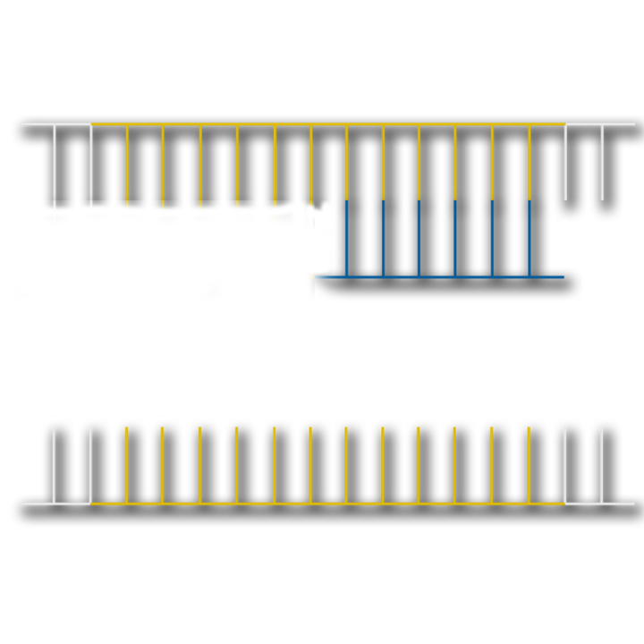
PCR – Mid-Cycle One
Copyright © 2013 Crosscutting Concepts, LLC. All Rights Reserved.
www.CrosscuttingConcepts.com

Slide 54
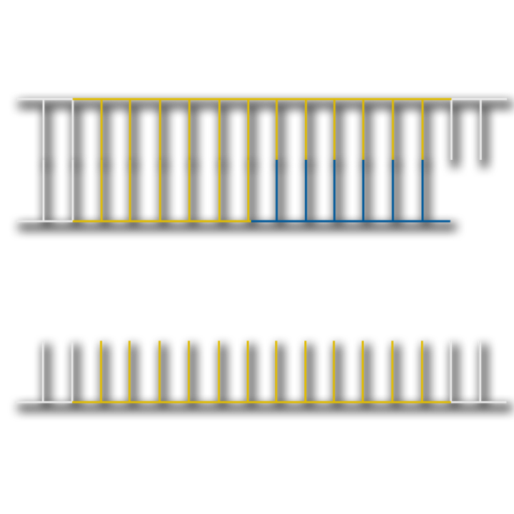
PCR – Mid-Cycle One
Copyright © 2013 Crosscutting Concepts, LLC. All Rights Reserved.
www.CrosscuttingConcepts.com

Slide 55
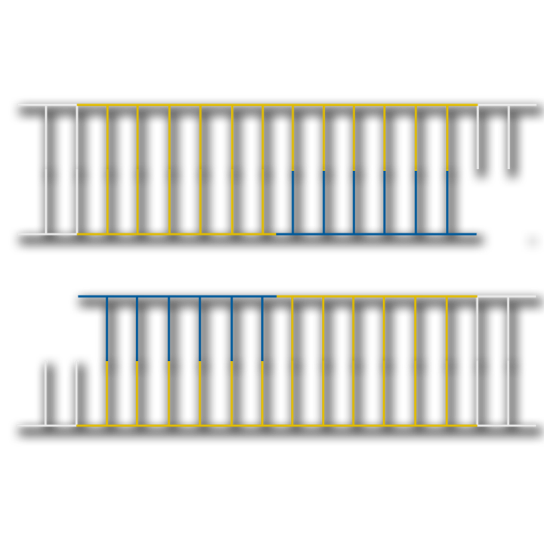
PCR – After Cycle One
Copyright © 2013 Crosscutting Concepts, LLC. All Rights Reserved.
www.CrosscuttingConcepts.com

Slide 56
PCR – Cycle Two
In the second cycle, the steps are repeated, this time there are two partially double-stranded molecules of DNA at the beginning.
The DNA is ‘unzipped’ by raising the temperature to 95°C
These primers again create a complementary strand to each of the four template strands in the 5’ to 3’ direction.
At the end of Cycle Two, four partially double-stranded DNA molecules are produced – all of them have the target sequence plus some flanking DNA.
Copyright © 2013 Crosscutting Concepts, LLC. All Rights Reserved.
www.CrosscuttingConcepts.com

Slide 57
PCR – After Cycle Two
Copyright © 2013 Crosscutting Concepts, LLC. All Rights Reserved.
www.CrosscuttingConcepts.com

Slide 58
PCR – Cycle Three
In the third cycle, the steps are repeated with four partially double-sided DNA molecules at the start.
The DNA is ‘unzipped’ and the primers attach to the complementary sequences on each half of the open target sequences.
These primers once more create a complementary strand to each of the eight template strands in the 5’ to 3’ direction.
At the end of Cycle Three, for the first time there are two double-stranded DNA molecules produced that contain only the target sequence. Six more are present which are longer and contain the target sequence plus some surrounding DNA.
Copyright © 2013 Crosscutting Concepts, LLC. All Rights Reserved.
www.CrosscuttingConcepts.com

Slide 59
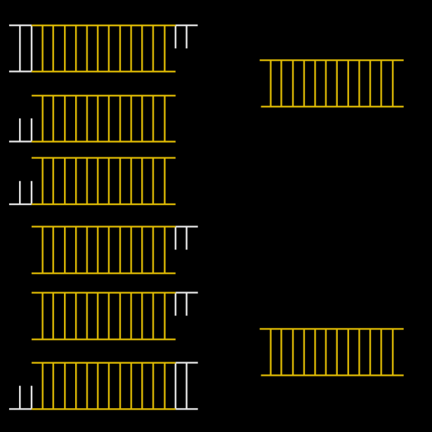
PCR – After Cycle Three
Copyright © 2013 Crosscutting Concepts, LLC. All Rights Reserved.
www.CrosscuttingConcepts.com

Slide 60
PCR – Cycle Four
In the fourth cycle, the steps are repeated with two double-sided DNA molecules that contain only the target sequence and six partially double-sided DNA molecules to begin with.
At the end of Cycle Four, there are eight DNA molecules produced that contain only the target sequence and eight longer only partially double-stranded molecules which contain the target sequence plus some surrounding DNA.
Copyright © 2013 Crosscutting Concepts, LLC. All Rights Reserved.
www.CrosscuttingConcepts.com

Slide 61
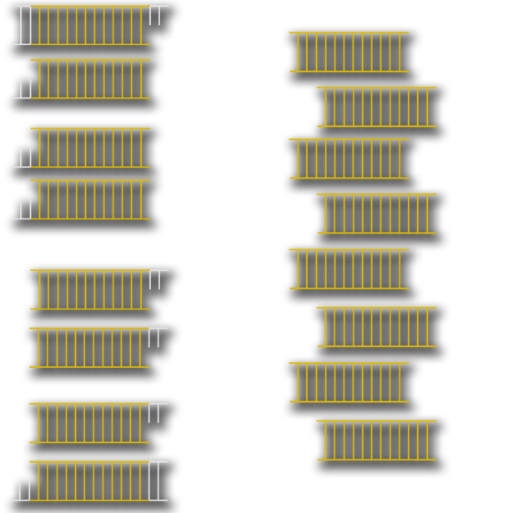
PCR – After Cycle Four
Copyright © 2013 Crosscutting Concepts, LLC. All Rights Reserved.
www.CrosscuttingConcepts.com

Slide 62
PCR – Cycle Five
In the fifth cycle, the steps are repeated with eight double-sided DNA molecules that contain only the target sequence and eight partially double-sided DNA molecules at the start.
Thus, at the end of Cycle Four, there are 22 double-stranded DNA molecules produced that contain only the target sequence and only ten longer, partially double-stranded molecules which contain the target sequence plus some surrounding DNA.
Copyright © 2013 Crosscutting Concepts, LLC. All Rights Reserved.
www.CrosscuttingConcepts.com

Slide 63
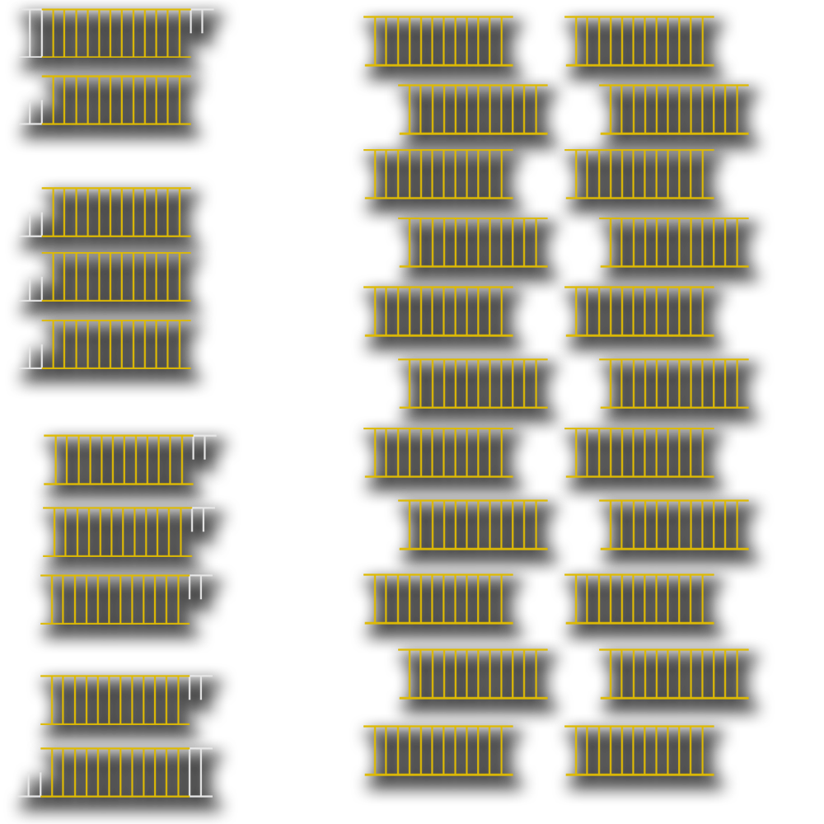
PCR – After Cycle Five
Copyright © 2013 Crosscutting Concepts, LLC. All Rights Reserved.
www.CrosscuttingConcepts.com

Slide 64
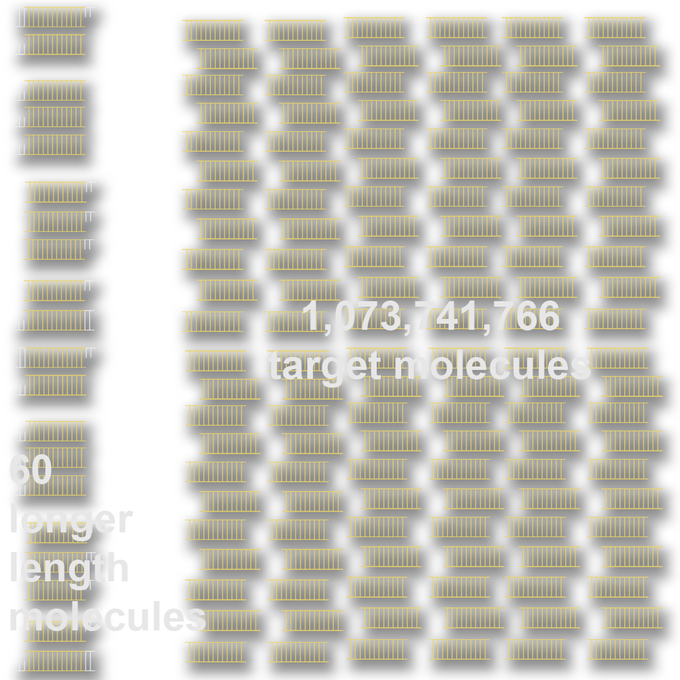
PCR – After Cycle 30
Copyright © 2013 Crosscutting Concepts, LLC. All Rights Reserved.
www.CrosscuttingConcepts.com

Slide 65
So how does the forensic scientist apply these principles of DNA analysis to an active crime scene?
Copyright © 2013 Crosscutting Concepts, LLC. All Rights Reserved.
www.CrosscuttingConcepts.com

Slide 66
Copyright © 2013 Crosscutting Concepts, LLC. All Rights Reserved.
www.CrosscuttingConcepts.com

Slide 67
Forensic DNA Process
During a crime event, many different actions can result in the transfer of biological material from both victim and suspect to items and surfaces at the scene.
The types of material and their method of transfer can tell us much about what happened during the crime event as well as giving us a starting point for later analysis of biological material.
Copyright © 2013 Crosscutting Concepts, LLC. All Rights Reserved.
www.CrosscuttingConcepts.com
Copyright © 2013 Crosscutting Concepts, LLC. All Rights Reserved.
www.CrosscuttingConcepts.com

Slide 68
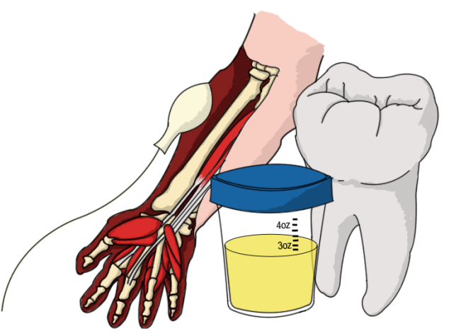
Sources of Biological Evidence
Blood
Semen
Saliva
Urine/Feces
Hair
Teeth/Bone
Tissue
Cells

Slide 69
Forensic DNA Process
The first step in any forensic DNA process is to identify potential sources of material at the scene, then catalog and collect them.
Known samples from victims or suspects can be immediately used for DNA extraction. In instances of violent crime, samples need to be characterized (i.e. blood or saliva) before extraction begins.
Copyright © 2013 Crosscutting Concepts, LLC. All Rights Reserved.
www.CrosscuttingConcepts.com

Slide 70
Forensic DNA Process
Samples must be analyzed to determine how much DNA is present.
PCR amplification increases the copy number of the STR DNA fragments we will study.
PCR products are then run on a gel so that the results can be analyzed and compared to suspect(s) results to produce either a definitive mismatch or a possible match.
Copyright © 2013 Crosscutting Concepts, LLC. All Rights Reserved.
www.CrosscuttingConcepts.com

Slide 71
Forensic DNA Process
For each STR gene, scientists use the known allelic frequencies to calculate the likelihood that this genotype exists in the population.
The individual probabilities of each STR gene in a sample are then multiplied together to get the percentage of people in the population that could have all those specific genotypes.
Copyright © 2013 Crosscutting Concepts, LLC. All Rights Reserved.
www.CrosscuttingConcepts.com

Slide 72
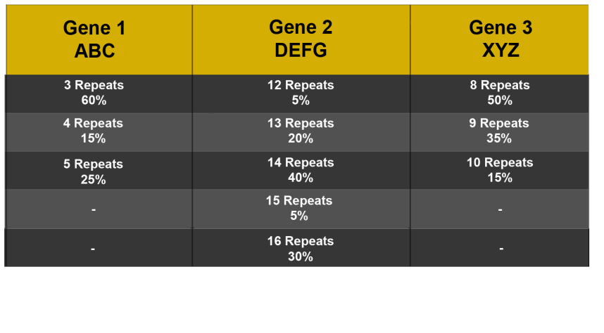
STR Probability Calculation
In the following lab, you’ll be asked to calculate the probability that a certain combination of alleles exists within a population.
To learn about this method, we’re going to use example genes ABC, DEFG, and XYZ.
Copyright © 2013 Crosscutting Concepts, LLC. All Rights Reserved.
www.CrosscuttingConcepts.com

Slide 73
STR Probability Calculation
For this example, the sample found at the crime scene had
ABC: 3 repeats and 4 repeats
DEFG: 14 repeats and 16 repeats
XYZ: homozygous 8 repeats
ABC
3 Repeats: .60
4 Repeats: .15
DEFG
14 Repeats: .40
16 Repeats: .30
XYZ
8 Repeats: .50
8 Repeats: .50
Recall that in the Hardy-Weinberg equation, homozygous is represented by p² and heterozygous is represented by 2pq
Copyright © 2013 Crosscutting Concepts, LLC. All Rights Reserved.
www.CrosscuttingConcepts.com

Slide 74
STR Probability Calculation
Because two of the genes in our sample are heterozygous and one is homozygous, we will use the following calculations to find the probability of each gene’s allele combination in our population.
ABC
2(0.6 x 0.15)
2(0.09)
0.18
DEFG
2(0.4 x 0.3)
2(0.12)
0.24
XYZ
(0.5 x 0.5)
(0.25)
0.25
Now we know the individual probabilities for each of the genes in our sample, but to find out the probability of this particular combination existing in our population, we must multiply the three results together.
Copyright © 2013 Crosscutting Concepts, LLC. All Rights Reserved.
www.CrosscuttingConcepts.com

Slide 75
STR Probability Calculation
ABC DEFG XYZ
0.18 0.24 0.25
(0.18 x 0.24 x 0.25)
0.0108
This means that 108 people out of 10,000 have this particular combination of alleles for these three genes.
Forensic STR analysis uses between 12 and 16 genes, because the probability of many individuals sharing all of those allele combinations is very low – less than one in a billion.
Copyright © 2013 Crosscutting Concepts, LLC. All Rights Reserved.
www.CrosscuttingConcepts.com

Slide 76
Forensic DNA Limitations
It’s very important to remember that – no matter what is shown on late night crime dramas – DNA is not a ‘magic bullet’ for forensics.
Depending on the type of crime and the way it is handled, DNA evidence at the scene may be contaminated, degraded or even not present at all.
Inhibitors to PCR amplification are often present.
DNA samples might be a mix between the victim and the criminal. Those mixtures are challenging to separate.
The STR genes used forensically are the same in identical twins. Further testing can distinguish between identical twins, but these tests are expensive and time-consuming.
Copyright © 2013 Crosscutting Concepts, LLC. All Rights Reserved.
www.CrosscuttingConcepts.com

Slide 77
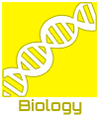
An Identity Crisis™ DNA Typing

