Slide 1
HALF LIFE CALCULATIONS

Slide 2
1. WHAT IS HALF LIFE
THE TIME IT TAKES FOR HALF OF A RADIOACTIVE SUBSTANCE TO DECAY
BASED ON PROBABILITY
DIFFERENT ISOTOPES HAVE DIFFERENT HALF LIVES
AMOUNT RADIOACTIVE AFTER EACH HALF LIFE = ½ ¼ 1/8 1/16 1/32 1/64 …
CAN USE TO FIND THE AGE OF ROCKS OR FOSSILS
PARENT=STILL RADIOACTIVE, DAUGHTER=NOT RADIOACTVE ANYMORE

Slide 3
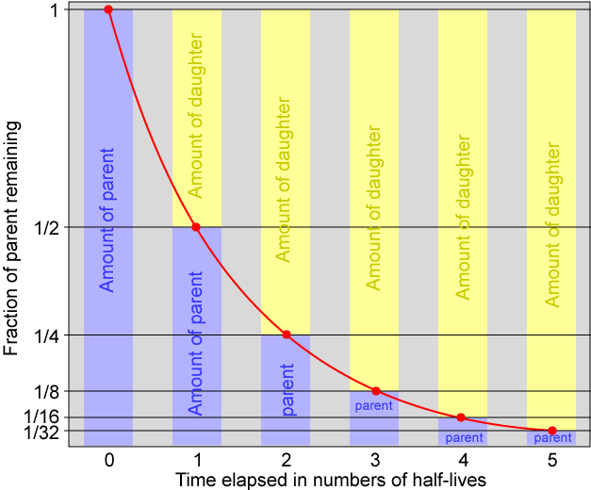

Slide 4
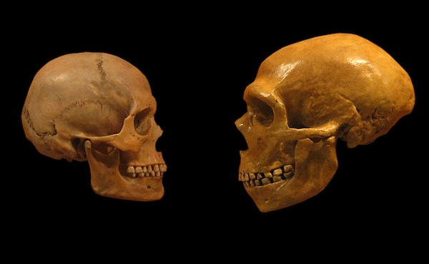
2. WHY IS HALF LIFE IMPORTANT?
PLANTS AND ANIMALS TAKE IN CARBON 14 DURING LIFE
WE KNOW ON AVERAGE HOW MUCH IS IN A LIVE BONE
DEAD PLANTS AND ANIMALS DON’T EAT OR BREATHE
EVERY 5730 YEARS HALF OF IT WILL TURN INTO NITROGEN 14 (WE CAN CALCULATE THE AGE OF A BONE)

Slide 5
EX) IF A LIVE BONE HAS 100 GRAMS OF CARBON 14, AND A DEAD BONE (SAME MASS) HAS ONLY 25 GRAMS OF CARBON 14, HOW MANY TIMES WAS YOUR AMOUNT CUT IN HALF? TWO TIMES HOW OLD IS THE BONE? 2 X 5730 YEARS OR 11460 YEARS. CAN CARBON 14 BE USED FOR ROCKS? NO, THEY DON’T EAT OR BREATHE.

Slide 6
