Slide 1
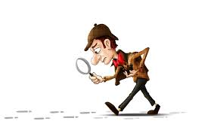
The Crime Scene and Evidence
2015 Revision
Adapted from “Forensic Science” by Kendall Hunt, Lyle and Louise Mystery by Crosscutting concepts, and Criminalistics
Notes:
Read JonBenet case on page 26-27 in criminalistics

Slide 2
Today’s Brain Teaser
Yesterday she was 13. On her next birthday she will be 15. How can this be?
Alone I am 24th, with a friend I am 20. Another friend and I am unclean. What am I?

Slide 3
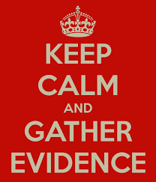
The CSI and Crime Lab Teams
Field Investigative Unit | Crime Lab Scientist
Secure the crime scene (first responder or first officer on the scene) and assist victims who need medical attention | Receive/sign for evidence
Photograph the crime scene | Review paperwork
Search the crime scene | Complete chemical and/or physical tests on evidence
Properly collect and package evidence | Complete an analysis of findings
Complete proper forms: Evidence submission form Chain of custody forms | Provide expert testimony
Deliver or ship evidence to proper processing site
Provide expert testimony

Slide 4
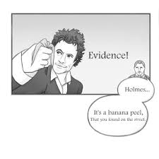
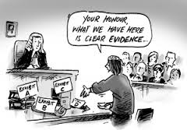
What is Physical Evidence?
Can be any material or object
Can be large or small
Can be microscopic
Can be a solid, liquid or gas
Must be identified and its origin determined
Physical and chemical properties
pH
Size
Shape
Color
Odor
Density
Solubility
Hardness
Refractive index
Reaction with other substances

Slide 5
“Rules” for Physical Evidence
Any object that can establish that a crime has or has not be committed
Links crime to perpetrator (the one who commits the crime or suspect)
Links crime to victim
Must be found or recorded at the crime scene and carefully preserved for examination

Slide 6
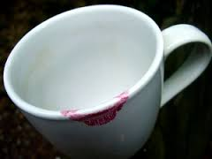
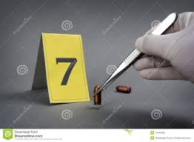
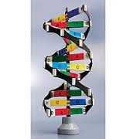
Types of Physical Evidence
Class evidence:
The evidence is anything that can be linked to a group of people but not an individual
Blood type
Shoes
Tires
Glass
Fiber
Hair except for root
Individual evidence
Characteristics that are unique to a single person or a specific item that only one person can possess
DNA
Hair root
Fingerprint
Worn footwear that has molded to the individual’s feet and taken on patterns of that person’s gait

Slide 7
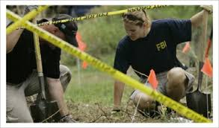
1. Securing the Scene
First officer or first responder on the scene is responsible g Secure the scene/protecting the area and get medical attention for any victims.
Notes of anyone present; leaving area; hazardous materials, etc.
Persons needing medical assistance take priority and arresting the perpetrator
Record statements made by victim or any information provided
Process:
Exclude all unauthorized persons (including family members of victim)
Direct essential persons such as medical teams to the victim via a route that minimizes the disruption to the scene
Direct additional officers to isolate area
Identify all persons at the scene (bystanders, witnesses) and detain potential suspects/witnesses for interviews
Log name and time of day of everyone who enters/leaves
EVERY INDIVIDUAL IS A POSSIBLE DESTROYER OF PHYSICAL EVIDENCE AND THIS COULD AFFECT THE OUTCOME OF THE CASE IN COURT

Slide 8
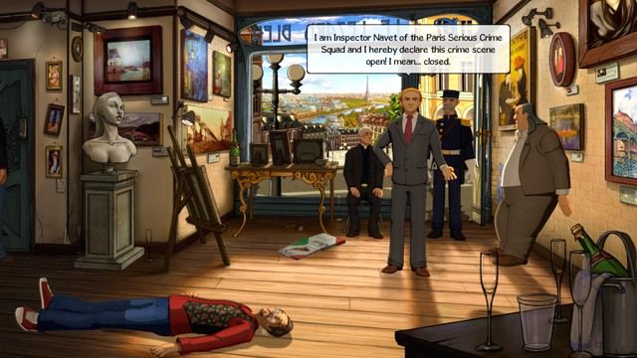
Lead Investigator:
evaluates the area; determines perimeter; establishes point of entry/exit of perpetrator
Document &photograph the scene
No smoking, drinking, eating, littering (alters scene)
Nothing should be moved (including bodies) or disturbed unless there is a specific threat (don’t turn on faucets, flush toilets, open or close windows, adjust heat or air, change temperature in any way)

Slide 9
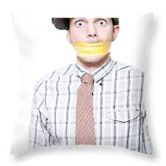
2. Separate the Witnesses
Witnesses must be separated and asked for their account of the story.
When did the crime occur?
Who called in the crime?
Who is the victim?
Can the perpetrator be identified?
What did you see happen?
Where were you when you observed the crime scene?
Think about why it is important for the witnesses to be interviewed separately?

Slide 10
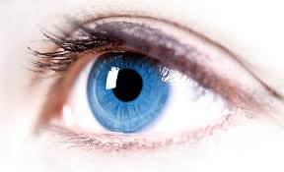
The eyewitness
This is a person who “saw” something related to the crime
(Claim)
Eyewitnesses are able to provide direct evidence or prima facie evidence during their statement made under oath. This is testimonial evidence.
In a 1977 study of >2000 lineups, 45% of potential offenders who were recognized yielded an 82% conviction rate.
In 347 cases where eyewitness testimony was the only evidence, there was a 74% conviction rate
A 1983 report showed that jurors relied more on eyewitness testimony than fingerprint evidence.
(counterclaim)
According to the Innocence Project, eyewitness misidentification is the single greatest cause of wrongful convictions. It plays a role in 75% of the convictions that are over-turned by DNA testing.
Case of Ronald Cotton
https://youtu.be/u-SBTRLoPuo?list=PLZaLEnIRUj-eB2sGprwyAPmkP22zxJS7P
https://youtu.be/I4V6aoYuDcg
https://youtu.be/x6fRH5MLBIU?list=PLZaLEnIRUj-eB2sGprwyAPmkP22zxJS7P

Slide 11
Factors Affecting Eyewitness Accounts
Crime scene was too dark
The encounter with the perpetrator was too brief
Presence of a weapon may have diverted attention
Stress may cause the witness to become confused
Errors in memory processing
Time elapsed between the crime and questioning
Has the witness seen any new information since the crime: photos, news, other witnesses, etc. that might influence memory.
Excerpt from Marcia Clark
https://youtu.be/PB2OegI6wvI

Slide 12
Some witnesses are better at remembering sex and hair color of the suspect while others are more accurate at height, age, race.
Other points to consider:
Type of crime
How witness saw it
Victims of serious crimes have more accurate memory over a longer period of time.
Presence of a weapon tends to enhance focus and memory
Children do not remember events as well as adults. What a child remembers sometimes depends on the way he is interviewed.
Interviewing techniques: open-ended questions are better
Does the witness know the accused?
“the absolutely certain” witness story is most likely true.

Slide 13
3. Scan the Scene
Distinguish primary crime scene (where the crime actually occurred) from the secondary crime scene (contains evidence to the crime)
Determine what photographs should be taken

Slide 14
4. Seeing the Scene
Photographs with measuring rulers
Triangulation of stationary objects should be included in photos as reference points.
All markers should be included in photographs.

Slide 15
Recording the Scene
Document the original state of the scene
Provides useful information for later examination and presentation in court
3 methods: notes, photographs, sketches
Notes:
time of call to scene, caller name, time, date, person taking call, investigator notification, case number, preliminary information given
Notes should include persons present, arrival times, exit times, time processing begins and ends
Lead investigator: does initial walk through and notes before processing begins
Don’t leave any notes to memory----write at scene
Audio tape recording or video recording (keeps hands free; avoid embarrassing conversations)

Slide 16
Photography
Scene must be UNALTERED!!!
Evidence markers used to locate objects, stains, fibers, etc.
Photograph objects from all necessary angles, close up and far away; showing locations of objects relative to other things
Do not introduce evidence to a crime scene that was previously removed before photographing---make notes of anything removed prior
Helpful for recording biological evidence like blood in its original condition because it will later be altered during testing
Bodies should be photographed in original positions from multiple angles and then the space underneath should be photographed after body is removed.
Film vs. digital (both are used; digital has pros/cons)
Some argue that digital can be enhanced and altered by computer programs
Digital photos can be stitched into panoramic photos revealing a three dimensional view of scene
Notes:
Crime scene photos of J. Macdonald house

Slide 17
5. Sketch the Scene
Sketches
Shows clearly the layout of an indoor or outdoor crime scene and the relationship in space of all significant items and features
Shows location of collected evidence
Shows possible paths of entry, exit and movement through the scene
Rough sketch: a draft representation of all essential information and measurements at a crime scene (drawn at the scene)
Finished sketch: a precise rendering of the scene drawn to scale
Computer aided drafting programs
Sketches should note position of body (if any).
All objects should be measured from two immovable landmarks.
Directions and scale of distance should be noted.

Slide 18
6. Search for Evidence
Must be thorough
Must be factual and unbiased
Must happen immediately to eliminate suspicion of “covering up” something or “trying to frame someone by introducing evidence not at the scene)
Search pattern depends on locale and size of the area as well as actions of the suspect and victim
Types:
strip/line/parallel search and grid search (well defined boundaries for search)
spiral search (can be difficult and evidence can be missed)
wheel/ray search (not a preferred method because areas between the rays are often not searched)
quadrant/zone search: (best suited for scenes that cover a large area)

Slide 19
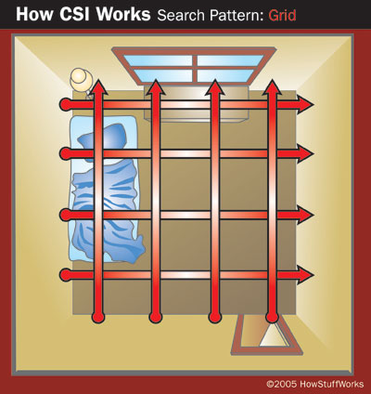
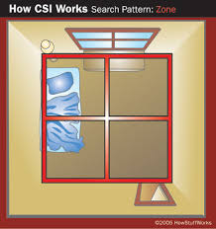
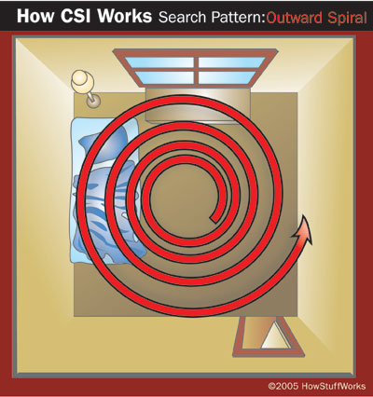
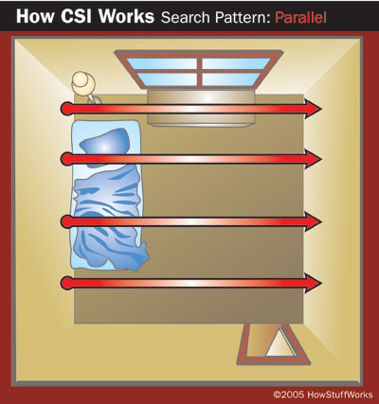
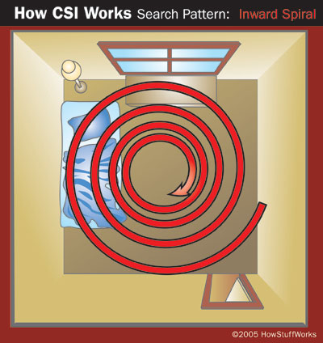
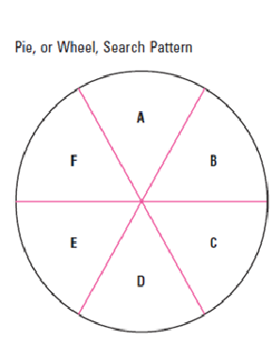
Large area looking for a large object in two directions as in arson cases
Building or other structure—homicides, home invasions, robberies, sexual assaults
large area looking for a large object
In a single direction—site of a plane crash
Large area, no barriers like in an open field—
Kidnapping, homicide

Slide 20
7. Securing and Collecting Evidence (Bagged and Tagged Separately)
Use latex gloves and forceps to collect evidence
Minute traces to large amounts; microscopic to massive objects
Victims clothing (each item wrapped separately)
Material from sweeping and vacuuming (package different areas separately)
Fingernail scrapings from victim and others in contain with victim
Hair samples from head and pubic areas
Blood samples
Swabs from vagina anus, mouth and penis (sex crimes)
Bullets
Hand and finger swabs (gunshot residue)
Fabric fibers, cigarette butts, insects, etc. (do not remove hairs or fibers from clothing—send entire garment)
Note: time is crucial as some lose forensic value over time due to decomposition, exposure to environment, etc. Once body is buried, efforts to obtain these samples can be futile.

Slide 21
Remember……..
Do not cross contaminate evidence by putting different samples in the same container.
Clean any equipment that is not disposable after use.
Keep evidence in original condition to maintain integrity
Use disposable tools to collect biological evidence
Assume that all body fluids are infectious!
Change gloves frequently while collecting evidence
Use masks, and gowns (protective coverings)
Be sure all evidence is labeled and chain of custody is followed
Do not use ordinary mailing envelopes because fine powders and fibers can leak out. Use folded paper (druggist fold) to create a paper container.

Slide 22
Evidence Containers
Paper bags (for objects with blood, semen)in order to avoid moisture/mold problems
Unbreakable pill bottles with pressure lids (hair, fibers, glass, small/trace evidence)
Manila envelopes
Glass vials
Sealable plastic bags
Metal pill boxes
For items that have been burned (cases of arson), airtight containers must be used to prevent evaporation of volatile petroleum residues

Slide 23
DNA evidence
Can be obtained from saliva, sweat, skin cells, blood
Stamps, envelopes, chewing gum, cigarette butts, sweatband of a hat, bedsheets, lipstick,
One key concern: contamination during collection
Contamination introduces foreign DNA through the coughing/sneezing process during collection
Transfer contamination: touches other objects
Wear facemask, gloves, use disposable forceps
Can wear shoe covers and coveralls

Slide 24
Label the Evidence
Case number
Inventory number
Description of evidence
Name of suspect
Name of victim
Date and time of recovery
Signature of person recovering the evidence
Signature of witnesses present during collection
Seal all containers with tape and signature of the packaging official

Slide 25
Chain of Custody
Continuity of possession
Must be established for evidence presented in court
Standard procedure for identification, marking, and completing evidence submission forms for lab analysis
Every person who has handled or examined the evidence must be accounted for.
Guarantees the authenticity and integrity of the evidence
Collectors initials, date, and time if necessary
Tag or label all items and containers
Containers are sealed with evidence tape bearing the collectors initials and date.
Someone removing evidence must then re-seal with tape and initial on the new seal.
Transfer of evidence form

Slide 26
Standard/Reference Samples
Many tests require comparison with a standard/reference standard
Physical evidence whose origin is known such as blood or hair that can be used to compare to a sample from the scene
Standard samples can come from the victim, suspect or other know source
Example: paint sample in hit & run accident
Buccal (cheek) swab serves as reference for blood DNA comparison
Substrate control: uncontaminated surface material close to an areas where physical evidence has been deposited.

Slide 27
Crime Scene Safety
OSHA (Occupational Safety and Health Administration)
Blood borne pathogens
Treat all specimens as hazardous and capable of transmitting HIV, Hepatitis, etc.
No food or drink in lab areas, crime scenes, etc.
International Association for Identification Safety Committee:
Double layers of latex gloves (minimal)
Shoe covers
Large contamination areas: liquid repellent suits
Particle mask/respirator or face shield when potentially infectious dust, mist, spray may be encountered through scraping, folding, and collection of samples
Be alert to sharp objects, knives, hypodermic needles, razor blades, etc.
Use red biohazard plastic bags for suspected biohazard items
Wear uncontaminated gloves while note taking. Pens, markers, etc. used while wearing contaminated gloves should be disposed using biohazard bag.
Remove torn or ripped contaminated equipment immediately and clean the affected areas with 10 percent bleach.
No eating, drinking, smoking or application of make-up
Label contaminated clothing, etc. that is not disposable and place in yellow infectious linen bags for cleaning.

Slide 28
4th Amendment
“The right of the people to be secure in their persons, houses, papers, and effects, against unreasonable searches and seizure, shall not be violated and no warrants shall issue, but upon probable cause, supported by oath or affirmation, and particularly describing the place to be searched, and the persons or things to be seized.”
Allowances:
Existence of emergency circumstances
Need to prevent the immediate loss or destruction of evidence
A search of a person and property within the immediate control of the person provided it is made incident to a lawful arrest
A search made by consent of the parties involved

Slide 29
Supreme Court Rulings
Mincey v. Arizona: police entered Mincey’s apartment after an undercover officer forced entry and was killed; four day search of scene and confiscation of drug paraphernalia, drugs, and bullets which were introduced as evidence. Mincey convicted but filed appeal on grounds of unlawful search and seizure
Michigan v. Tyler: Fire and police returned to scene of fire and collected evidence the morning after and then on 3 subsequent occasions. Tyler convicted of arson using evidence obtained but later conviction overturned because there was not consent or warrant issued for the 3 additional searches.
Lesson learned: when time and circumstances permit, obtain a search warrant before investigating and retrieving physical evidence at a crime scene.

