Slide 1
Forensic Toxicology
Adapted from
The Mystery of Lyle and Louise (www.crosscuttingconcepts.com
I

Slide 2
History of Forensic Drug Testing
1830’s: James Marsh was summoned to testify in the trial of James Bodie. Bodie was accused of killing his grandfather by putting arsenic in his coffee. Marsh had been working on a test for arsenic.
Original test: Sample + H₂S + HCl (yielded an unstable product that would indicate arsenic but deteriorated quickly)
Reasonable doubt led jurors to acquit. Marsh returned to the lab and refined his test:
Sulfuric acid and arsenic-free zinc is mixed with the sample. If arsenic is present in the sample, arsine gas is produced which when ignited leaves a metallic arsenic residue that is stable.
Karl Landsteiner’s work with blood led the way for blood to be used as a testing sample.

Slide 3
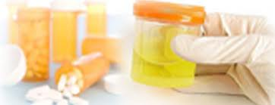
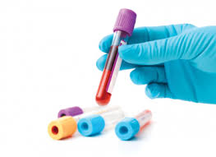
Forensic Toxicology
The branch of forensics that performs testing and analysis for drugs and chemicals that may be related to or found at a crime scene.
Common samples:
Blood
Urine
Hair
Body fluids
These may be recovered from a crime scene, be in an individual’s possession, or acquired for drug screening tests by schools, sports or employers.

Slide 4
Drug screening versus compound identification
Drug screening: the expert is looking for a particular substance
Example:
a urine drug screen may be ordered by a coach to see if an athlete is using a particular steroid.
An employer suspects that an employee is smoking marijuana at work. A drug screen sample is obtained and testing for THC.
Compound Identification: an unknown substance is identified through running multiple tests to determine if controlled or illegal substances are present.

Slide 5
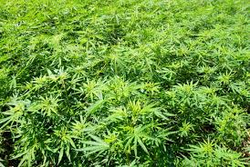
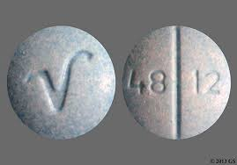
In the United States, an estimated 75% of evidence obtained by law enforcement is drug related.
Some drugs can be identified visually:
Marijuana
(www.radicalruss.com)
Intact prescription pills (have a stamp that identifies the drug)
(wwwl.cvs.com)

Slide 6
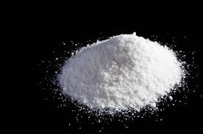
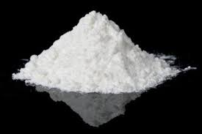
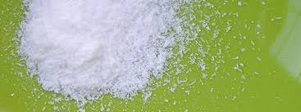
It is, however, impossible to determine the identity of a zip-lock bag of white powder by simple visual examination.
methamphetamine
cocaine
aspirin

Slide 7
State and Federal guidelines determine the level of charge brought against a person who is in possession of an illegal substance.
Knowing the exact substance and specific amount can mean the difference between a misdemeanor charge and a felony charge.
Penalties also differ from substance to substance. Each offense is taken seriously and subsequent arrests net harsher penalties including larger fines and prison time.
Qualitative tests can define what type of drug is present but cannot tell how much drug is present
Quantitative tests use a mass percentage to determine the amount of drug present in a sample
http://www.ncleg.net/EnactedLegislation/Statutes/HTML/BySection/Chapter_90/GS_90-95.html

Slide 8
Drug Testing
Commercially available screening kits allow law enforcement to conduct presumptive screening in the field.
Advantages:
Can be done at the crime scene
Gives quick initial identification of a particular substance
Assists in quick decisions in the field
Reduces the number of samples sent to the laboratory
Cost saving method; only positive tests must be sent to lab to confirm
Can rule out substances
Disadvantages:
False positive results due to interfering substances
Must know what drug you want to test for because the kits are specific for a particular drug.

Slide 9
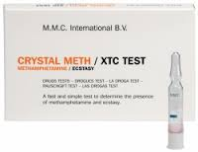
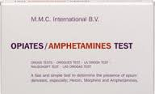
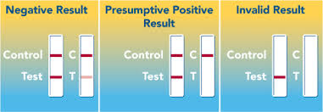
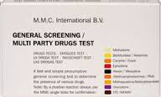
Presumptive Tests
Most rely on interpreting a color change (colorimetric)
Direct testing of the questioned substance or indirect testing of blood, urine, saliva or other body fluids.
Highly sensitive/no expensive equipment
Many use sulfuric acid which reacts with the unknown to produce the color change which is read against a reference color
Others rely on a specific odor such as the test for cocaine which produces a fishy or minty smell.

Slide 10
Presumptive Tests
T ype | Chemicals Used | Postive Color results
Marquis color | Formaldehyde, sulfuric acid | Purple: heroine, morphine, opium compounds Orange-brown: amphetamine
Cobalt Thiocyanate | Cobalt thiocyanate, distilled water, glycerin, hydrochloric acid, chloroform | Blue: cocaine
Dillie-Koppanyi | Cobalt acetate and isopropylamine | Violet-blue: barbituates
Duquenois-Levine | Vanillin, acetaldehyde, ethyl alcohol | Blue-purple: LSD
Van Urk | P-dimethylaminobenzaldelyde, hydrochloric acid, ethyl alcohol | Blue-purple: LSD

Slide 11
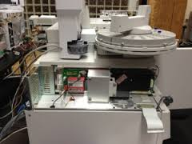
Confirmatory Tests
Used to confirm a positive result from a presumptive test and accurately identify substances so that drug evidence can be admissible in court
Advantages:
More specific
Accurate
Less risk of false positives
Disadvantages
Expensive equipment is needed
Requires a forensic drug chemist to analyze the information produced by the machine

Slide 12
Gas Chromatography-Mass Spectrometry (GC-MS)
Gas chromatograph
Reduces the structure of the chemical compound to individual molecules based on chemical properties
The molecules travel through a column and take different amounts of time to exit allowing the mass spectrometer to capture and detect each individual molecule.
The GC produces fragments and the MS classifies the chemical compounds. It creates a ratio with its mass and electrical charge called the mass-to-charge ratio.

Slide 13
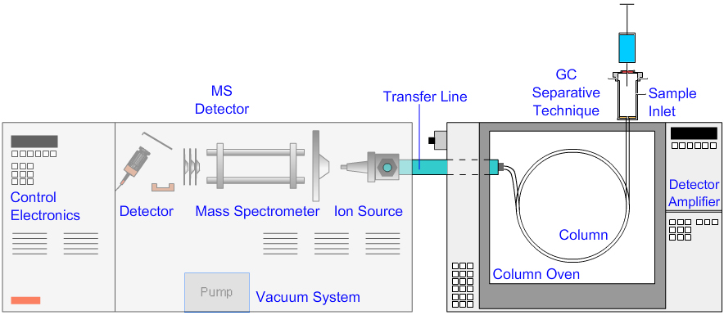
Diagram of the GC-MS
www.chromacademy.com

Slide 14
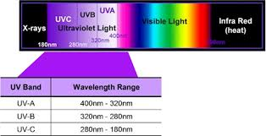
Ultraviolet Spectrophotometry
Similar to GC-MS
Unknown is identified through detection of the light being reflected by the main elements of a compound
The results are analyzed and compared to a known sample range to identify the unknown drug

Slide 15
Quality Assurance
Testing methods must be accurate and produce expected results with known control samples that are positive and negative for a given drug. These control samples ensure that the test is working properly. If control samples do not produce the expected results the test is considered “Invalid”.
Testing laboratories must follow procedures as written in the procedure manuals. Only one sample should be open and tested at a time. Chain of custody is important and must be followed at all times.

Slide 16
Common Illegal Substances
Marijuana
Most widely used hallucinogen
Tetrahydrocannabinal or THC is the active substance that ranges from 1 to 20 percent (in female marijuana flowers)
Cocaine:
stimulant made from the coca plant grown in the Amazon
To produce on pound of cocaine, 500 pounds of coca plant is needed
Most is made into a powder and snorted or crystallized and heated into fumes to be inhaled (crack)
Acts on the central nervous system to produce alertness and energy. Decreases the appetite and need for sleep

Slide 17
Methamphetamine
Highly dangerous drug abused for its feelings of euphoria
Can be injected, snorted, smoked and ingested orally
In controlled doses it is used to treat ADHA, obesity and narcolepsy
Meth addicts develop a condition called “meth mouth” because they don’t seek dental care and use money for drug habit instead. They also can develop sensations of bugs crawling under the skin which causes them to scratch the skin and develop sores.

Slide 18
Opioids
Widely used as a pain killer prescribed by physicians
Acts on the neuron receptors in the brain and spinal cord to block pain signals
Examples: vicodin, lortab, morphine, some cough medicines
Derived from harvested opium plant seeds

Slide 19
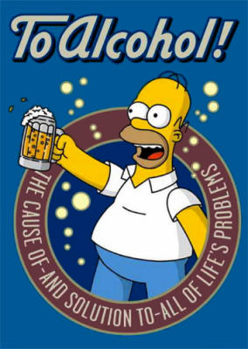
Alcohol
Over 31% of traffic fatalities in 2010 were
alcohol related.
Field sobriety tests:
Walking the line
Touching the nose with eyes closed
Reciting alphabet backwards
These types of tests do not quantify the amount of alcohol nor do they confirm that a driver is over the legal limit.
Portable breathalyzers: instrument that is able to quantify the amount of alcohol in the suspect’s blood by calculating the alcohol content of the “breath” blown into the device.
A confirmatory test (usually a blood or urine alcohol test) is done following chain of custody in order to be admitted as evidence in court.

Slide 20
Alcohol Absorption/Evaporation
Alcohol gets absorbed from the stomach and intestines into the bloodstream. Some alcohol gets broken down in the stomach due to an enzyme present in the stomach acid. Males tend to produce more of this enzyme than females. As a result, males tend to be able to consume more alcohol than females before the results are felt.
Alcohol is not chemically changed in the bloodstream.
As blood passes through the lungs, some of the ingested alcohol moves across the membranes of the lungs air sacs into the air and evaporates.
Ratio of 1:2100 (concentration in lungs/concentration in blood)

Slide 21
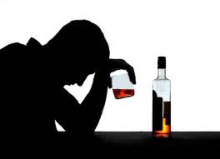
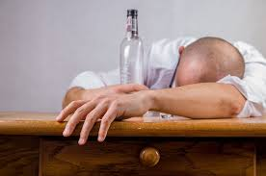
Legal Limits
American Medical Association: person can become impaired when BAC hits 0.05 which means that there is 0.05 grams of alcohol per 100ml of blood.
All 50 states have 0.08 as the legal limit with even lower limits for truck drivers and persons under 21.

Slide 22
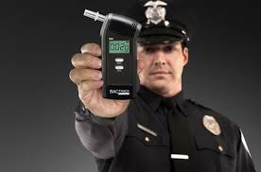
Testing Devices:
Fuel cell method:
chemical reaction generates an electrical signal in response to the breakdown of alcohol in the fuel cell
Fuel cell converts alcohol and water to acetic acid, H+ and electrons at the anode
At the cathode, H+ and electrons combine with oxygen to regenerate water. This produces a flow of electrons from anode to cathode. This flow is measured and signal is displayed.
Higher alcohol level = more electrons produced
https://youtu.be/rvVzlg26bCM
Infrared Spectroscopy:
based on the premise that all compounds absorb some infrared radiation at particular wavelengths because of the their chemical bond arrangement
The infrared spectrum of an unknown is compared to the spectra results of known compounds to identify the unknown.

Slide 23
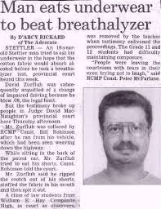
Factors that affect alcohol tests
Drinking on an empty stomach (faster metabolism)
Drinking with a fever (false positive)
Using mouthwash or breath spray (false positive)
Nyquil
No good way to spoof the systems.
https://youtu.be/D7gb8v9R3m8

