Slide 1
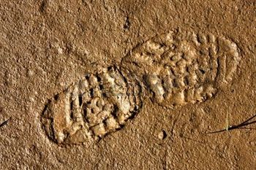
Forensic Impression Evidence
Shoeprint Analysis
Dental Impression Analysis
Toolmark analysis

Slide 2
Footprint Evidence
Found at approximately 40% of crime scenes
Second to DNA as most common evidence found
Useful in proof of presence at a crime scene
Also known as (a.k.a.) shoe prints, foot prints, footwear marks (interchangeable terms)
World’s oldest footprint estimated to be over 3 million years old was discovered in 2007 at Siwa Oasis in Egypt.
First recorded use of footprints in forensic investigation: early 1800’s in Warwick, England

Slide 3
Two types of impressions
Positive
Two dimensional
Created by a person transferring matter such as dust or blood from the shoe to a surface walked upon
Negative
Three dimensional
Impression created when shoe removes residue from the surface walked upon
Example: walking through mud or cement

Slide 4
O.J. Simpson’s Bruno Mali Shoes
Inculpatory or incriminating evidence: bloody footprint found at the crime scene
William Bodziak, FBI footprint analyst confirmed prints were from a size 12 Bruno Mali shoe
Shoes were rare in U.S. (only 299 pairs sold here).
At the time of presentation, prosecution had no proof that Simpson had purchased shoes.
Later, a tabloid photo surfaced showing Simpson wearing the shoes in question.

Slide 5
The Unabomber Case
Theodore Kaczynski (a.k.a. unabomber)
Life sentence without parole
Bombing spree that lasted from 1978 to 1995
Evidence from his Montana cabin included shoes with fake soles
He attached soles from smaller sized shoe to his own shoe to mislead investigators
Plead guilty to crimes

Slide 6
Class characteristics of Shoe Prints
Unique to all shoes of a particular brand and style
Outsole pattern
Symbols
Design features
Helps investigators to determine the manufacturer of the shoe
Type and brand is determined so that the exact size of shoe can be determined.
In some cases, a specific brand and style of shoe used by the criminal can lead to exclusion of other brands and sizes.

Slide 7
Individual characteristics of Shoes
Unique to the shoe
Manufacturing irregularities
Chips or holes in the tread
Substances added to or removed from the shoe during wear: rocks, gum, tar, tacks, nails
Cracks or warping due to wear
Missing pieces of rubber
Indentations created by objects that come in contact with the rubber.
Help narrow down the search for a specific shoe.

Slide 8
Wear Pattern
Formed by the gradual wearing away of rubber due to friction between the walking surface and the sole.
Longer the shoe is worn = more pronounced the wear pattern
Wear more pronounced where the foot first makes contact with the ground.
Can be used to assess the walking pattern of the person
Wear pattern on outside rear near heel indicates the walker pronates or walks with supination (ankle turned out, away from the other foot)
Wear pattern on inside of the shoe towards toe indicates overpronation (walks with ankle turned in towards other foot)
Print that is uniform across the forefront indicates the wearer walks with neutral or normal pronation (foot contacts ground evenly).

Slide 9
Analysis
No minimum number of class or individual characteristics to establish identification
One characteristic alone can be used to identify a shoe
Must be clear, detailed, defined, and contain significant features in common with the impression
If similar characteristic were a simple hole or pinprick that could be easily found on multiple shoes then more identifying characteristics would be needed

Slide 10
Other Information Obtained from Shoeprints
Direction and rate of movement
Faster rate: deep prints with front of foot pressed deeper into ground than rest of print and long stride
Sex
Women: smaller prints that might be slightly pigeon-toed with a small stride
Men: tend to walk with toes pointed straight forward or tilted slightly outward
Whether the individual is aware that they are being tracked
Carrying something: print will appear consistently deeper on one foot

Slide 11
Gait: stride length and width or distance between two heel prints of the same foot
Stride length used in correlation with shoe size can help estimate height.
Foot length is approximately 15% of the person’s height.
This ratio does not apply to 10-20% of the population but can be used to narrow the field of suspects and give an idea of the individual being sought.

Slide 12
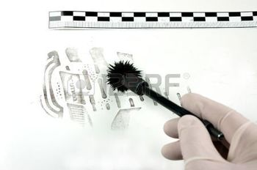
“What is not looked for will not be found.” W. Bodziak
Recovering footprints is tedious.
All surfaces should be considered sources of prints.
Footprints are sometimes neglected at the crime scene. Emphasis is often on finding fingerprints
Every step taken by a person will leave a mark or impression of some type.

Slide 13
Processing the Scene
Are footprints relevant to what happened?
Where can footprints be found?
Floors
Paper
Glass
Cardboard
Use oblique light to help visualize prints
Use care not to disturb evidence.
What methods must be used? Often multiple techniques are required to lift the prints with least amount of distortion.
Photograph! Photograph! Visual evidence of the original footprint before lifting showing relationship to the crime scene

Slide 14
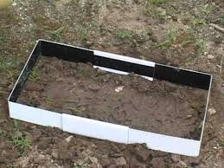
Casting
Use for 3-dimensional footwear impressions
“taking a mold”
Provides true-to-size physical model
If print is in sand or there is concern that print might be disturbed by casting, the print is sprayed with aerosol glue or hairspray to prep it.
Muddy prints: draw moisture away using pipette or a hair dryer.
https://youtu.be/mquyNZaNbPo
https://youtu.be/iCuM4WjJbhI

Slide 15
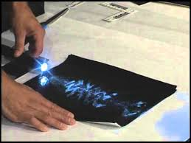
Two-dimensional prints may be found on
Glass, wood flooring , cardboard, fabric
Lift using a hydraulic press and gelatin lifters or electrostatic devices
Gelatin lifter: sheet of paper with a strong adhesive on one side used to lift print from most surfaces
Porous surfaces such as cardboard or fabric: hydraulic press is used to push down on the gelatin
Electrostatic devices: good for hard to access areas, carpeting, wood, fabric
Uses high voltage power unit to charge metallic film; matter forming the print clings to the film. Can be used on the human body.

Slide 16
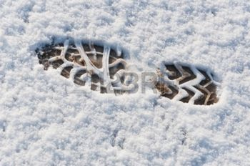
Surface and location of print may limit the amount of time in which the print can be lifted.
Prints in blood may last years.
Prints in water may evaporate.
Prints in sand can be brushed away.
Sometimes this results in a hurried processing and lifting of prints.

Slide 17
Tire Treads and Impressions
To collect and preserve tire tread impressions, the same procedures as shoe prints should be done.
Photograph the original tire print before processing
Place casting dam around the imprint
Mix the casting material according to instructions
Pour casting material into impression along the sides and allow it to flow into the impression
Allow the casting to set for at least 60 minutes before attempting to remove. Package in cardboard box with appropriate labels/information. Send to lab.

Slide 18
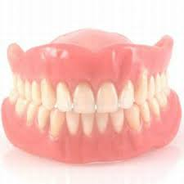
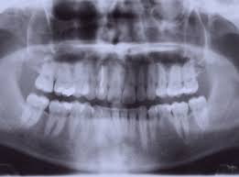
Dental Impressions and Bite marks
Forensic odontology (forensic dentistry): combines dentistry with law enforcement
Primary duty is human identification
Examine evidence from cases involving violent crime, child abuse, elder abuse, missing persons, and mass disasters
Helps identify victims, suspects, and establish leads in an investigation

Slide 19
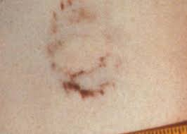
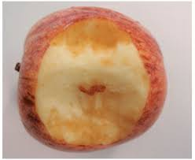
Perpetrators often leave behind evidence:
Bitten food
Chewed objects
Bite marks on the skin of a victim

Slide 20
Majority of a forensic dentists work falls into two areas or types of cases:
Missing and unidentified persons
Recognition, documentation and preservation of bite mark evidence
Important when fingerprints cannot be obtained from skeletonized remains
Help to place a suspect at a scene or identify the perpetrator of a violent crime

Slide 21
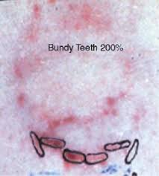
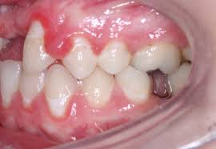
Dental Evidence
Anything that relates to human dental anatomy or coming from the oral cavity
Tooth shape
Metal restorations such as crowns and fillings
Skull and jawbone irregularities
Skull fragments
Teeth marks in the skin, soft objects such as gum, food
Most famous bite mark of the 20th century was the one of Ted Bundy.

Slide 22
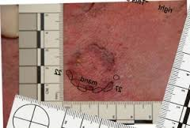
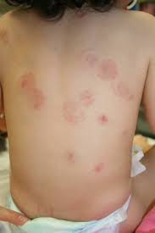
During a violent crime, both the victim and perpetrator may bite during the assault.
Photograph
Impressions taken to get a 3-D model
Analyze bite pattern
Immediately document as soon as marks are noticed because if the victim is alive, natural healing will cause the bruises and cuts from the bite to disappear.

Slide 23
Bite Mark Analysis
Attempt to connect biter to the pattern left behind on a person or object which is linked to a crime
Two assumptions:
Characteristics of the teeth involved in the biting are unique in all individuals
Uniqueness is transferred and recorded in the injury
Note: ability of skin to register sufficient detail varies; bite marks may be distorted or not well defined
May be used in inclusion or exclusion of suspects
Difficult to identify a single individual as the biter

Slide 24
The CSI or medical examiner must recognize that the wound on a victim is a bite mark.
Typical bite mark is somewhat circular or oval.
Two opposing, symmetrical U-shaped arches
Along the margin of the arches are round or almost circular bruises
Used to identify size, shape, arrangement and distribution of the surfaces of the teeth in contact with skin
May not always have a complete set of marks if the bite was obstructed by an object such as a sleeve.

Slide 25
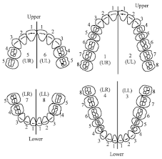
Human teeth are arranged in a predictable pattern.
Variations in size, shape, position as well as wear from chewing, dental health and treatment give each person a “unique” dental profile.
Teeth change during a person’s lifetime. (braces, extraction, decay/fillings, crowns)

Slide 26
Evaluating the Bite Mark
Criteria:
Front teeth are the primary biting teeth in bite marks
Six upper and six lower front teeth (central and lateral incisors and the cuspids)
The upper jaw (maxilla) is wider than the lower jaw (mandible).
A bite mark showing upper and lower front teeth will show a total of 12 teeth marking the skin.

Slide 27
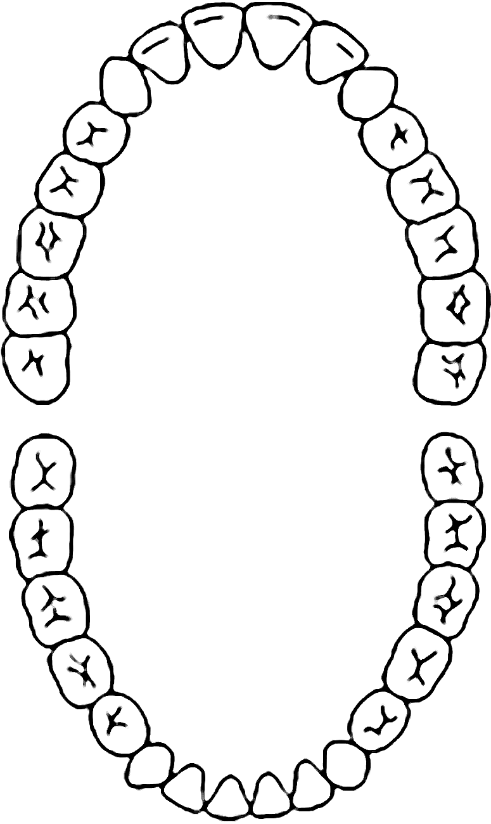
Central incisors
Upper jaw (maxilla)
Lateral incisors
Cuspids
(canine)
First premolar
2nd premolar
1st molar
Lower Jaw (mandible)
2nd molar
3rd molar
(wisdom)

Slide 28
Steps in Evaluating Marks
Determine which marks were made from upper and lower teeth
Upper front 4 teeth make rectangular marks.
Central incisors are wider than lateral incisors
Upper and lower cuspids leave round or oval shaped marks
Lower front 4 teeth make rectangular marks
Spaces or gaps may indicate a missing tooth.
Fainter bruising in bite mark: less pressure from the teeth possible due to some feature on the tooth such as chipping or tooth that is shorter than neighboring teeth or an object such as clothing that interfered.
Skin may be torn or moved during biting.

Slide 29
Measure distances between teeth marks. Do this for teeth that are adjacent to each other as well as opposite each other.
Exemplars from suspect are compared to victim’s bite marks. Exemplars may be taken from the suspect using dental casting to make a mold of the teeth.
Photograph the suspects teeth too.

