Slide 1
FORCES AND MOTION BALANCED FORCES? UNBALANCED FORCES? FRICTION?

Slide 2
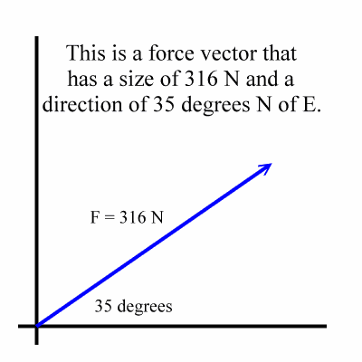
A. FORCE - ANY ACTION THAT CHANGES THE STATE OF REST OR MOTION OF AN OBJECT
A PUSH OR A PULL
INCLUDES MAGNITUDE AND DIRECTION

Slide 3
B. BALANCED FORCES – WHEN THE TOTAL FORCES ACTING ON AN OBJECT ADD UP TO ZERO
NET FORCE IS ZERO
THESE OBJECTS STAND STILL OR MOVE AT CONSTANT SPEED
EX) A HANGING LAMP - CHAIN BALANCES GRAVITY
EX) CAR AT CONSTANT SPEED – FORCE OF ENGINE IS BALANCED AGAINST FRICTION WITH ROAD AND AIR

Slide 4
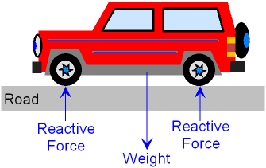
EX) BALANCED FORCES
PLANE AT CONSTANT SPEED PARKED CAR

Slide 5
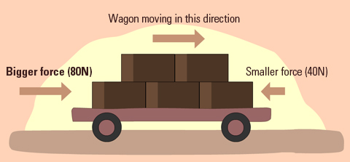
C. UNBALANCED FORCES – MAKE AN OBJECT ACCELERATE IN THE DIRECTION OF THE GREATER FORCE
ILLUSTRATE : NET FORCE OF 40 EAST

Slide 6
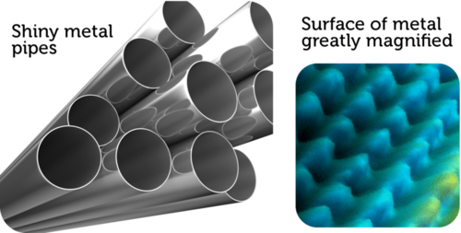
D. FRICTION – A FORCE THAT OPPOSES MOTION BETWEEN TWO SURFACES IN CONTACT
SURFACES HAVE MICROSCOPIC HILLS AND VALLEYS THAT “GRAB” EACH OTHER

Slide 7
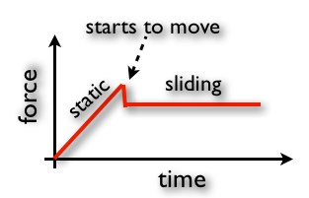
E. TYPES OF FRICTION
1. STATIC FRICTION – THE FRICTION BETWEEN TWO SURFACES AT REST (STRONG TO OVERCOME)
2. KINETIC FRICTION – THE FRICTION BETWEEN TWO SURFACES THAT ARE ALREADY SLIDING ACROSS EACH OTHER (NOT AS STRONG)

Slide 8
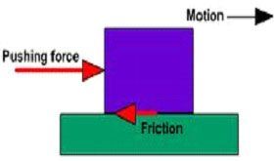
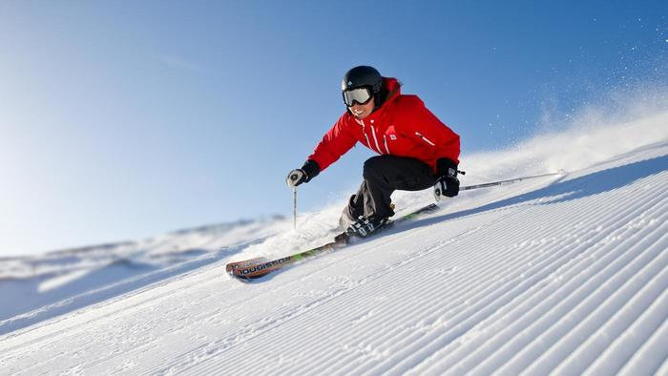
3. SLIDING FRICTION – TWO OBJECTS SLIDE OVER EACH OTHER

Slide 9
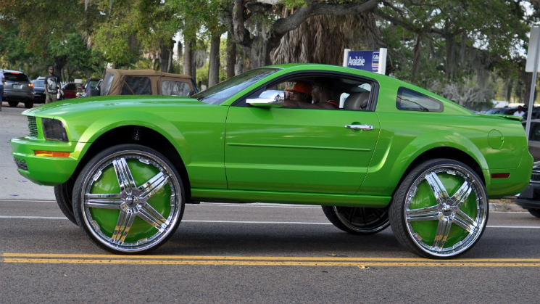
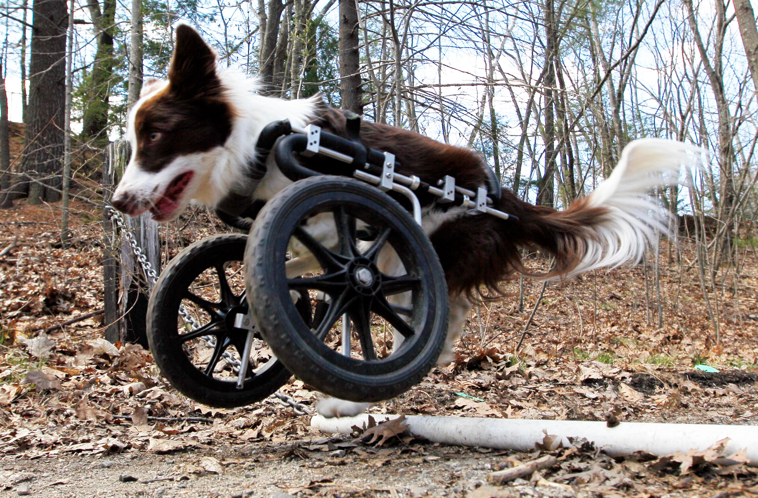
4. ROLLING FRICTION – A ROUND OBJECT ROLLS OVER A FLAT ONE

Slide 10
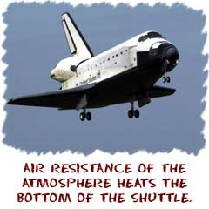
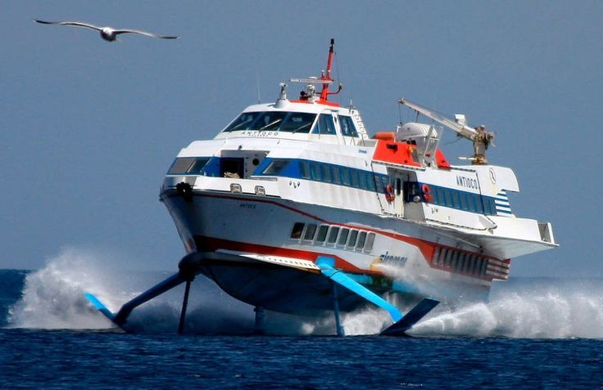
5. FLUID FRICTION – WHEN AN OBJECT MOVES THROUGH THE AIR (AIR RESISTANCE) OR A LIQUID SUCH AS WATER

Slide 11
F. WAYS TO REDUCE UNWANTED FRICTION
STREAMLINING VEHICLES
LUBRICANTS SUCH AS OIL, GREASE AND WAX
SANDING SURFACES SMOOTH
BALL BEARINGS
FUNNY LOOKING SWIM HATS

Slide 12
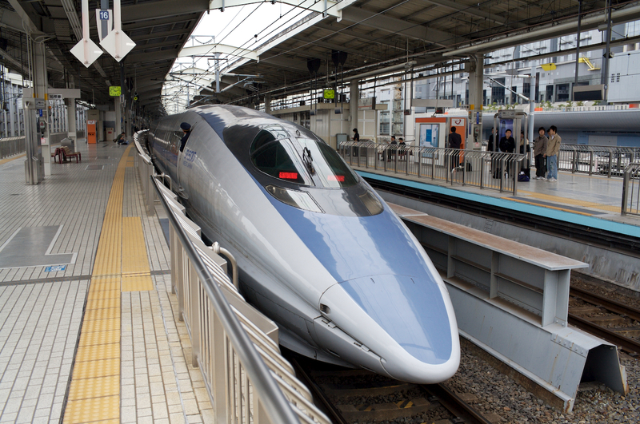
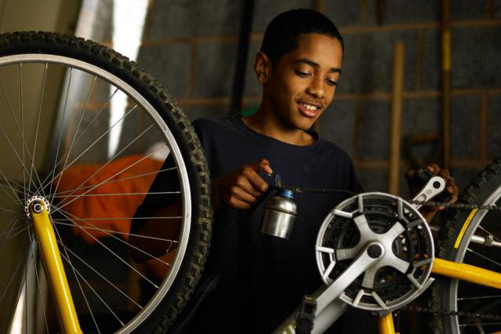
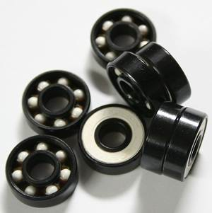
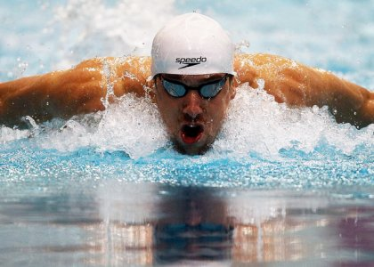

Slide 13
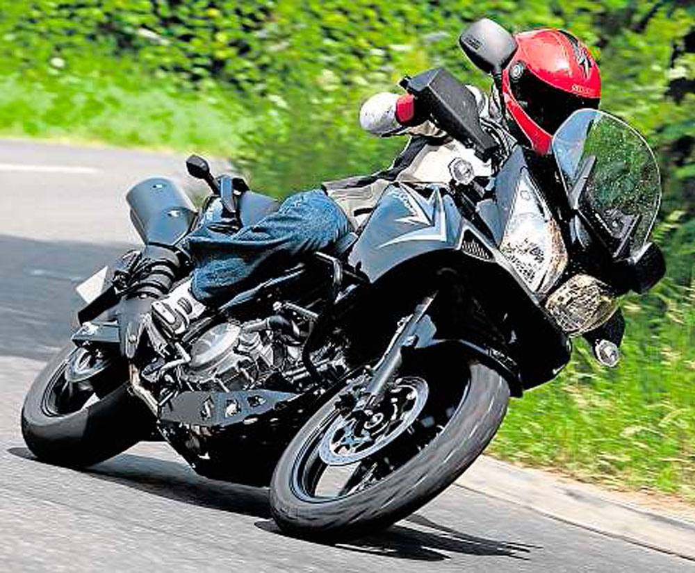
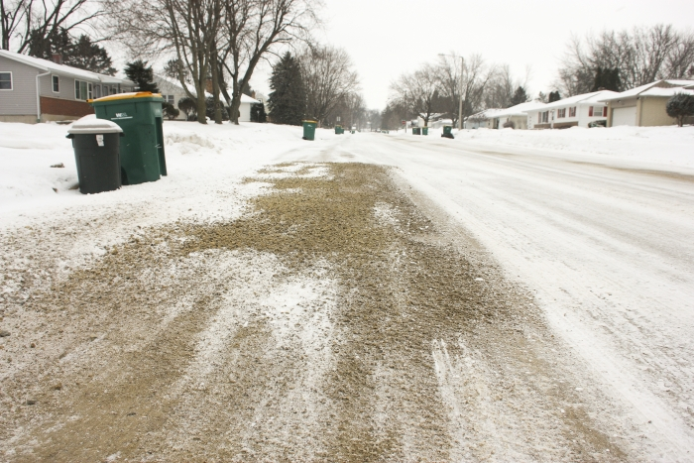
G. GOOD FRICTION – TIRE TREADS ALLOW CARS TO MOVE, BASEBALL GLOVES, SAND ON ICY SIDEWALK

Slide 14
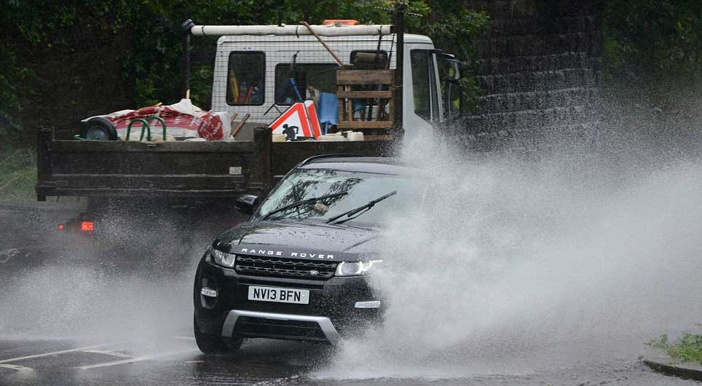
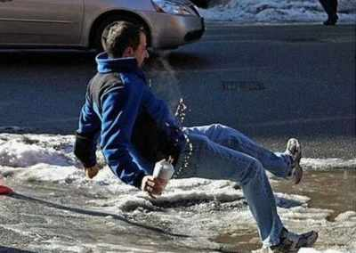
H. BAD FRICTION – HYDROPLANING ON WET ROADS, SLIPPING ON ICE, SPACE SHUTTLE DISASTER UPON REENTRY TO ATMOSPHERE

Slide 15
