Slide 1
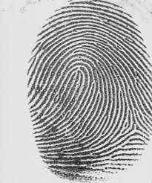
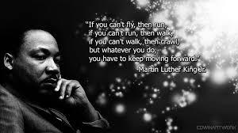
Fingerprint Analysis

Slide 2
Did James Earl Ray Act Alone???
James Earl Ray…..
career criminal serving time for armed robbery
Escaped Missouri State Prison almost one year before King’s assassination
April 3, 1968: arrived in Memphis; rented a room the next day across the street from Dr.King’s motel

Slide 3
At 6:00pm on April 4, 1968, Dr. King stepped out on the balcony of his motel. A shot rang out. He was pronounced dead at 7:05pm.
Assailant ran on foot; left a blanket-covered package near a building; fled in a white Mustang
The package: high powered rifle with a scope, a radio, clothes, binoculars, beer cans, receipt for binoculars

Slide 4
The power of a print
One week later: Mustang found;
Fingerprints in Mustang, on the rifle, on the binoculars, and on a beer can----linked to James Earl Ray

Slide 5
History of Fingerprinting
*Chinese used prints as legal signatures
*William Herschel: used palm prints as signatures
*Henry Fauld: published papers suggesting the use of fingerprints as personal identification; ideas were rejected at first

Slide 6
Early Classification
* Francis Galton (1892): published textbook called Fingerprints
*outlined the anatomy of fingerprints
*suggested methods of recording prints
*proposed 3 pattern types: loops, arches, whorls

Slide 7
*Sir Edward Richard Henry: classification system used by most English speaking countries
Dr. Juan Vucetich: his system is used mainly in Spanish speaking countries

Slide 8
Admissible in court??
1999: United States v. Byron Mitchell
Attorneys for defendant argued that fingerprints could not be proven unique under the guidelines cited in Daubert (admissibility case).
Judge upheld admissibility of fingerprints as scientific evidence and ruled that human friction ridges are unique and permanent and that friction ridge skin patterns are also unique/permanent

Slide 9
First Principle of Fingerprints
Fingerprints are an individual characteristic; no two fingers have yet been found to possess identical ridge characteristics
Galton’s calculation: possible existence of 64 billion different fingerprints
Probability of having the same print as another person: 1 in 64 billion

Slide 10
Ridge characteristics or minutae
in addition to general shape and pattern, ridge patterns give additional individuality to fingerprints.
In order for prints to match, characteristics must reveal characteristics that are identical with the same relative location as determined by an expert

Slide 11
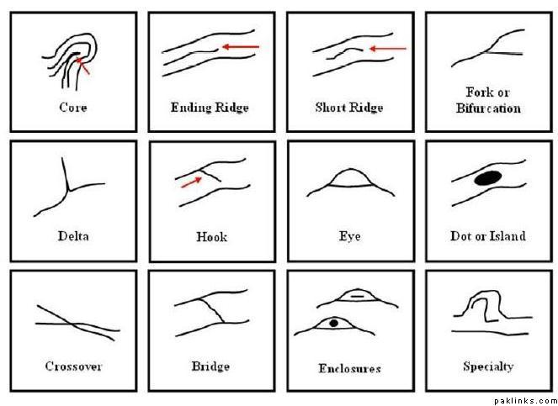
Ridge
Patterns
8-16 ridge
patterns that
match is the
range that
is sufficient
to meet
criteria of
individuality

Slide 12
2nd Principle of Fingerprints
A fingerprint remains unchanged during an individual’s lifetime.
Fingerprints are reproductions of the friction skin ridges on the palm side of the fingers and thumbs.
Formed before birth (at about 14-16 weeks gestation)

Slide 13
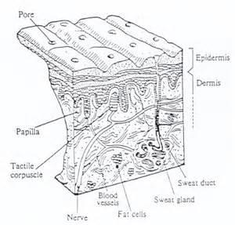
Friction ridges provide grip to reduce slippage.
The dermal papillae forms a boundary
of cells that determine the form
and pattern of the ridges.
Each ridge has a single row of
pores that serve as openings for
the sweat glands.

Slide 14
Can fingerprints be
changed?
Many criminals have tried to remove their prints by burning them, cutting them or using acid to remove them. (Famous Gangster John Dillinger used acid)
To remove prints, one would have to cut 1-2 millimeters beneath the skin’s surface and damage the dermal papillae.
*trying to remove them usually results in adding more unique characteristics such as scars, etc.

Slide 15
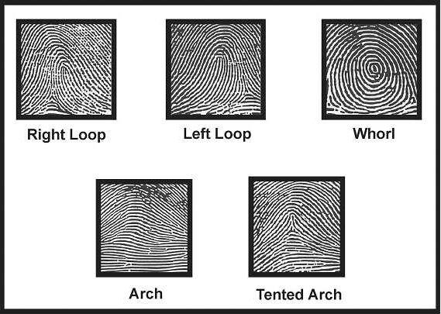
3rd principle of Fingerprints
Fingerprints have ridge patterns that permit them to be systematically classified.

Slide 16
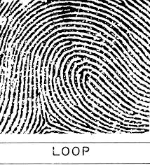
Loops (60-65 percent)
*must have one or more ridges
entering from one side of the print,
recurving, and exiting from the same side of entry
*ulnar loop: loop opens toward the little finger
*radial loop: loop opens toward the thumb
*delta: ridge point at or nearest the type line divergence

Slide 17
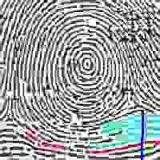
Whorls(30-35 percent)
*spiral appearance
*must have at least two deltas and type lines
*a plain whorl and a central pocket loop have at least one ridge that makes a complete circuit
*very common pattern especially on the thumb

Slide 18
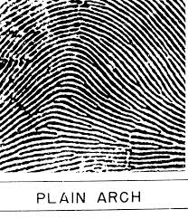
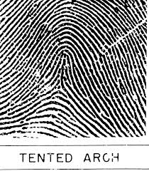
Arches(5 percent)
ridge lines enter from one side and
flow out the other side.
wavelike pattern
no core
no delta
very simple fingerprint
uncommon

Slide 19
Classification of Fingerprints (Henry)
uses loops, whorls and arches and categorizes print patterns into one of these categories.
Assigns a number value to each finger based on the presence of a whorl pattern
results represent a ration of odd/even finger value

Slide 20
 | thumb | index | middle | ring | pinky | thumb | index | middle | ring | pinky
no. (#) | 1 | 2 | 3 | 4 | 5 | 6 | 7 | 8 | 9 | 10
whorl present | 16 | 16 | 8 | 8 | 4 | 4 | 2 | 2 | 1 | 1
ex. | 0 | 16 | 0 | 8 | 0 | 0 | 2 | 0
Sum of odd finger values _______ + 1 = ______
Sum of even finger values_____+1 = _______
Grouping ratio: odd/even = ________

Slide 21
Crime Scene Prints
Known prints: deliberately collected from the subject using ink impression
Patent prints: visible prints made by fingers coated with a substance such as dirt, blood, ink

Slide 22
Plastic prints: 3-dimensional print made in a pliable surface such as wet paint, wax, soap
Latent prints: invisible to the naked eye; require some enhancement technique or development method; prints are impressions made by the transfer of oils, perspiration on the skin

Slide 23
Enhancement and Development
Non-porous (non-absorbent) and porous (absorbent) surfaces require different techniques.
Non-porous: powders or super glue fuming
Porous: iodine fuming, ninhydrin, physical developer, laser, or fluorescence

Slide 24
Non-porous surfaces…..
Powders Powder: http://www.youtube.com/watch?v=BZNXFbG-ux4
* fluorescent: glows under a black light
*aluminum powder: light colored for use on dark surfaces
*carbon powder: dark powder for use on light surfaces
Magnetic powder
All powders adere to the oils in the fingerprint.

Slide 25
super glue fuming: super glue is heated and the cyanoacrylate ester reacts with the oils and proteins in the fingerprint. A white product of the reaction coats the ridges of the print revealing the details.
Cyanoacrylate: http://www.youtube.com/watch?v=XgqwMeWlzgI

Slide 26
Porous surfaces….
*Iodine fuming: the oldest method; iodine crystals are heated and the resulting gaseous iodine reacts with the salts in the perspiration.
Results in a brownish colored print.
Prints are not permanent and will fade. Must be photographed immediately.
Iodine: http://www.youtube.com/watch?v=XLvZkx7HEEA

Slide 27
*Physical developer: a silver nitrate based chemical.
silver nitrate reacts with the salt in perspiration to produce silver chloride which is insoluble and will adhere to the print as a white coating.
http://www.youtube.com/watch?v=EZ4dIvspLqw

Slide 28
Other Methods:
*Ninhydrin: http://www.youtube.com/watch?v=fF_v-MymoOk
*Gentian violet: : http://www.youtube.com/watch?v=vBYYrwo8I6s
*Acidified Hydrogen Peroxide: http://www.youtube.com/watch?v=6rvyetrDjJc

Slide 29
*Fluorescent techniques and alternate light sources
uses high intensity light (not laser) that filters the origin light and induces luminescence at the wavelength to excite the electrons in the latent print.

Slide 30
*argon ion laser: natural fluorescence by components in perspiration and blood

Slide 31
Preservation of Prints
* must photograph before preservation
*if object is too large to take, prints may be lifted after a powder is applied
* wide scotch tape is used to lift
*transfer tape to a card for better examination

Slide 32
Prints and the Crime Scene
*prints at the crime scene are not going to be perfect.
*often are only partial prints or may be smudged
*photographs or scanned images can be done to help with examining the details

Slide 33
AFIS
Automated Fingerprint Identification System
*database of store prints
*used to classify prints
*can generate a “hit” list within hours rather than the tedious “days” it takes to examine by hand
*experienced technician must verify match

Slide 34
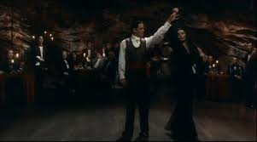
The Halloween Party Burglary
Last evening Mrs. Adams annual Halloween bash was crashed by a masked perpetrator calling himself duct tape man. He made all the guests at the party empty their pockets and purses.

Slide 35
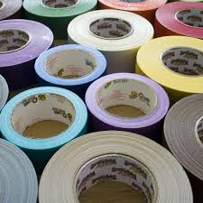
He stripped them of money and jewels and duct taped them to their chairs, walls, or wherever he could put them.

Slide 36
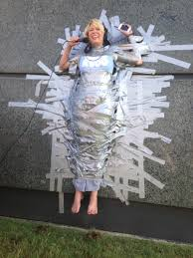
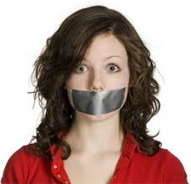
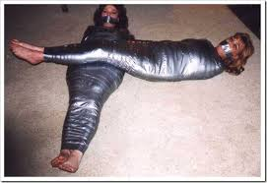
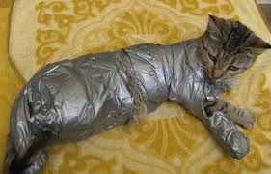
At midnight, wednesday and pugsley came home from the
haunted woods and discovered
their parents and party guests bound and tied. Even the cat couldn’t
escape.

Slide 37
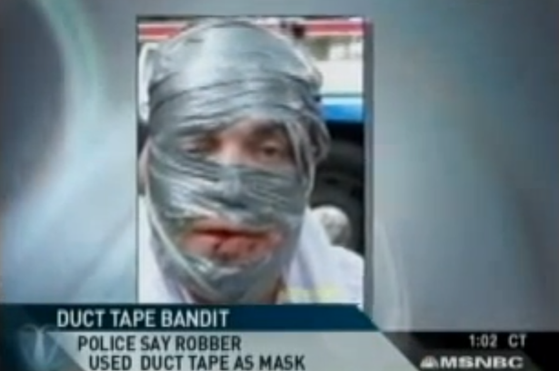
Pugsley Called the Police.
Gomez and
Morticia
gave
complete
descriptions
to the police
who alerted the media.

Slide 38
Evidence was collected.
TYour bag contains evidence collected at the scene of the party. Your group’s task is to process the evidence for fingerprints and provide a report to the Chief investigator.

Slide 39
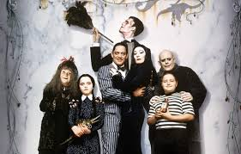
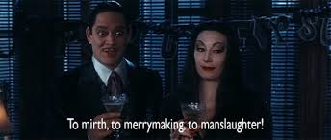
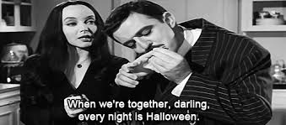
The Adams family is
counting on you!

