Slide 1
Chemistry Exam Review
by unit

Slide 2
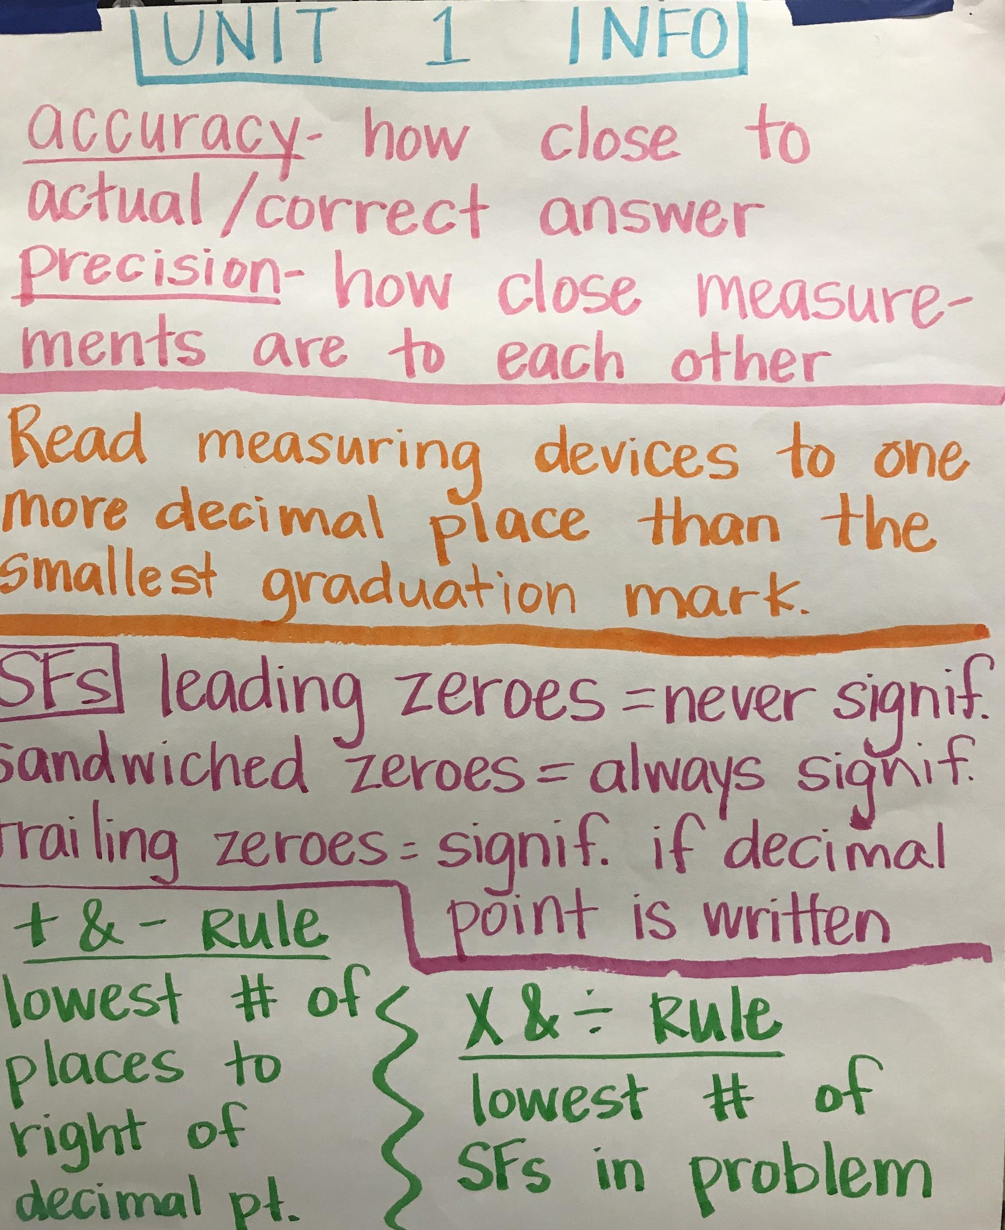
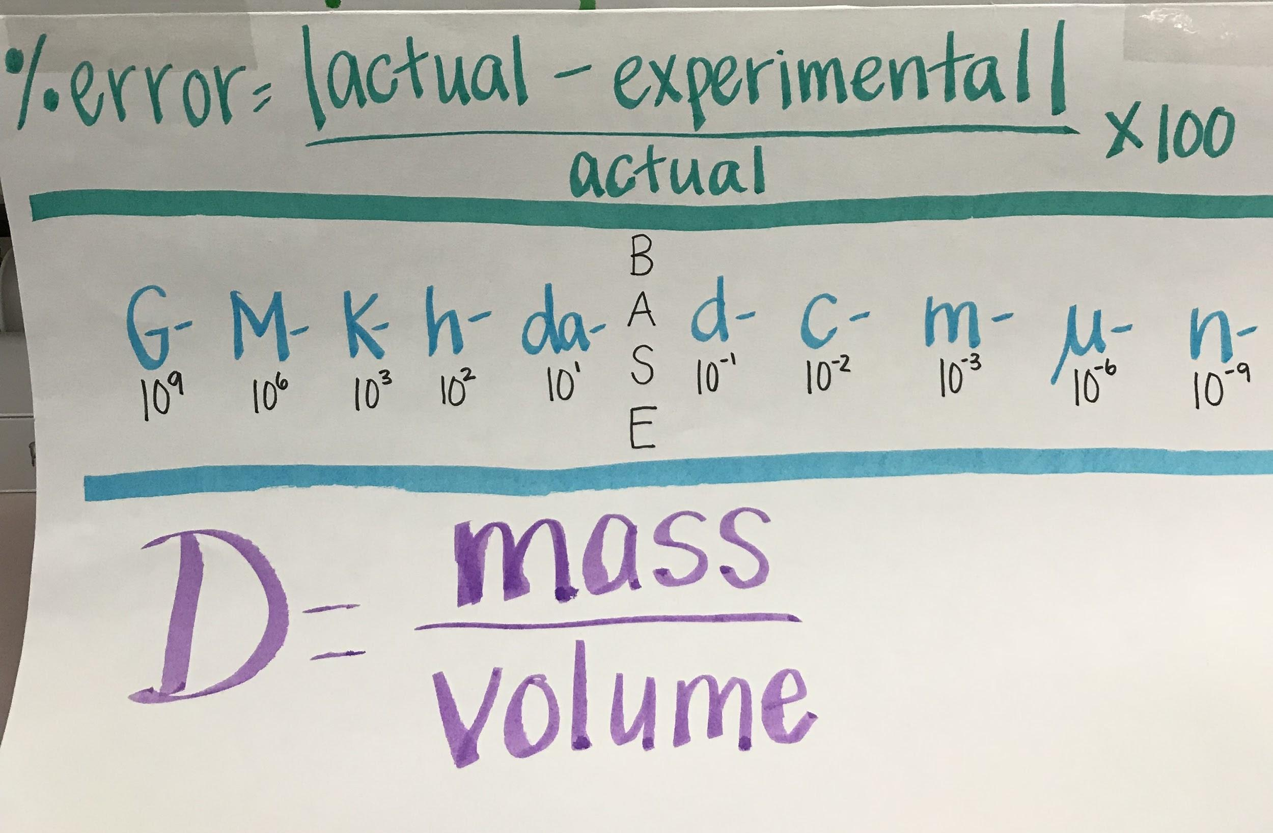

Slide 3
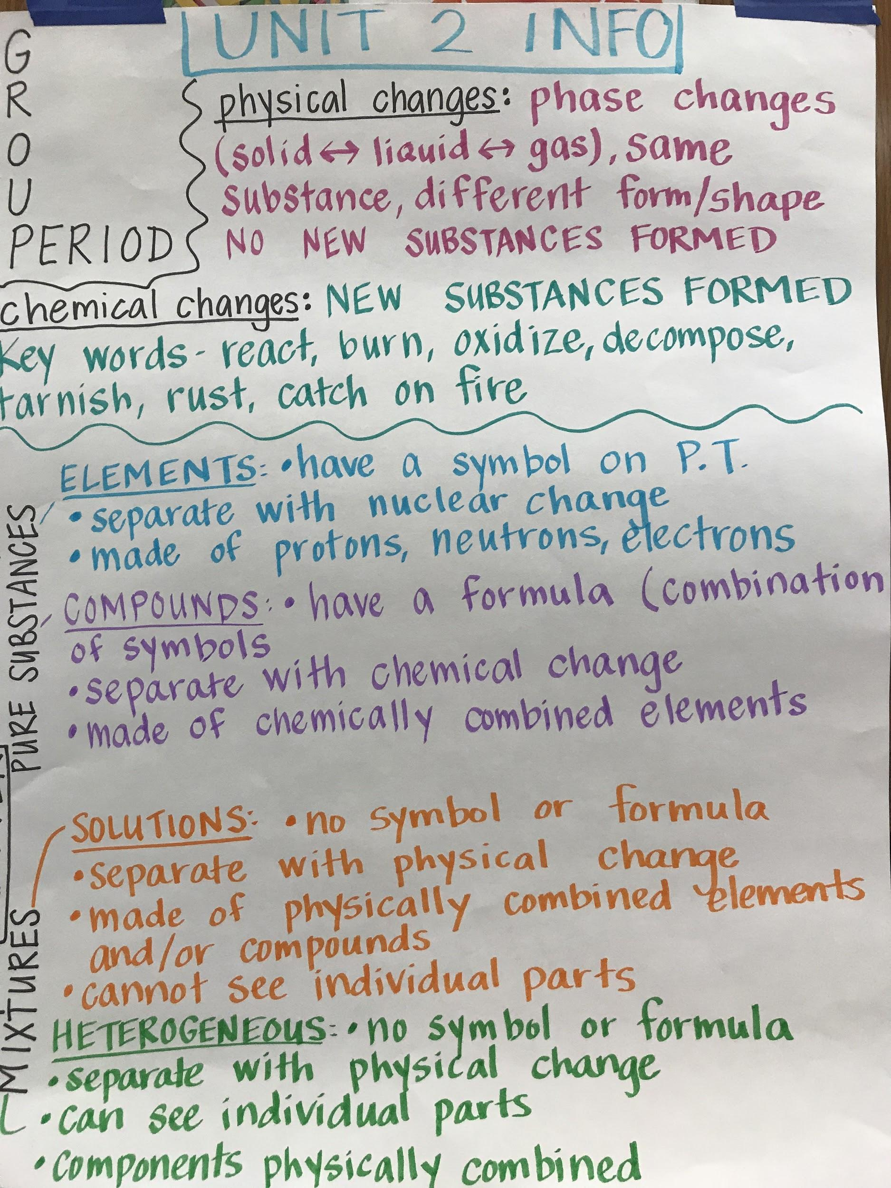

Slide 5
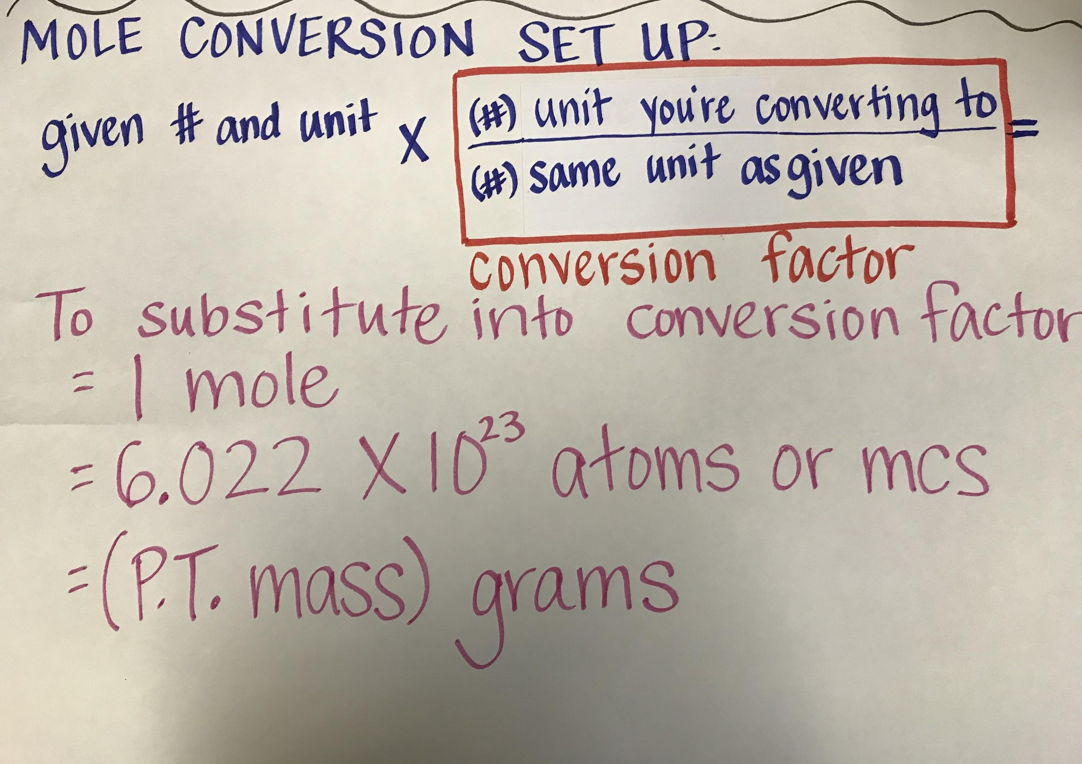

Slide 6
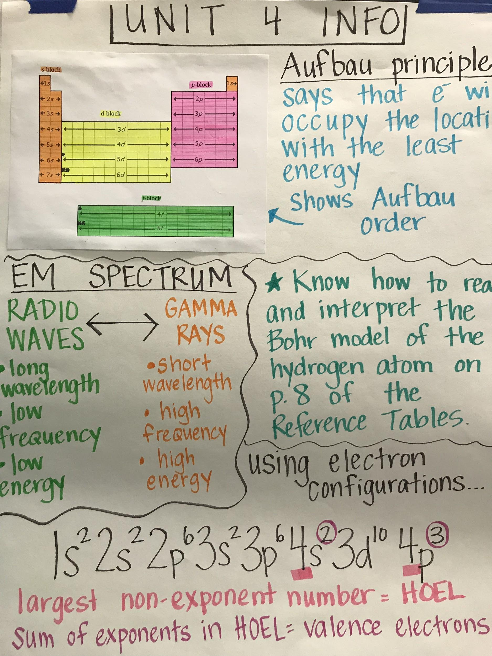

Slide 7
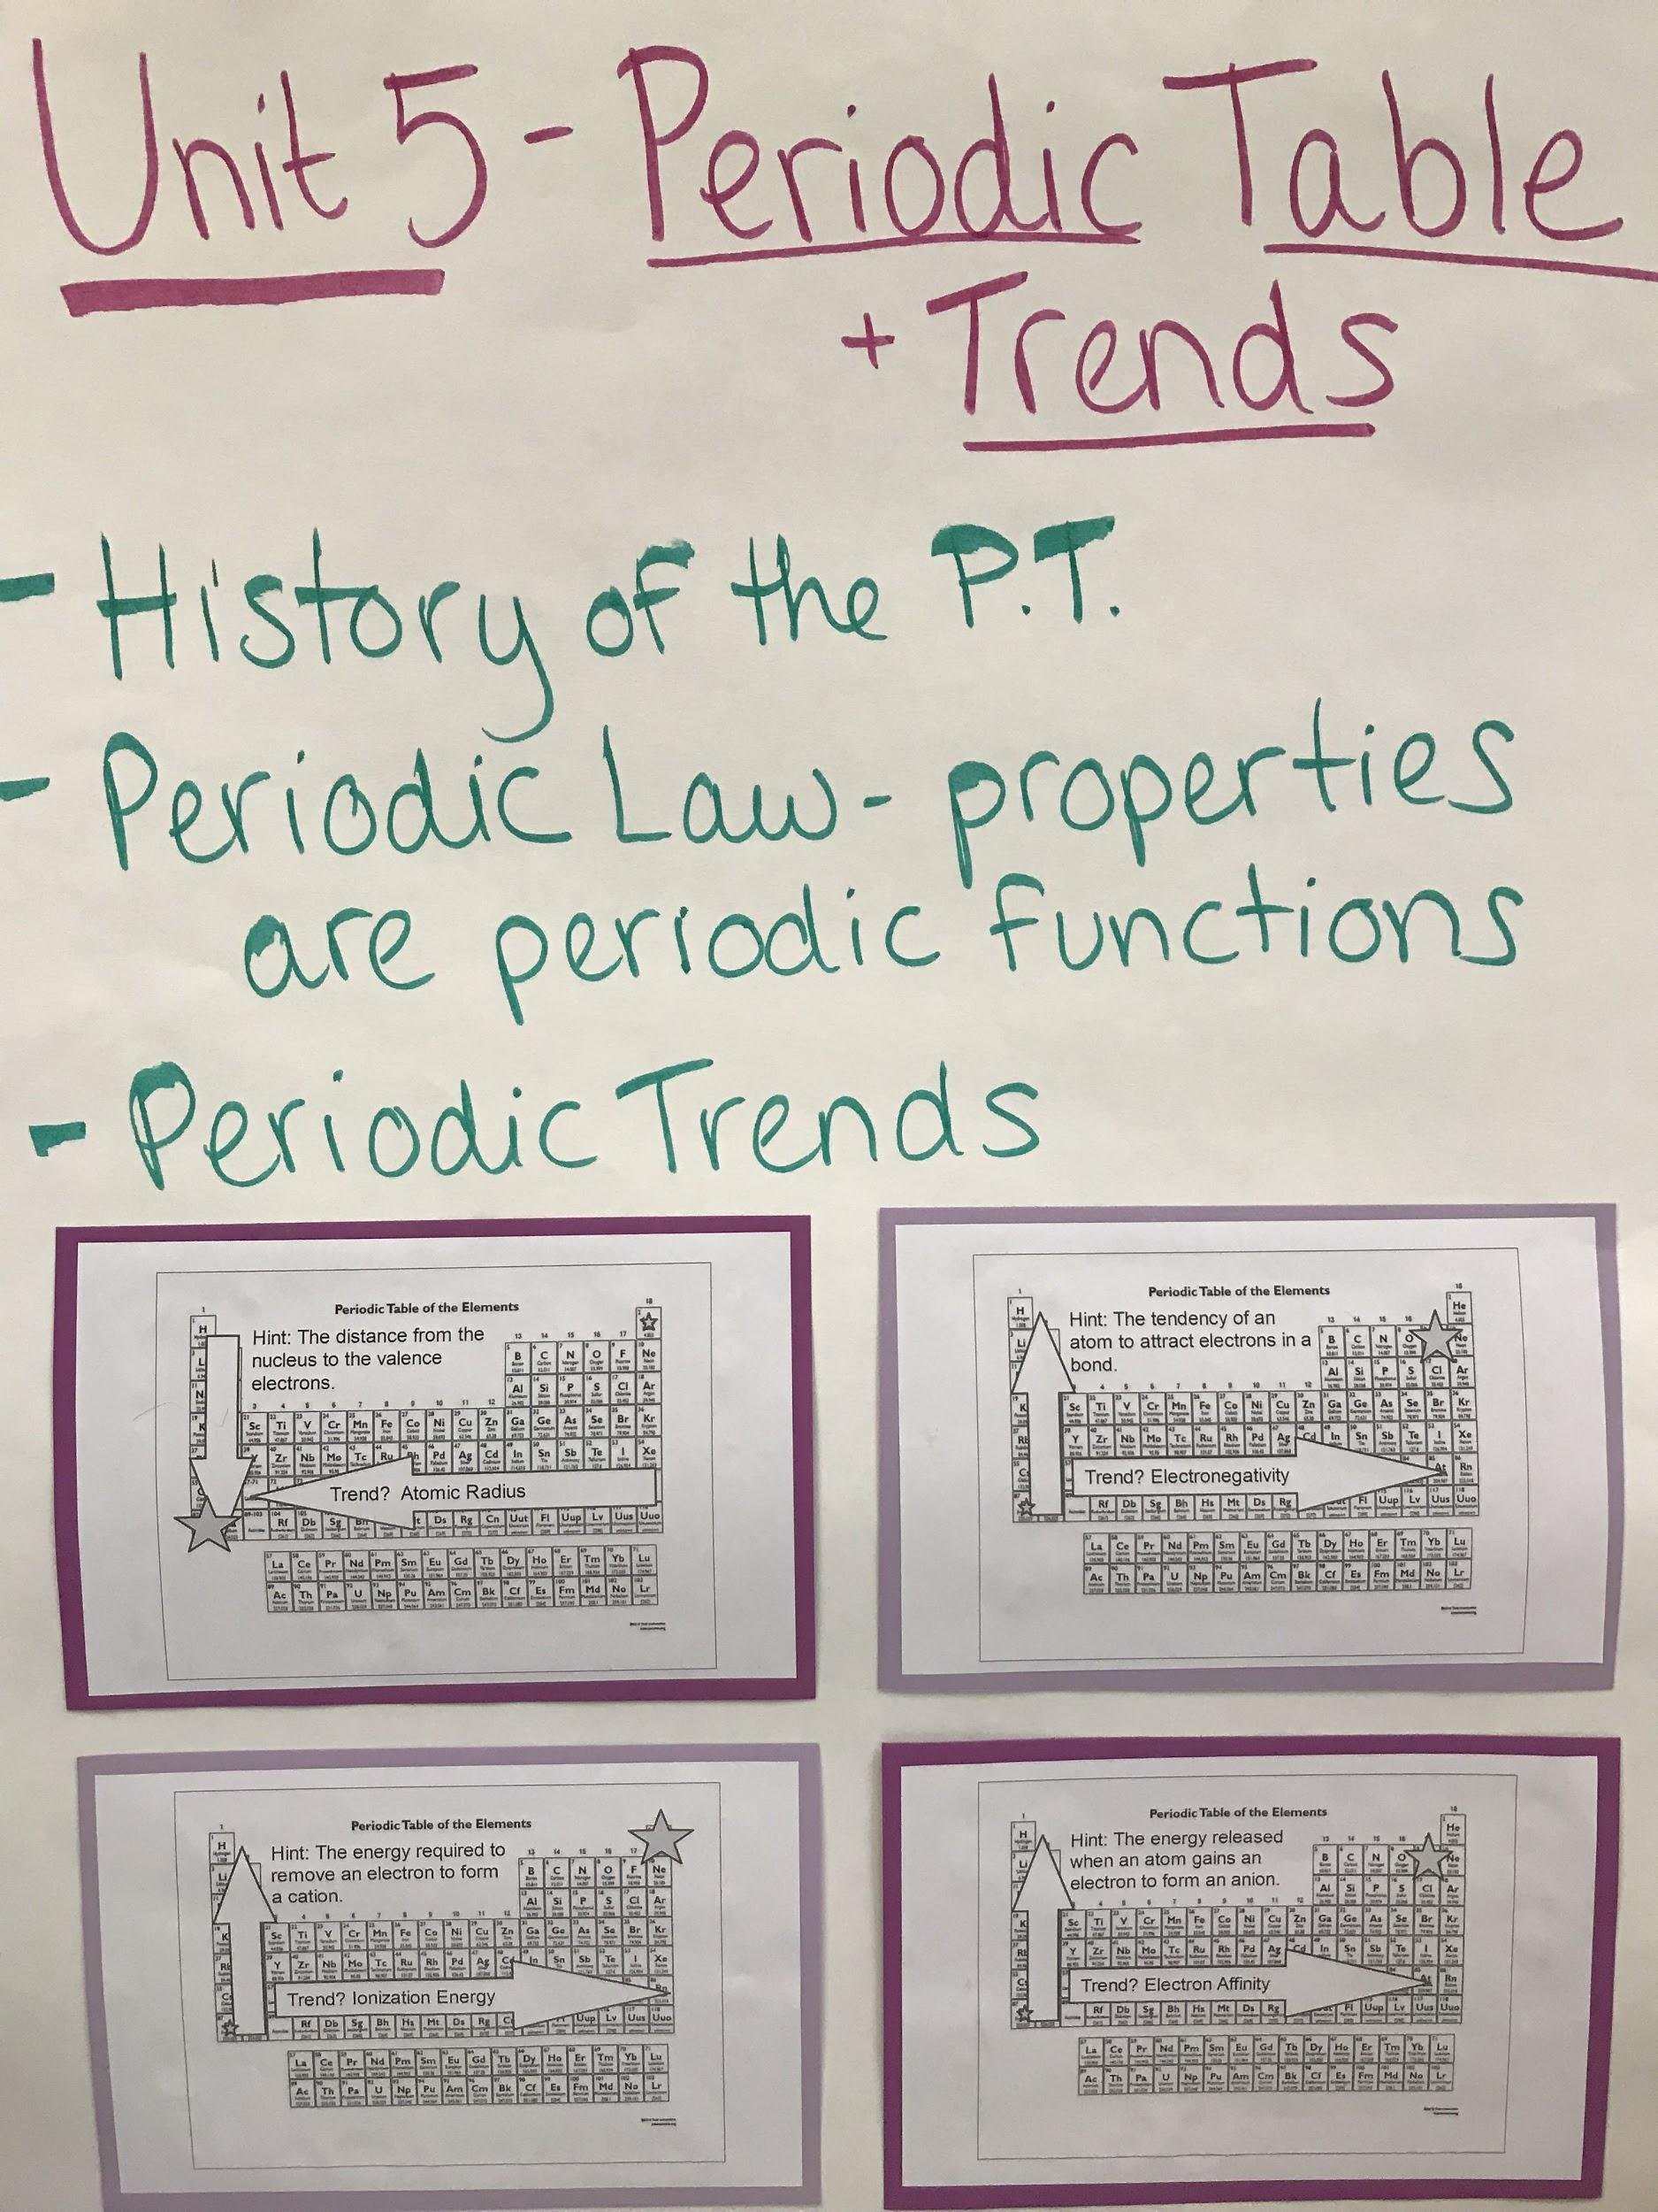

Slide 8
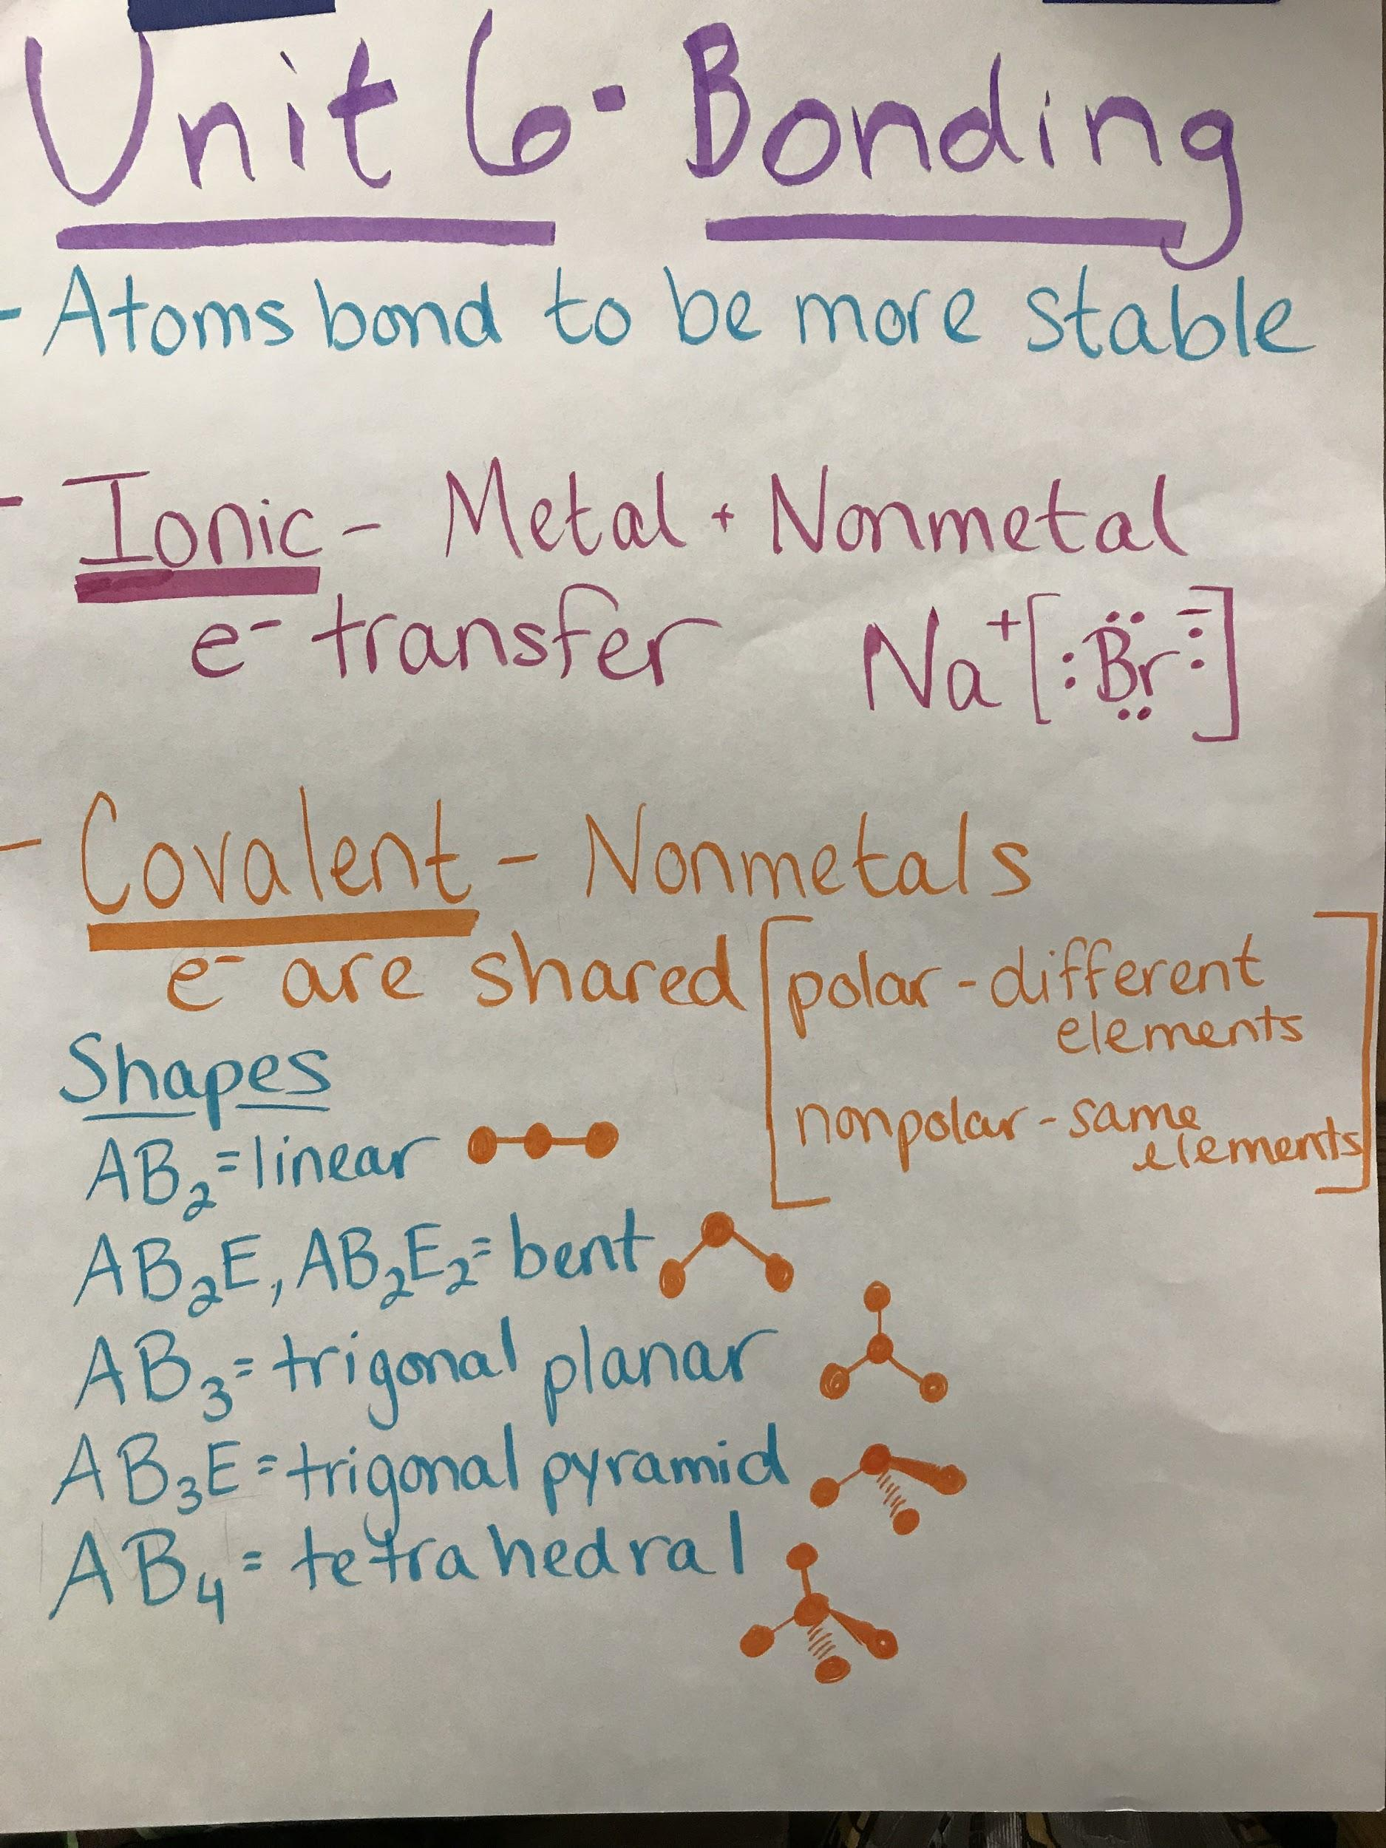
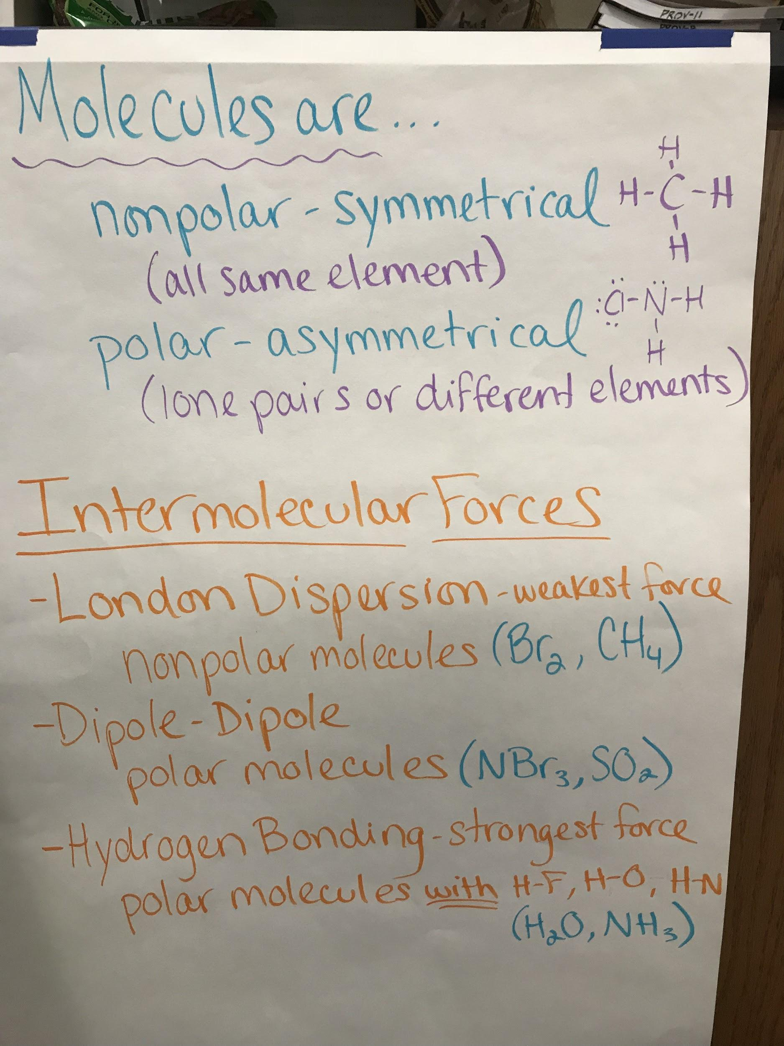

Slide 9
MORE UNIT 6 INFO - BONDING
*CATION = positive ion (atom that has lost electrons)
ANION = negative ion (atom that has gained electrons)
*MULTIPLE BONDS…
Single bond → Double Bond → Triple Bond
Weakest -------------------------> Strongest
Longest --------------------------> Shortest
*IONIC VS. MOLECULAR COMPOUNDS
-transfer of e- -sharing of e-
-metal & nonmetal -2 or more nonmetals
-high MP/BP -low MP/BP
-most dissolve in water -few dissolve in water
-conduct electricity when -do not conduct electricity
melted or dissolved in water

Slide 10
UNIT 7 INFO - CHEMICAL FORMULAS
Binary compounds (only 2 elements)
If first element is a nonmetal…
Use Greek prefixes
Second word ends with -ide
If first element is metal in Group 1, 2, Al,
Zn, Cd, or Ag…
Name of metal
Second word ends with -ide
If first element is metal NOT in Group 1,
2, Al, Zn, Cd, or Ag…
Name of metal
(Roman numeral)
Second word ends with -ide
Tertiary compounds (more than 2 elements)
If first element is metal in Group 1, 2, Al, Zn, Cd, or Ag…
Name of metal
Name of polyatomic ion
If first element is metal NOT in Group 1, 2, Al, Zn, Cd, or Ag…
Name of metal
(Roman numeral)
Name of polyatomic ion
**To determine Roman numeral, following instructions for finding the oxidation number on the next slide.**

Slide 11
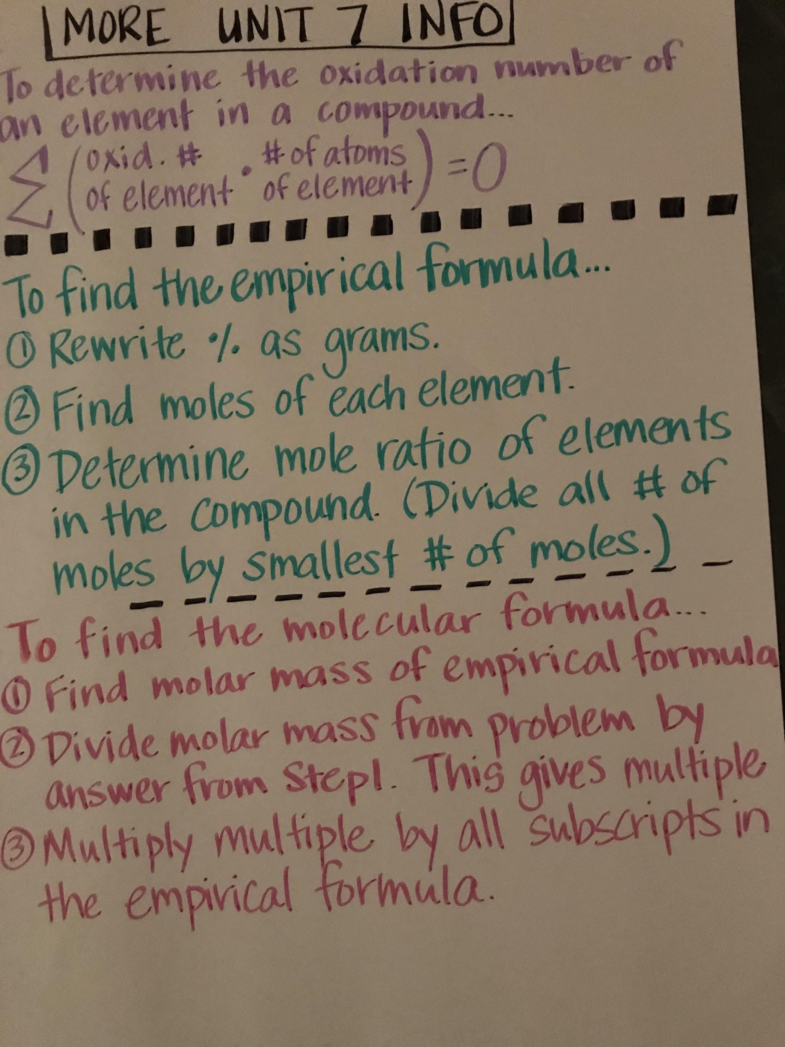

Slide 13
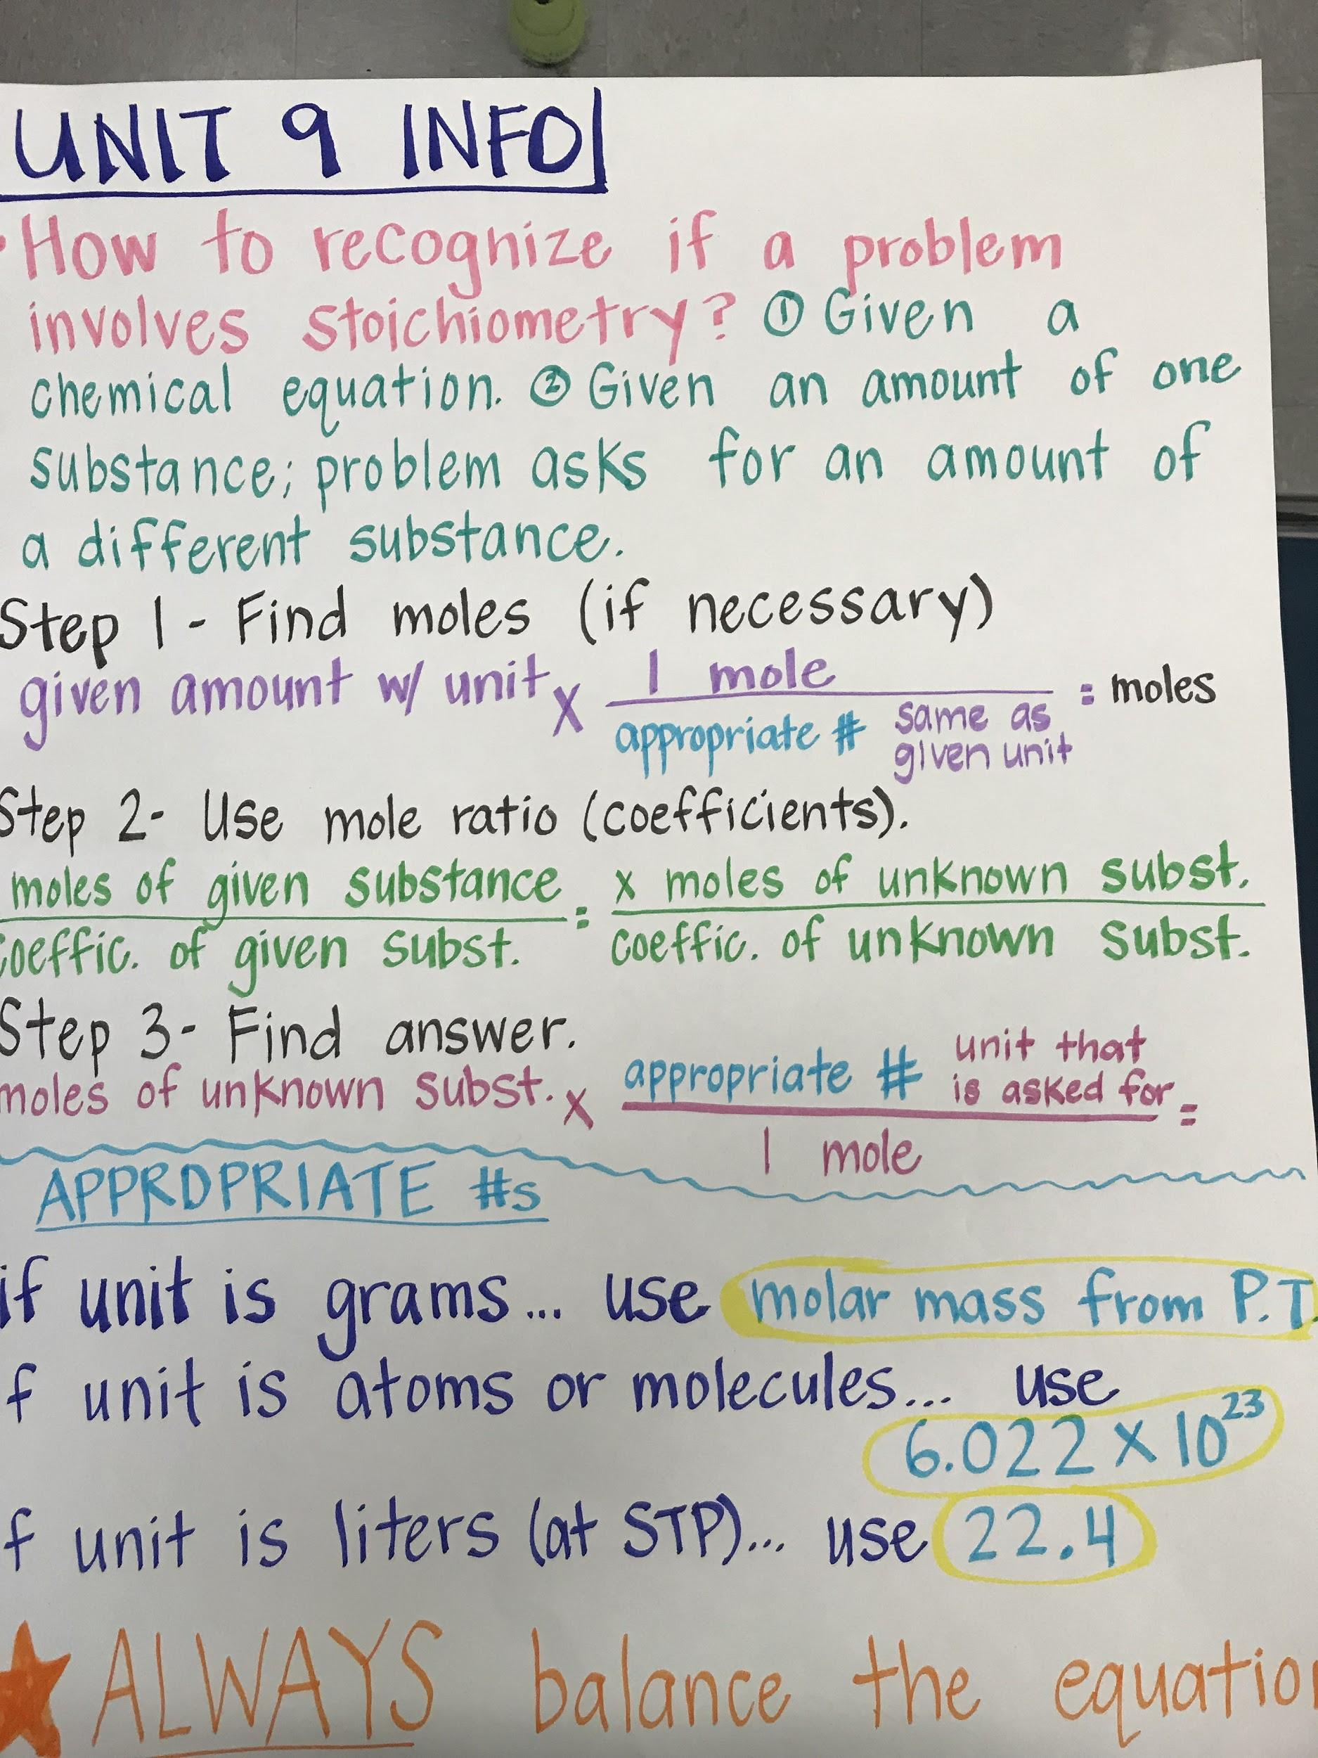

Slide 14
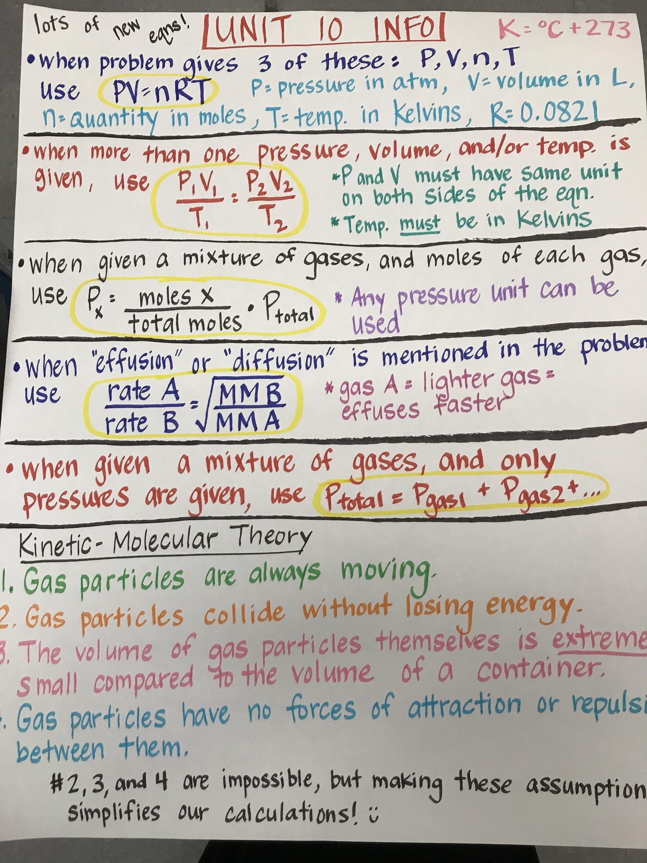

Slide 15
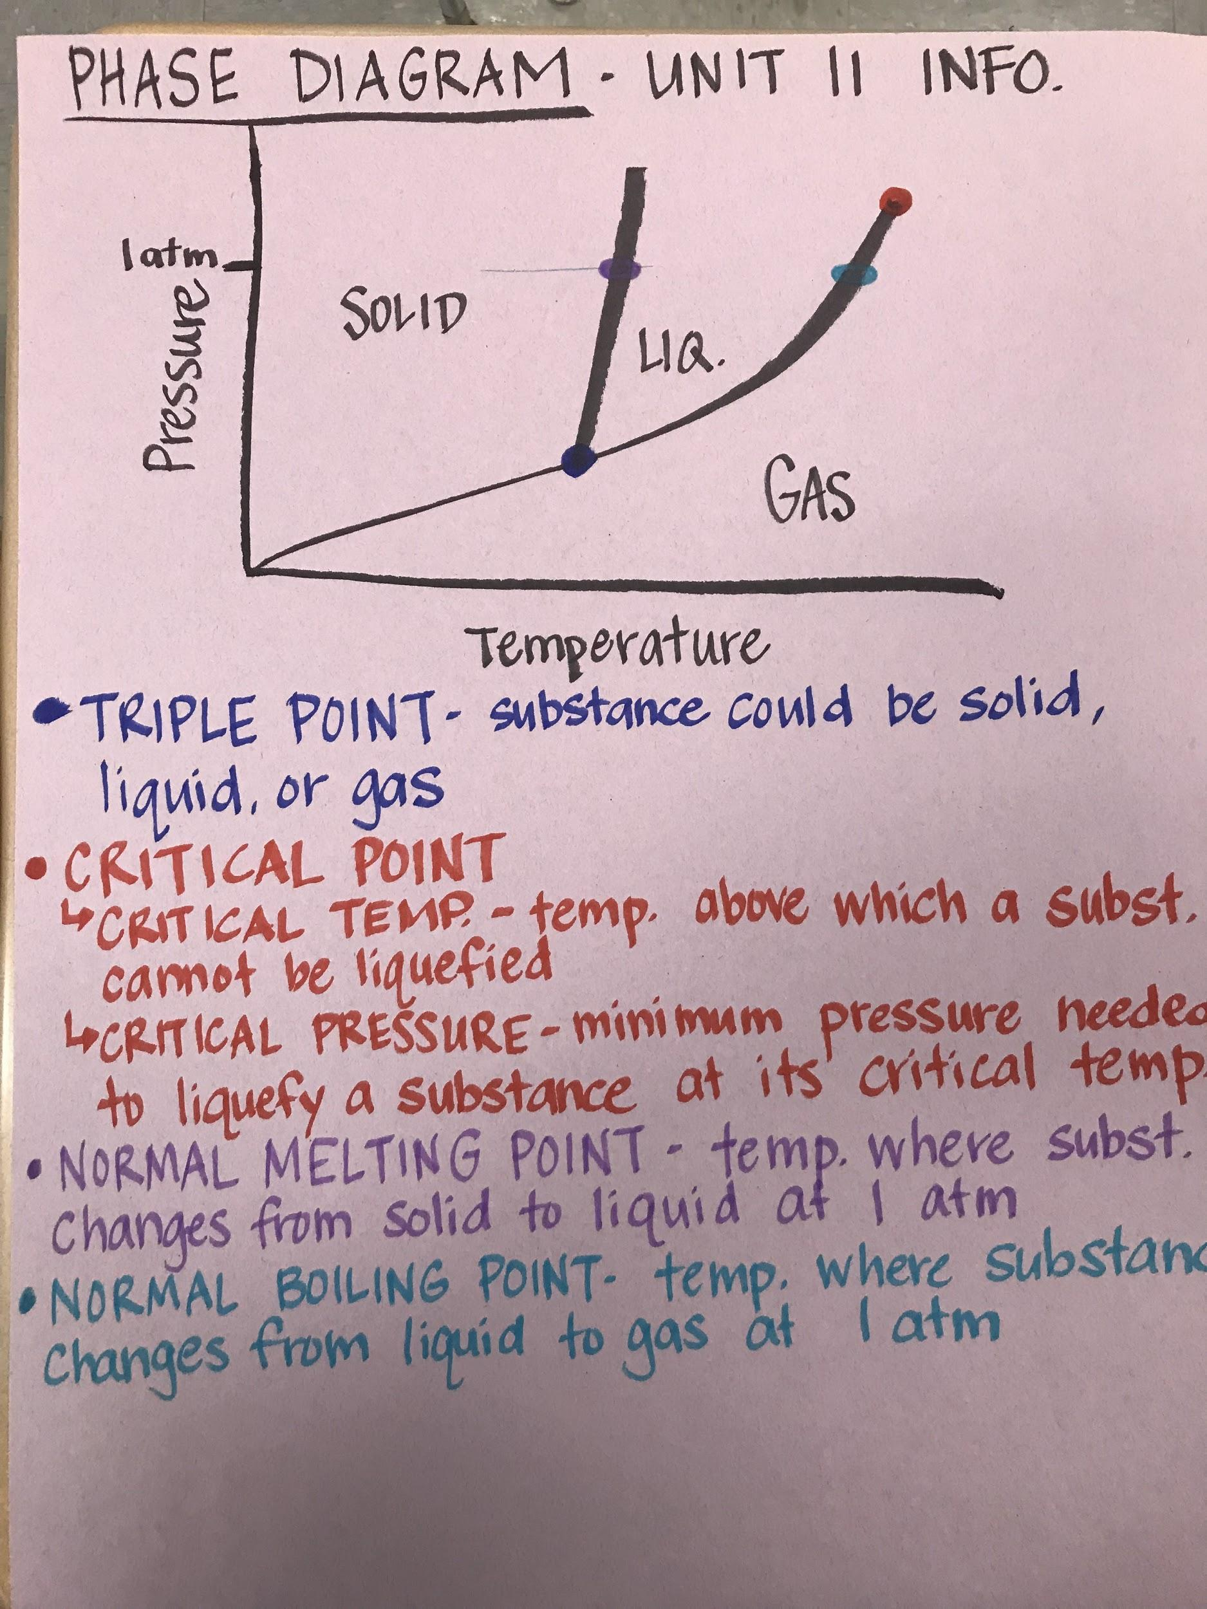
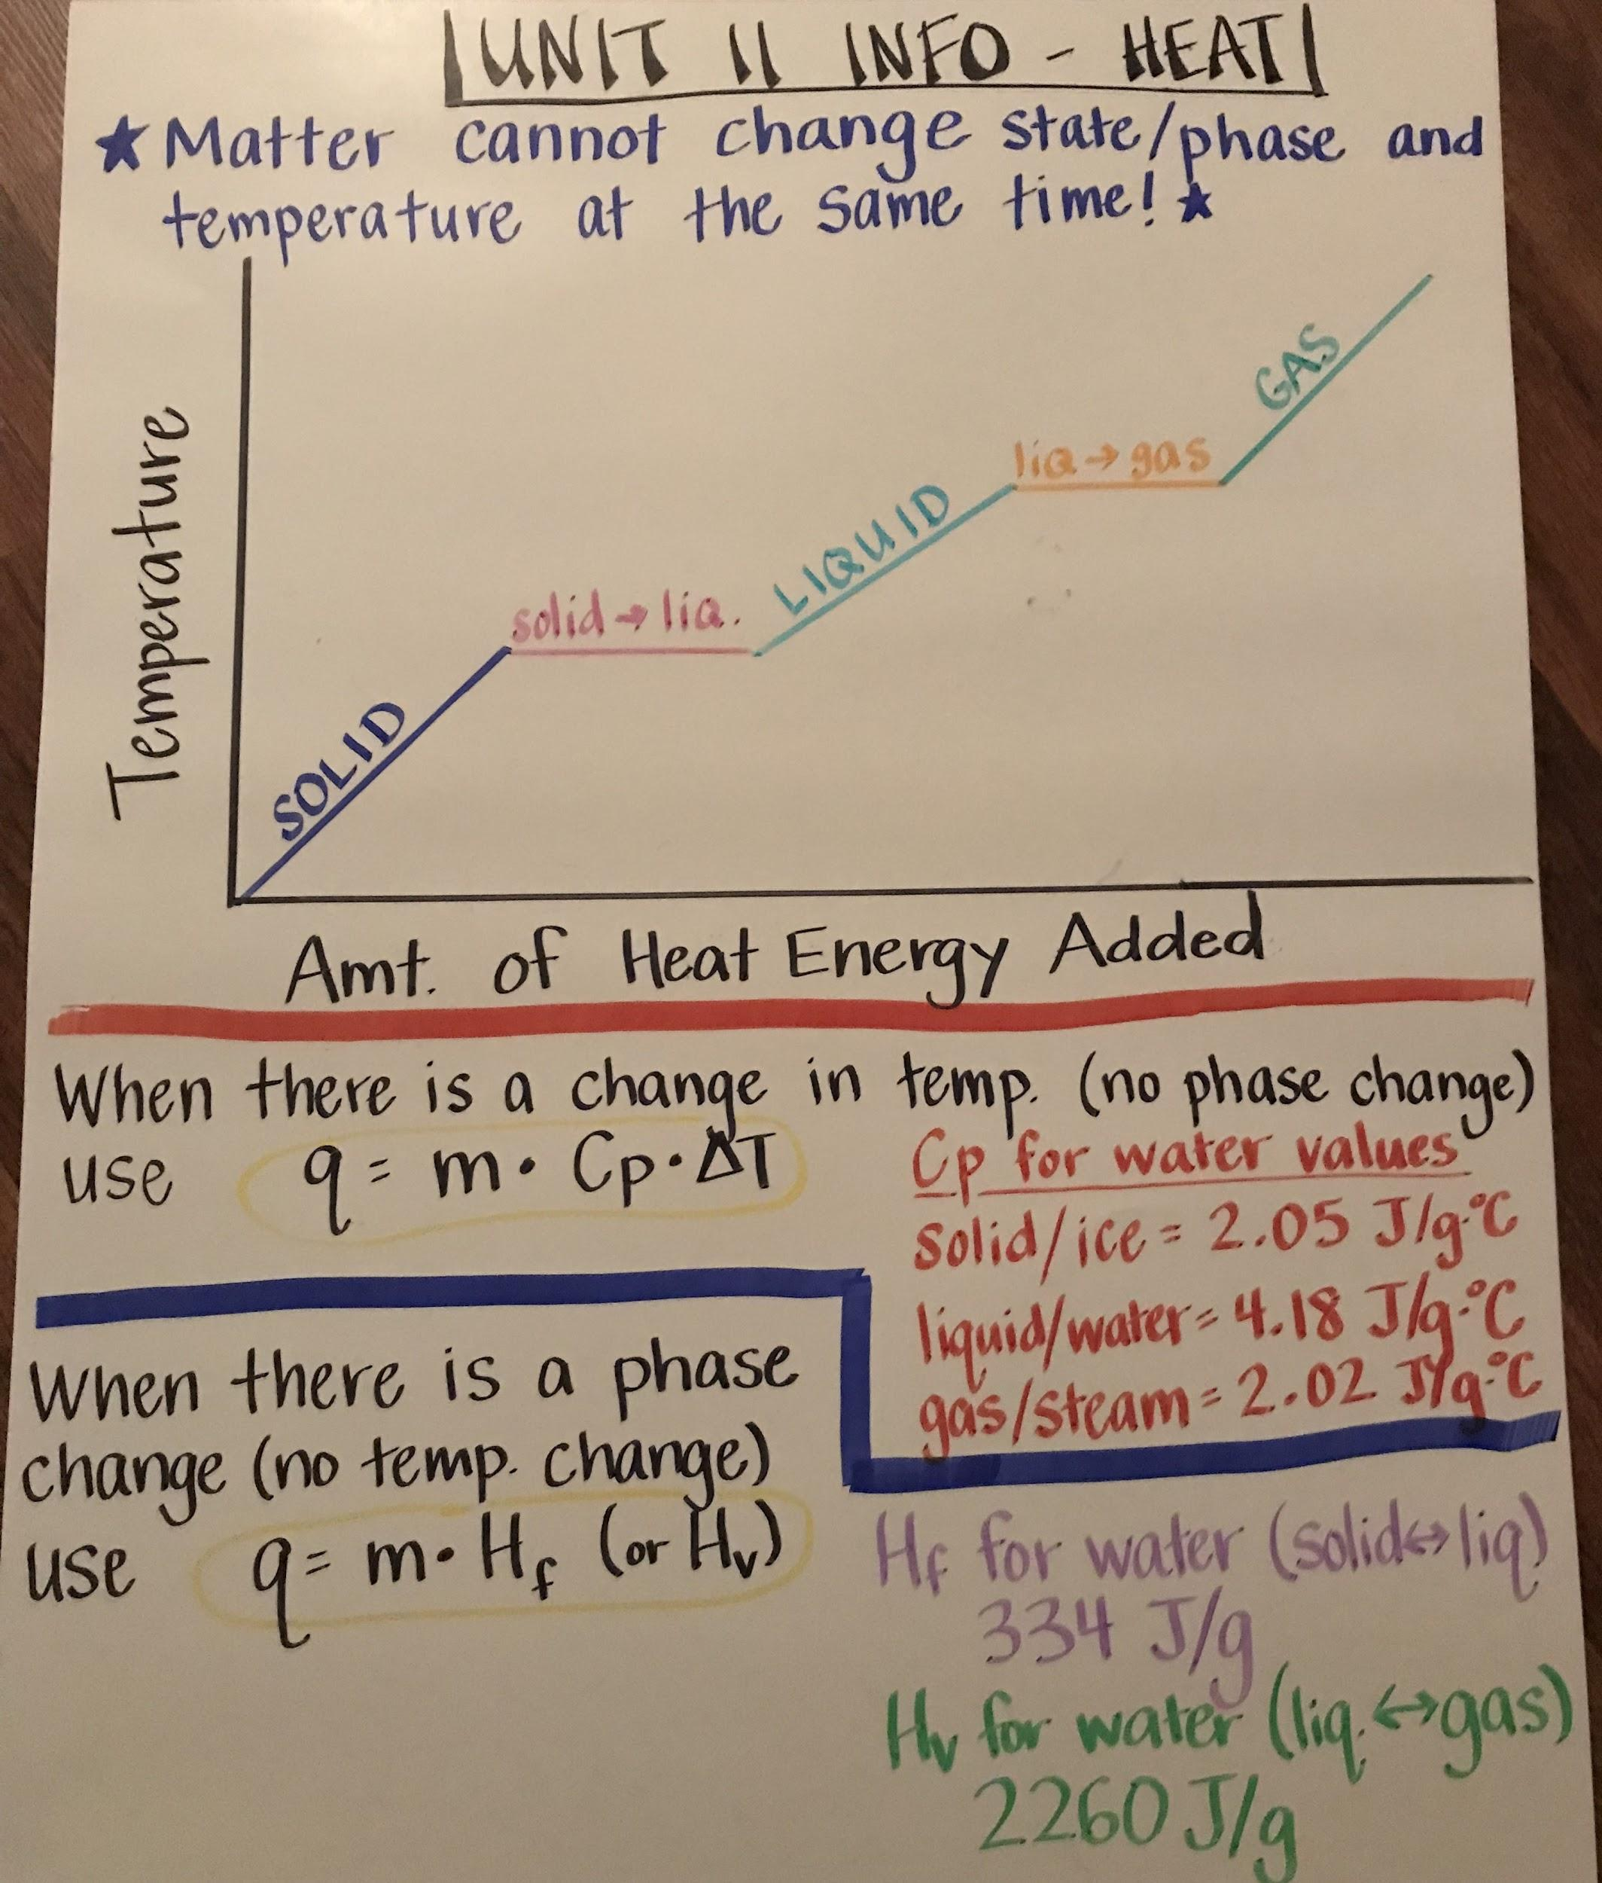

Slide 16
UNIT 12 INFO - SOLUTIONS
*Be able to answer questions about and interpret solubility curve graphs - including determining if a solution is saturated, unsaturated, or supersaturated.
*Solution Concentration:
Molarity (M) = moles solute and M₁V₁ = M₂V₂
Liters solution
*Net ionic equations:
-Determine solubility of products using rules on p. 6 of Reference Tables
-Product of a net ionic equation is always the solid/insoluble product
-Reactants are aqueous solutions of the two ions that make up the solid product
*When adding a solute to a solvent, the boiling point (BP) increases and the freezing point (FP) decreases. (Salt water has a higher BP and a lower FP than pure water.)
*Electrolytes are substances that conduct electricity when they are dissolved in water (or when they are melted). Electrolytes are ionic and soluble in water.

Slide 17
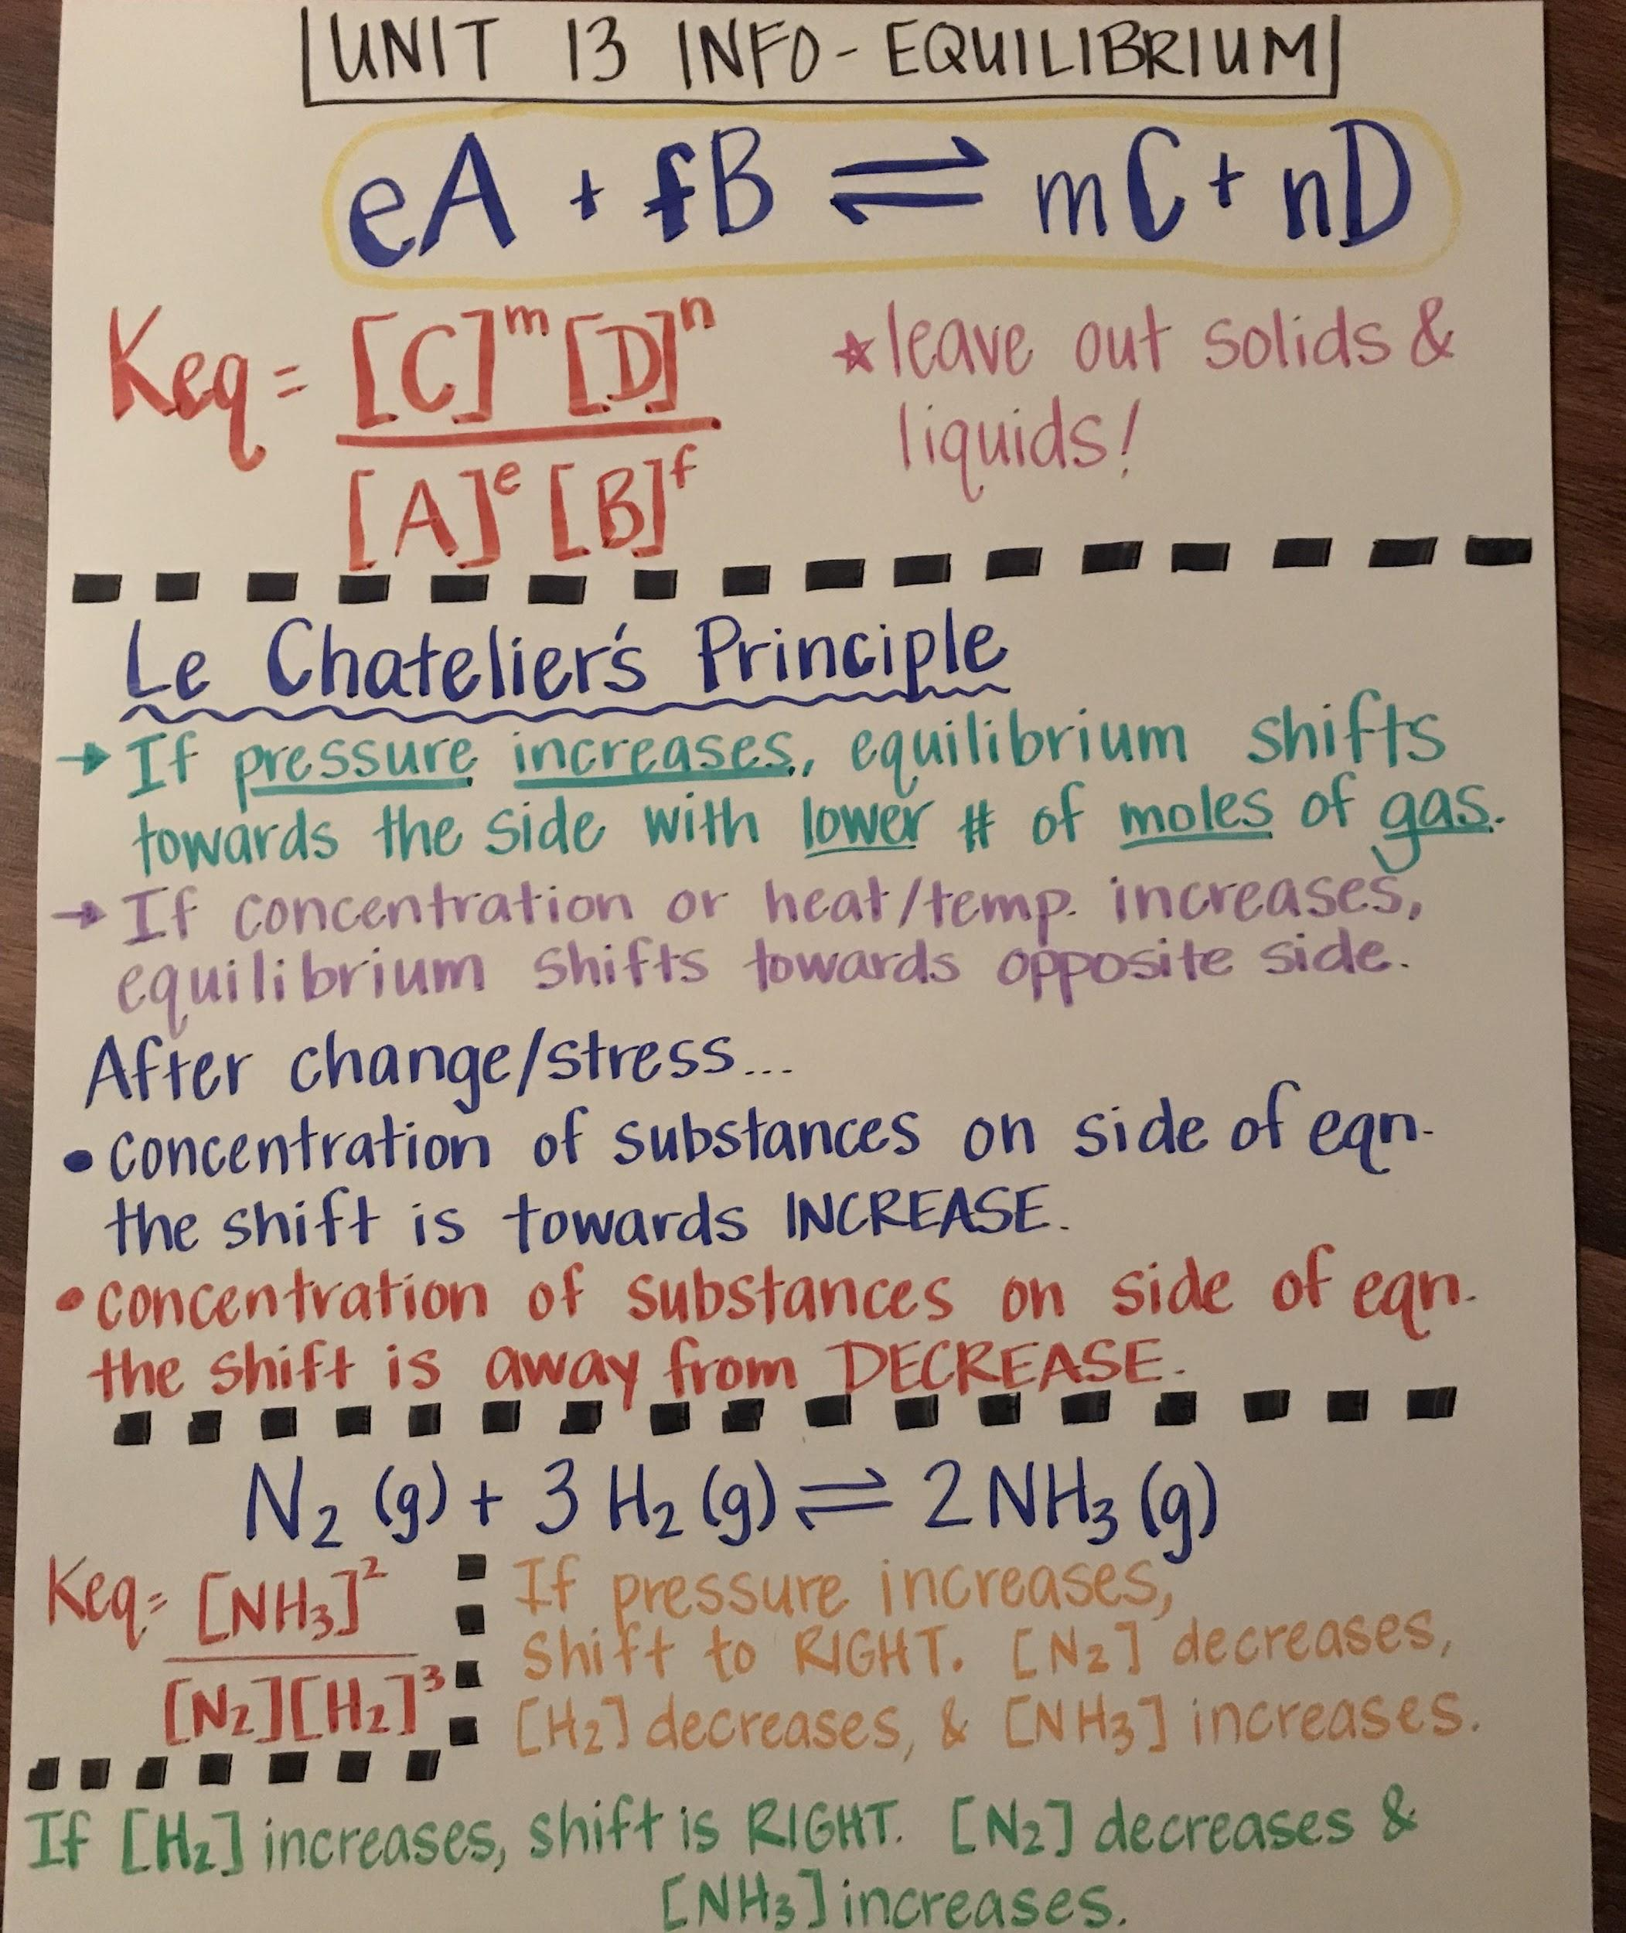

Slide 18
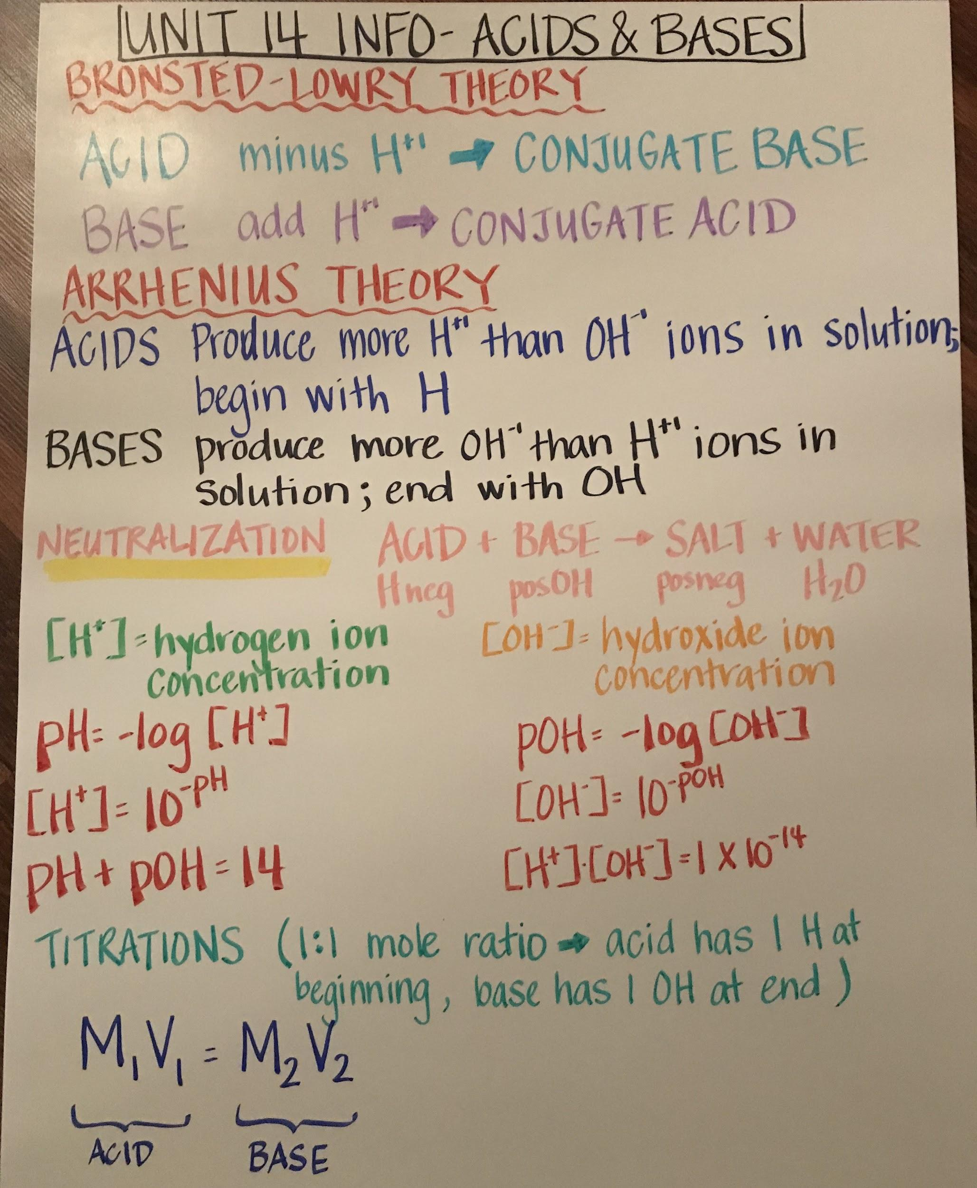

Slide 19
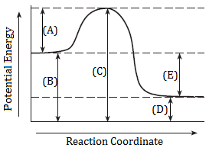
UNIT 15 INFO
= activation energy (Ea)
(B) = PE of the reactants
(C) = PE of the activated complex
(D) = PE of the products
(E) = heat of reaction (ΔH)

Slide 20
UNIT 16 INFO
*Balancing nuclear equations…
+Make sure that the sum of the top numbers on the left side equals the sum of the top numbers on the right side.
+Make sure that the sum of the bottom numbers on the left side equals the sum of the bottom numbers on the right side.
+Use the bottom number to determine the element.
*Half-Life
-Try making a chart like this and filling in what you can from the problem:
 | Start |  | End
Time (linear scale) | 0
Amount (halves)

