Slide 1
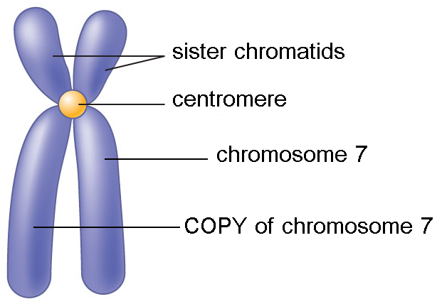
Chromosomes
Replicated (doubled) during this phase – Interphase (S phase)
Travel in pairs known as – Sister Chromatids
Attach to Spindle Fibers at the – Centromere
made by the centrioles

Slide 2
Phases of Mitosis
Interphase
Three Parts:
G1, S, and G2
chromatin

Slide 3
Phases of Mitosis
Prophase
PREPARE
DNA goes from chromatin to chromosomes
SPINDLE FIBERS start to form
Nuclear membrane starts to beak down

Slide 4
Phases of Mitosis
Metaphase
MIDDLE
Chromosomes line up in the MIDDLE of the cell
Attached to the spindle fibers at the centromere
Sister chromatids

Slide 5
Phases of Mitosis
Anaphase
AWAY/APART
Centromeres split
1 copy of each sister chromatid travels to each side of the cell

Slide 6
Phases of Mitosis
Telophase
TWO
TWO nuclei begin to form
A cell cannot have two nuclei so it must split immediately

Slide 7
Phases of Mitosis
Cytokinesis
CELL MEMBRANE
Cell membrane pinches off in between and the two new cells are formed
Both cells are the SAME and they are genetically IDENTICAL to the original cell
This is called ASEXUAL reproduction

Slide 8
Mitosis vs. Meiosis
There are 2 types of cells SEX/GAMETES cells and BODY/SOMATIC cells
Human body cells have 46 chromosomes ( 23 PAIRS )
Human body cells are called DIPLOID ( 2 of every chromosome)
1 from MOM & 1 from DAD
Human sex cells have 23 chromosomes ( EGG & SPERM cells)
Human sex cells are called HAPLOID ( 1 of every chromosome)
EGG + SPERM = BABY (23 + 23 = 46)

Slide 9
MITOSIS makes BODY cells
You start with 1 cell and end with 2
MEIOSIS makes SEX cells
You start with 1 cell and end with 4
The offspring are GENETICALLY DIFFERENT to the parent
The offspring are GENETICALLY IDENTICAL to the parent

Slide 10
Asexual vs. Sexual reproduction
Asexual – ONE source of DNA MITOSIS
Advantage – FAST!! Bacteria = 20 minutes
Disadvantage – NO genetic VARIATION!!
Sexual – TWO sources of DNA MEIOSIS
Advantage – GENETIC VARIATION!! Stronger species
Disadvantage – SLOW!! Humans = 15 years +/-

Slide 11
Inheritance & Punnett Squares
Trait - characteristics (physical – LOOKS) & (physiological (WORKS)
Allele – different forms of a gene (OPTIONS)
Dominant – the allele that shows CAPITAL LETTER
Recessive – the allele that’s hidden lowercase letter
Eye color, hair color, etc.
Sickle cell, cystic fibrosis, etc.
Alleles for eye color – brown, blue, green, etc.
Alleles for hair color – brown, blonde, red, etc.

Slide 12
Homozygous – both alleles the SAME TT or tt
Heterozygous – both alleles are DIFFERENT Tt
Phenotype – Physical look (descriptive words: tall, short, yellow, green)
Genotype – ‘Type o Genes’ you got - ask two questions
Homo = SAME
Hetero = DIFFERENT
Homo or Hetero?
Dominant or Recessive?
TT = Homozygous Dominant

Slide 13
Punnett Square – tool used to PREDICT offspring
The letters on the OUTSIDE of the Punnett Square represent the SPERM and EGG of the parents
P generation
T T
t t
Tt
Tt
Tt
Tt
The letters on the INSIDE of the Punnett Square represent the OFFSPRING (Babies)
F1 generation

Slide 14
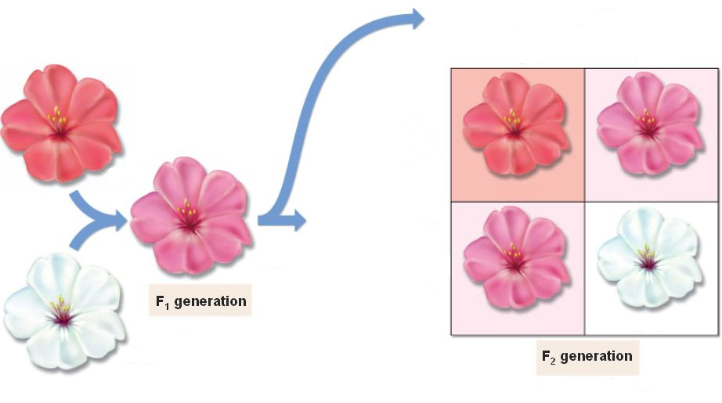
Non-Mendelian Inheritance
Incomplete – Traits BLEND to form a NEW trait
Use apostrophes/prime
R R
R R’
R’
R’
RR’
RR’
R R’
RR
RR¹
RR’
RR’
RR’
R’R’
RR – red R’R’ – white RR’ - pink

Slide 15
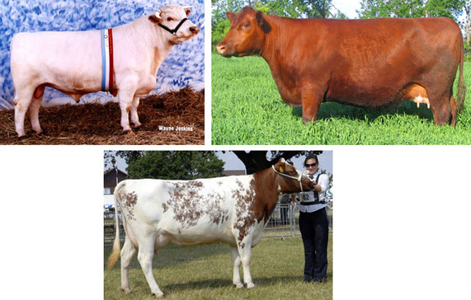
Non-Mendelian Inheritance
Use 2 different letters
Codominance – Traits show up SIDE by SIDE
B B
WW– white
BB – brown
W
W
BW
BW
BW
BW
BW - roan

Slide 16
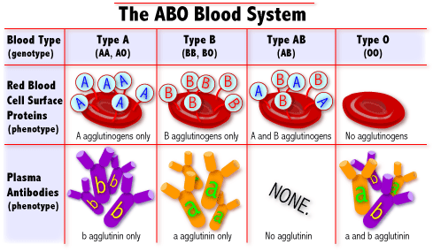
Non-Mendelian Inheritance
Multiple Alleles – More than 2 options ex. blood types
I^{A} i
I^{B}
i
I^{A} I^{B}
I^{B}i
I^{A}i
ii
A and B are dominant
O is recessive
I^{A} = A I^{B} = B i = O

Slide 17
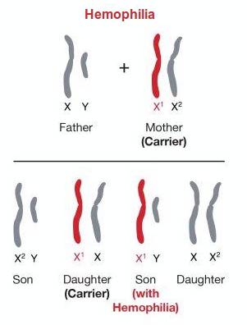
Non-Mendelian Inheritance
Sex-Linked – trait carried on X chromosome
RECESSIVE ex. Color blindness
Hemophilia
X^{H} X^{h}
X^{H} Y
X^{H}X^{H}
X^{H}X^{h}
Normal female
Carrier female
X^{H}Y
X^{h}Y
Normal male
Sick male
X^{H} – normal X^{h} – hemophiliac

Slide 18
Females CARRY the trait but males suffer from them
WHY?
Because females are XX – they have an extra X chromosome if they get a ‘bad’ X
Males don’t have an extra X – they are XY

Slide 19
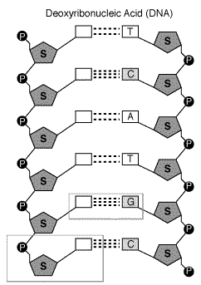
DNA, RNA & Protein Synthesis
DNA Structure
Deoxyribose sugar
A
Hydrogen Bonds
G
Phospate
T
Base Pair
A T pair up
C G pair up
Nucleotide
A
Sugar, phosphate & nitrogen base
C
G

Slide 20
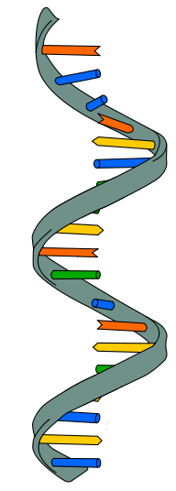
RNA Structure
No T U instead
3 types
mRNA: messenger (carries the genetic code from the DNA to the ribosome)
rRNA: ribosomal (makes up the ribosome)
tRNA: transfer (transfers amino acids)
Ribose sugar
Single Strand

Slide 21
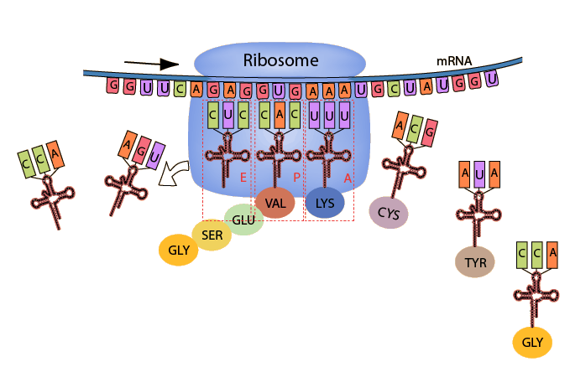
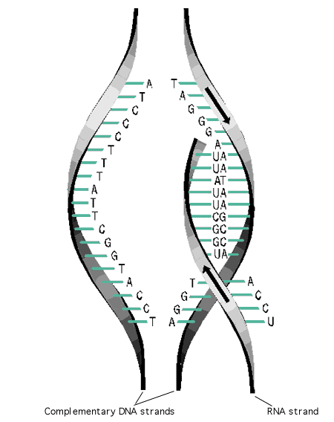
DNA
mRNA
Protein
Transcription
Translation
Happens in NUCLEUS
Happens in cytoplasm @ RIBOSOME
Product - mRNA
Product - Protein

Slide 22
DNA can’t leave the nucleus, but must get the protein recipe to the ribosome
DNA makes mRNA copy of recipe that leaves the nucleus
DNA stays in the nucleus – safe and unchanged

Slide 23
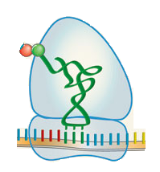
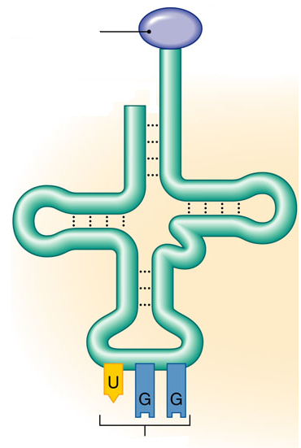
Three types of RNA
mRNA – MESSAGE – made in nucleus during transcription. Leaves nucleus and travels to ribosome
rRNA – READ – reads the mRNA codon by codon & signals tRNA for correct amino acid
tRNA – TRANSFER – transfers the correct amino acid to the growing protein
Codon
tRNA
rRNA
Amino Acid
Anticodon

Slide 24
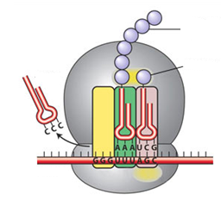
Translation Diagram
PEPTIDE bond
Protein/Polypeptide
Amino Acid
tRNA
rRNA ribosome
Anticodon
mRNA
Codons

Slide 25
DNA strand ACG GGA CAT ATC
mRNA strand UGC CCU GUA UAG
Amino Acids cys pro val stop

Slide 26
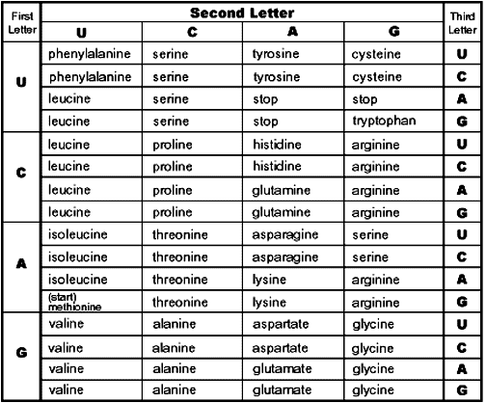
Codon Chart

Slide 27
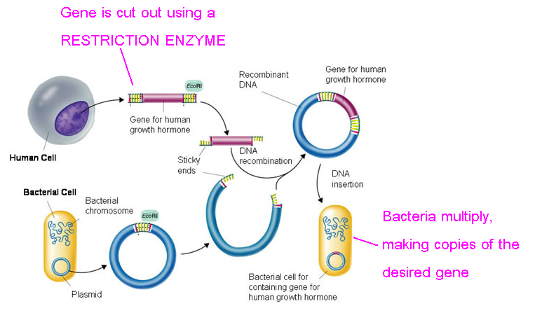
Transgenic Organism – organism with DNA from a different source
Ex. Bacteria with human insulin gene
Made with RECOMBINANT DNA

Slide 28
5 steps
Cut out ‘good’ gene you want copies of
Cut open bacterial plasmid/DNA
Splice together good gene & bacterial plasmid/DNA
Reinsert plasmid/DNA into bacteria
Bacteria divides, making copies of the good gene
What do you use to cut DNA?
Restriction enzyme

Slide 29
Used to make – Insulin, HGH (human growth hormone )

Slide 30
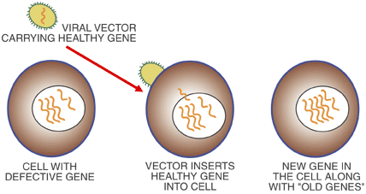
Gene Therapy – using genetic engineering to treat genetic disorders
“put GOOD genes in to cover up defective genes”
Used to treat diseases such as –
Cystic fibrosis
SCID (severe combined immunodeficiency)
~bubble boy syndrome

