Slide 1
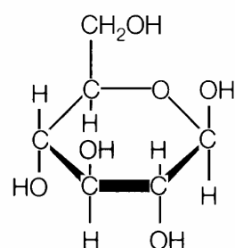
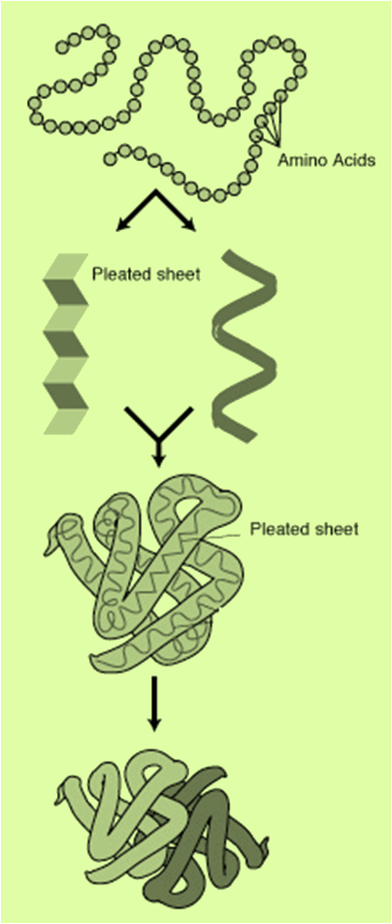
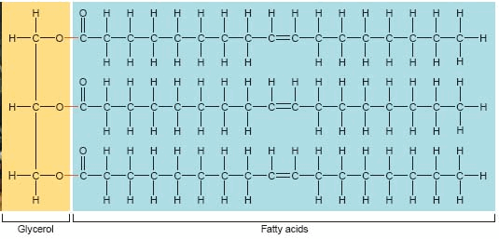
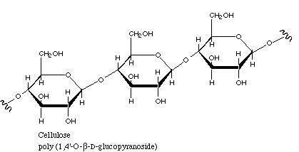
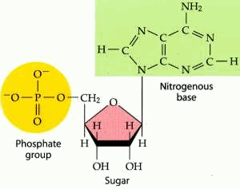
Do Now
5
Identify the organic molecules.
4
2
3
1

Slide 2
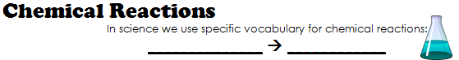
Chemical Reactions
reactant
product
2 + 2
= 4

Slide 3
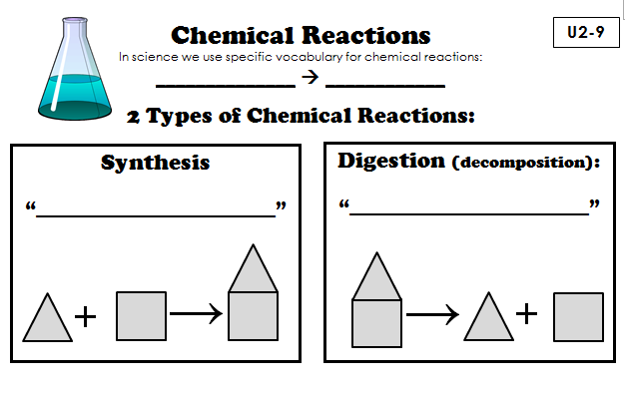
Chemical Reactions
reactant
product
build it up
break it down

Slide 4
Synthesis
Digestion
“build it up”
“break it down”
Sugar/Monosaccharide
Starch/Polysaccharide
Starch/Polysaccharide
Sugar/Monosaccharide

Slide 5
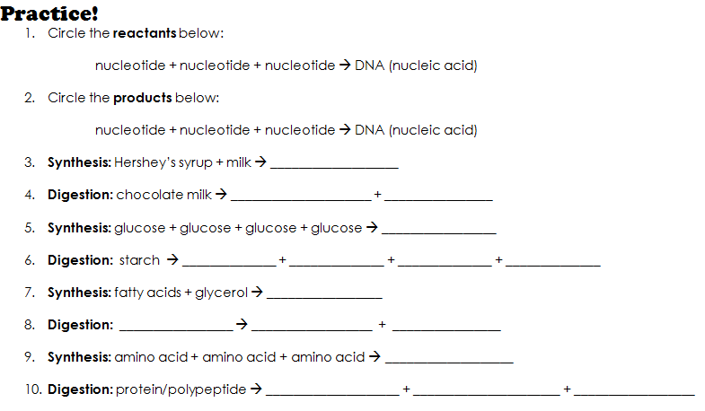
lipid

Slide 6
Do Now
What do we find on the RIGHT side of the arrow in a chemical reaction?
What do we find on the LEFT side of the arrow in a chemical reaction?
What are the 2 types of chemical reactions?
What type of chemical reaction is the following:
CO2 ➔ C + O2

Slide 7
LET’S MAKE IT FASTER!

Slide 8
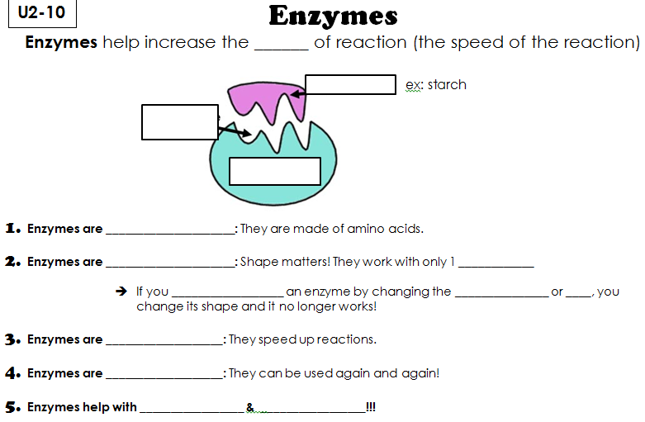
rate
active
site
substrate
enzyme

Slide 9
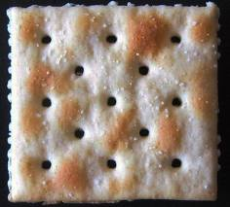
Saltines!

Slide 10
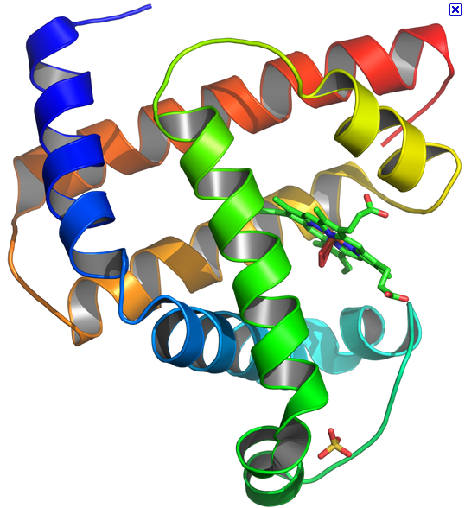
Enzymes
Proteins
1. Enzymes are ______
They are made of amino acids!

Slide 11
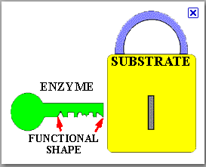
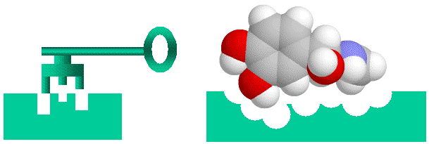
Enzymes
Specific
2. Enzymes are _____________
They work with only 1 SUBSTRATE

Slide 12
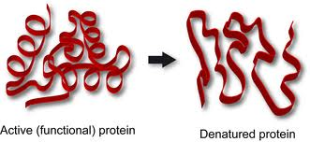
denature
→ If you __________________ an enzyme by changing the _______________ or ____, you change its shape and it no longer works!
temp.
pH

Slide 13
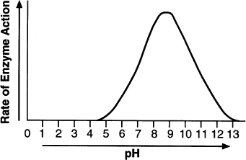
Optimum= Best! Found at the peak!

Slide 14
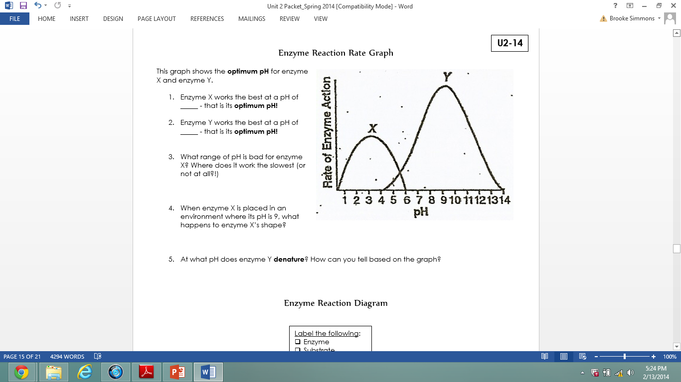

Slide 15
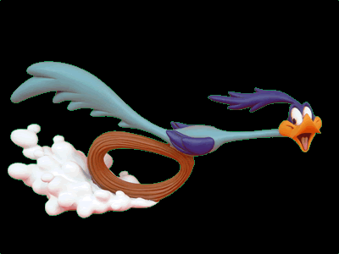
Enzymes
catalysts
3. Enzymes are _____________.
“catalyze reactions”
They speed up reactions!

Slide 16

Enzymes
reusable
4. Enzymes are _____________.
They can be used again and again!

Slide 17
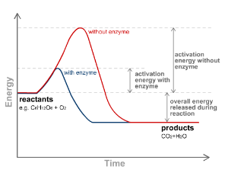
Enzymes
lower
activation
5. Enzymes _______ the ___________
which is the _______ needed for a reaction to occur.
energy

Slide 18
Enzymes
digestion
6. Enzymes help with _____________ & ___________.
synthesis

Slide 19
Naming Enzymes
These are all enzymes:
Amylase
Sucrase
Lactase
Peroxidase
Fructase
What pattern do you notice?

Slide 20
Naming Enzymes
These are all enzymes:
Amylase
Sucrase
Lactase
Peroxidase
Fructase
What pattern do you notice?
Enzymes have the ending -ase

Slide 21
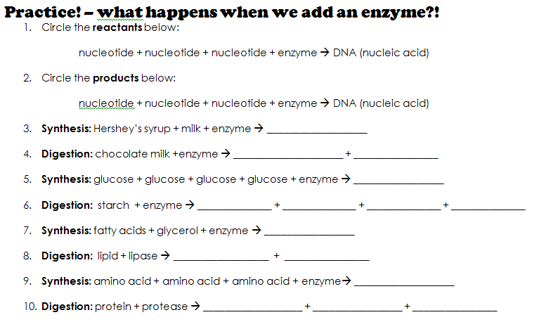

Slide 23
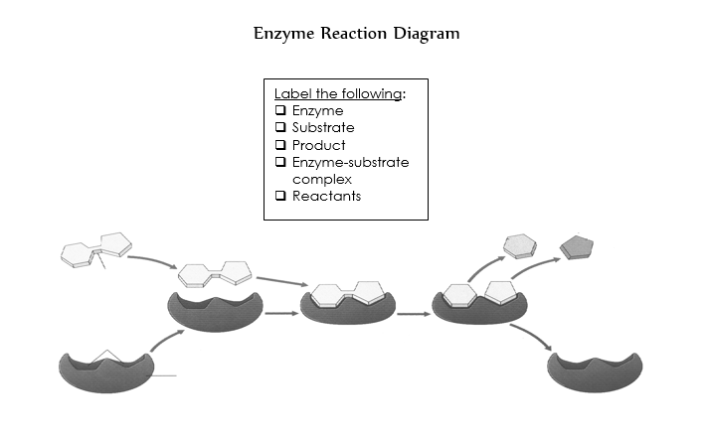

Slide 24
Lactose Intolerance

Slide 25
Practice
Complete Page U2–15
Complete Crossword Puzzle
Begin working on the Unit 2 Study Guide on page U2-19 & U2-20

Slide 26
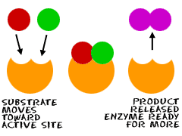
Do Now
What do enzymes do?
What are the subunits of enzymes?
An enzyme works best at a pH of 3.7. Explain what will happen if that same enzyme were placed in a basic environment.
Describe what is happening in these cartoons.
Describe what the 1 main difference is between these two reactions

Slide 27
Enzyme catalyzed reactions
“Building up”
“Breaking down”
What are these two types of reactions called?

Slide 28
Enzyme catalyzed reactions
“Building up”
“Breaking down”
Label the following parts in the pictures:
Enzyme
Substrate
Active site
Reactants
Products

Slide 29
Looking Ahead
Binder check will be VERY soon and it is a grade
Organic Molecules & Enzymes quiz next week
Unit 2 Test
Check the class Weebly for updates

Slide 30
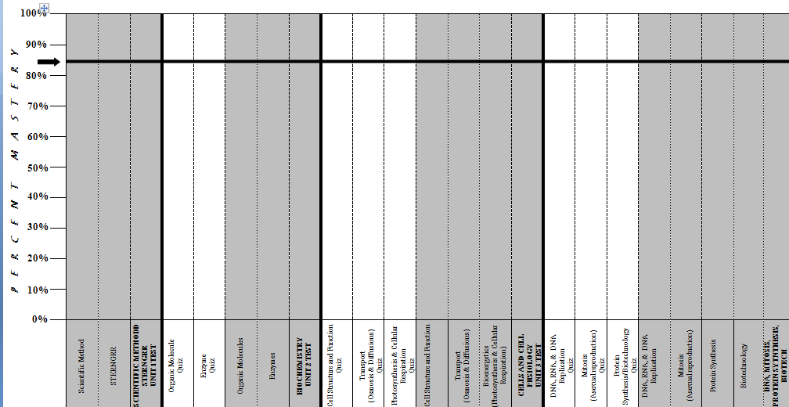
Student Mastery Tracker

Slide 31
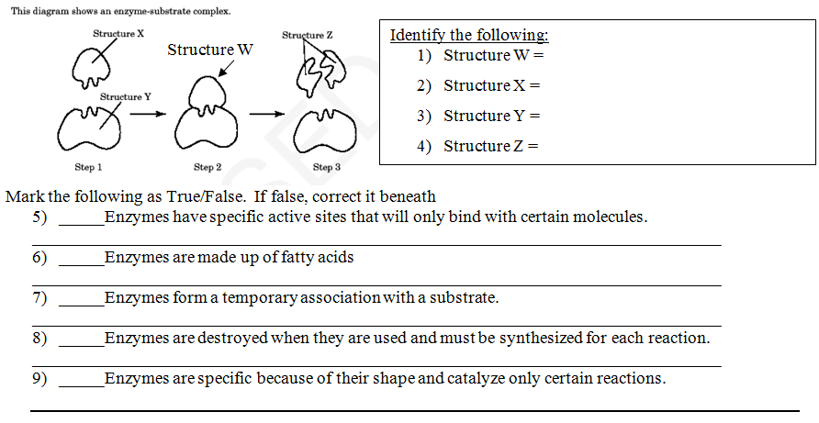
Enzyme review

Slide 32
Naming Enzymes
These are all enzymes:
Amylase
Sucrase
Lactase
Peroxidase
Fructase
What pattern do you notice?

Slide 33
Naming Enzymes
These are all enzymes:
Amylase
Sucrase
Lactase
Peroxidase
Fructase
What pattern do you notice?
Enzymes have the ending
-ase

Slide 34
Naming Sugars
These are all sugars:
Glucose
Sucrose
Lactose
Galactose
Fructose
What pattern do you notice?

Slide 35
Naming Sugars
These are all sugars:
Glucose
Sucrose
Lactose
Galactose
Fructose
What pattern do you notice?
Sugars have the ending
-ose

Slide 36
Enzyme Lab
There are 4 stations:
Enzymes and temperature
Enzymes and pH
Enzymes are specific
Enzymes are reusable

Slide 37
Station 1: Enzymes and Temperature
When done, answer questions 1-3 on page U2-14

Slide 38
Station 2: Enzymes and pH
When done, answer questions 4 & 5 on page U2-14

Slide 39
Station 3: Enzymes are Specific

Slide 40
Station 4: Enzymes are Reusable
DO NOT POUR OUT AVOCADO!!!!
JUST DRAIN THE WATER!!
RE-USE THE SAME PIECE OF AVOCADO FOR STEP 5

Slide 41
Enzyme Lab Questions (pg. 16)
Before asking Ms. Simmons for help:
Read the question again – what is it asking?
Ask a person in your lab group
Ask another student in class

Slide 42
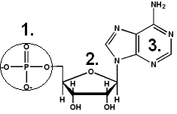
Do Now
Use the picture to the left to answer questions 1-4.
What is the correct name for part number 1 on the molecule above?
What is the name for part number 3 on the molecule above?
What is this molecule?
4. What is the larger molecule it makes up?
5. Which of the following will NOT denature a protein in a human?
  Strong acid
  Strong base
  High temperature
  homeostasis

Slide 43
Review for Unit 2 Test
Enzyme Graphing Worksheet
Create Your Own Enzyme Activity
Finish Unit 2 Packets (all pages must be complete to receive full credit)
Frayer Vocab (5 vocab words)
Class Jeopardy
Take out your binders for a notebook check!

Slide 44
Do Now
STUDY your Unit 2 packet. You have a test today! We will start promptly at 7:25.

Slide 45
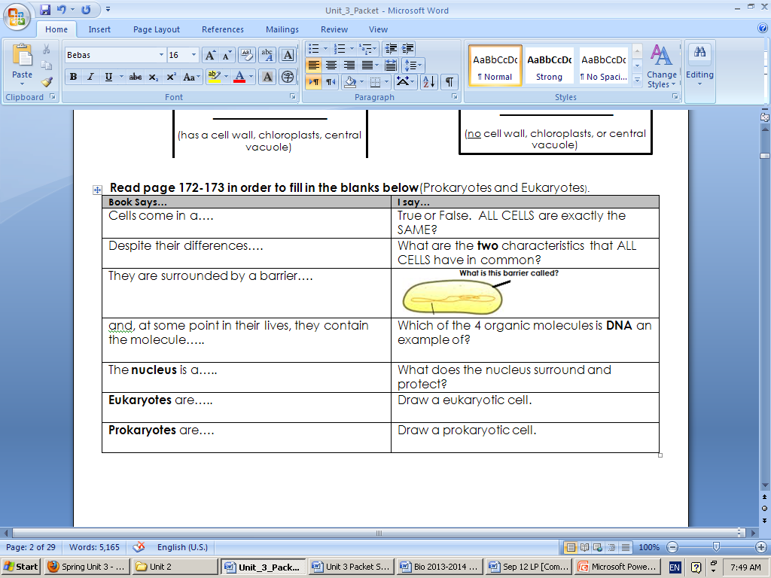
When you finish, COMPLETE UNIT 2 packet. THEN fill out the chart below using a textbook, pages 172-173

