Slide 1
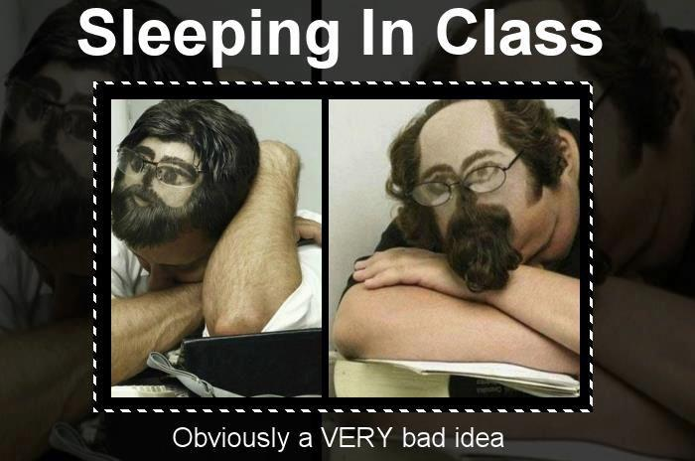
ENERGY TYPES (AN OVERVIEW OF ALL TYPES) REMEMBER, ENERGY IS ANYTHING THAT HAS THE ABILITY TO DO WORK! Not this!

Slide 2
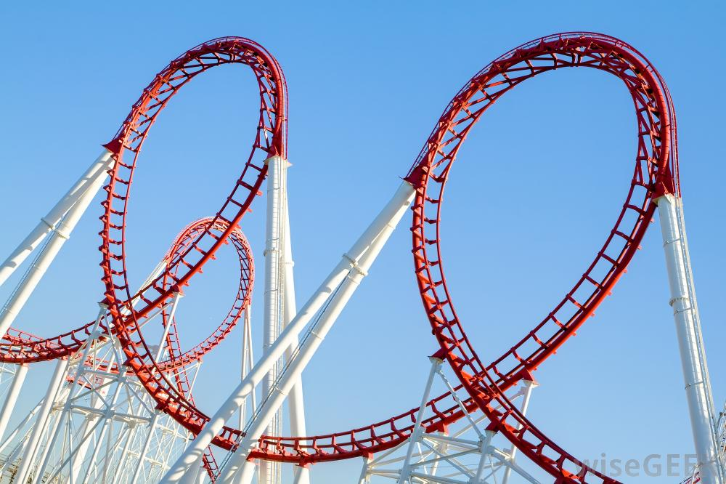
MECHANICAL ENERGY
THE TOTAL KINETIC AND POTENTIAL ENERGY IN A SYSTEM
AFFECTS MOTION OF LARGE OBJECTS AS A WHOLE

Slide 3
NONMECHANICAL ENERGY
KINETIC OR POTENTIAL ENERGY IN OBJECTS AT THE ATOMIC LEVEL OR IN WAVES
USUALLY HARD TO SEE UNLESS BEING CONVERTED TO OTHER FORMS

Slide 4
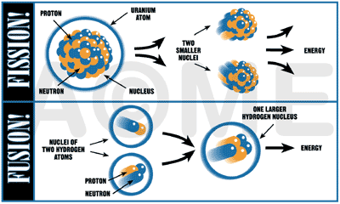
1. NUCLEAR ENERGY
ENERGY FROM THE FISSION(SPLITTING) OR FUSION (COMBINING ) OF ATOMIC NUCLEII
EX) FUSION ON THE SUN PROVIDES EARTH WITH MOST OF IT’S ENERGY

Slide 5
2. LIGHT
LIGHT ENERGY FROM THE SUN TRAVELS THROUGH EMPTY SPACE IN THE FORM OF ELECTROMAGNETIC WAVES AND TURNS TO HEAT WHEN IT HITS ATOMS
EX) PHOTOSYNTHESIS – GREEN PLANTS USE SUNLIGHT TO MAKE SUGAR

Slide 6
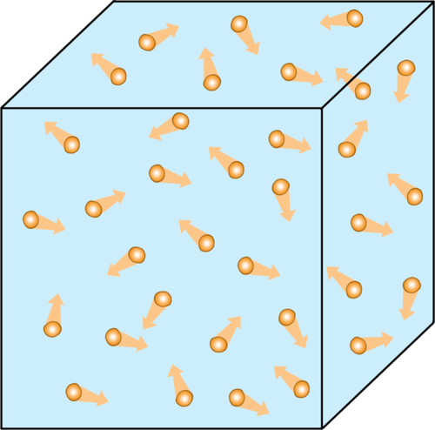
3. HEAT
THE VIBRATION OF PARTICLES IN PLACE (IS A TYPE OF KINETIC ENERGY)
MANY ENERGY TRANSFERS END UP AS HEAT

Slide 7
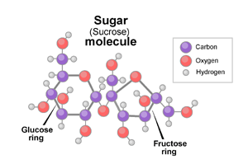
4. CHEMICAL ENERGY
THE ENERGY STORED IN THE CHEMICAL BONDS OF MOLECULES
EX) FOOD, GASOLINE AND DYNOMITE HAVE STORED ENERGY IN THEIR MOLECULES
EX) PHOTOSYNTHESIS – GREEN PLANTS USE SUNLIGHT TO MAKE SUGAR
RESPIRATION – LIVING THINGS RELEASE ENERGY TO LIVE(MOVE, STAY WARM,ETC)

Slide 8
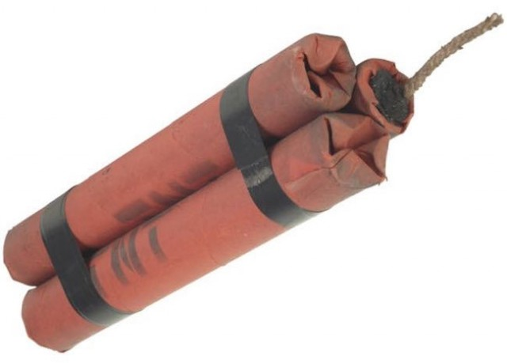
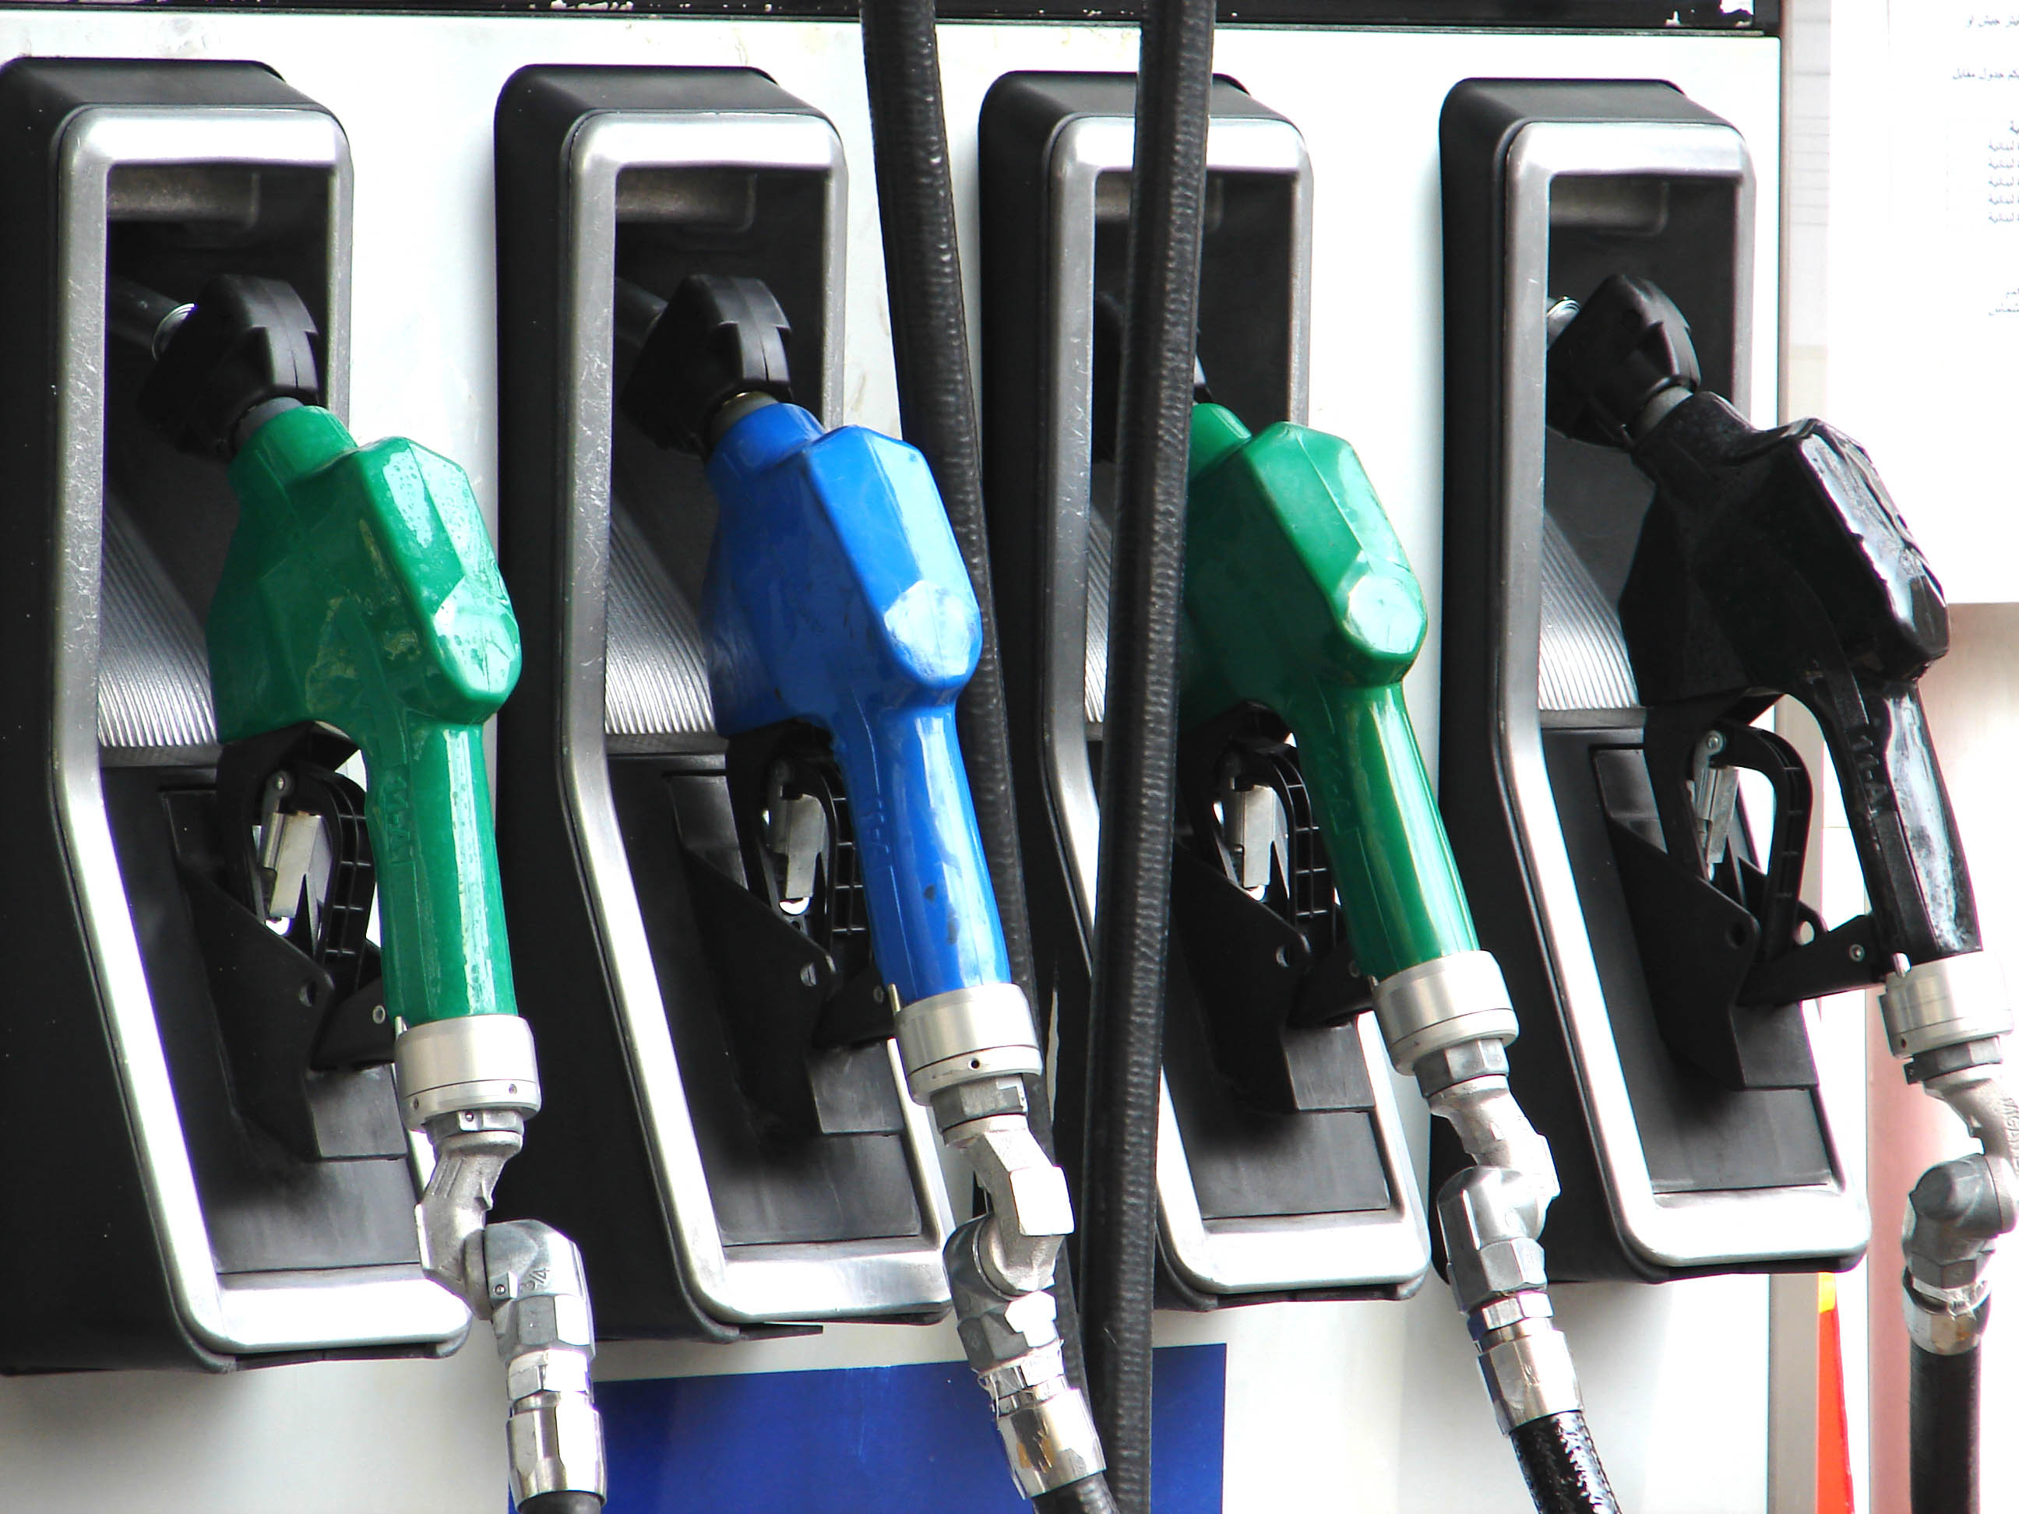
CHEMICAL ENERGY SOURCES

Slide 9
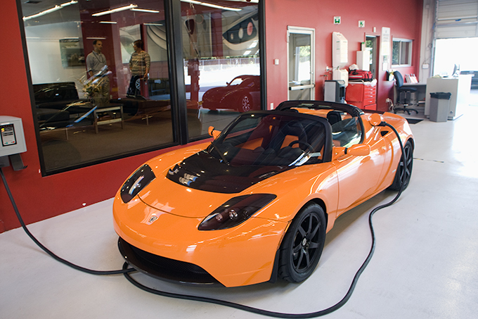
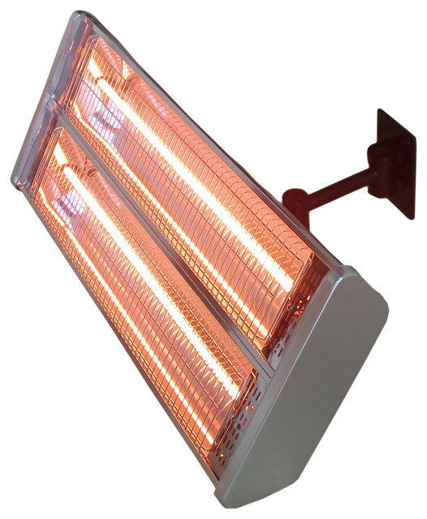
5. ELECTRICITY
MOVING ELECTRONS IN APPLIANCES CAN CREATE:
A. HEAT
B. LIGHT
C. MOVEMENT IN ELECTRIC MOTORS

Slide 10
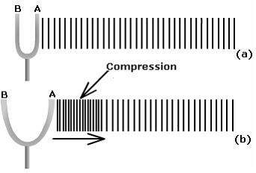
6. SOUND
LONGITUDINAL WAVES THAT TRAVEL THROUGH A MEDIUM SUCH AS AIR.
EX) HAVE YOU STOOD IN FRONT OF A SPEAKER OR WATCHED A CARS WINDOWS MOVE IN AND OUT?

Slide 11
INPUT ENERGY - THE ENERGY GOING INTO A SYSTEM IN AN ENERGY CONVERSION EX) CHEMICAL ENERGY AS GAS GOING INTO A CAR OUTPUT ENERGY – THE ENERGY COMING OUT OF A SYSTEM IN AN ENERGY CONVERSION EX) MECHANICAL ENERGY OF A CAR MOVING FROM BURNING THE GASOLINE

