Slide 1
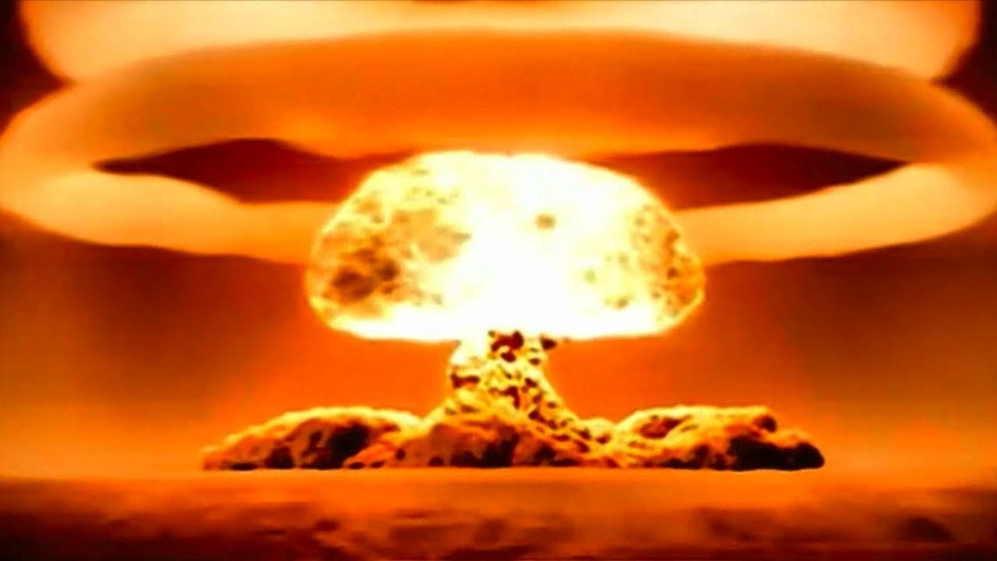
Energy transformations and the conservation of energy!

Slide 2
1. Energy transformations
WHEN ENERGY CHANGES FROM ONE FORM TO ANOTHER
EX) THE ROLLER COASTER HAS ALL OF IT’S ENERGY AT THE TOP OF THE FIRST HILL AS POTENTIAL ENERGY
THIS CHANGES DURING THE RIDE

Slide 3
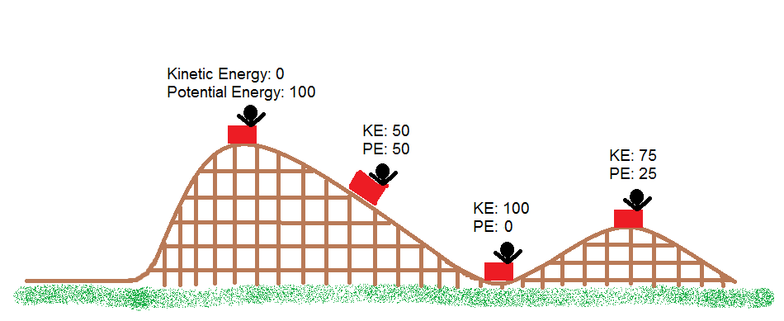
-SOME ENERGY IS LOST AS HEAT AND SOUND DUE TO FRICTION AND AIR RESISTANCE -CAN YOU EVER CLIMB A HILL BIGGER THAN THE FIRST? NO!!!!!!

Slide 4
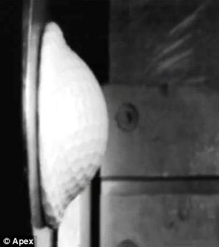
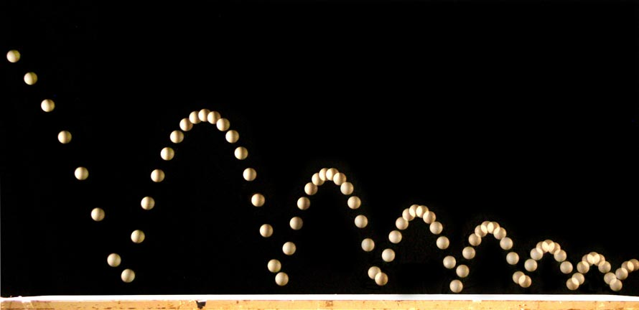
EX#2) WHY DOES A BOUNCING BALL STOP BOUNCING?
NOT ALL OF THE KE IS CHANGED TO ELASTIC PE
SOME IS LOST TO NONMECHANICAL ENERGY SUCH AS HEAT, SOUND, AS WELL AS AIR RESISTANCE AND FRICTION

Slide 5
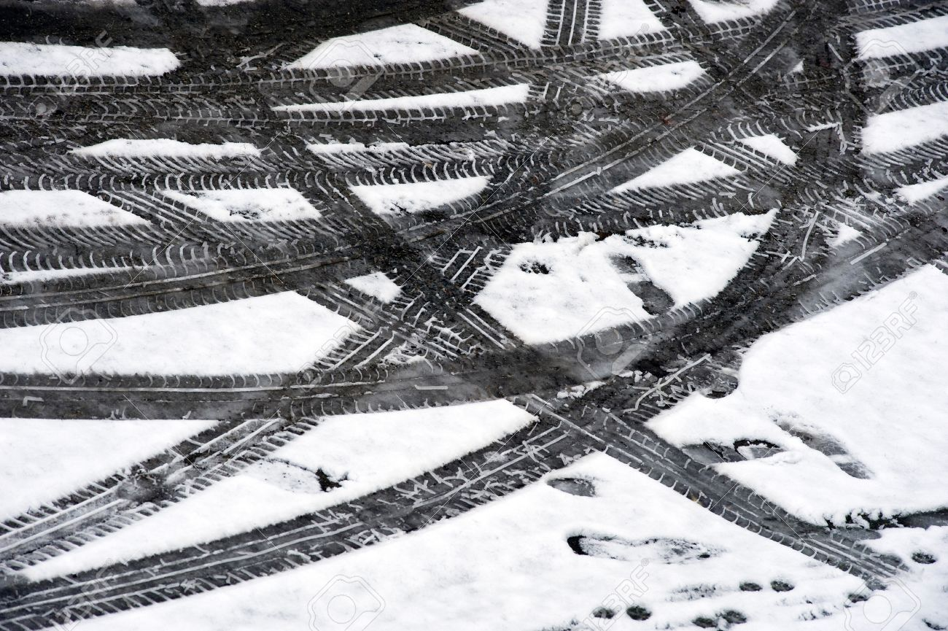
2. THE LAW OF CONSERVATION OF ENERGY
ENERGY CANNOT BE CREATED OR DESTROYED
IF ENERGY IN A SYSTEM INCREASES, IT MUST HAVE COME FROM OUTSIDE THE SYSTEM
IF IT LEAVES, IT ENTERS INTO ANOTHER SYSTEM EX) ROLLER COASTER HEATS AIR
CAR TIRES HEAT ROAD SURFACE

Slide 6
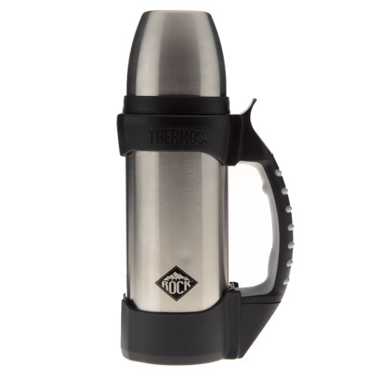
CLOSED SYSTEMS
SYSTEMS THAT ALLOW VERY LITTLE ENERGY IN OR OUT
LIKE A GOOD THERMOS!

Slide 7
OPEN SYSTEMS
SYSTEMS THAT EXCHANGE ENERGY WITH THEIR SURROUNDINGS
MOST SYSTEMS ARE OPEN
IS EARTH AS A WHOLE, AN OPEN OR CLOSED SYSTEM?

Slide 8
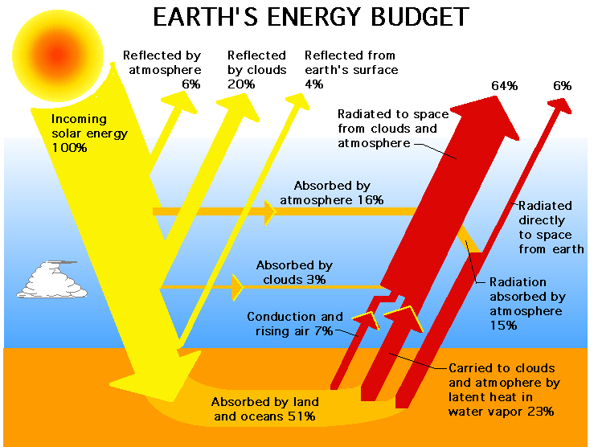
-OPEN BECAUSE WE GET ENERGY FROM THE SUN AND RADIATE SOME INTO SPACE EX 2)INSULATION HELPS REDUCE ENERGY LOSS IN A HOME BUT IT IS IMPOSSIBLE NOT TO LOSE ANY ENERGY

Slide 9
3. MACHINE EFFICIENCY
HOW MUCH USEFUL WORK (WHAT YOU WANT DONE) A MACHINE CAN DO COMPARED TO HOW MUCH WORK GOES INTO THE MACHINE
YOU ALWAYS HAVE TO PUT MORE WORK INTO A MACHINE THAN YOU GET OUT DUE TO FRICTION AND HEAT PRODUCTION
NO MACHINE IS 100% EFFICIENT
TEETER TOTTER IS CLOSE!

Slide 10
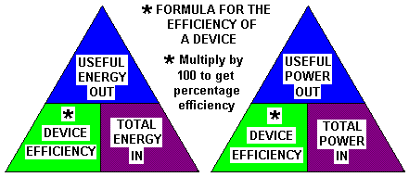
EFFICIENCY = WORK OUTPUT X 100% WORK INPUT

