Slide 1
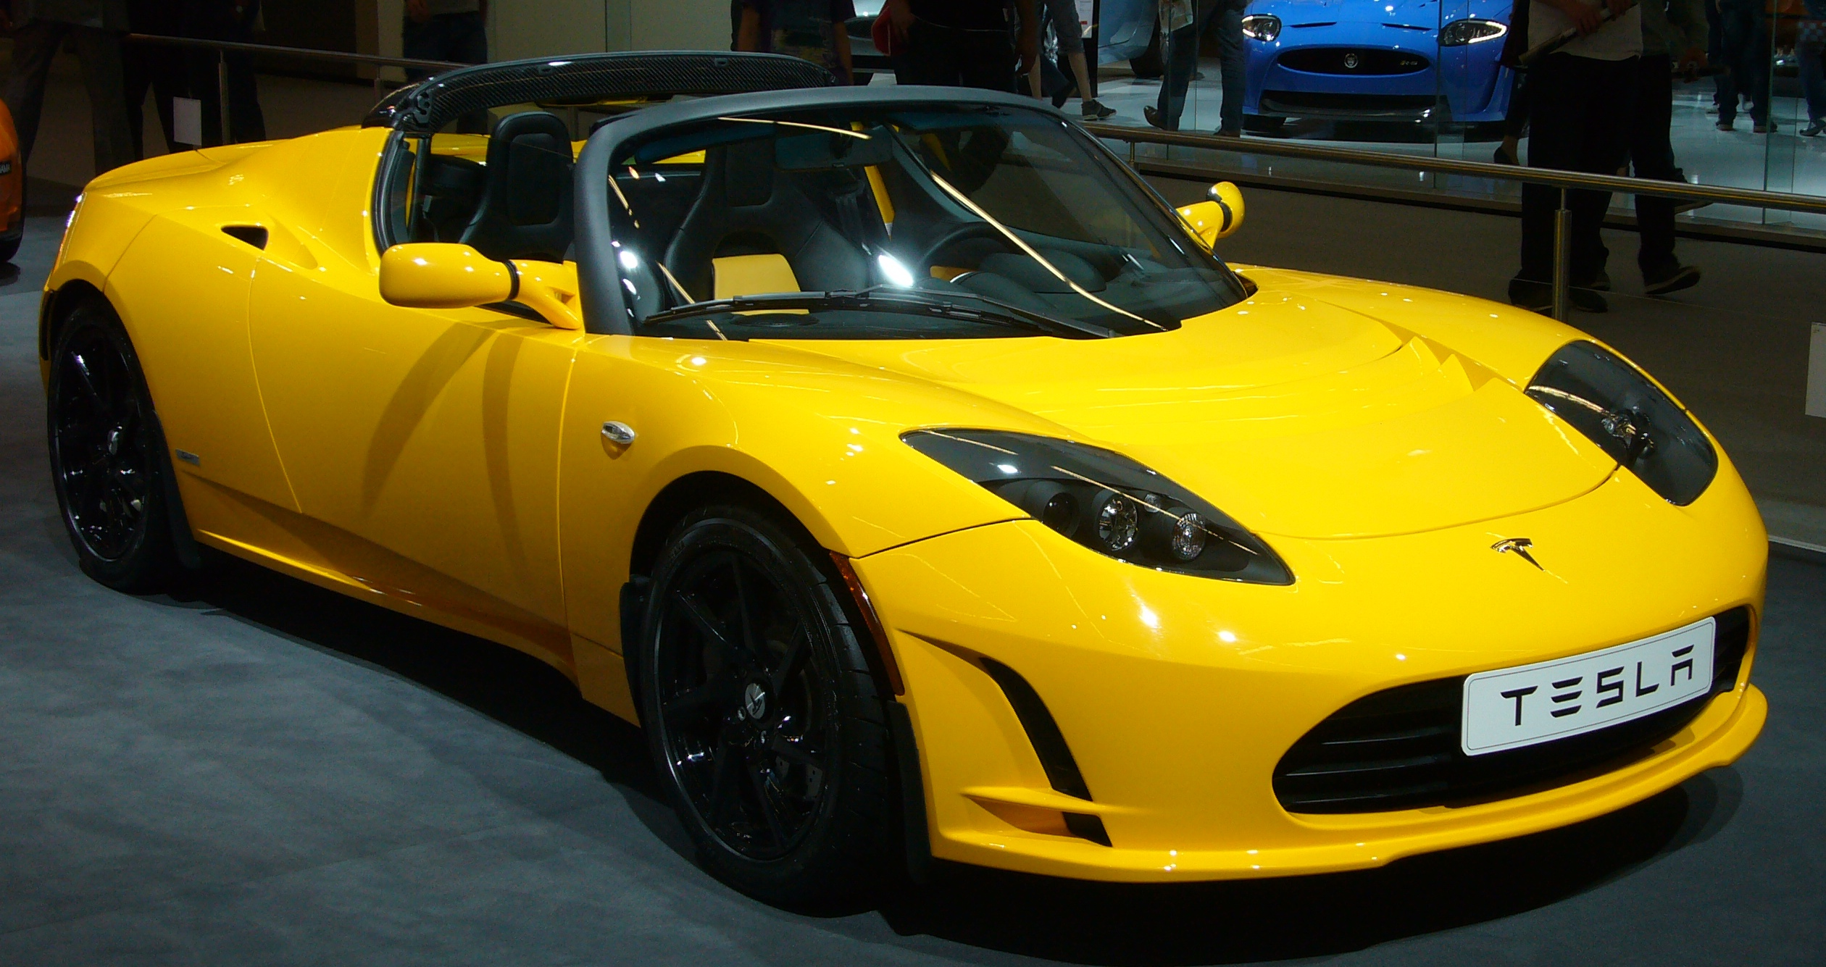
ELECTRICITY AND MAGNETISM

Slide 2
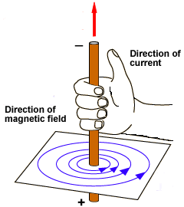
ELECTRIC CURRENTS
PRODUCE MAGNETIC FIELDS AND MAGNETIC FIELDS CAN PRODUCE ELECTRIC CURRENT
FIELD IS IN THE DIRECTION OF THE RIGHT HAND RULE

Slide 3
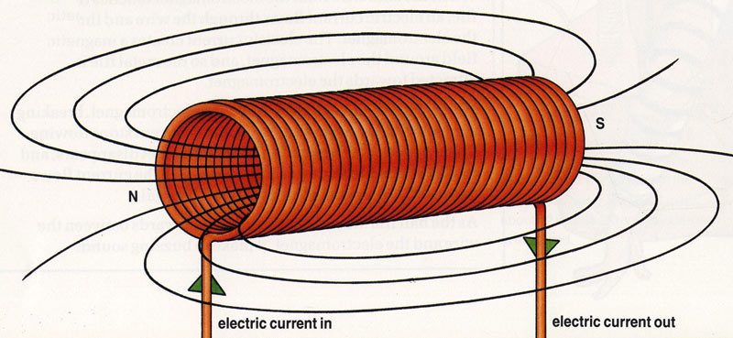
WHAT IS A SOLENOID
COIL OF WIRES WITH A CURRENT IN IT
MAKES MORE MAGNETISM THAN ONE WIRE

Slide 4
WHAT IS AN ELECTROMAGNET
A COIL WITH CURRENT (SOLENOID) WRAPPED AROUND A SOFT IRON CORE
MORE WRAPS MAKES STRONGER MAGNET
A GALVANOMETER IS AN ELECTROMAGNET USED TO MEASURE CURRENT

Slide 5
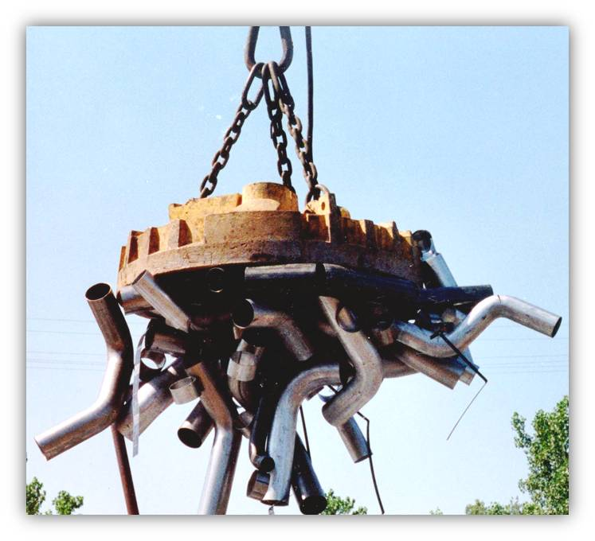

Slide 6
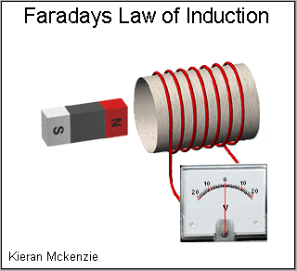
ELECTROMAGNETIC INDUCTION
CREATING AN ELECTRIC CURRENT BY CHANGING A MAGNETIC FIELD NEAR WIRES
CALLED FARADAYS LAW

Slide 7
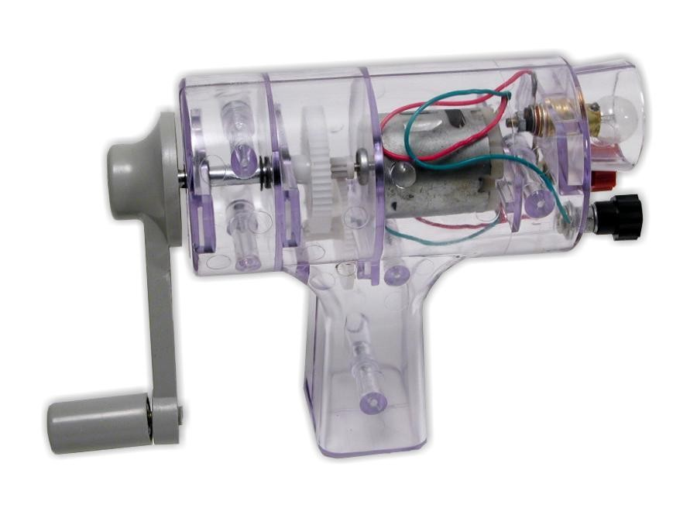
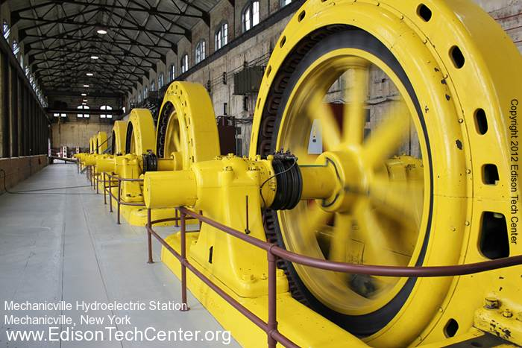
GENERATORS
CHANGE MECHANICAL ENERGY (MOVEMENT) TO ELECTRICAL ENERGY IN THE FORM OF AC OR ALTERNATING CURRENT
SPIN MAGNETS AROUND A COIL OF WIRES OR SPIN WIRES BETWEEN MAGNETS
PUSH AND PULL ELECTRONS

Slide 8
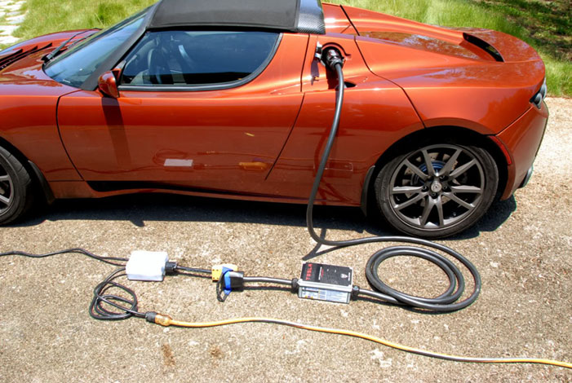
ELECTRIC MOTORS (OPPOSITE OF GENERATORS)
CHANGE ELECTRICAL ENERGY INTO MECHANICAL ENERGY
PLUG IN OR RUN ON BATTERIES

Slide 9
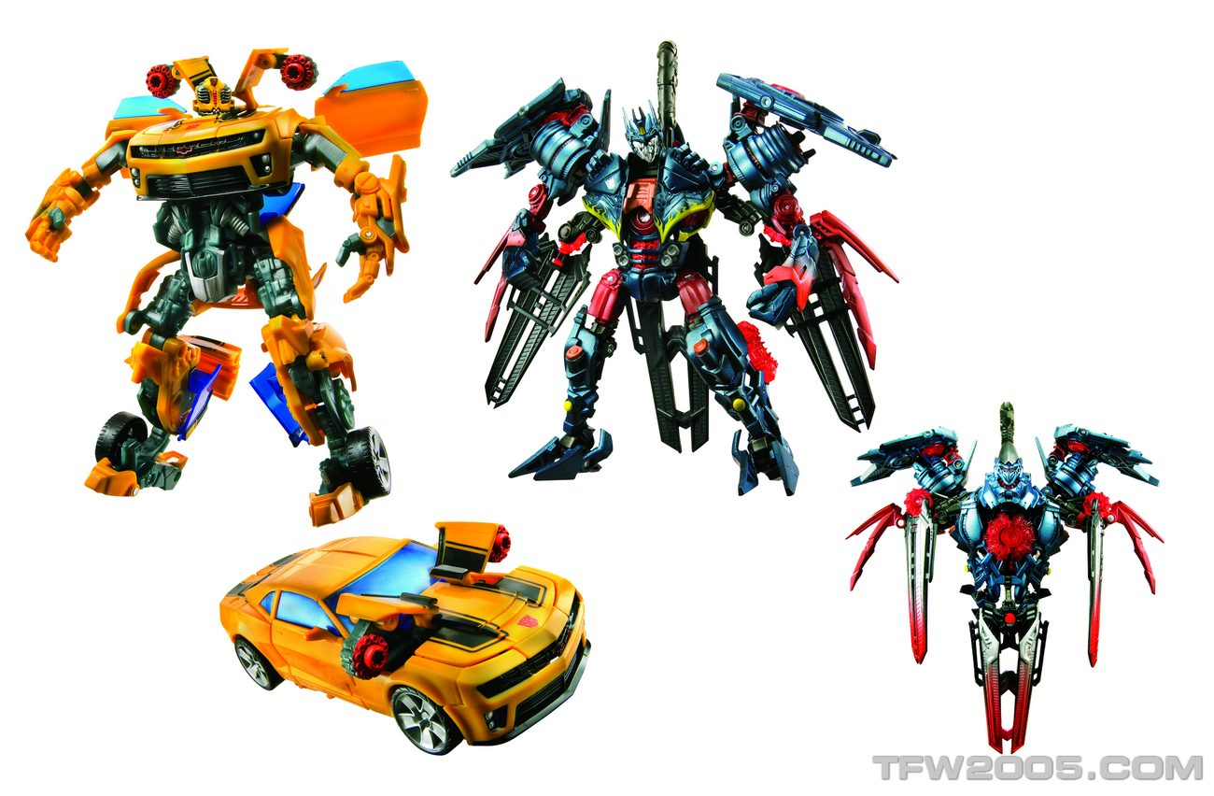
TRANSFORMERS
NO!!!! NOT THESE KIND!!!!!

Slide 10
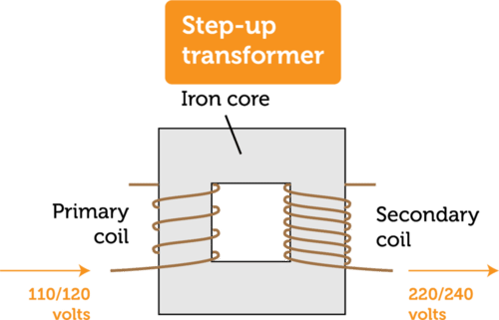
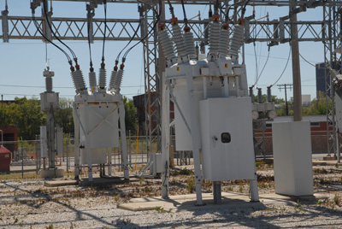
STEP UP TRANSFORMERS
INCREASE VOLTAGE BY INCREASING TURNS OF WIRE AROUND A CLOSED IRON LOOP
USED NEAR POWER PLANT TO TRANSPORT CURRENT

Slide 11
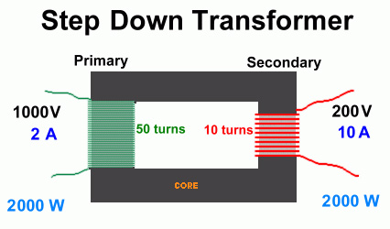
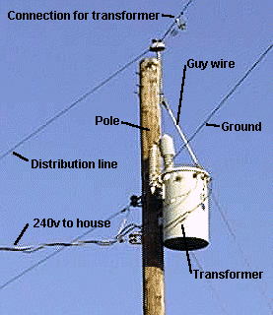
STEP DOWN TRANSFORMERS
DECREASE VOLTAGE BY DECREASING TURNS AROUND A CLOSED IRON LOOP
USED NEAR HOMES TO REDUCE VOLTAGE
MOST VOLTAGE IS 120 V

