Slide 1
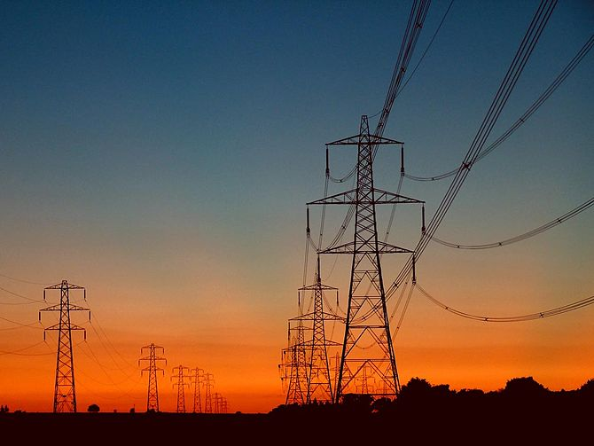
ELECTRICAL CURRENT

Slide 2
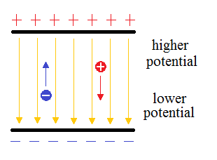
1. ELECTRICAL POTENTIAL ENERGY
ABILITY TO MOVE A CHARGE
DEPENDS ON POSITION IN AN ELECTRIC FIELD

Slide 3
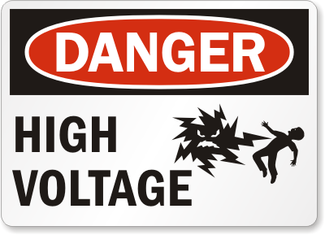
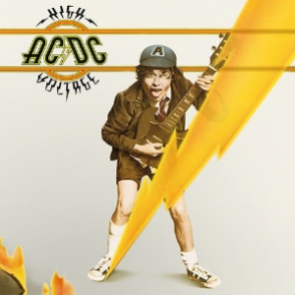
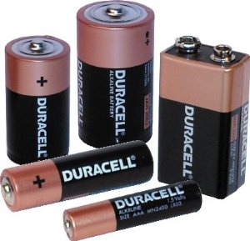
2. VOLTAGE (V)
THE WORK NEEDED TO MOVE A CHARGE
THE “PUSH”
THE POTENTIAL DIFFERENCE OR CHANGE IN ENERGY WHEN PARTICLES MOVE
MEASURED IN VOLTS (V)

Slide 4
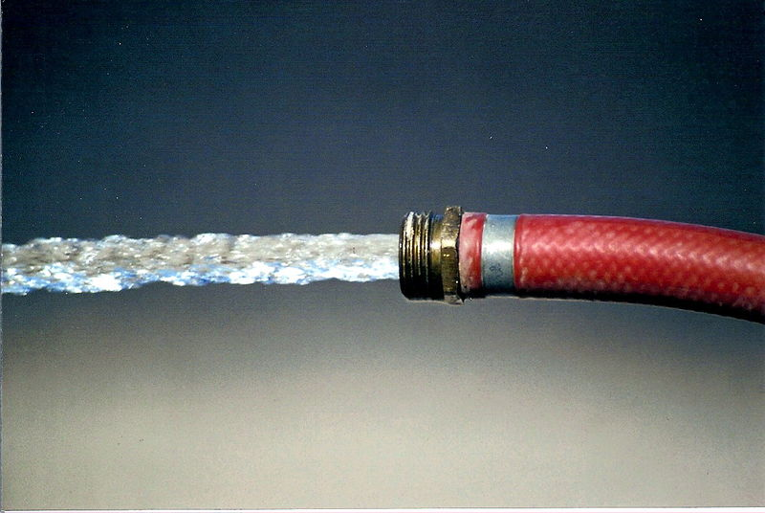
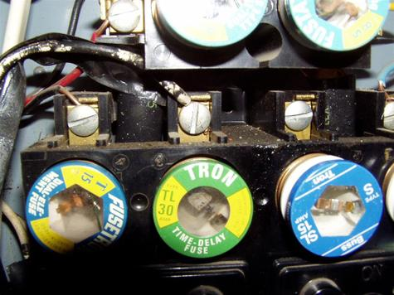
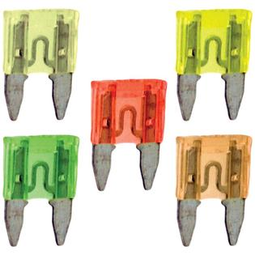
3. CURRENT (I)
THE RATE THAT CHARGES MOVE
AMOUNT OF CHARGE PER SECOND
MEASURED IN AMPERES (AMPS FOR SHORT)
SYMBOL IS ( I )
TO REMEMBER THINK CIA! ( CURRENT, I, AMPS )

Slide 5
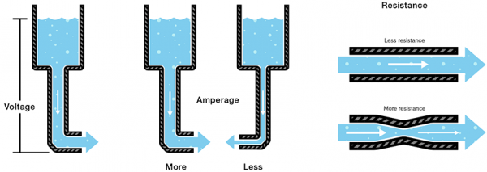
4. RESISTANCE ( R )
THE OPPOSITION TO THE FLOW OF CHARGES
DEPENDS ON THE MATERIAL
MEASURED IN OHMS

Slide 6
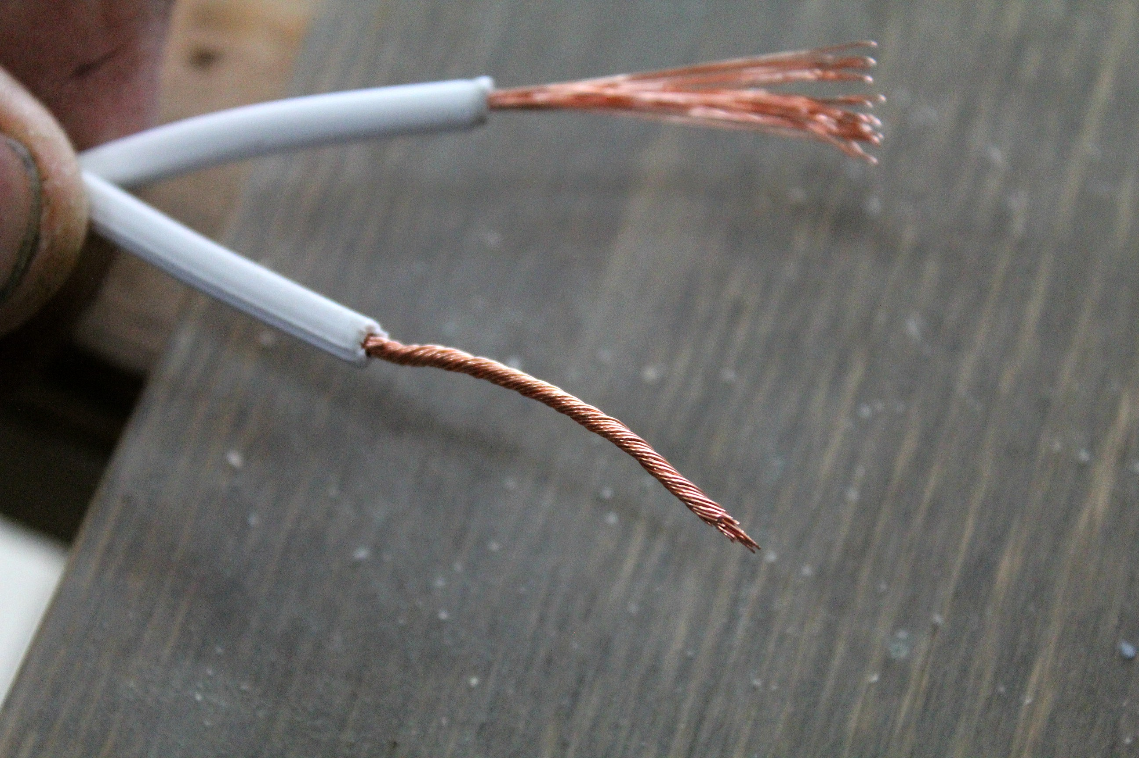
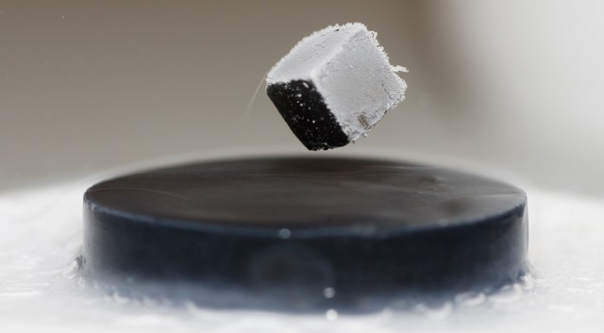
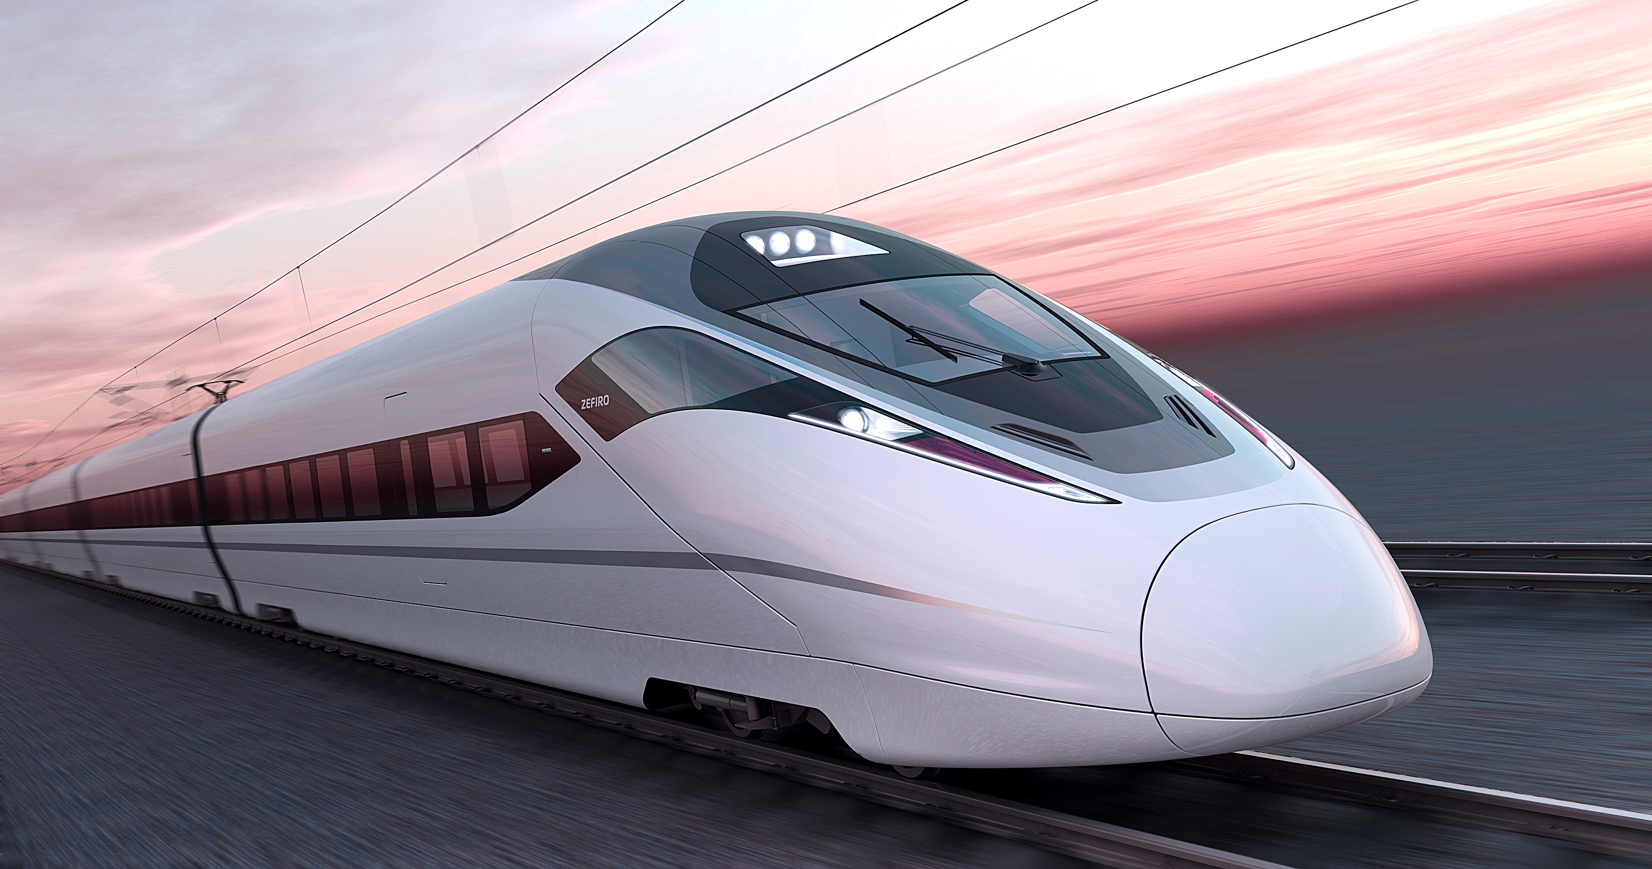
- INSULATORS HAVE HIGH RESISTANCE - SEMICONDUCTORS HAVE SOME RESISTANCE - CONDUCTORS HAVE LITTLE RESISTANCE - SUPERCONDUCTORS HAVE NO RESISTANCE AT LOW TEMPERATURES (FOUND IN POWERFUL MAGNETS AND MAGLEV TRAINS)

Slide 7
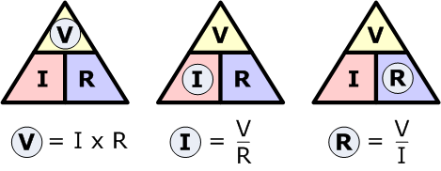
OHMS LAW
IT TAKES ONE VOLT OF PUSH TO OVERCOME ONE OHM OF RESISTANCE AND MOVE ONE AMP OF CURRENT
RESISTANCE = VOLTAGE
CURRENT
R = V
I

Slide 8
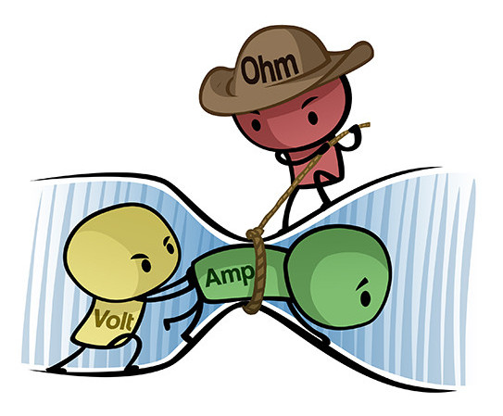

Slide 9
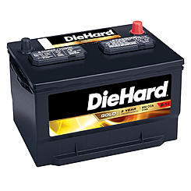
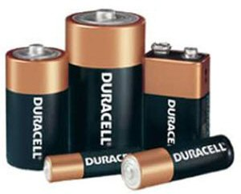
5. ELECTRIC CELLS (YOU CALL THEM BATTERIES)
CREATE A DIRECT CURRENT ( DC ) OR ONE WAY CURRENT
EX) WET CELL IS A CAR BATTERY
EX) DRY CELL IS A FLASHLIGHT BATTERY

Slide 10
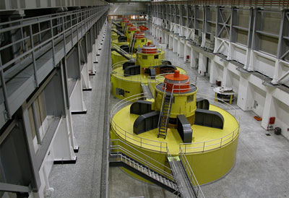
6. GENERATORS
PRODUCE ALTERNATING CURRENT ( AC ) WHICH PUSH AND PULL ELECTRONS
SPINS MAGNETS NEAR WIRES OR VISA VERSA
THINGS YOU PLUG IN RUN ON AC.
YOUR HOUSE RUNS ON AC

Slide 11
