Slide 1
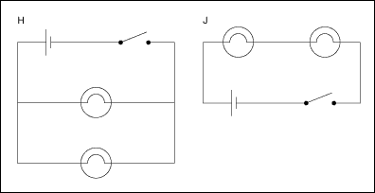
ELECTRIC CIRCUITS

Slide 2
1. WHAT ARE CIRCUITS?
A SET OF ELECTRICAL DEVICES THAT PROVIDE A COMPLETE PATH FOR ELECTRIC CHARGES
REPRESENTED BY A SCHEMATIC DIAGRAM
2 MAIN TYPES

Slide 3
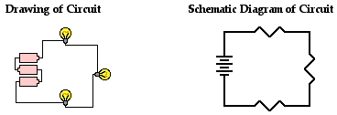
A. SERIES CIRCUIT
PROVIDES ONLY ONE PATH FOR CHARGES
ONE PART GOES OUT, THEY ALL GO OUT!
TOTAL CURRENT IN EACH DEVICE IS THE SAME (RESISTANCE AND VOLTAGE VARIES)
MANY CHRISTMAS TREE LIGHTS ARE SERIES

Slide 4
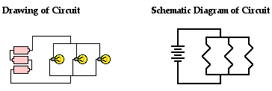
B. PARALLEL CIRCUIT
CHARGES HAVE MORE THAN ONE PATH TO FOLLOW
IF ONE PART GOES OUT THE OTHER PARTS MAY STAY ON
TOTAL CURRENT IS FOUND BY ADDING CURRENTS IN EACH LOOP (VOLTAGE SAME IN ALL DEVICES)
YOUR HOUSE IS WIRED IN PARALEL

Slide 5
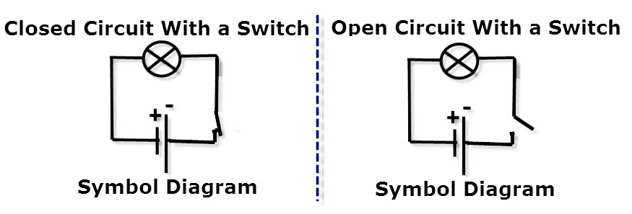
- AN OPEN CIRCUIT HAS A BREAK IN THE PATH AND IS OFF - A CLOSED CIRCUIT HAS NO BREAKS AND IS ON

Slide 6
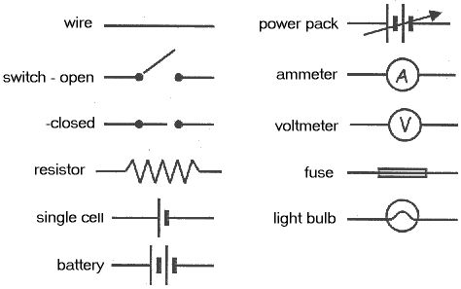
2. SCHEMATIC SYMBOLS (DRAW ONLY THE ONES LISTED ON YOUR NOTES)

Slide 7
3. FUSES AND CIRCUIT BREAKERS
PROTECT WIRES FROM OVERHEATING AND CAUSING A FIRE BY OPENING THE CIRCUIT
FUSES – HAVE A METAL STRIP THAT MELTS WHEN THE CURRENT IS TOO LARGE. NOT USED MUCH ANYMORE IN HOUSES. STILL USED IN CARS AND APPLIANCES.
CIRCUIT BREAKERS – HAVE A BIMETAL STRIP THAT OPENS CIRCUIT WHEN CURRENT IS TOO LARGE. CAN BE REUSED!
THE HAIRDRYER, BATHROOM LIGHTS AND RADIO MAY TRIP THE CIRCUIT BREAKER IN YOUR BATHROOM IF ALL ARE ON AT THE SAME TIME

Slide 8
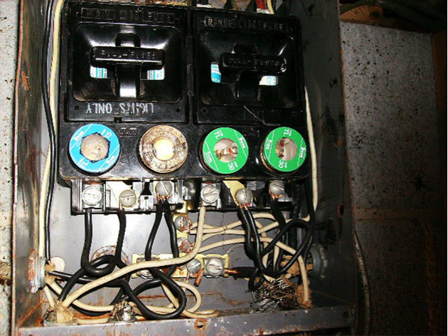
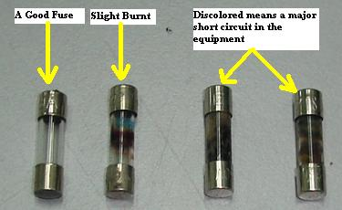
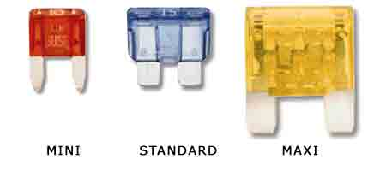
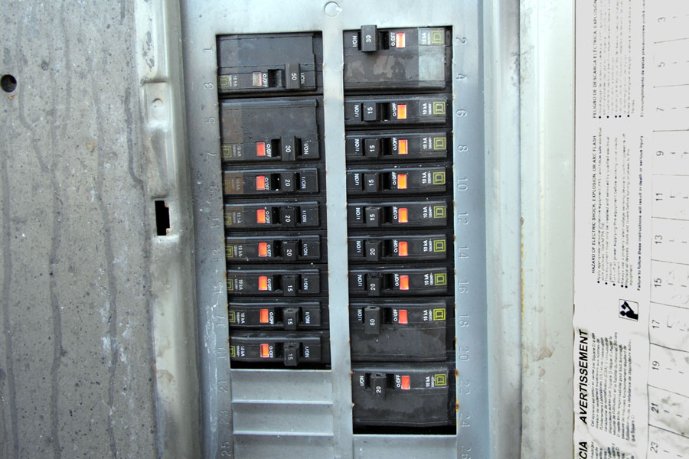
PICTURES OF FUSES AND CIRCUIT BREAKERS

Slide 9
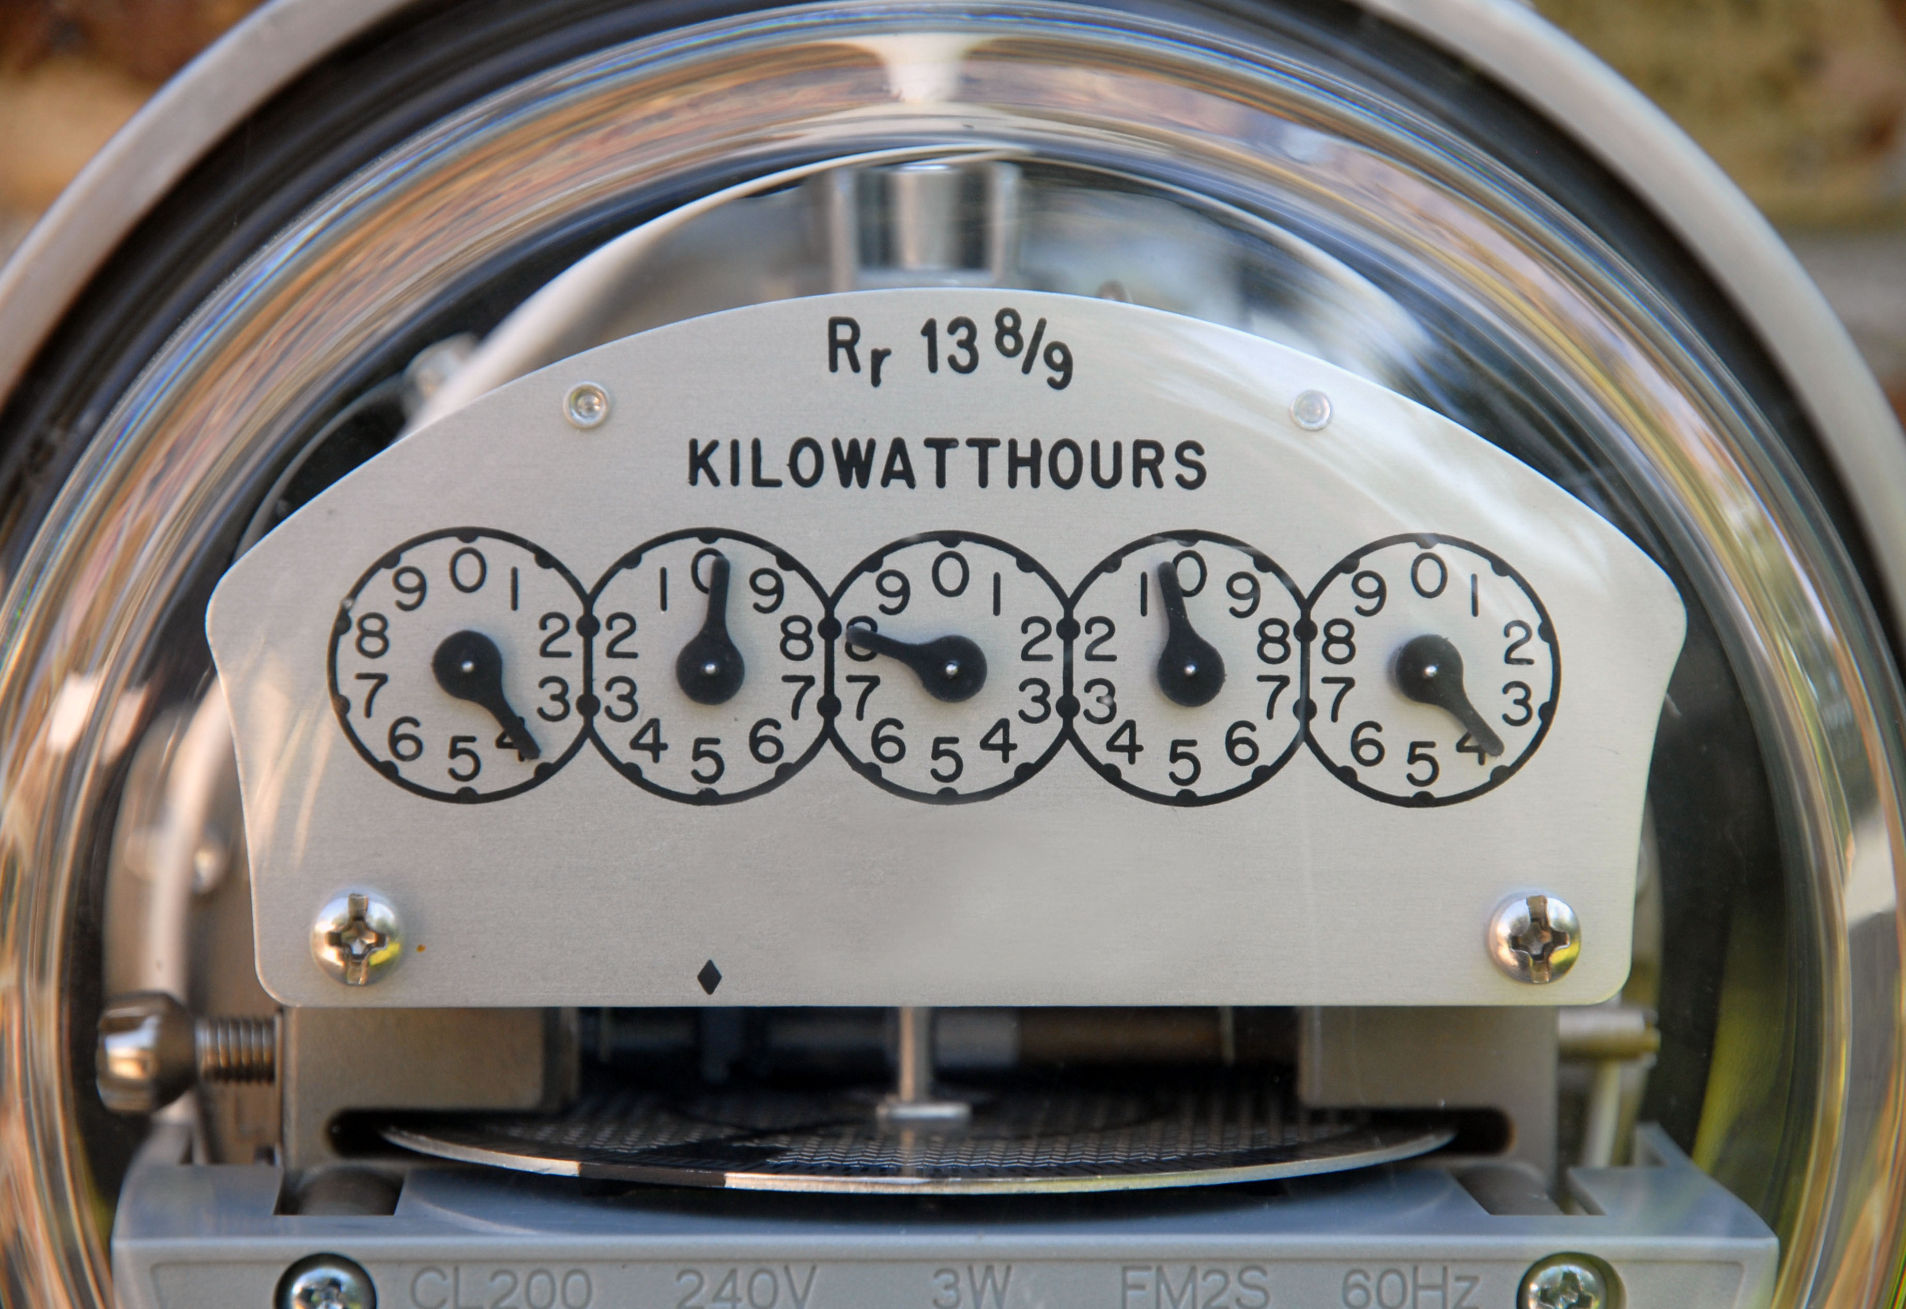
4. ELECTRIC POWER (P)
THE RATE AT WHICH ELECTRICAL ENERGY IS USED
MEASURED IN WATTS (W)
ONE KILOWATT = 1000 WATTS
ELECTRIC COMPANIES MEASURE HOW MANY KILOWATTS PER HOUR YOU USE IN KILOWATT-HOURS

Slide 10
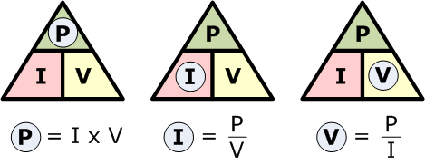
- POWER EQUATION
P = V x I WATTS = VOLTS X AMPS

Slide 11
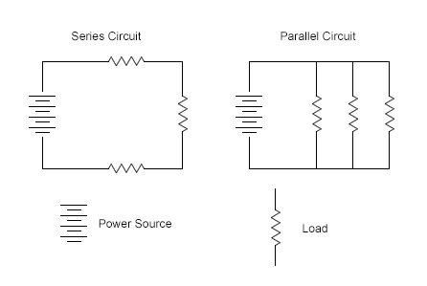

Slide 13
