Slide 1
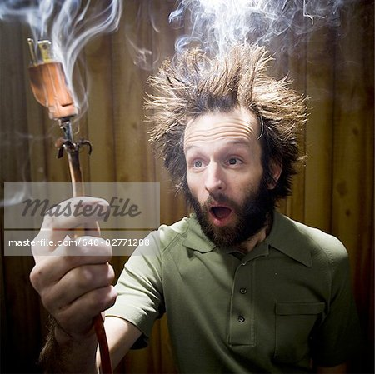
ELECTRIC CHARGE

Slide 2
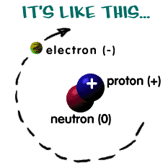
1. WHAT IS ELECTRIC CHARGE
PROPERTY THAT CREATES ELECTRIC AND MAGNETIC FORCES
PROTONS +
ELECTRONS -
NEUTRONS HAVE NO CHARGE 0

Slide 3
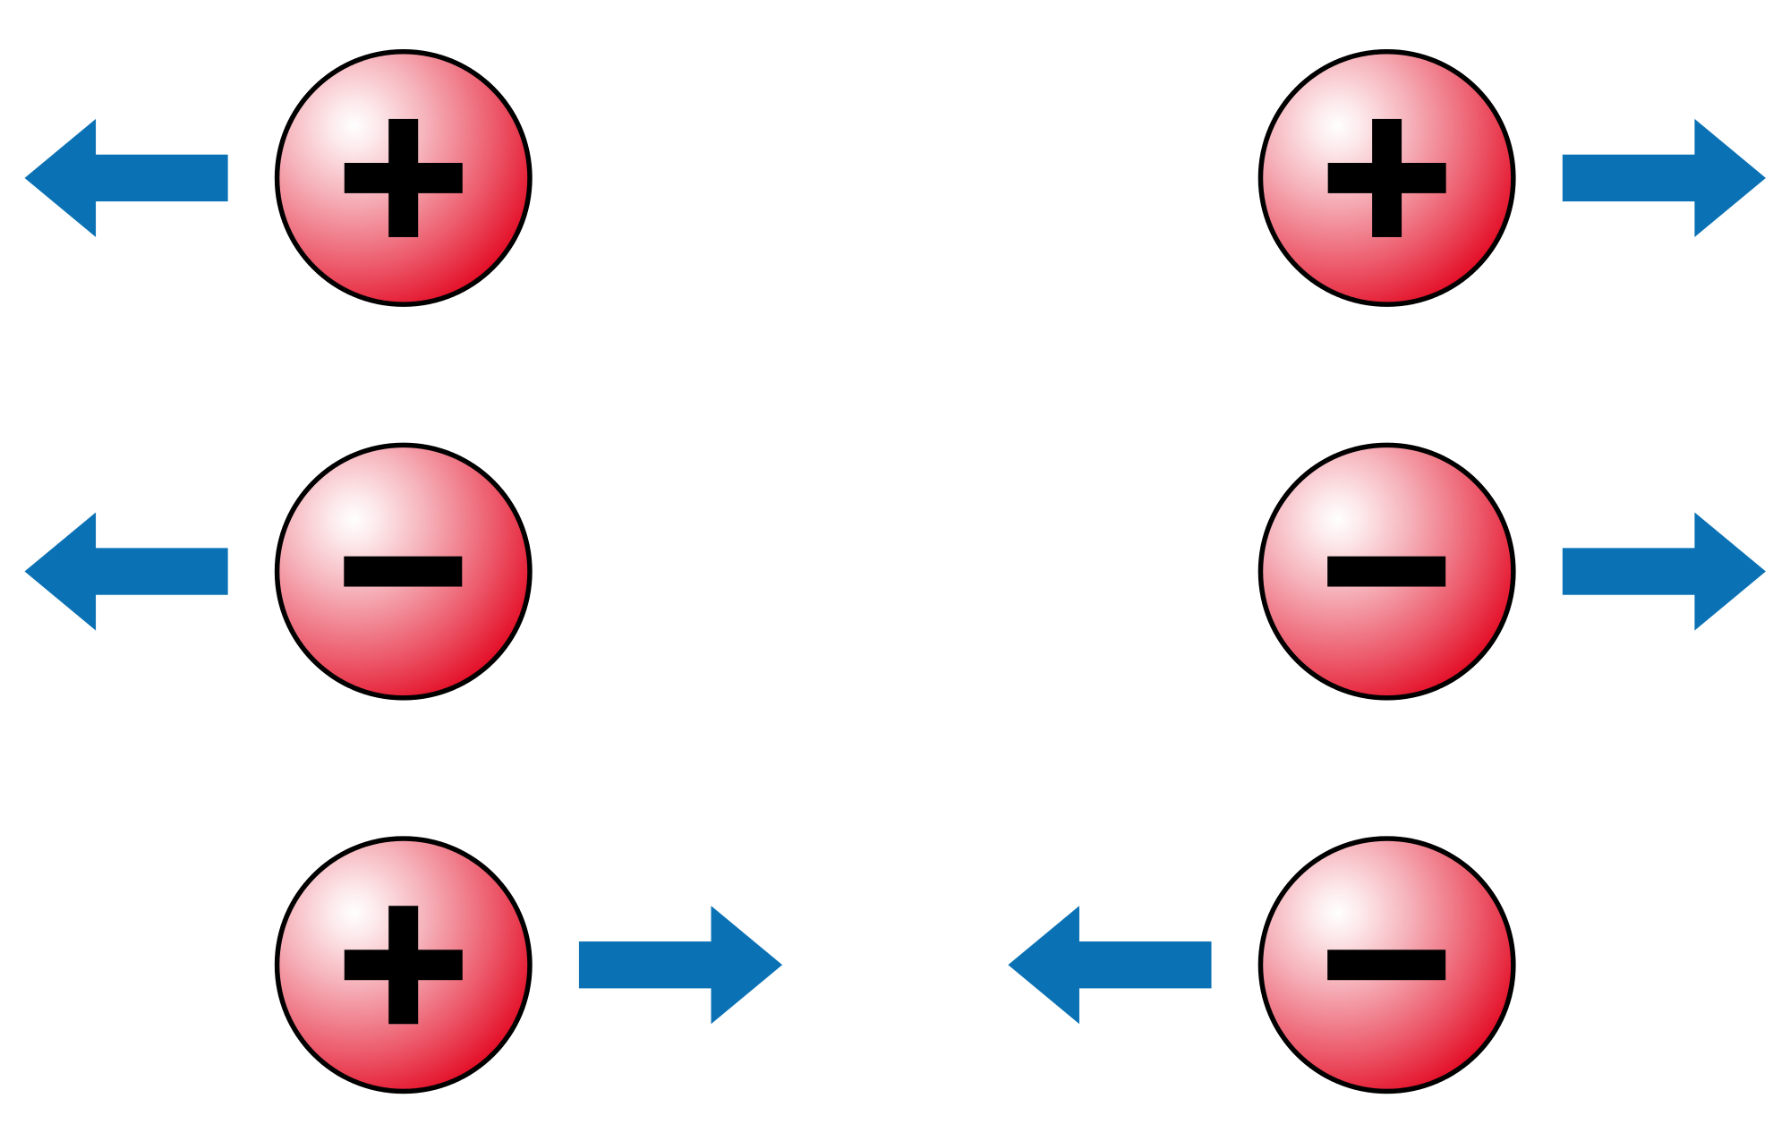
2. OPPOSITES ATTRACT AND LIKE CHARGES REPEL
PROTONS ATTRACT ELECTRONS BUT REPEL OTHER PROTONS
ELECTRONS ATTRACT PROTONS BUT REPEL OTHER ELECTRONS
NEUTRONS AREN’T ATTRACTED TO ANYBODY

Slide 4
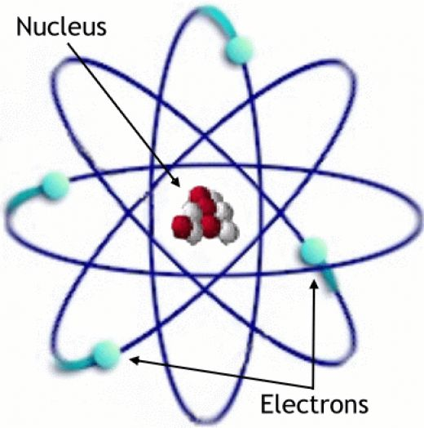
3. WHICH PARTICLE IS FREE TO MOVE?
THE ELECTRON
IT IS NOT HELD IN THE NUCLEUS

Slide 5
4. CONDUCTORS, SEMICONDUCTORS AND INSULATORS
CONDUCTORS- ALLOW ELECTRONS TO FLOW EASILY EX) COPPER OR GOLD
SEMICONDUCTORS- PROVIDE SOME RESISTANCE TO THE FLOW OF ELECTRONS EX) SILICON
INSULATORS- RESIST THE FLOW OF ELECTRONS EX) RUBBER OR WOOD

Slide 6
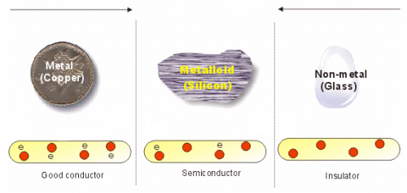

Slide 7
5. HOW CAN AN OBJECT OBTAIN A CHARGE?
BY HAVING AN UNEVEN NUMBER OF PROTONS AND ELECTRONS (3 METHODS TO DO THAT)
CONDUCTION – CHARGING AN OBJECT BY TOUCHING IT
INDUCTION – CHARGING AN OBJECT BY COMING CLOSE TO IT
FRICTION – CHARGING OF OBJECTS BY RUBBING

Slide 8
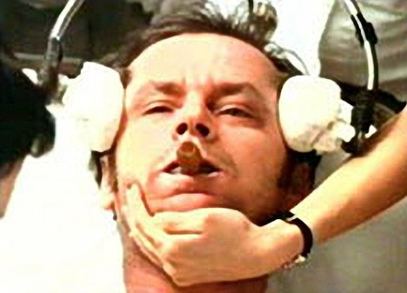
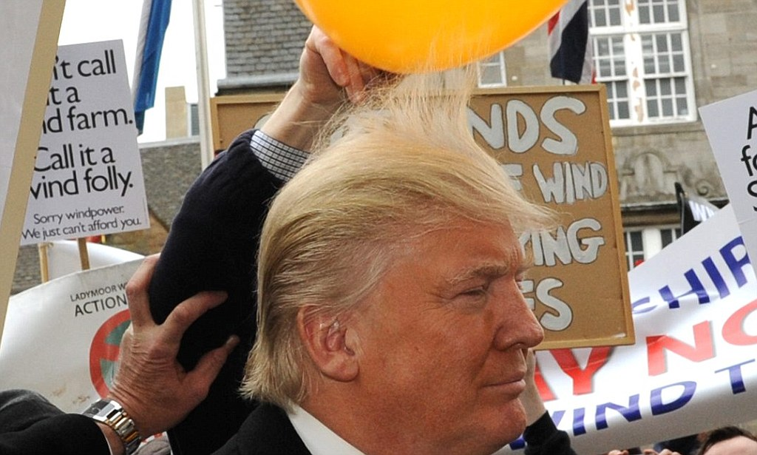
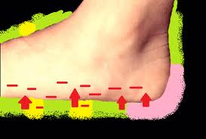

Slide 9
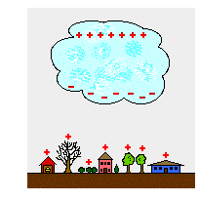
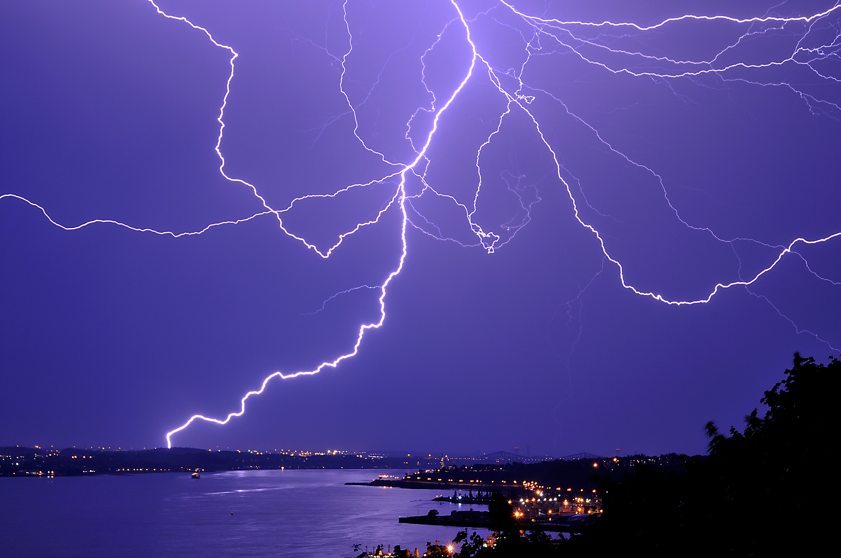
6. WHAT IS STATIC ELECTRICITY
THE ACCUMULATION OF EXCESS CHARGES ON AN OBJECT
EX) LIGHTNING IS CAUSED BY STATIC ELECTRICITY IN STORM CLOUDS
THE LIGHTNING ITSELF IS A STATIC DISCHARGE

Slide 10
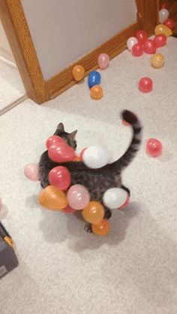

Slide 11
7. THE ELECTRIC FORCE AN OBJECT HAS
ACTS IN A SPACE CALLED THE ELECTRIC FIELD
INCREASES AS YOU INCREASE THE CHARGE OF THE OBJECT
DECREASES AS YOU INCREASE THE DISTANCE FROM THE OBJECT
CAN BE REPRESENTED BY ELECTRIC FIELD LINES
SEE NEXT SLIDE!

Slide 12
