Slide 1
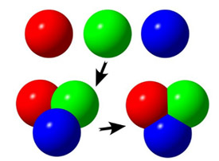
1.WHAT HAPPENS DURING A CHEMICAL REACTION?
ATOMS ARE REARRANGED. NOT DESTROYED!
BONDS ARE MADE AND/OR BROKEN

Slide 2
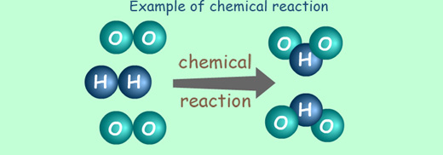
2. REACTANTS – GO INTO A REACTION PRODUCTS – COME OUT OF A REACTION
LAW OF CONSERVATION OF MATTER
WHAT GOES IN MUST COME OUT!

Slide 3
3. HOW CAN YOU TELL A CHEMICAL REACTION TOOK PLACE?
A. ENERGY TRANSFER (HEAT OR LIGHT GIVEN OFF,GETS COLD)
B. COLOR CHANGE
C. PRECIPITATE FORMS(SOLID MADE FROM TWO LIQUIDS)
D. NEW ODOR PRODUCED
E. FIZZING OR FOAMING

Slide 4
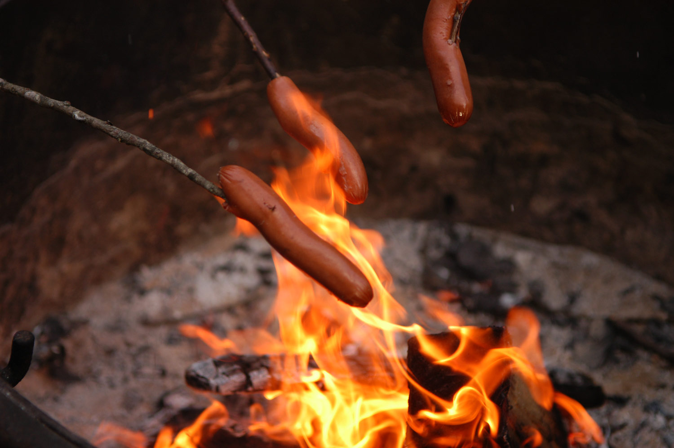
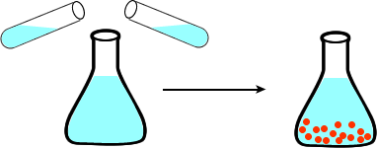
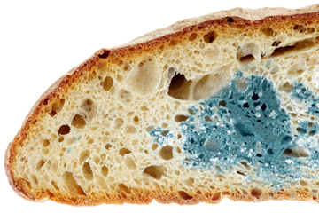
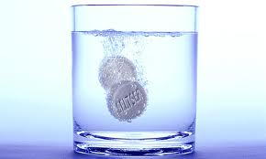
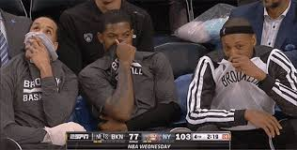

Slide 5
4. WHAT IS AN EXOTHERMIC REACTION?
ONE THAT RELEASES ENERGY TO THE ENVIRONMENT USUALLY AS HEAT OR LIGHT
EX) EXPLOSION OF A FIRECRACKER (REACTANTS HAVE MORE ENERGY THAN THE PRODUCTS)

Slide 6
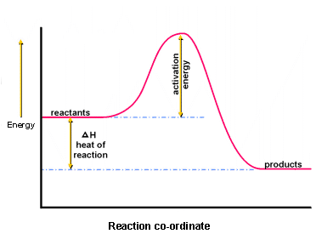

Slide 7
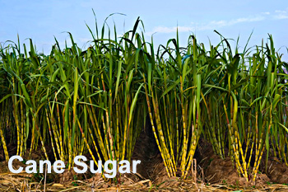
5. WHAT IS AN ENDOTHERMIC REACTION?
ONE THAT TAKES ENERGY FROM THE ENVIRONMENT USUALLY AS HEAT OR LIGHT.
EX) PHOTOSYNTHESIS ( FINISHED PRODUCT, “SUGAR” HAS MORE ENERGY THAN CARBON DIOXIDE AND WATER FROM WHICH IT IS MADE.

Slide 8
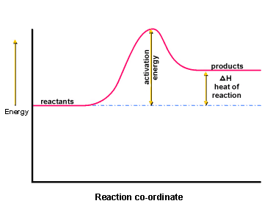

Slide 9
6. WHAT ARE THE FOUR MAIN TYPES OF REACTIONS? PAY ATTENTION AND IT WILL BE EASY!

Slide 10
A. SYNTHESIS
TWO CHEMICALS COMBINE TO FORM ONE
EX) H2 + O2 → H20

Slide 11
B. DECOMPOSITION REACTION
ONE CHEMICAL BREAKS APART INTO MORE THAN ONE.
EX) Al2O3 → Al + O2

Slide 12
C. SINGLE REPLACEMENT
ONE MEMBER OF A PARTNERSHIP GETS REPLACED.
EX) Fe + H2O → Fe3O4 + H2

Slide 13
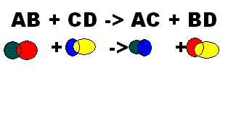
D. DOUBLE REPLACEMENT
TWO PAIRS SWITCH PARTNERS.
EX) Na2SO4 + CaCl2 → CaSO4 + NaCl

Slide 15
HgO → Hg + O₂
H₂ + N₂ → NH₃
Cl₂ + NaBr → NaCl + Br₂
CuCl₂ + H₂S → CuS + HCl

