Slide 1
1. IONIC COMPOUNDS
INVOLVES A TRANSFER OF ELECTRONS
OCCURS BETWEEN METALS (GIVING ELECTRONS) AND NONMETALS (TAKING ELECTRONS)
FORM NETWOK SOLIDS EX) SALT
CONDUCT ELECTRICITY IN WATER IONS MOVE!

Slide 2
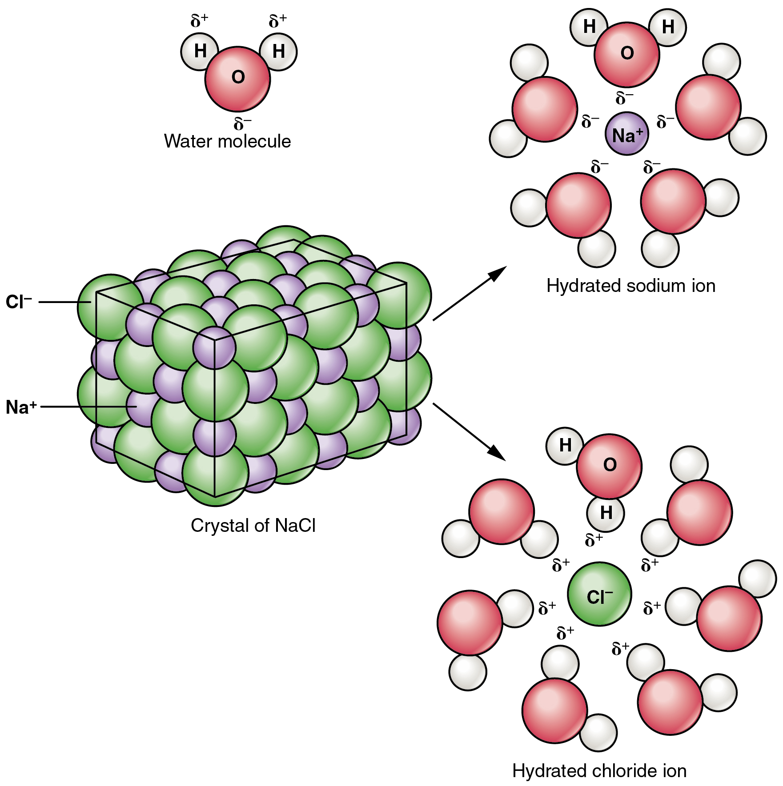

Slide 3
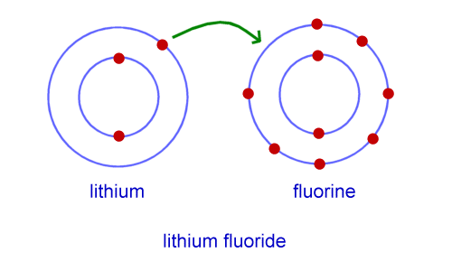

Slide 4
2. COVALENT COMPOUNDS
INVOLVES SHARING ELECTRONS
OCCURS BETWEEN NONMETALS
FORMS MOLECULES EX) SUGAR, WATER, NITROGEN GAS (AIR)
DON’T CONDUCT ELECTRICITY IN WATER

Slide 5
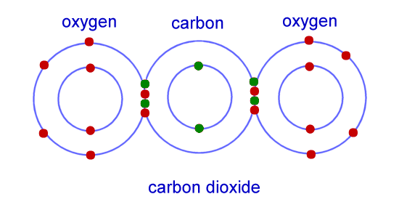

Slide 6
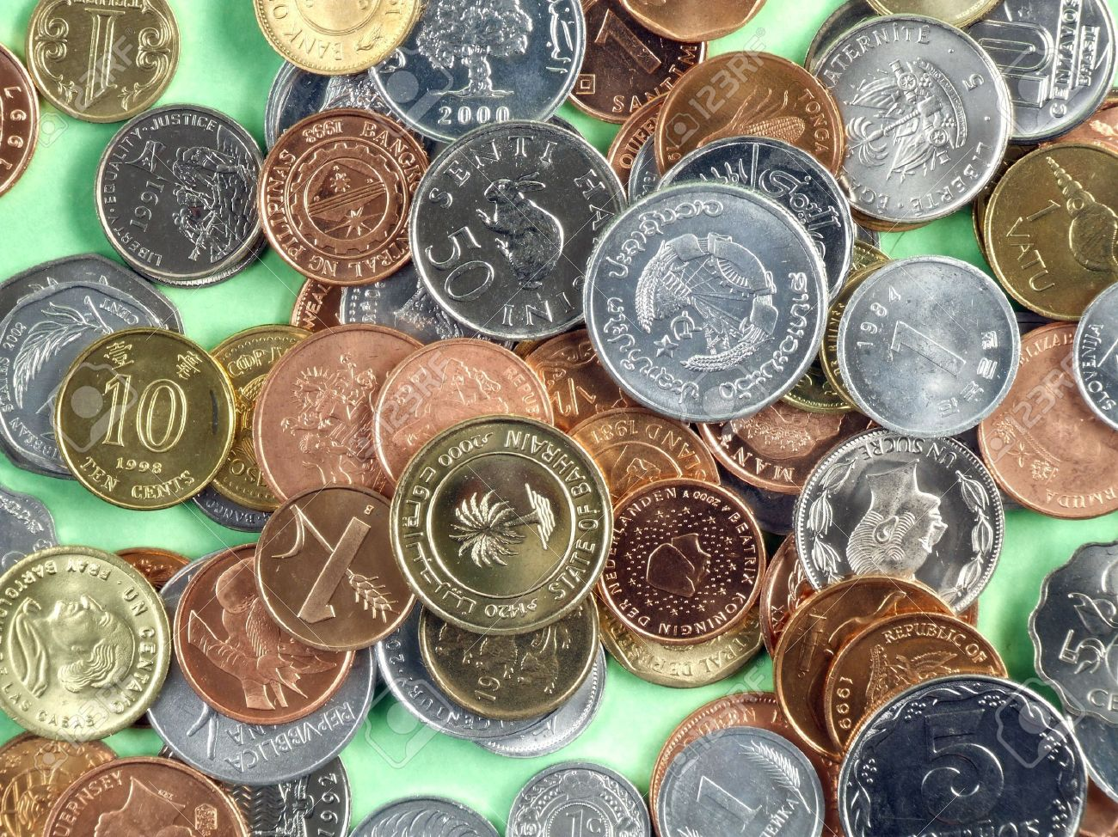
3. METALLIC BONDS
FREE SEA OF ELECTRONS
ELECTRONS ARE ATTRACTED TO ALL IONS IN A PIECE OF METAL AND FLOW AROUND
REASON FOR MALLEABILITY
REASON FOR CONDUCTIVITY

Slide 7
