Slide 1
Blood & Blood Spatter Analysis a.k.a. Forensic Serology
Sources
www.crosscuttingconcepts.com
Forensic Chemistry by David E. Newton
Infobase Publishing; 2007

Slide 2
Take out your notebook and copy the following questions. Provide a short answer.
Blood is……….
The most common blood type is………
Agglutination is……..
A presumptive test is ……….
A confirmatory test is……….

Slide 3
BLOOD as Evidence
Valued as evidence especially in violent crimes such as murder and rape
Characteristics are variable among the population making it possible to rule in or rule out a person as the perpetrator.
Stains and blood spatter patterns reveal information about the crime

Slide 4
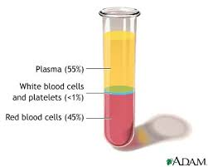
What is Blood?
Components of blood:
Plasma: the pale, yellowish colored liquid portion that contains proteins, enzymes, antibodies, dissolved nutrients
Red blood cells: carry oxygen to cells; carbon dioxide from cells; get the red color from hemoglobin
White blood cells: several different types: lymphocytes, monocytes, and neutrophils; responsible for immunity and fighting infection
Platelets: tiny fragments of cells that aid in blood clotting

Slide 5
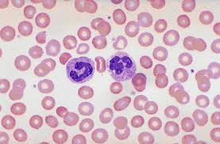
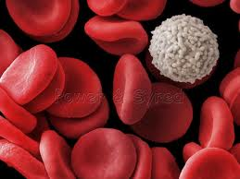
White blood cells
Red Blood Cells
platelets

Slide 6
Blood Types
Karl Landsteiner:
Searched to explain why it is not possible to transfuse blood from any one human into any other human
Why did some people do well when transfused blood from another person and others die? Why did the transfusion fail?
Later announced that human blood can be classified into a few classes or types known today as types A, B, AB, and O.

Slide 7
Early 1970’s: forensics began using blood groupings for clues to link blood to an individual.
Blood type is considered class evidence because it is not unique to an individual the way DNA and fingerprints are unique.

Slide 8
The rise of blood as evidence
There was little research in forensic serology prior to the 20th century.
A couple of tests for blood were developed in the late 1800’s:
Guaic test (by van Deem) and the hydrogen peroxide test (by Schonbein). Both tests detect hemoglobin in blood.
Mathieu Orfila: suggested that blood could be analyzed using a microscope.

Slide 9
The type of blood represents the antigens present on the red blood cell.
Blood Type | Antigen on RBC | Antibody in plasma
Type A | A antigen | B antibody
Type B | B antigen | A antibody
Type AB | A and B antigens | No antibody
Type O | No A or B antigen | Both A and B antibodies

Slide 10
Using Blood type to solve a crime
Frequency of types in the population
Blood type | Expected Frequency
A positive | 1 in 3
A negative | 1 in 16
B positive | 1 in 12
B negative | 1 in 67
AB positive | 1 in 29
AB negative | 1 in 167
O positive | 1 in 3
O negative | 1 in 15

Slide 11
Type | African American | Asian | Caucasian | HIspanic
O positive | 47% | 39% | 37% | 53%
O negative | 4% | 1% | 8% | 4%
A positive | 24% | 27% | 33% | 29%
A negative | 2% | 0.5% | 7% | 2%
B positive | 18% | 25% | 9% | 9%
AB positive | 4% | 7% | 3% | 2%
AB negative | 0.3% | 0.1% | 1% | 0.2%
Correlation of Blood Type and Race

Slide 12
Blood types continued……
Agglutination: the clumping of blood cells
Results from an antigen-antibody reaction
Blood cells containing a specific antigen will clump when mixed with blood that contains the antibody against that antigen.
This was the reason behind failed transfusions in Landsteiner’s time.

Slide 13
Blood types continued…..
Why failed transfusions cause death?
Patients cells clump.
Clumped cells block blood vessels and stop flow of blood.
Clumped cells can rupture releasing contents such as free hemoglobin that is toxic to the body when it is not attached to the red blood cell.

Slide 14
Using Blood type to solve a crime
Can be used to narrow down a pool of suspects if the blood type (class evidence)
Example: if the stain is type A then potential suspects that are not type A can be excluded.
The presence of the Rh antigen on red blood cells) gives another criteria for inclusion or exclusion as well.
There are other antigens that have also been discovered that help to further narrow the range of suspects.
Ex. Duffy, Kidd, MNS, Kell, Lewis, Lutheran
There are also antigens present on White Blood cells know as HLA (human lymphocyte) antigens.

Slide 15
Blood Stains
First determine whether the stain is blood or some other red substance.
Blood released from the body is bright red for about the first 3 to 5 minutes. As it dries it turns a brown to black color.
Wet blood is usually easier to test than dried blood.

Slide 16
Presumptive test: a quick test that can be performed at the scene to determine if a piece of evidence is relevant and needs to be sent for further testing.
Presumptive tests can save time and money.

Slide 17
Presumptive Tests for Blood……
One of the earliest
Adler’s or Benzidine test; mix hydrogen peroxide with benzidine and treat the blood stain.
Oxidation-reduction reaction:
Benzidine + Hydrogen peroxide + hemoglobin in blood → diazo dye that is blue-green in color.
The benzidine is reduced in the reaction.
In 1973, the EPA banned benzidine as a carcinogen.

Slide 18
https://www.youtube.com/watch?v=pnH2HnB-GrI
Kastle-Meyer Test
Reagent contains: potassium hydroxide (KOH), phenolphthalein (in indicator) and zinc dust
Stain is treated with the reagent.
The Reaction: when Kastle-Meyer reagent is combined with hydrogen peroxide and blood, the hemoglobin in the blood catalyzes the conversion of phenolphthalein causing it to change to a deep pink color.
Can give false positive with vegetable materials present

Slide 19
Hemastix test:
Cellulose strip with a mixture of o-toluidine and hydrogen peroxide on a tiny pad
Moisten strip and dip in to the sample to be tested
The reaction: Hemoglobin catalyzes the conversion of o-toluidine to a green colored product.
Intensity of the green color is matched to a scale to indicate the concentration of blood present in the sample.

Slide 20
Luminol (5-amino-2,3-dihydro-1,4-phthalizinedione)
First developed by Walter Specht in 1937
The reaction: Luminol when treated with hydrogen peroxide in the presence of blood, one ring of the luminol breaks apart. Nitrogen gas is released and 3-aminophthlate is produced in an excited state. After a brief moment, the 3-APA gives off a photon (425 nm). A blue flourescent light is noted.
Highly sensitive: detects bloodstains diluted up to 10 million; works well on old blood stains too
Does not interfere with blood typing or DNA analysis
Can give false positives with plant enzymes, oxidizers, metals, and chlorine

Slide 21
Presumptive Test Summary
Presumptive Test | Indication of Positive | Situation Used | False Positives
Phenolphtalein (Kastle-Meyer) | Bright pink color | on visible stains | Vegetable material (potatoes and horseradish)
Tetramethylbenzidine (TMB) / Hemastix | Green to blue-green color | on visible stains | Oxidizing agents, catalyst, vegetable peroxidase, cosmetics
Luminol | Blue-white to yellow-green light | latent blood | Plant enzymes, oxidizing agents, metals, chlorine
Fluorescein | Fluoresce with UV light source | latent blood, vertical surface | Copper, hypochlorite

Slide 22
Confirmatory Tests for Blood
Teichmann test (1853)
Reagent: mixture of glacial acetic acid and sodium chloride
The reaction: reagent causes hemoglobin molecules in blood to split producing brown crystals of hemin (purple to almost black)

Slide 23
Confirmatory Tests for Blood
Takayma Test (1912)
The reaction: pyridine is added to blood causing the reduction of hemoglobin to a pyridine-hemoglobin complex that is salmon pink color.

Slide 24
Human blood or animal blood
Once a stain has tested positive for blood, the origin (animal or human) must be determined.
Ouchterlony test or precipitin test (1960)
The test: based on antibody-antigen reaction
Experimental animal (rabbit) is injected with sample of human blood. Rabbit makes antibodies to human blood cells. Blood is drawn from rabbit and mixed with the unknown blood sample. If the blood is human, clumping will be observed and it can be concluded that the unknown blood was human.

Slide 25
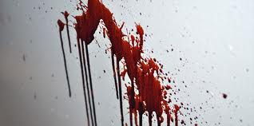
Bloodstain Patterns
Important elements of Blood pattern analysis:
Type of surface on which blood falls
Smooth, hard surface results in more clearly defined drops
Shapes of the individual drops
Round (circular) shape means the blood dropped vertically
Drops at an angle appear more elliptical
Greater angle = more elliptical shape
Pointed end always faces the direction of the source

Slide 26
Spatter Patterns
Low velocity: outward projection of blood drops in a relatively cohesive amoeba-shaped array
Medium velocity: individual droplets that are about 1 millimeter or more in diameter [weapon moves with a velocity of 100 ft/sec (30 m/s)]
Possible weapons: person’s fist, hammer, knife or baseball bat (blunt instruments)
High velocity: droplets less than 1 millimeter in diameter (tiny drops) produced by rapidly moving object such as a bullet fired from a gun

Slide 27
What can a blood spatter tell you……
The source of the blood (where the victim was struck)
The type of impact that produced the blood
The number of incidents that occurred to produce the blood (how many impacts)
The direction and speed that the victim was moving during the crime
The position of the victim during the crime
Whether the victim’s arteries were cut

Slide 28
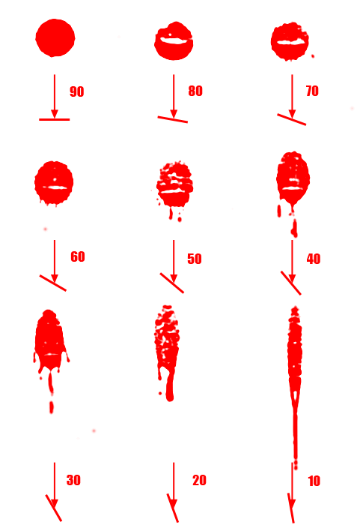
www.crosscuttingconcepts.com

Slide 29
Trigonometry and Angle of Impact
To determine the angle of impact:
Measure the width and length of the blood spatter. Length must be longer than width.
Divide width by length.
Take the arcsine of your result.
This formula will not produce accurate results at extreme angles ( less than 10˚ or greater than 60 ˚). o determine the angle of impact:
Measure the width and length of the blood spatter. Length must be longer than width.
Divide width by length.
Take the arcsine of your result.
This formula will not produce accurate results at extreme angles ( less than 10˚ or greater than 60 ˚).

Slide 30
Find your blood pattern sheets from yesterday.
Begin measuring each blood drop.
Measure the length and width for each drop. You can write this information on the droplet sheet next to each drop. Once you have 3 or 4 consistent measurements, average them and record on your lab data sheet. Instructions to follow for what to do next.

Slide 31
Area of Convergence (2d area)
After many strings have been placed, a general area of convergence will appear where the strings overlap.
This can also be done on a computer with image analysis software.
www.crosscuttingconcepts.com

Slide 32
Point of Origin (3d volume)
The procedure for generating the point of origin is just like the area of convergence, except the angle of impact for each stain is calculated.
This is a method of adding a third dimension to the 2d area of convergence calculation.
n is just like the area of convergence, except the angle of impact for each stain is calculated.
This is a method of adding a third dimension to the 2d area of convergence calculation.
2d Solution – no angular data

