Slide 2
Forensic Odontology
Forensic odontology is a unique field that combines the skills of a specially trained dentist with those of law enforcement.
The forensic dentist’s primary duty is human identification.
They examine evidence from cases involving violent crime, abuse, missing persons, and disaster scenarios to identify victims or suspects.

Slide 3
Forensic Odontology
The majority of a forensic dentist’s case load are two types of case:
Missing and unidentified persons
Recognition, documentation, and preservation of bite mark evidence

Slide 4
Dental Evidence
Dental evidence includes anything relating to human dental anatomy or derived from the oral environment such as:
Tooth shapes
Metal restorations
Skull and jawbone irregularities
Skull fragments
Teeth are sometimes all that remains of a body in catastrophic conditions.

Slide 5
Evidence Left Behind
A perpetrator of a crime often leaves evidence at the scene.
Bitten food or chewed objects may be recovered by investigators and examined by a forensic dentist.
Forensic dentists examine bite marks and compare with replicas of the suspect’s teeth.

Slide 6
Teeth Marks
Teeth marks can be found in soft objects.
The most famous bite mark case of the 20th century involved the serial murderer Ted Bundy.
In 1978, a human bite mark was discovered on the body of one of his murder victims.
The jury attested that the bite mark evidence was very compelling in their decision to convict Bundy of murder.

Slide 7
Analysis of Bite Marks
Any patterns produced by teeth in a biting incident must be photographed next to a scale.
The analysis of a bite pattern’s possible link to a suspect depends on accurate and reliable collection of the evidence.
This included immediate documentation of the marks. Natural healing will soon eliminate evidence in the form of bruises and cuts.

Slide 8
Analysis of Bite Marks
The objective of bite mark analysis is to connect or eliminate a suspect to a bite mark.
The ability of human skin to register detail is highly variable. Many bite marks are ill defined or distorted.

Slide 9
Analysis of Bite Marks
In a 1999 meeting of the American Board of Forensic Odontology, workshop participants were asked to identify sets of bite marks. The instructor found a 63% rate of false identifications.
Bite mark distortion can rarely be quantified. Therefore, bite marks found at the scene are often analyzed under the assumption that they have undergone minimal distortion even though skin can distort greatly.

Slide 10
Analysis of Bite Marks
Bite mark analysis is based on the assumption that the characteristics of teeth involved in biting are unique amongst individuals. However, there is very little reliable research to support these assumptions.
Bite marks are better used for excluding possible suspects than pinpointing a single individual.

Slide 11
Analysis of Bite Marks
“If you say that this bite fits this person and nobody else in the world, and if you use the bite mark as the only piece of physical evidence linking an attacker to his victim, that’s not science — that’s junk.”
Dr. Richard Souviron
Chief Forensic Odontologist
Miami-Dade Medical Examiner’s Office.

Slide 12
Analysis of Bite Marks
Bite marks have a high degree of variability and are difficult to generalize.
Common traits of bite marks are:
Semi-circular
Two opposing U-shaped arches separated by a space at their bases
A series of round bruises around the arches
Possible small cuts

Slide 13
Analysis of Bite Marks
Full bite marks are rarely recovered due to interfering objects between the teeth and skin, such as a shirt.
Forensic dentists rely on the variations that occur in tooth size, shape, and position between individuals to provide the uniqueness required for a forensic comparison.

Slide 14
Analysis of Bite Marks
Unlike fingerprints, teeth change greatly throughout a person’s lifetime.
These changes are based on activity, health, and dental treatment.
They can result in the creation of a unique dental profile for an individual but may also prove to be a false negative if much time has passed between the collection of evidence and the collection of dental standards from the suspect.

Slide 15
Analysis of Bite Marks
The first step in bite mark analysis is to determine which marks are from the upper and lower jaws.
Front teeth are seen as primary biting teeth. There are 6 upper and 6 lower front teeth. A bite mark will show 12 teeth severely marking the skin.
The upper jaw is wider than the lower jaw.

Slide 16
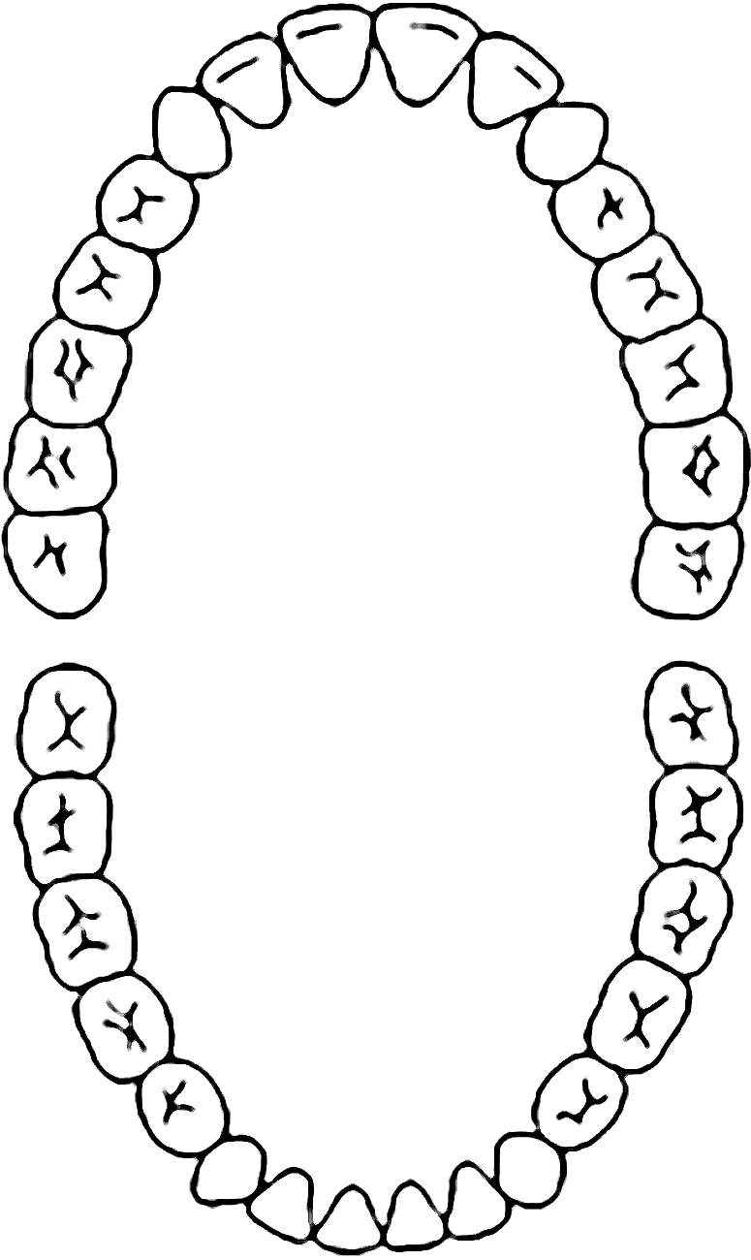
Analysis of Bite Marks
The next step is to determine which marks were made from which teeth.
The upper 4 front teeth make rectangular marks.
The central incisors are wider than lateral incisors.

Slide 17
Analysis of Bite Marks
The next step is to determine which marks were made from which teeth.
The upper and lower cuspids tend to leave round or oval-shaped marks.
The lower 4 front teeth make rectangular marks that are all similar in width.

Slide 18
Analysis of Bite Marks
Areas between biting teeth that exhibit less bruising are attributed to a missing, short, or damaged tooth.
This can also be caused by an object becoming trapped between the skin and tooth, the skin could have moved to relieve stress, or there was variation in the biting mechanism itself.

Slide 19
Analysis of Bite Marks
After the teeth have been identified, the bite mark pattern is measured.
The tooth mark size as well as distances between teeth are measured.
Skin stretching may deform the pattern to make these measurements of little value.

Slide 20
Analysis of Bite Marks
Once the data has been collected, the forensic dentist is asked to compare the evidence to the suspect’s teeth.
For standards to compare the forensic dentist may make castings of the suspect’s bite with dental stone.
Notes on tooth damage are taken and checked against the unknown bite mark.

Slide 21
Analysis of Bite Marks
The photographs of the unknown bite mark are reproduced at 1:1 scale and compared to the casting.
Transparent overlays of the bite mark photos may be used to aid in comparison.

Slide 22
Analysis of Bite Marks
The first characteristics considered are the arch size and shape. This can quickly eliminate a suspect with no additional analysis.
If the suspect has not been eliminated, studies of the prominent dental features are inspected for agreement with the bite mark. Secondary features must also match.
Wax bite impressions may be used to capture the biting edges of teeth and are useful for comparison purposes.

Slide 23
Drawing Conclusions
Although the forensic dentist is an expert, the forensic importance of a bite mark is an educated opinion.
There are no guarantees that the same bite mark evidence would be interpreted in the same way by two or more forensic dentists.
Specialized expertise is needed to understand the strengths and limitations of bite mark analysis.

