Slide 1
1. WHAT IS A COMPOUND
A PURE SUBSTANCE MADE OF TWO OR MORE ELEMENTS CHEMICALLY BONDED
HAS IT’S OWN PHYSICAL AND CHEMICAL PROPERTIES
CAN ONLY BE SEPARATED BY A CHEMICAL REACTION (UNLIKE MIXTURES)
EX) SALT SUGAR WATER RUST

Slide 2
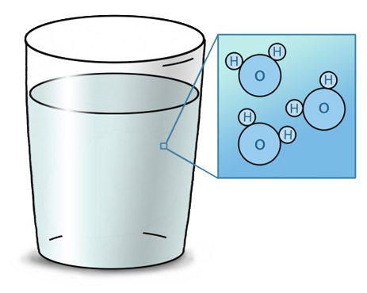
2. WHAT IS A MOLECULE
THE SMALLEST PART OF A COMPOUND THAT HAS THE PROPERTIES OF THE COMPOUND
EX) A MOLECULE OF WATER

Slide 3
3. WHAT IS A FORMULA
A COMBINATION OF SYMBOLS AND SUBSCRIPTS #S USED TO TELL YOU THE RATIO OF ATOMS IN A COMPOUND ( SEE EXAMPLES BELOW)
FORMULA ELEMENTS PRESENT TOTAL ATOMS
CO₂ 1 CARBON 2 OXYGEN 3
C₆H₁₂O₆ 6 CARBON 12 HYDROGEN 24
6 OXYGEN

Slide 4
* IF SYMBOLS ARE INSIDE PARENTHESIS, MULTIPLY EVERYTHING INSIDE BY THE NUMBER OUTSIDE
FORMULA ELEMENTS PRESENT TOTAL ATOMS
Ca₃(PO₄)₂ 3 CALCIUM 13
2 PHOSPHOROUS
8 OXYGEN
Al(NO₃)₃ 1 ALUMINUM 13
3 NITROGEN
9 OXYGEN

Slide 5
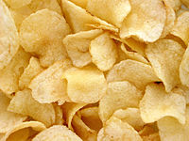
4. ARE PROPERTIES OF COMPOUNDS LIKE THE PROPERTIES OF THE ELEMENTS IN THEM ? NO!
WHEN ELEMENTS COMBINE TO FORM COMPOUNDS, THE PHYSICAL AND CHEMICAL PROPERTIES ARE DIFFERENT
WHEN COMPOUNDS BREAK APART, NEW PROPERTIES ARE ALSO CREATED
EX) SODIUM Na EXPLOSIVE METAL
CHLORINE Cl POISON GAS
NaCl TABLE SALT YUMMY

Slide 6
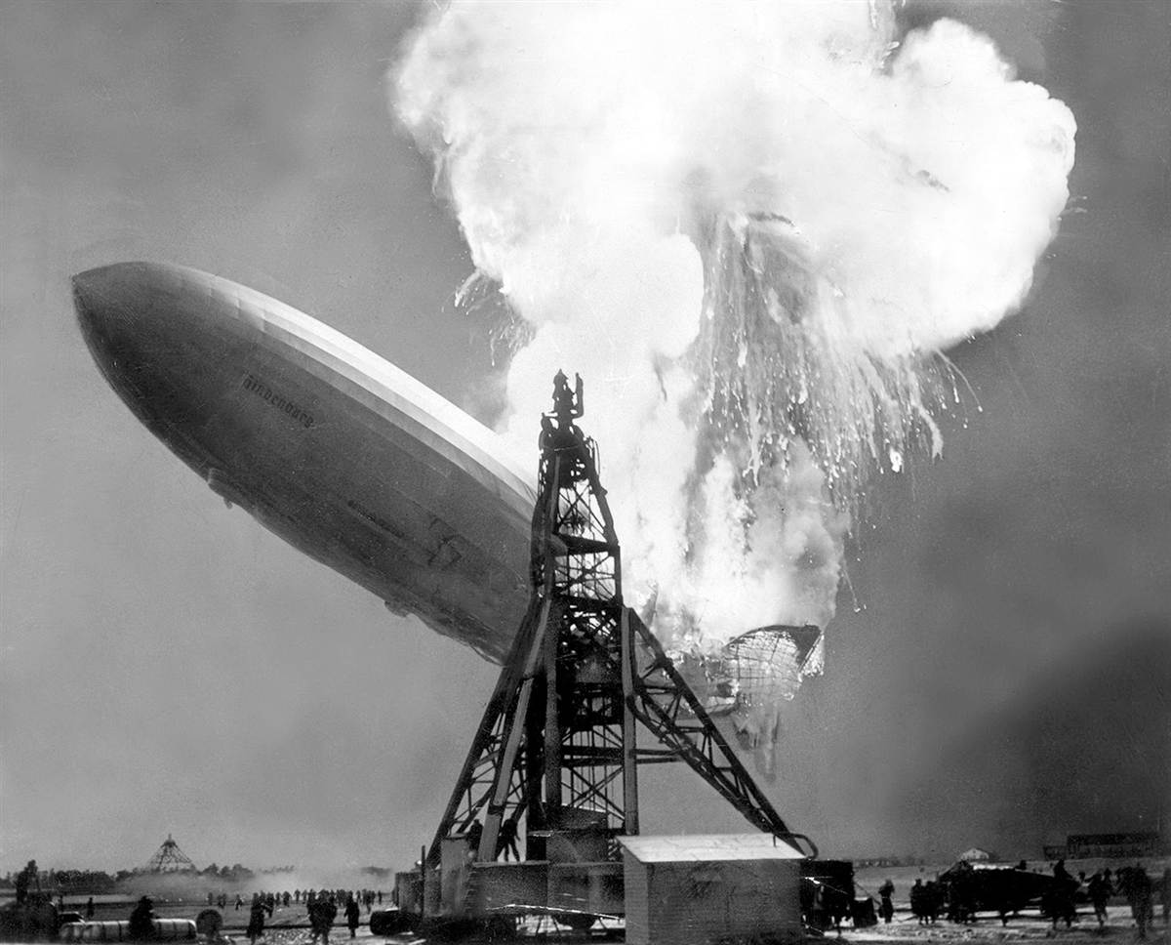
ANOTHER EXAMPLE
WATER OR H₂O IS MADE FROM OXYGEN GAS AND HYDROGEN GAS
HYDROGEN GAS IS FLAMMABLE AND OXYGEN GAS SUPPORTS BURNING BUT WATER PUTS OUT FIRES.

