Slide 2
What is a Questioned Document?
A questioned document is one in which the document in its entirety, or in part, is subject to question as to its authenticity and/or origin.
Any signature, handwriting, typewriting, or other mark whose source or authenticity is in dispute or is doubtful.

Slide 3
Most Common Questioned Documents
Letters
Checks
Drivers Licenses
Contracts
Wills
Petitions
Voter registration
Passports
Threatening letters
Suicide notes
Lottery tickets

Slide 4
Cases Involving Questioned Documents
Forgery
Counterfeiting
Mail fraud
Kidnapping
Con games
Embezzlement
Gambling
Theft
Robbery
Arson
Burglary
Homicide
Psychological profiling

Slide 5
Questioned Document History
The 19th century brought increasing urbanization and industry.
Industrialization made many products, like ink and paper, more readily available.
Governments and trade companies quickly adopted large-scale paper use.
Cultural shift from the exchange of money and a handshake to the exchange of money and a signature.

Slide 6
Questioned Document History
Need grew for people that could establish or confirm the authenticity of a document.
Attorneys would look toward penman for help in these cases. They often testified that they could tell the difference between authors through handwriting.
Accepted in court because they used scientific methods (for example, side by side comparison).

Slide 7
Questioned Document History
Dreyfus affair (1894-1906) set back the document analysis discipline.
Alfred Dreyfus, French army officer, accused of treason through letters found attempting to sell French secrets to Germany.
Convicted in part on amateur document analysis.
Later confirmed that Dreyfus did not write the letters.
Albert Osborn, American handwriting expert, noticed that there needed to be a well-founded common base of handwriting knowledge.
Did this through inviting penmen throughout the country to share their experiences and expertise in handwriting cases.

Slide 8
Questioned Document History
Osborn is considered the founder of the scientific Questioned Document field due to the results of his research, published in the book Questioned Documents.
Widely accepted because of his extensive use of scientific techniques, and became the basis of modern forensic document analysis.
Albert Osborn also contributed to the highly-publicized Lindbergh Baby Case.
As a result of his work and national attention, the QD field was included in many Federal and State agencies.
These professionals are now called Questioned Document Examiners.

Slide 9
Graphologist VS QD Examiner
Graphologist
Profiles character or personality by drawing conclusions from certain types of characteristics in the handwriting sample.
Does not compare handwriting to determine authenticity or origin. Remember, most of graphology lacks scientific proof.
However, some principles of graphology are correct:
Handwriting can be affected by illness, old age, etc.
There are many different “systems of graphology”.

Slide 10
Graphology Examples

Slide 11
Questioned Document Examiner
Applies scientific approaches to the whole document in order to recognize the source or other evidence that can determine authenticity of the document in question.
The first QDEs were called “handwriting specialists” because that was the primary means of agreements or contracts.

Slide 12
Handwriting Theory
Handwriting is just as unique as your fingerprints.
Important differences between fingerprints and handwriting:
Fingerprints have a genetic basis, and do not change after birth.
Handwriting is a learned process and tends to change over time.

Slide 13
The Handwriting Learning Process
A child learns a model of the alphabet.
They progress to drawing block letters (also called “print” or “manuscript”) based on guides.
Then typically on to cursive writing guides.
Child does not yet have handwriting of their own because they are consciously creating an artistic representation.
Child gets better at remembering letter formations and now draws them from memory.
This is where variations and deviations come from and he/she begins developing their own handwriting style.

Slide 14
The Learning Process
Its not until individual characteristics become habitual and repetitious that handwriting has become mature. The person can then write as a sub-conscious act.
This is the level where we can make the comparison between fingerprints and handwriting.
Just as there are no 2 fingerprints the same, handwriting is also unique.

Slide 15
Class Characteristics in Handwriting
Class Characteristics are similarities between individuals who learned the same type of writing systems.
Serve to narrow down the search when comparing a questioned document to standard writing systems.
Common handwriting systems: Palmer, Zaner-Bloser, and Spencerian.

Slide 16
Individual Characteristics
These are characteristics that are true only to a specific writer.
It is a combination of individual characteristics that make handwriting unique to him/her.

Slide 17
Types of Individual Characteristics
Skill Level
Slant
Form
Movement
Proportions
Height
“I” Dot
“t” Crossing
Loops
Pressure
Baseline Alignment
Pen Lifts
Speed
Embellishments
Entry/Exit Strokes
Retracing
Spelling/Spacing
Format
Case

Slide 18
Skill level
General gauge of the precision and complexity in a document.
Important characteristic of identification or non-identification.
Judged on a continuum of high skill level to low skill level.

Slide 19
High Skill Level

Slide 20
Low Skill Level

Slide 21
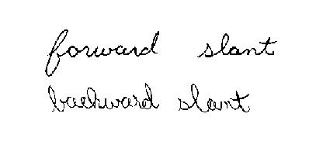
Slant
Slant is the angle of writing and can be forward or backward.
This alone is not a good basis for judgment.
Forwards and backward slants are not indicative to handedness.

Slide 22
Form
Most basic individual characteristic and is very important to QDE.
Form is the way a writer makes a letter or movement of letters.

Slide 23
Movement and Pressure
Movement is the way a pen moves in order to make a mark or form a letter
This can help distinguish the difference in form. 2 letters can be the same, but made in a different way.
Pressure is the difference in ink or pencil in width or shade. Helps show direction of movement.

Slide 24
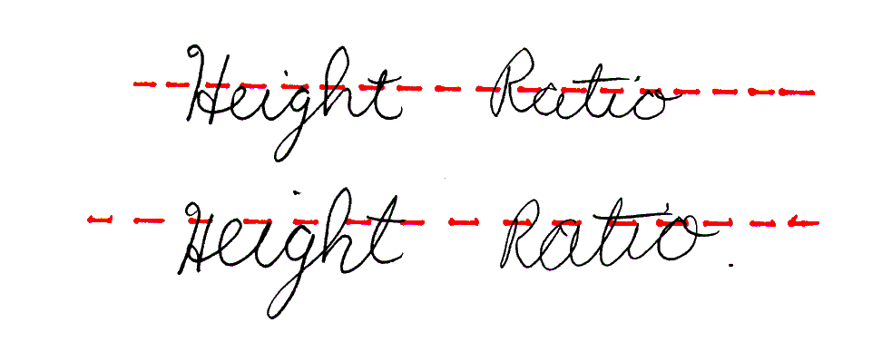
Proportions, Height, & Loops
Proportion is the symmetry of an individual letter.
Loops also have proportions.
Height comparison between one letter to another.
Specific height and proportion tendencies are usually habitual in a specific writer.

Slide 25
The “I” dot and “t” crossing
Highly varied between individuals.

Slide 26
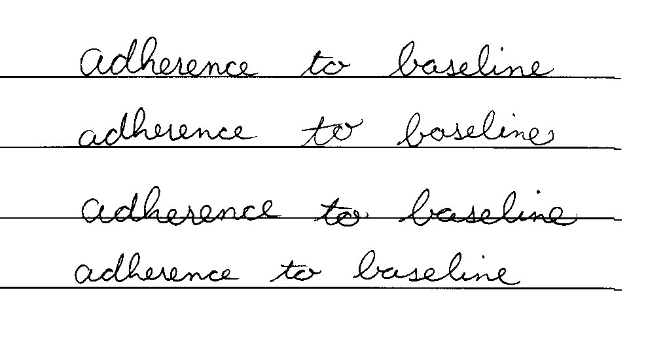
Baseline Alignment
One significant way QD examiners determine whether suspect writing has been altered or is consistent with the rest of the writing or other examples.

Slide 27
Pen Lifts and Embellishments
Pen lifts are when the pen or pencil is lifted from the paper and reapplied to finish a word or sentence.
Most people have pen lifts in their writing.
Embellishments decorate writing.
Usually found at the beginning of words, but can be seen other places.

Slide 28
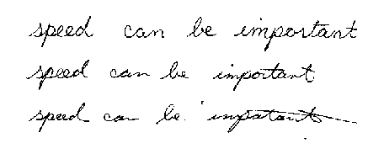
Speed
The speed of a writer is a key indicator for QDEs in the examination process.
Fast and slow speeds are difficult to duplicate leaving behind inconsistencies in the writing.

Slide 29
Entry/Exit/Connecting Strokes
Entry/Exit Strokes are the ways a writer begins and ends certain letter or words and can be very specific to an individual.
Connecting strokes between letters are subject to similar analysis.

Slide 30
Retracing
Retracing is fixing a portion of writing that is not readable or pleasing to the writer.
In some cases this can indicate forgery, but it is very common in normal handwriting to retrace letters or words.

Slide 31
Spelling/Spacing
Spelling is an individual characteristic because of education or habits and can be an easy way to eliminate or pin point suspects.
Spacing is the area between letters or words and can vary greatly between writers.

Slide 32
Format and Case
Writers often have very specific formatting habits when depicting things like dates, numbers, abbreviations, and punctuation.
Checks include many formatting examples
Case usage commonly varies, such as when a writer uses upper case letters where lower case letters should be present.

Slide 33
Collecting Questioned Documents
Original document is preferred.
QDE would rather not have copies, but can still use them.
All evidence should be marked by the QDE.
Usually initials and date.
If document cannot be marked it should be placed in an envelope and sealed with initials and date.
Maintain chain of custody.
And of course, DOCUMENT EVERYTHING.

Slide 34
Character of Handwriting
No single handwriting characteristic can in itself be taken as the basis for a positive comparison.
The final conclusion must be based on a sufficient number of common characteristics between the known and questioned writing samples.
There are no hard and fast rules for a sufficient number of personal characteristics; it is a judgment call made by the expert examiner in the context of each case.

Slide 35
Collecting Samples or Exemplars
Exemplar – Handwriting used as a standard for comparison with the document in question.
2 types of exemplars:
Dictated or requested
Undictated or collected

Slide 36
Ink and Paper Comparisons
A study of the chemical composition of the ink used on documents may verify whether or not known and questioned documents were prepared by the same pen; the paper itself may also be analyzed.
A nondestructive approach to comparing ink lines is accomplished with a visible-light microspectrophotometer.
Thin-layer chromatography is also suitable for ink comparisons.

Slide 37
Ink Analysis
The U. S. Secret Service has an ink analysis program and maintains a library of over 6,000 inks.
Handwritten notes as well as printed documents can be analyzed.
Chemical tests of ink (ink solubility, paper chromatography and thin layer chromatography) can be performed on printed or written material. Typically, up to 10 one-millimeter samples will be removed from the paper, with some samples containing printing from the questioned sections and some samples from more reliable control sections.

Slide 38
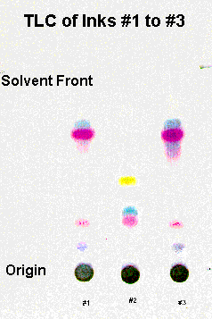
Thin Layer Chromatography

Slide 39
Typewriters and Printing Devices
The two requests most often made of the examiner in connection with the examination of typewriters and printing devices are:
whether the make and model of the typewriter and printing devices used to prepare the questioned document can be identified.
whether a particular suspect typewriter or printing device can be identified as having prepared the questioned document.
In order to do this, the individual type character’s style, shape, and size are compared to a complete reference collection of past and present typefaces.

Slide 40
Characteristics From Use
As is true for any mechanical device, use of a printing device will result in wear and damage to the machine’s moving parts.
These changes will occur in a fashion that is both random and irregular, thereby imparting individual characteristics to the printing device.
The document examiner has to deal with problems involving business and personal computers, which often produce typed copies that have only subtle defects.
Another area of investigation is the typewriter ribbon, which may contain type impressions. Declining in use in the electronic age.

Slide 41
Digital Technology
In the cases of photocopiers, fax machines, and computer printers, an examiner may be called on to identify the make and model of a machine or to compare a questioned document with test samples from a suspect machine.
A side by side comparison is made between the questioned document and the printed exemplars to compare markings produced by the machine.
Examiners compare transitory defect marks, fax machine headers, toner, toner application methods, and mechanical and printing characteristics.

Slide 42
Alterations
Document examiners must deal with evidence that has been changed in several ways, such as through alterations, erasures, and obliterations.
Erasures by rubber erasers, sandpaper, razor blade or knife to remove writing or typing disturb the fibers of the paper and are readily apparent when examined with a microscope.
If an alteration is made to a document with ink differing from the original, it can sometimes be detected due to differences in the luminescent properties of the inks.

Slide 43
Instruments Used in QD Labs
Stereo Microscope
Light Microscope
Video Spectral Comparator (VSC) – uses infrared and ultraviolet waves to distinguish different inks, reveal text that has been overwritten, discover additions, etc.
Electrostatic Detection Apparatus (ESDA) – detects indented writing by applying an electrostatic powder that is drawn into indentations.

Slide 44
VSC & ESDA

Slide 45
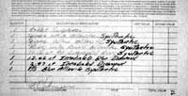
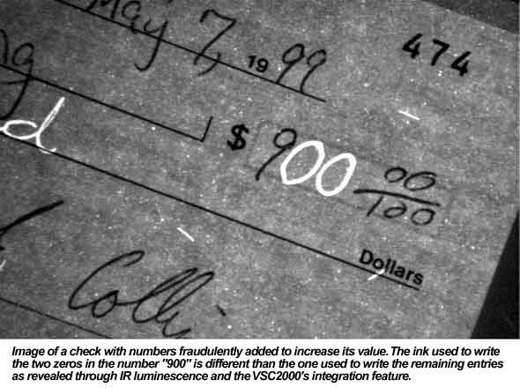
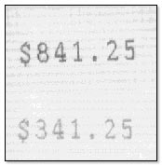
Examples of Forged Documents

Slide 46
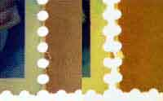
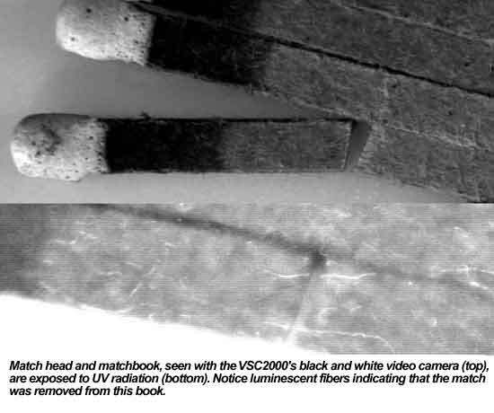
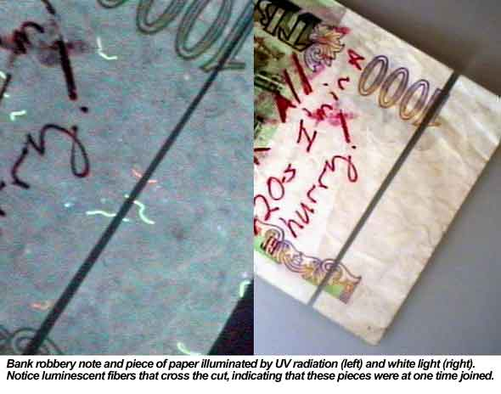
Examples of Questioned Documents

Slide 47
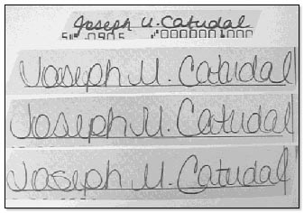
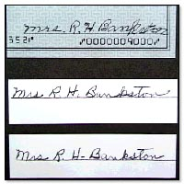
Examples of Conflicting Signatures

Slide 48
Identity Fraud
Criminals process trash to steal mail or credit card applications.
Shredding or tearing up mail with credit or banking information is helpful in preventing these crimes.

Slide 49
Lottery Ticket Fraud
Take losing tickets and modify them to appear to be winners.
Some people collect winning tickets from customers and then cash them in.
Avoid this by signing tickets before getting them checked.

